Slide 1
Linux Project
Team 10
김찬현 20172977
유호성 20172256
조성규 20170562
최윤호 20170026

Slide 2
Data Structure – Linked List
Real position
Odd
Even
1
3
5
HEAD
6
4
2
next_n
prev_n

Slide 3
Data Structure – Linked List
Real position
Odd
Even
1
3
5
HEAD
7
4
2
Not Allowed
next_n
prev_n

Slide 4
Data Structure – Linked List
Real position
Odd
Even
1
3
5
HEAD
4
4
No information of order
next_n
prev_n

Slide 5
Data Structure – Linked List
Index position
1
2
3
4
5
6
HEAD
next_i
prev_i

Slide 6








Data Structure – Linked List
Real position + Index position
Odd
Even
1
3
5
HEAD
6
4
2

Slide 7
Insert
Set the Standard Num => 3 => Find
Odd
Even
1
3
5
HEAD
6
4
2
7

Slide 8




Insert
2. Pointer Connect with index order
Odd
Even
1
3
5
HEAD
6
4
2
7

Slide 9




Insert
3. Pointer Connect with Real order
Odd
Even
3
5
7
4
2
1
HEAD
6

Slide 10
Insert
Conclusion: - find value is 3. - new value is 7. - Real position is HEAD’s left. - Index postion is between the 3 and 4. (example)

Slide 11
Search
1. Set a value to find - 3
Odd
Even
3
5
7
4
2
1
HEAD
6

Slide 12
Search
2. Determining whether value is odd or even.
Odd
Even
3
5
7
4
2
1
HEAD
6

Slide 13
Search
3. ‘3’ is odd. So, search direction is LEFT.
Odd
Even
3
5
7
4
2
1
HEAD
6

Slide 14
Search
4. If cur node’s value is 3, terminate.
Odd
Even
3
5
7
4
2
1
HEAD
6

Slide 15
Search
Conclusion: - find value is 3. - The number of nodes passing through for search has decreased by nearly half.

Slide 16
Delete
1. Set a value to delete - 3
Odd
Even
3
5
7
4
2
1
HEAD
6

Slide 17
Delete
2. Determining whether value is odd or even.
Odd
Even
3
5
7
4
2
1
HEAD
6

Slide 18
Delete
3. ‘3’ is odd. So, traverse direction is LEFT.
Odd
Even
3
5
7
4
2
1
HEAD
6

Slide 19
Delete
4. If cur node’s value is 3, delete and terminate.
Odd
Even
3
5
7
4
2
1
HEAD
6

Slide 20
Delete
Conclusion: - delete value is 3. - The number of nodes passing through for search has decreased by nearly half.

Slide 21
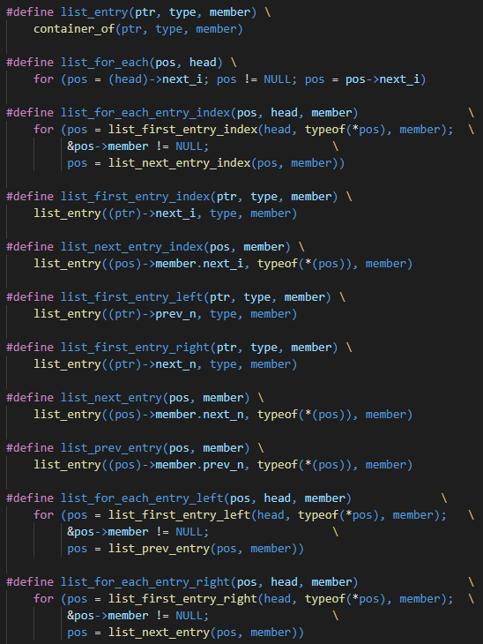


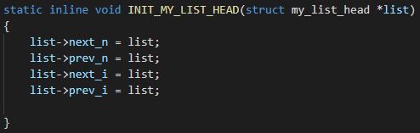
Source code
- customized #define functions and structures

Slide 22
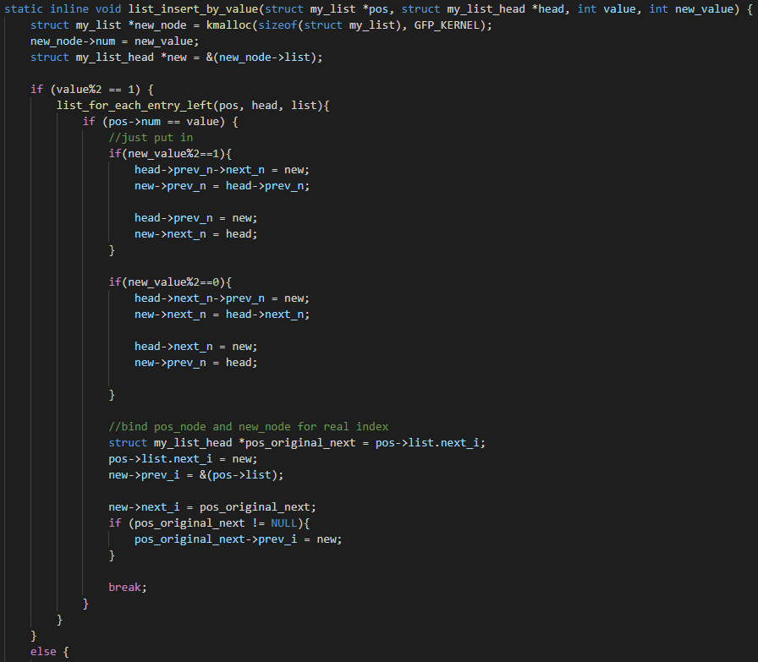
Source code
- Insert

Slide 23
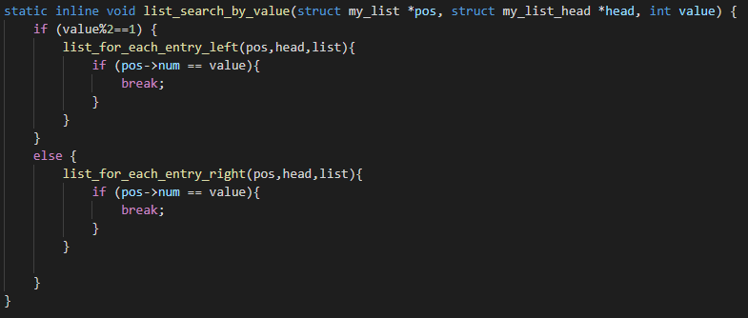
Source code
- Search

Slide 24
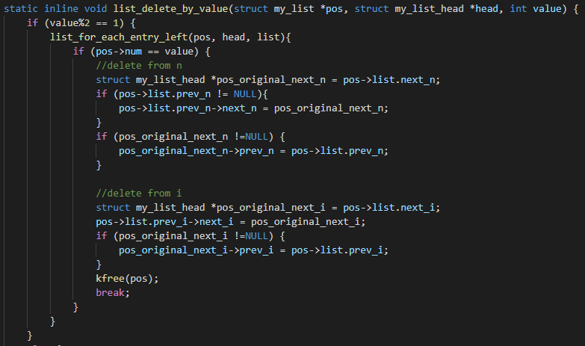
Source code
- Delete

Slide 25
First Result
It doesn’t save as much time as we expected.
Assumed that using 4 pointers makes more time cost.

Slide 26
Second Version
To maximize strength of our new linked list, removed index position pointers
Which can save odd and even numbers separately.
Have strength to find certain node faster than original model.
(search one side of head)

Slide 27
Thank you

