Slide 1

In what circumstance would a fan restrict airflow?
When you are hanging from it.

Slide 2
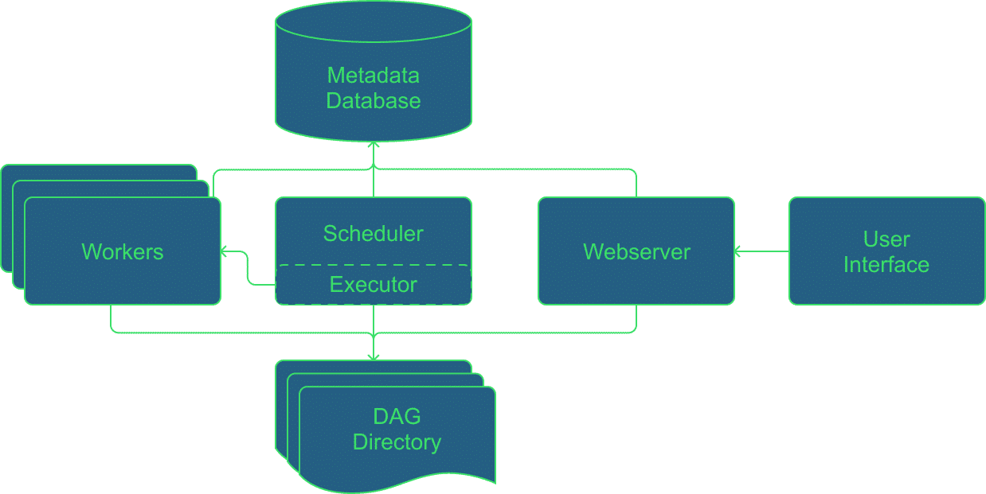
Архитетура

Slide 3

DAG (Directed Acyclic Graph)

Slide 4
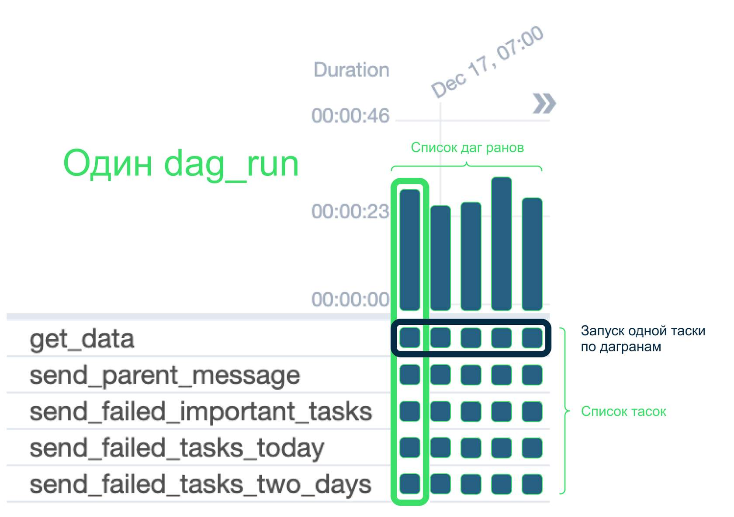
DagRun в Airflow

Slide 5
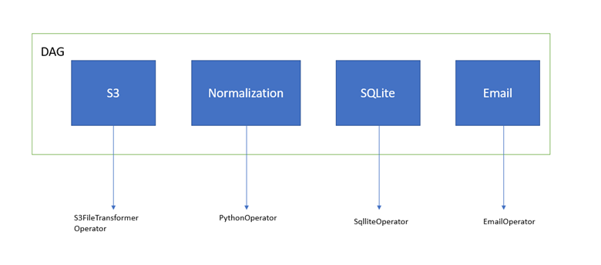
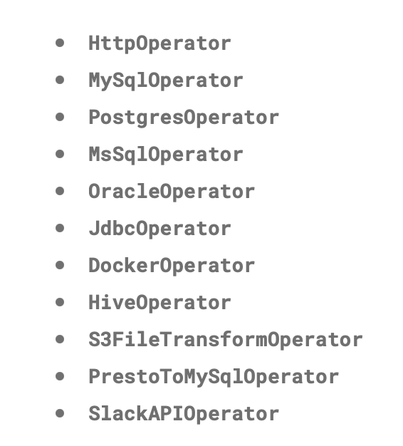
Operator

Slide 6
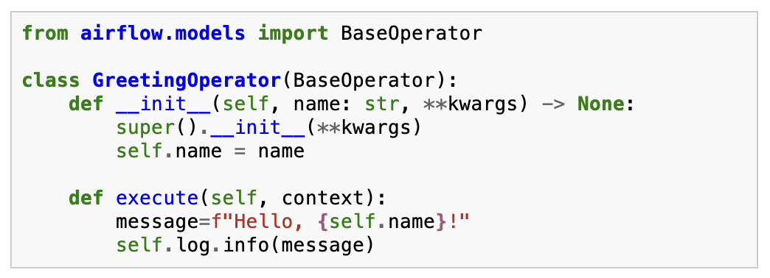

Custom operator usage example

Slide 7
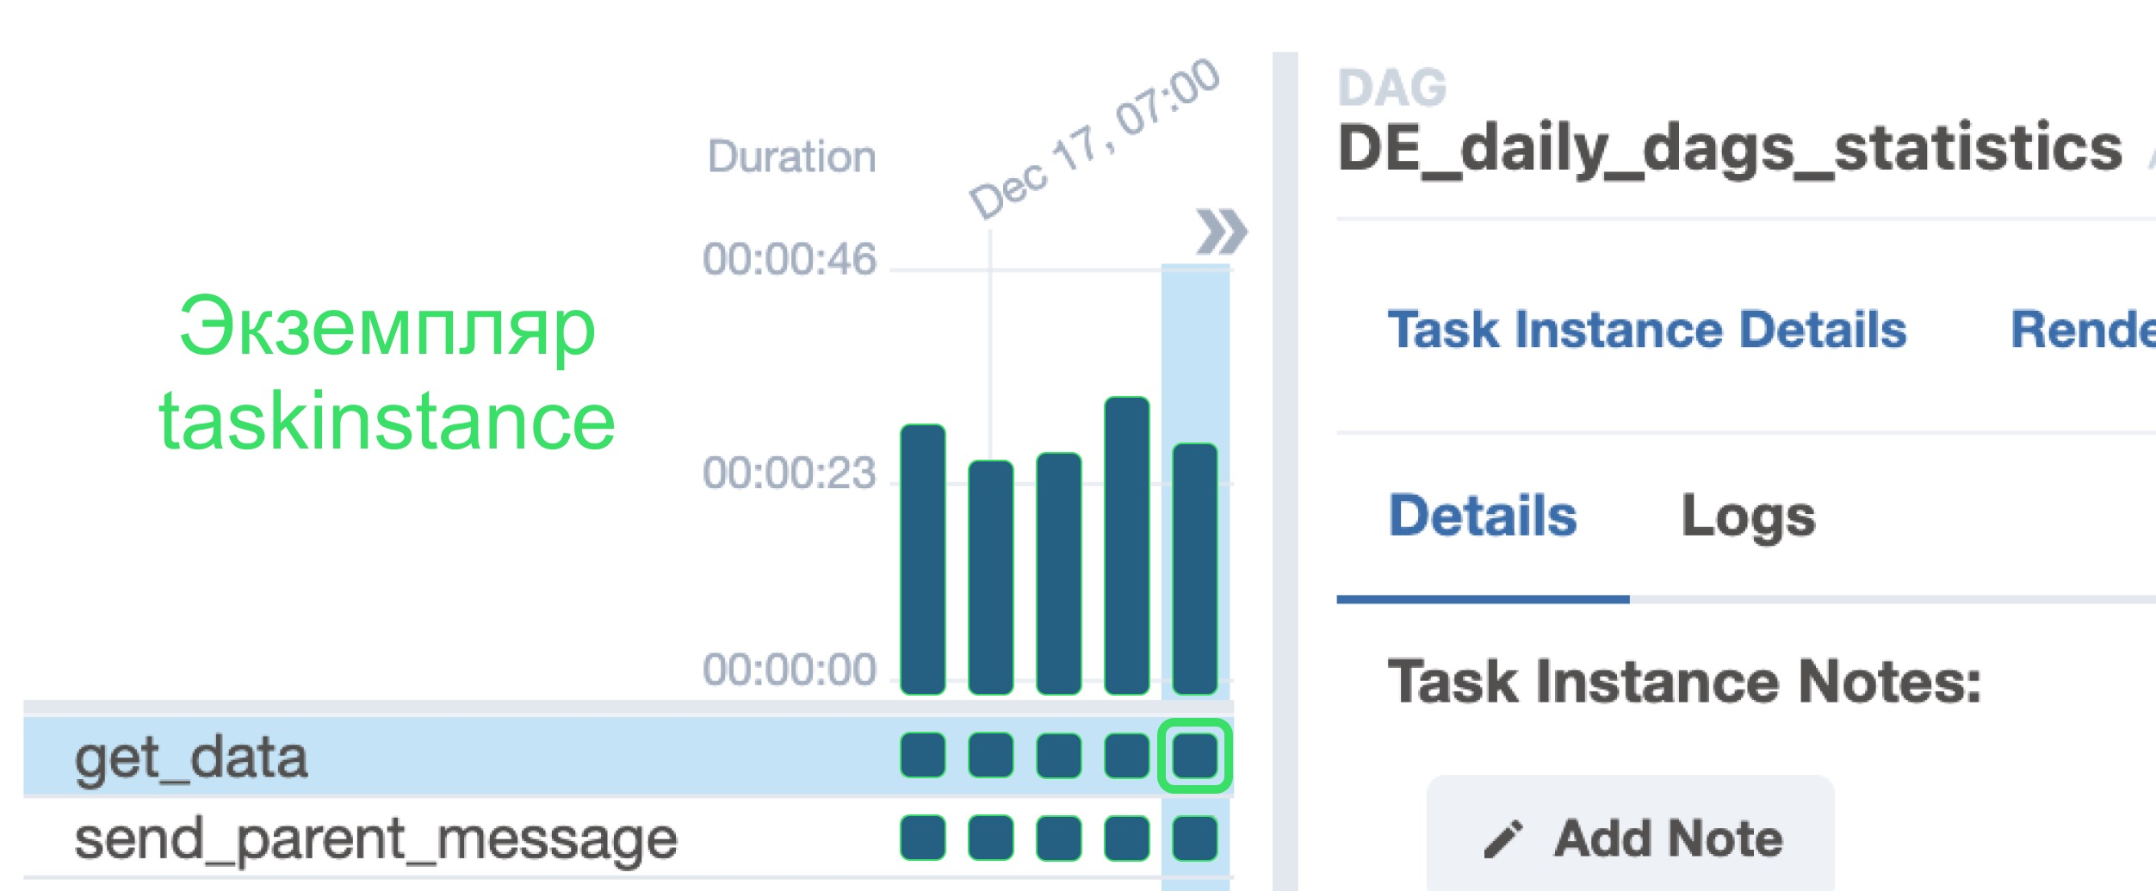
Task, TaskInstance

Slide 8
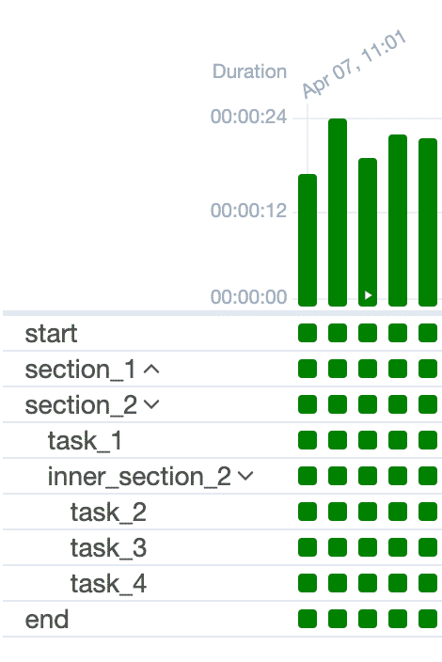
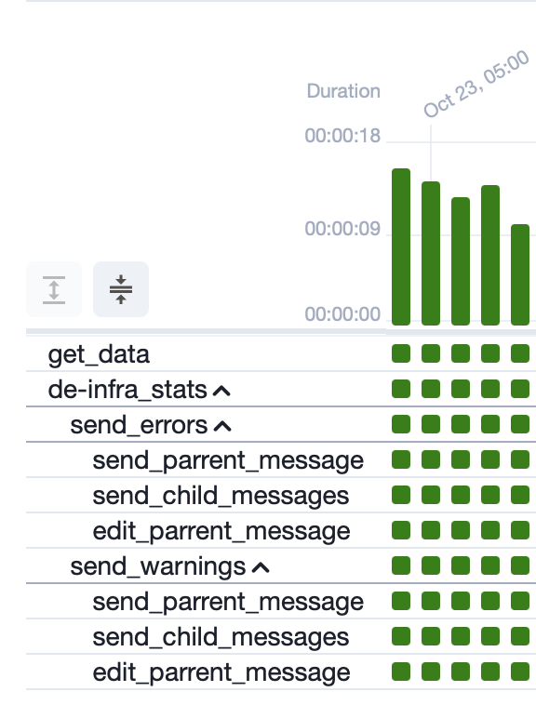
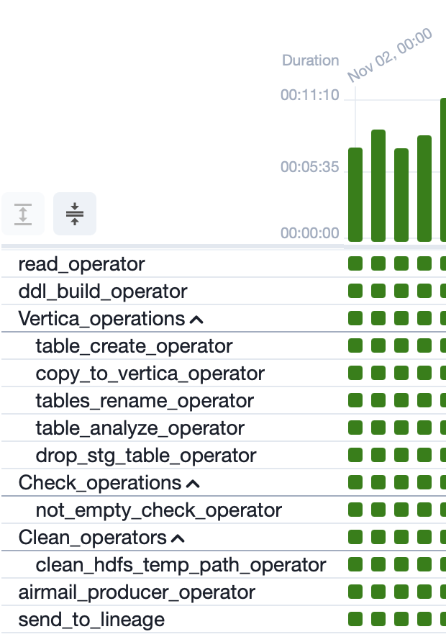
TaskGroup

Slide 9
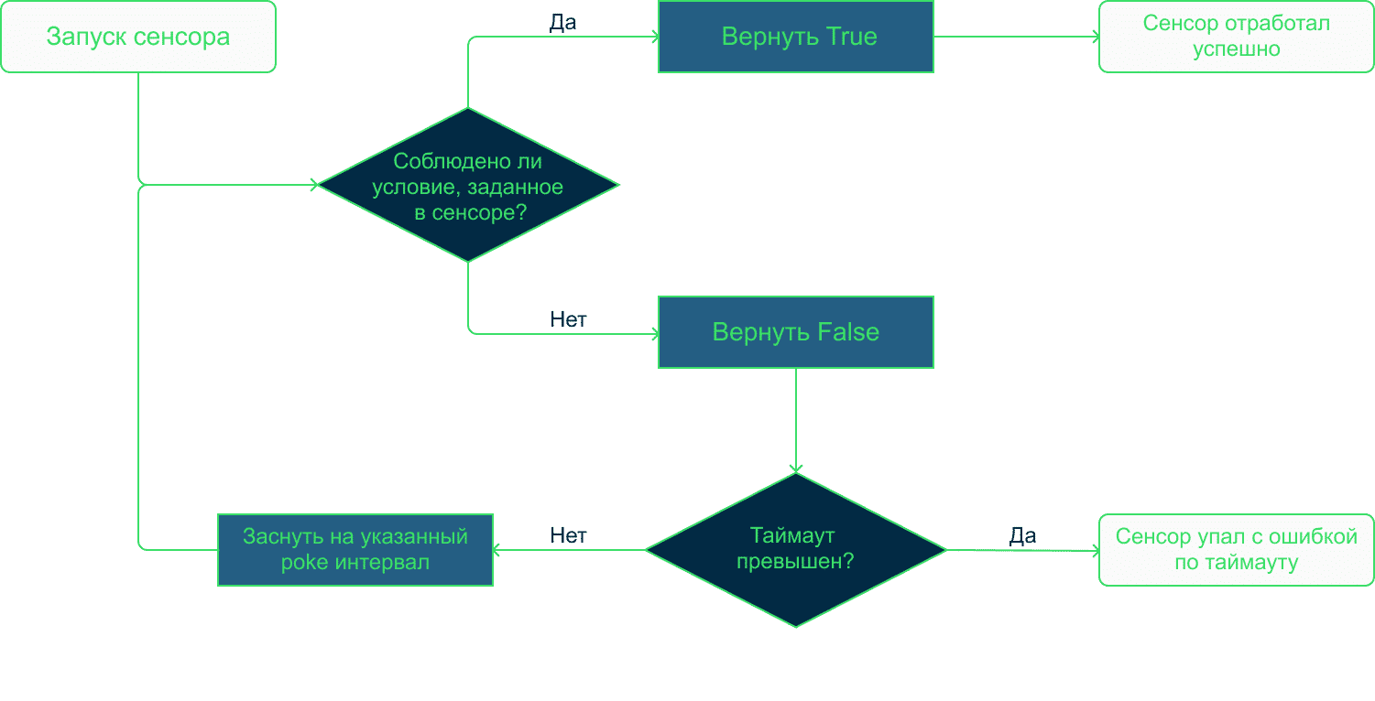
Sensor

Slide 10
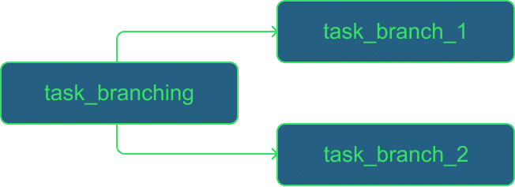
Branch

Slide 11


Variables

Slide 12


Connections

Slide 13
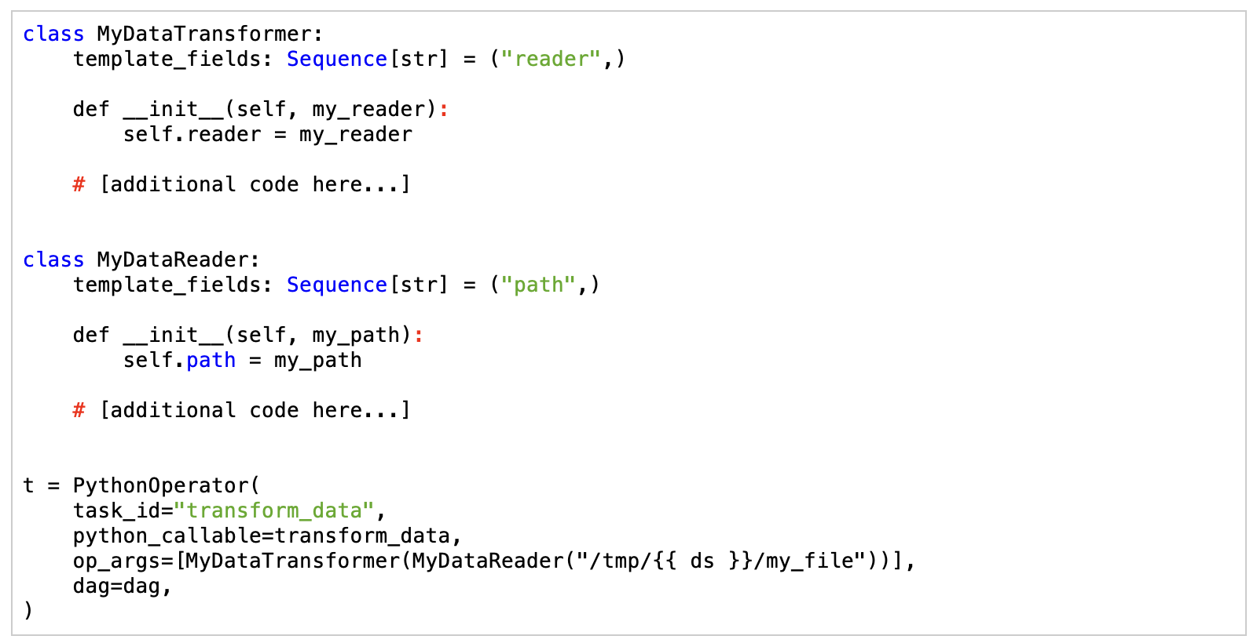
Templates reference (Jinja)

Slide 14
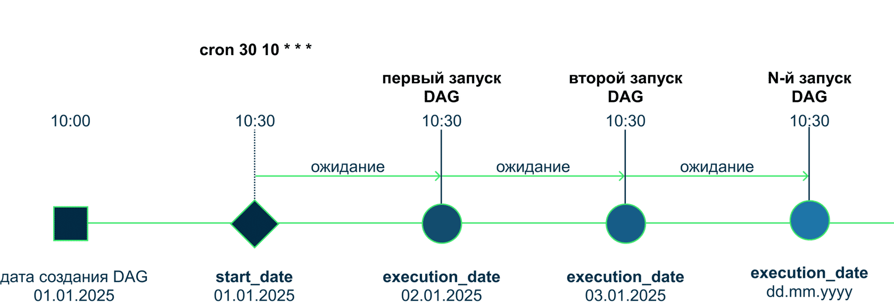
Execution Flow

Slide 15
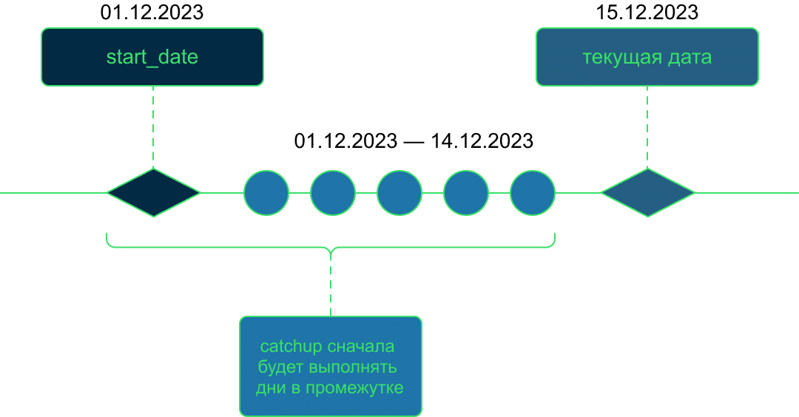
Catchup

Slide 16
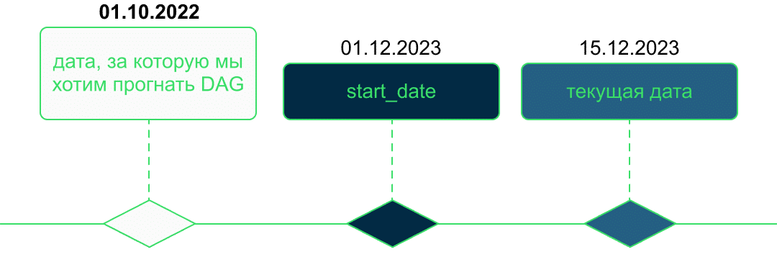
Backfill

Slide 17
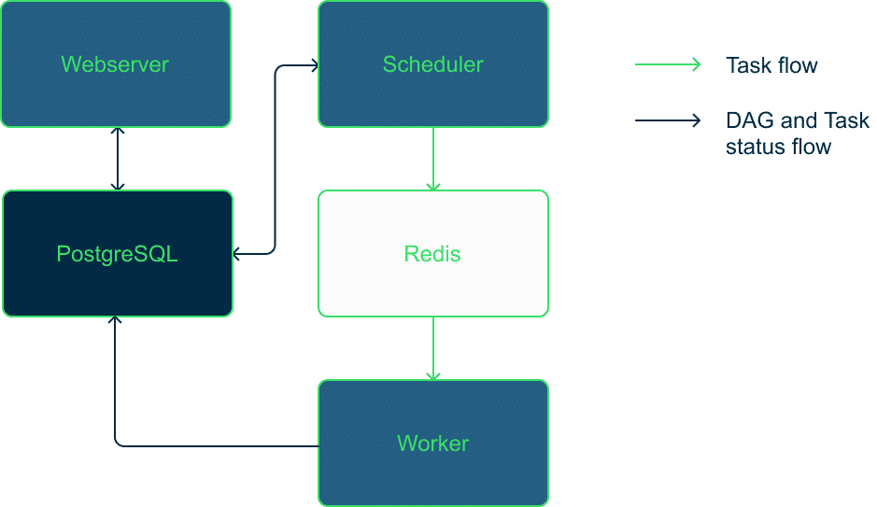
Алгоритм работы CeleryExecutor

Slide 18
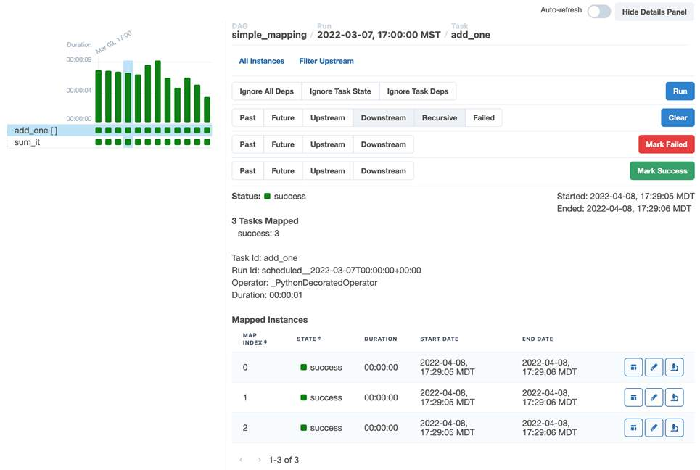

Dynamic Task

Slide 19
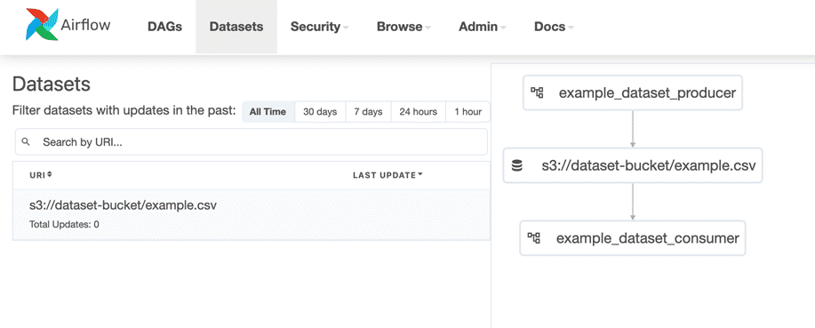
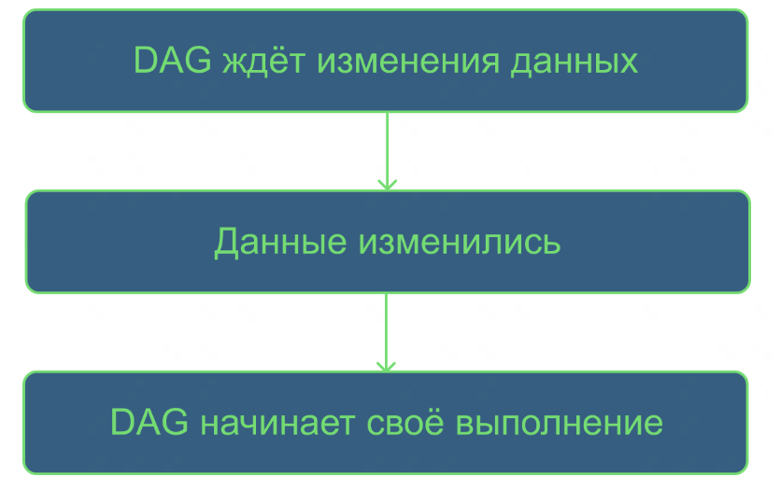
Dataset (Data-aware scheduling)

Slide 20
Конец!

