Slide 1
Histograms
Presented by: Amrit Poudel & Yunik TAMRAKAR

Slide 2

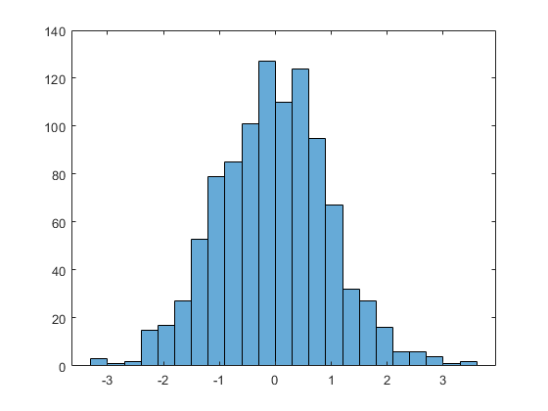
Introduction to histograms
Accurate Representation of distribution of numeric data
First introduced by Karl Pearson
Divided into bins or buckets
Which may or may not be equal
But, must be adjacent
Count no of functions falling into disjoint categories (non-overlapping bins)

Slide 3
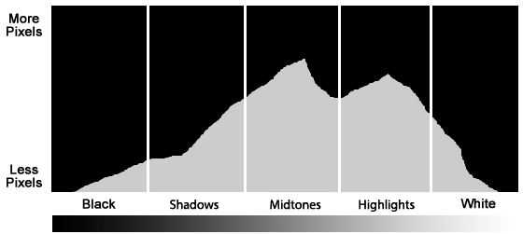
Applications
Has widespread application in data analysis
Notably in Pattern Recognition and Image Processing.
Image Analysis
Exposure, color composition analytics
Post processing
Quality Improvement

Slide 4

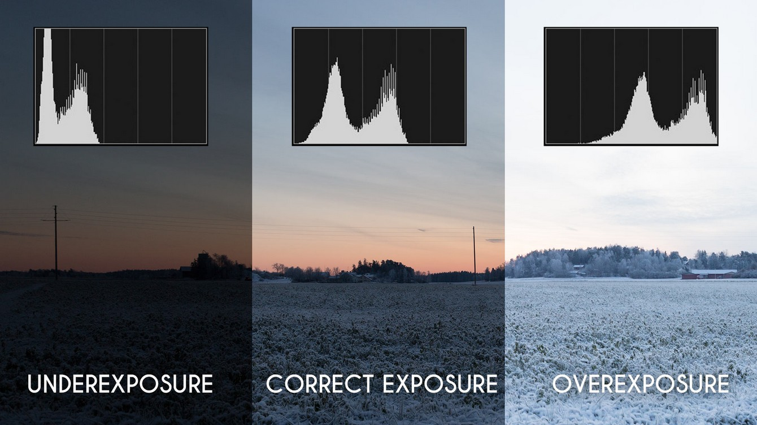
Histogram Analytics

Slide 5
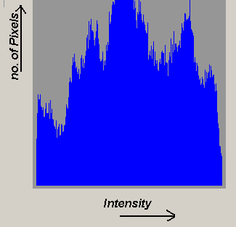
Histograms IN A GPGPGU CONTEXT
Compact representation of image data distribution.
Inherently sequential operation
Every pixel voted into limited set of bins
Serialization is problematic.
Parallel implementation of histogram necessary.
However, parallelization is challenging.

Slide 6
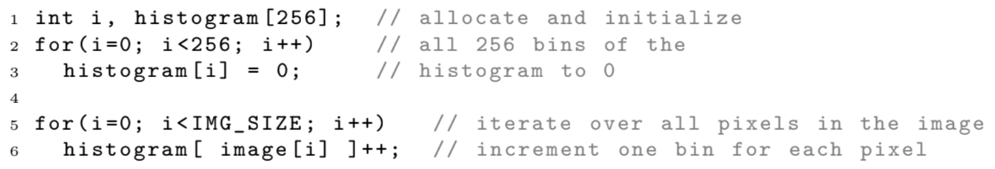
Naïve implementation of histogram code
This algorithm reads each pixel in the image one by one
Increments bin in histogram corresponding to the pixel value.
Cannot predict if two pixels will belong to the same bin or not
Atomic operations are implemented to ensure correctness
But large no of threads will cause position conflicts and thus, serialization.

Slide 7
Challenges in parallelization
Thousands of threads operating atomically on a limited no of bins.
Thread collision will be frequent
This results in serialization.
Position Conflict
If multiple threads try to update same memory location simultaneously.
No of such colliding threads = degree of conflict

Slide 8
SOLVING THE POSITION CONFLICT
Sub Histograms : spread the votes across memory positions
The Sub- Histograms, when placed on global memory impedes performance.
So, local memory is used.
Per Thread Approach
Declaring one sub-histogram per thread
Each thread requires full copy of all bins
Since Scratchpad memory is small, only small no of threads are active
If Scratchpad memory gets overflowed, the slow Global Memory for the bins must be used.

Slide 9
Further OPTIMIZATIONS
Per Warp Approach
Declaring one sub-histogram per warp
Reduces required amount of Scratchpad memory by factor of 32.
Atomic operations required.
Per Block Approach
Declaring one sub-histogram per work group/ block.
“R -per-block” / Replication approach
Interleaved read access

Slide 10
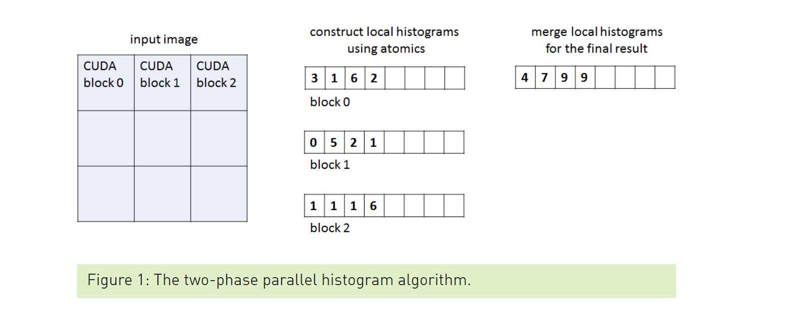
AN IMAGE HISTOGRAM WITH 256 BINS FOR EACH COLOR CHANNEL
Computation – relatively simple
For each pixel of the image, get the corresponding integer value and increment it by one.
Some bins will be used more than others -support efficient accumulation of the values across the full memory hierarchy
Atomic Operations
Main Challenge : Output Location is not known prior to reading the input
Results in collision.
Solution: Shared Memory Atomics
Two-Phase Histogram Algorithm

Slide 11
HISTOGRAM IMPLEMENTATION
Two phases and two corresponding C++ kernels
First phase: each CUDA thread block processes a region of the image and accumulates a corresponding local histogram, storing the local histogram in global memory at the end of the phase
Two Implementations in first Kernel:
one that stores per-block local histograms in global memory, and one that stores them in shared memory
The work separation between blocks in the first phase reduces contention when accumulating values into the same bin.
Second Kernel: accumulates all per-block histograms into the final histogram stored in global memory

Slide 12
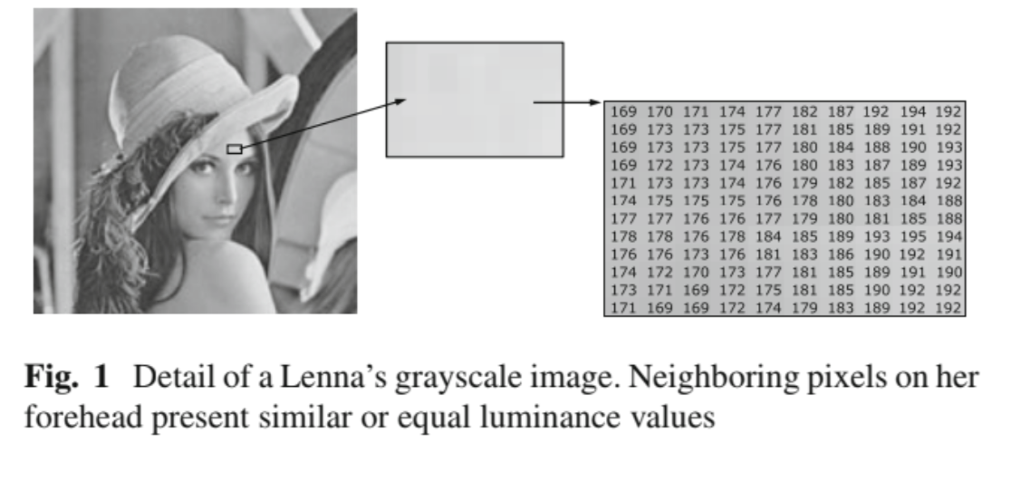
High spatial correlation of pixels
Same range of neighboring pixels
Adjacent pixels may have same value
Threads in warp will vote in limited range of histogram
Position Conflicts

Slide 13
REPLICATION
Method to make consecutive threads vote in consecutive sub-histograms
Steps:
Initialize the sub-histograms in shared memory.
Threads read pixels in an interleaved manner.
Vote in a number of 'R' sub-histograms per block (R= Replication factor)
Merge all the sub-histograms together in global memory.
However, this results in bank conflict.

Slide 14
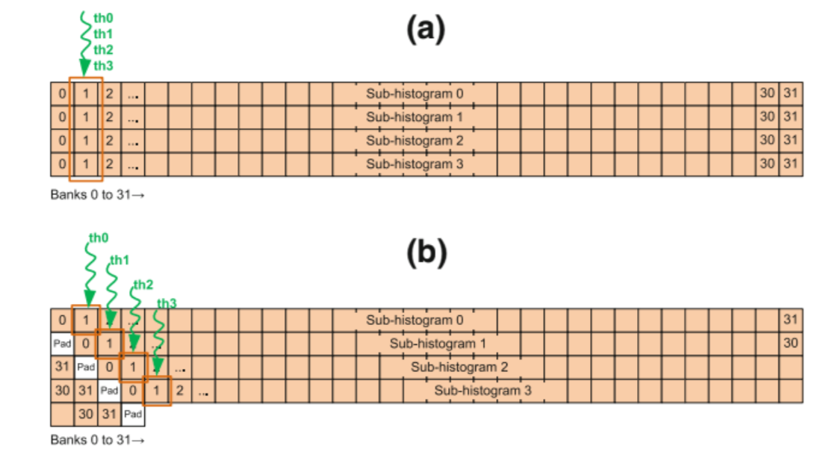
Bank conflict and padding in replication
In a} Threads 0-3 try access bank 1 sequentially.
In b} padding is applied to make threads vote in different banks

Slide 15
Interleaved ACCESS
Consecutive threads of warp read consecutive pixels
For coalesced memory access
Since, nearby pixels in a real image have similar color values
It will result in inter-warp conflicts
So, an image is divided into as many parts as no of warps in a block
Such that each warp w(j) accesses only part 'j' of the image
This decreases inter-warp conflict
Preserves coalesced access

Slide 16
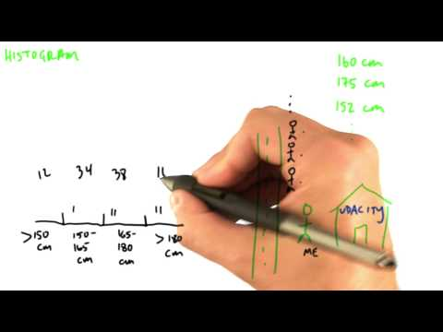
More on histogram

