Slide 1
Automatic Identification of Claim Spans on Twitter
https://codalab.lisn.upsaclay.fr/competitions/13099
Joseph Picchi
Shiyao Guo
Yuning Yang

Slide 2
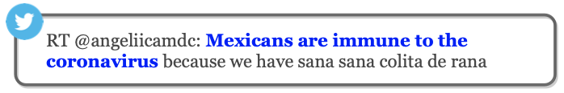
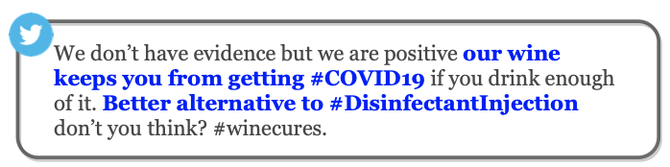
Motivation
Social media breeds misinformation
Most fact-checking is performed manually
4 fundamental research areas in AI-assisted fact-checking:
1. Identify claims
2. Detect previously fact-checked claims
3. Retrieve evidence
4. Verify the claim ← the goal of most previous work

Slide 3
Background
Previous work:
Conferences outlined the functionality pipeline for AI fact-checking
Claim detection is extensively studied
Span recognition models have targeted other domains
Previous AI fact-checking work has focused on downstream tasks
The task is posted as a challenge on CodaLab*, and it was formulated in a previous paper:
Defines the problem statement
Creates a large-scale annotated database
Develops a model
Performs model evaluation (F1 score is 0.8604)
* https://codalab.lisn.upsaclay.fr/competitions/13099

Slide 4
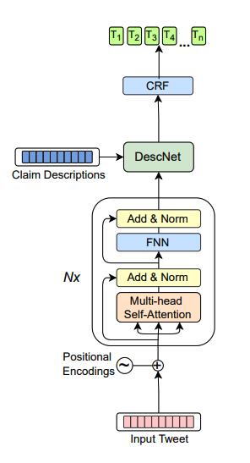
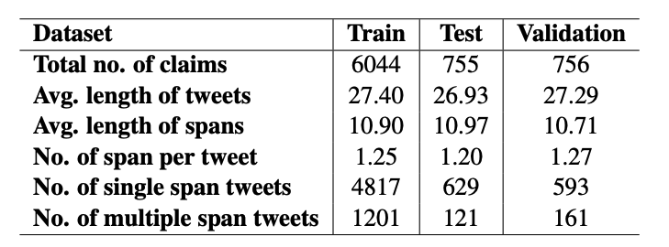
Approach
1. DataSet & Analysis - Data link: Codalab
2. Different Models Experiments & Comparison
CNN + CRF, BERT, SpanBERT, RoBERTa, DABERTa
3. Architecture of Current Best Model
1. Gupta et al. (2021)
2.Sundriyal, Megha, et al.(2022)

Slide 5
Future Work
Improve model performance on:
Figurative sentences
Sentences with metaphor
Claim-like premise

Slide 6
Attack Design
An algorithm to generate adversarial examples

Slide 7
Attacker Assumptions
Black-box model access
No knowledge of the model architecture, parameters, or training data
Can only query the target model
Give input sentences
Get output predictions and their confidence scores
Model

