Slide 1
Internet of Things
Lab5
Sending Data over MQTT

Slide 2
Introduction
In this lab, we will create a setup that allows a MKR 1000 WiFi board to send data to another MKR1000 board, using MQTT (Message Queuing Telemetry Transport). The sender device, simply publishes a message to a broker service, which then can be subscribed to by a receiver device.
The data we will send is simply random readings from the analog inputs on the MKR 1000 WiFi board, but can easily be replaced by any sensor. This lab uses the broker test.mosquitto.org, an open-source service, free to use by anyone.
For this you will will form groups of two students. You have to connect both your boards to the computer at the same time.

Slide 3
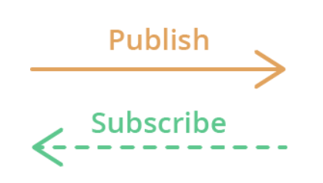
What is MQTT?
MQTT stands for Message Queuing Telemetry Transport. MQTT is a simple messaging protocol, designed for constrained devices with low bandwidth. So, it’s the perfect solution to exchange data between multiple IoT devices.
MQTT communication works as a publish and subscribe system. Devices publish messages on a specific topic. All devices that are subscribed to that topic receive the message.
Its main applications include sending messages to control outputs, read and publish data from sensor nodes and much more.

Slide 4

MQTT Basic Concepts
MQTT – Publish/Subscribe
The first concept is the publish and subscribe system. In a publish and subscribe system, a device can publish a message on a topic, or it can be subscribed to a particular topic to receive messages
MQTT – Messages
Messages are the information that you want to exchange between your devices. It can be a message like a command or data like sensor readings, for example.

Slide 5

MQTT Basic Concepts
MQTT – Topics
Another important concept is the topics. Topics are the way you register interest for incoming messages or how you specify where you want to publish the message.
Topics are represented with strings separated by a forward slash. Each forward slash indicates a topic level. Here’s an example of how you would create a topic for a lamp in your home office:

Slide 6
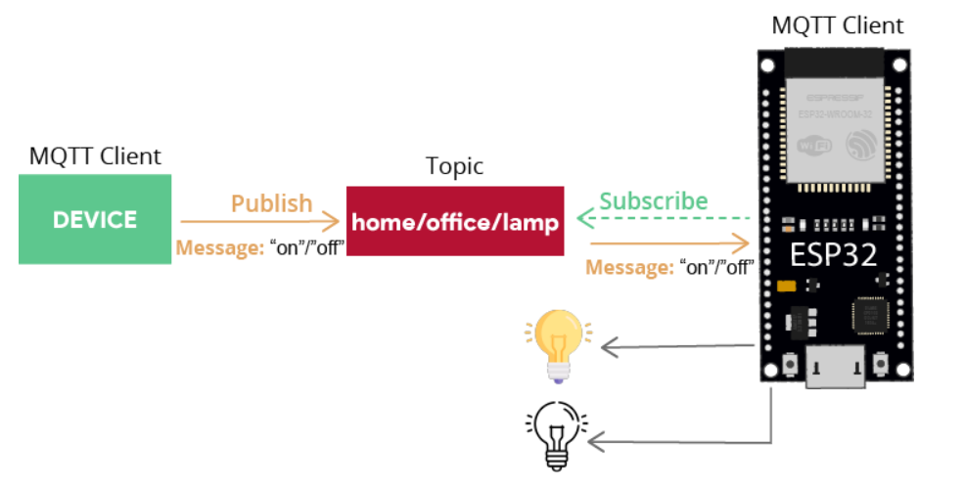
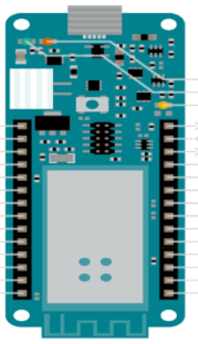
MQTT Basic Concepts
MQTT – Broker
The MQTT broker is responsible for receiving all messages, filtering the messages, deciding who is interested in them, and then publishing the message to all subscribed clients.

Slide 7
Practice
Step 1
First, let's make sure we have the drivers installed. If we are using the Web Editor, we do not need to install anything. If we are using an offline editor, we need to install it manually. This can be done by navigating to Tools > Board > Board Manager.... Here we need to look for the Arduino SAMD boards (32-bits ARM Cortex M0+) and install it.
Step 2
Now, we need to install the libraries needed. If we are using the Web Editor, there is no need to install anything. If we are using an offline editor, simply go to Tools > Manage libraries.., and search for ArduinoMqttClient and WiFi101 and install them both.

Slide 8
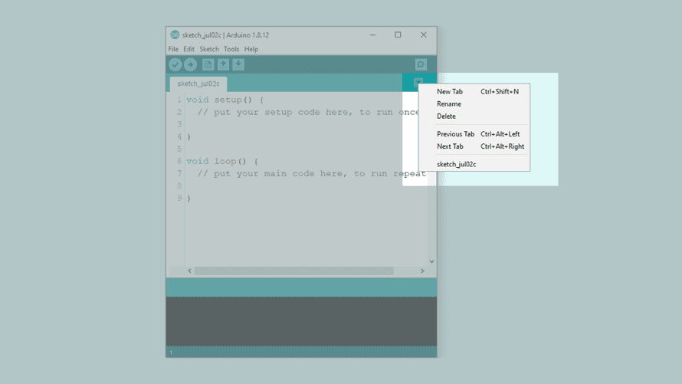
Practice - Programming the Publisher
We will now program the publisher device. Let's start by opening an empty sketch, and create a header file called arduino_secrets.h that we can store our Wi-Fi credentials in. To create a tab in the offline editor, click the arrow symbol underneath the Serial Monitor symbol, and click on the "New tab" option.

Slide 9
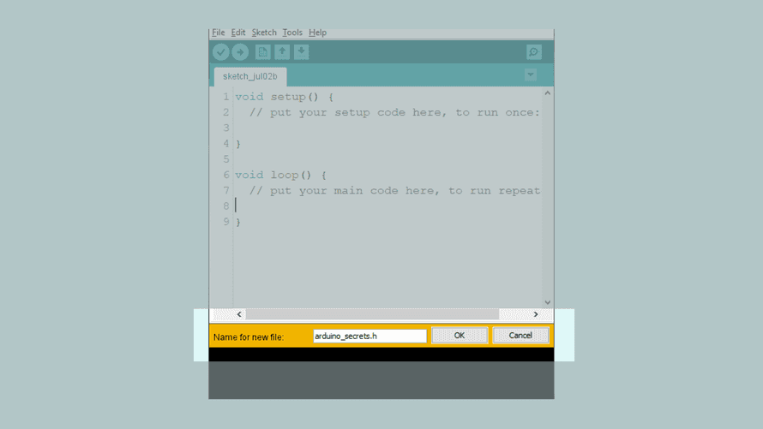
Practice - Programming the Publisher
Then, name the file "arduino_secrets.h".

Slide 10
Practice - Programming the Subscriber Device
We will now program the subscriber device. For this, we need to create a new sketch, and create another arduino_secrets.h file. For instructions read the previous topic
You can now start coding from the Subscriber files.

Slide 11
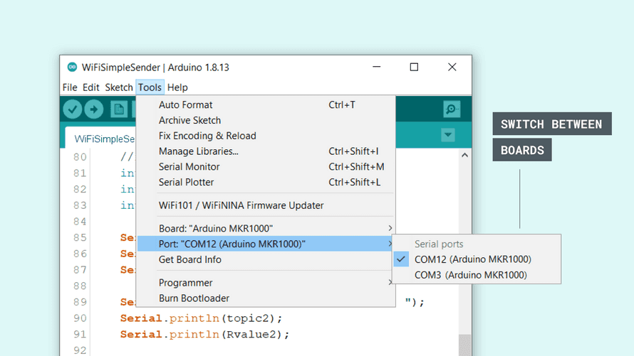
Results
If everything was successful during the upload, we now have a publisher and subscriber device. Next, we need to open the Serial Monitor for each board, one at a time. This will initialize the sketch. Since we can only have one Serial Monitor open at one time, we will need to switch the ports manually. Using only one computer can be a bit tedious, as we can never view the Serial Monitor of both devices at the same time.
In this tutorial, we are using two MKR 1000 WiFi boards. When switching between the ports, we can see them listed as COM12 and COM3.

Slide 12
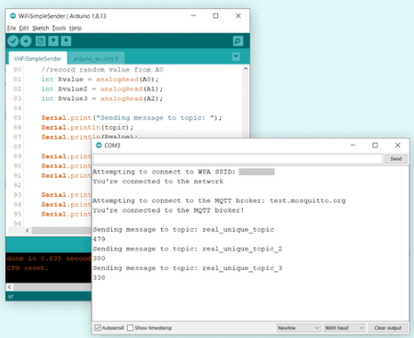
Results
When both devices have been initialized, they start connecting to the network. Now, let's open the Serial Monitor and keep it open for the publisher device.
We can now see that we are sending messages every 8 seconds (this interval can be changed at the top of the code). Each interval sends three messages, for each topic. Each topic contains the latest reading from an analog pin.

Slide 13
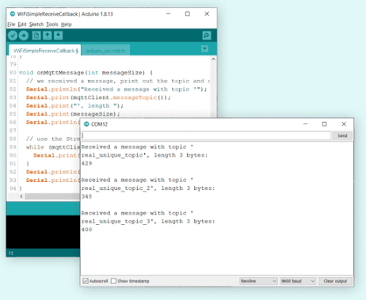
Results
Now, let's open the subscriber device's Serial Monitor, and keep it open. If everything is successful, we can now see the analog values. This means, that we have successfully published three topics on one device, and subscribed to them using another device.

Slide 14
Great job!

