Slide 1
NPEX Image Restoration Lab.
Lab 2: Deep Image Denoising
September 22nd, 2020
Sanghyun Son

Slide 2
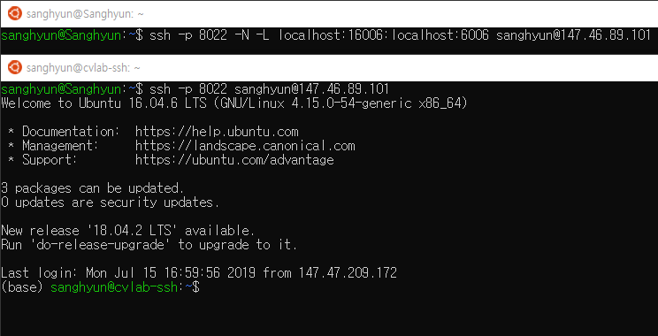
SSH Tunneling
If you are using Linux (or WSL)…
ssh -p 8022 -N -L localhost:16006:localhost:6006 [username]@[server] on any shell
You can launch the TensorBoard on the other shell

Slide 3
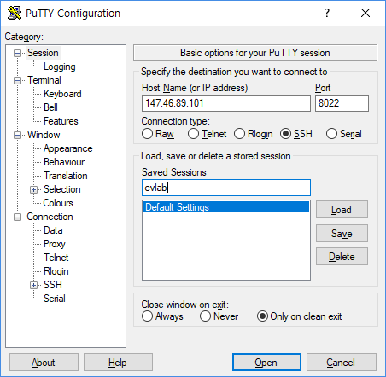
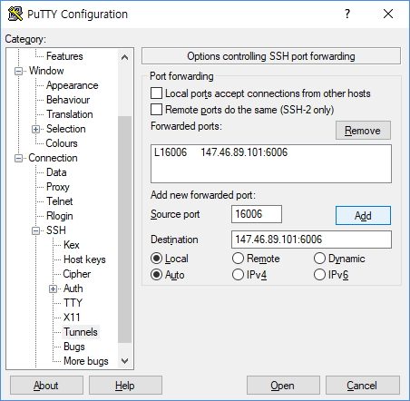
SSH Tunneling
If you are using Windows (PuTTY)…
Server IP
Port
16006
Server IP:6006

Slide 4
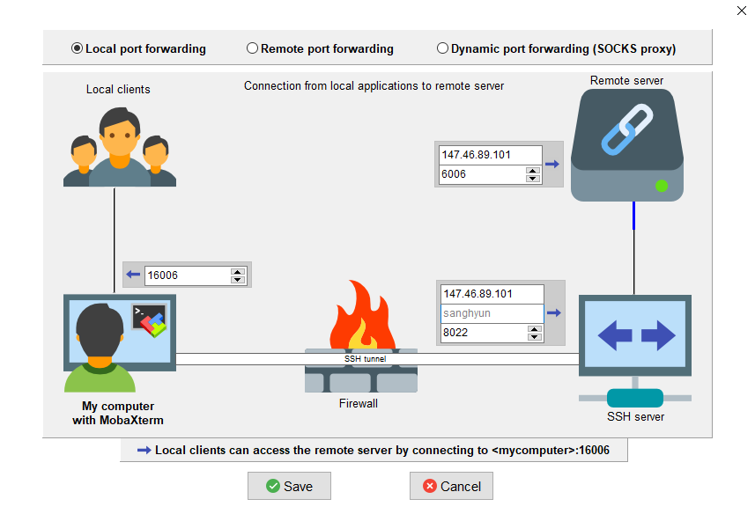
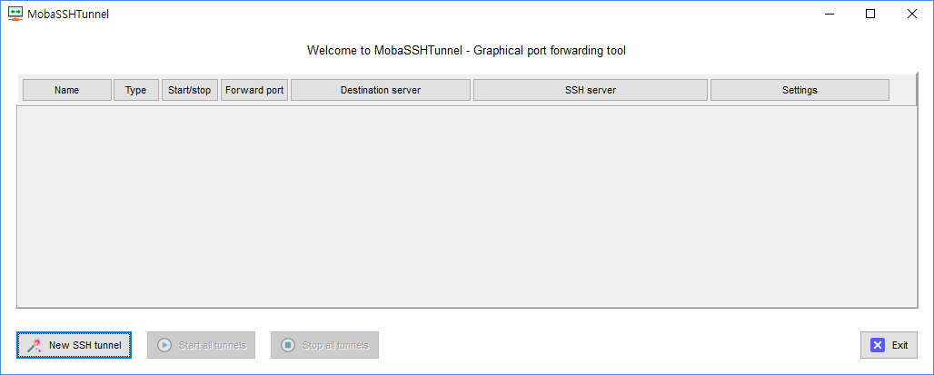
SSH Tunneling
If you are using Windows (MobaXterm)…
Then start the tunnel
Server IP
16006
6006
Server IP
Username
Port

Slide 5
SSH Tunneling
If you are using PuTTy or MobaXterm…
Launch the TensorBoard on the terminal you’ve entered tunneling arguments
tensorboard --logdir [log_directory] --bind_all --host=0.0.0.0
For a general server
For the NPEX server

Slide 6
Goal of This Course
Build a simple framework for general image restoration tasks
Understand differences between image restoration and other tasks
Generate various datasets for image restoration
Implement basic CNNs for image restoration
Train/Evaluate various image restoration models

Slide 7
Setup
Skeleton code:
https://github.com/thstkdgus35/npex-lab-2020
We can start from the day1 branch
We have some minor updates
(day1) git pull origin
day2 implementation is also provided in the day2 branch
git fetch origin
git checkout day2

Slide 8
Noisy Image Generation

Slide 11
Noisy Image Generation
We will assume a simple Gaussian noise model
I_{noise} = I_{clean} + n, where n ~ N(0, σ²)
numpy.random.randn can be used
Be careful to quantization
Clipping saturated values
Rounding
Do we need to fix n for each training input?
Do we need to fix n for each evaluation input?

Slide 12
Noisy Image Generation: Evaluation
Fix the noise for the evaluation dataset
To do:
Write a python script generate_noise.py
Add Gaussian noise to evaluation images
Save them in the input directory
npex-2020-lab/dataset/DIV2K_sub/eval/target/xxxx.png
σ = 20 by default

Slide 13
Noisy Image Generation: Training
We can generate noisy images on-the-fly
To do: We will design a new dataset class
Write a python script data/noisy.py and implement NoisyData class by inheriting data.backbone.RestorationData
Implement on-the-fly noise generation for training images
We don’t have to add/change many things…
Just override preprocess
loader_train and loader_eval in main.py also should be modified
We should use the same σ(=20) with the evaluation dataset (why 40 in the code?)

Slide 14
Image Restoration: Pipeline
Data loading
Data preprocessing
Model training
Model evaluation

Slide 15
Model Training

Slide 16
Goal of This Course
Build a simple framework for general image restoration tasks
Understand differences between image restoration and other tasks
Generate various datasets for image restoration
Implement basic CNNs for image restoration
Train/Evaluate various image restoration models

Slide 17
Image Restoration: Model Training
Before training…
We need to define a CNN
Let’s make it simple
Define a simple feedforward CNN
Two options:
Define conv1, conv2, … conv4 independently
Use nn.Sequential
Batch normalizations (BN): Optional
Input (3 x H x W)
Conv (3 x 3, 3→64)
ReLU
Conv (3 x 3, 64→64)
ReLU
Conv (3 x 3, 64→64)
ReLU
Conv (3 x 3, 64→3)
Output (3 x H x W)

Slide 18
Image Restoration: Model Training
Advanced techniques:
Parameterize all the numbers (with argparse)
Ex) The model can be represented as: CNN(n_channels, n_feats, kernel_size, n_convs, activation, BN) = CNN(3, 64, 3, 4, ReLU, False)
You can even parameterize the model
Need a basic understanding of Python module
The nested structure can make it bit complex
Input (3 x H x W)
Conv (3 x 3, 3→64)
ReLU
Conv (3 x 3, 64→64)
ReLU
Conv (3 x 3, 64→64)
ReLU
Conv (3 x 3, 64→3)
Output (3 x H x W)

Slide 19
Image Restoration: Model Training
Now we can train the CNN
Using the autograd is very simple
Each line corresponds to one line of code
Reset the gradient (zero_grad)
Feed an input batch
Calculate the loss value
Backpropagation (backward)
Weight update (step)

Slide 20
Image Restoration: Model Training
Optimizer in the PyTorch
Model Class
Control
optimizer.step
Optimizer Class
Model weights
w₀ | w₁ | ⋯ |  |  |  |  | w_{N}
Optimizer variables
(e.g. Momentum)
Model gradients
m₀ | m₁ | ⋯ |  |  |  |  | m_{N}
g₀ | g₁ | ⋯ |  |  |  |  | g_{N}
Control
optimizer.zero_grad

Slide 21
Image Restoration: Model Training
To do:
Finish the training loop (do_train) in main.py
We will use the MSE loss function (See the reference)
Relationship between PSNR and MSE?
Reset the gradient (optimizer.zero_grad)
Feed an input batch
Calculate the loss value (nn.functional.mse_loss)
Backpropagation (loss.backward)
Weight update (optimizer.step)

Slide 22
Image Restoration: Model Training
To do (Advanced):
Logging is what all we need
Use --sub_save [experiment-name] for better ablation study
Log the loss value in the TensorBoard (add_scalar) / iter
Save intermediate outputs in the TensorBoard (add_images) / 100 iters
Train the model for 10 epochs and see if the training loss decreases

Slide 23
Image Restoration: Model Training
export CUDA_VISIBLE_DEVICES=[IDX]
export CUDA_VISIBLE_DEVICES=0
export CUDA_VISIBLE_DEVICES=0,1
export CUDA_VISIBLE_DEVICES=1,3

Slide 24
Model Evaluation

Slide 25
Image Restoration: Model Evaluation
Be careful with our dataset class
crop/augment should be disabled
Do not calculate gradients
torch.no_grad(): will prevent it
Average performance matters
We don’t have to store every single loss values

Slide 26
Image Restoration: Model Evaluation
Evaluate the CNN after each epoch
No gradient calculation - much simpler than the training!
Feed an input batch
Calculate the loss/PSNR value
Keep the average loss/PSNR value in the TensorBoard / epoch
Save output images in the disk (TensorBoard is not recommended. Why?)

Slide 27
Image Restoration: Model Evaluation
I/O overhead: Revisited
Even saving output images can be a bottleneck in your code
OK if we only have 10 images for evaluation
Can be problematic if we have many (e.g., 100)
If evaluation + I/O requires over 30s / epoch
9000s (2.5h) / 300 epoch
Not desirable

Slide 28
Image Restoration: Model Evaluation
Some tricks to reduce overhead
Use a subset of your evaluation dataset
Periodic evaluation
(Advanced) Implement multiprocessing
Images are stored in a queue
Queued images are saved to the disk during training time
Can be implemented with ~50 lines of code
May require enough RAM

Slide 29
Image Restoration: Model Evaluation
To do:
Finish the evaluation loop (do_eval) in main.py
Train the model for 10 epochs and see if the evaluation PSNR increases
Run python main.py to execute your code
Compare output images with input images
Is your model working well?
How can we further improve the performance?

Slide 30
Day 2: Advanced
Optimize your GPU usage
GPUs are very expensive
You may want to fully utilize them
What we have to check?
Power consumption
Memory usage
GPU-Util

Slide 31
Day 2: Advanced
What can we do to improve efficiency?
Use larger model
Use larger patch size
Reduce I/O overhead
Test with
python main.py --model large
python main.py --model large --patch_size 128

Slide 32
Day 2: Advanced
Can we satisfy with Gaussian noise?
Gaussian: Sample-independent
Real-world noise is usually sample-dependent
and sensor-dependent
and camera-dependent
Try “Shot noise” in today’s framework
Noise intensity is proportional to square root of signal intensity
Which lines do we have to change?

Slide 33
Day 2: Review
Understand how to model noisy images
Implement a basic training loop for training a denoising CNN
Try various model architectures and evaluate their performances
On day 3…
Generate image super-resolution dataset
Define a simple CNN for super-resolution
Model checkpointing
Model fine-tuning
Advanced loss functions for image restoration
VGG-loss
Adversarial training

Slide 34
Day 2: More Advanced
Domain mismatch: Try different σ values for training and evaluation
Ex) σ=15 for the training / σ=20 for the evaluation
How do output images look like? (Compared to results from the model trained with σ=20)
How is the PSNR?
What happens if we use σ=20 for the training / σ=15 for the evaluation?
Larger and more effective architecture: Read this paper and try:
Implement RED[N] architecture
Train the model with noisy target

Slide 35
Day 2: More Advanced
Try real-world dataset to train your model
Smartphone Image Denoising Dataset: SIDD [Project page]
Review the paper
Is the dataset reliable?
What is the limitation of the dataset?
How can we use the dataset in our framework?

Slide 36
Thank you!
https://cv.snu.ac.kr
Sanghyun Son: sonsang35@gmail.com

