Slide 1
NPEX Image Restoration Lab.
Lab 3: Ablation Study & Deep Image Deblurring
September 23rd, 2020
Sanghyun Son

Slide 2
Setup
Skeleton code:
https://github.com/thstkdgus35/npex-lab-2020
Let’s start from the day2 branch
git pull origin
day3 branch provide today’s implementations
git fetch origin
git checkout day3

Slide 3
Dataset Preparation
Download the GOPRO dataset from here (GOPRO_sub)
Put it under npex-lab/dataset
Desired file paths:
npex-lab-2020/dataset/GOPRO_sub/train/input/xxxx.png
This time, we provide input images as well
Why?
S. Nah, et al., “Deep Multi-scale Convolutional Neural Networks for Dynamic Scene Deblurring” In CVPR 2017.

Slide 4
Toward Better Performance

Slide 5

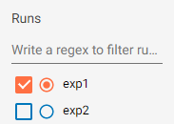
For Easier Ablation Study
Nested logging in TensorBoard
If the log file is placed under DIRECTORY and you’ve launched the TensorBoard with tensorboard --logdir DIRECTORY
If the log file is placed under DIRECTORY/SUB_DIRECTORY_1, … and you’ve launched the TensorBoard with tensorboard --logdir DIRECTORY
Use command line arguments!
-s or --save DIRECTORY
-u or --sub_save SUB_DIRECTORY_N
-s [experiment_name] -u exp1
Very good for ablation

Slide 6
For Easier Ablation Study
Dynamic model import
You can use other CNNs with -m or --model arguments
Ex) python main.py -m simple
Advantage?
You can change models without changing the code
Very good for version control

Slide 7
Goal of This Course
Build a simple framework for general image restoration tasks
Understand basic code structures of deep image restoration
Generate datasets for image restoration
Implement basic CNNs for image restoration
Train/Test various image restoration models

Slide 8
Before Get Started
Prepare some denoising models from day2
python main.py --epochs 20 -s ablation -u simple
python main.py --epochs 20 -m large -s ablation -u large
python main.py --epochs 20 -m large --patch_size 128 -s ablation -u large_p

Slide 9
Toward Better Performance
To do:
Try below modifications and check the model performance
Global residual learning (model/global.py) Output = Input + CNN(Input) CNN(Input) = Output - Input (noise)
Local residual learning (check model/resnet.py) Replace [Conv-ReLU-Conv] to a residual block
For easier ablation study…
Separate scripts of different models
Input (3 × H × W)
Conv (3 × 3, 3→64)
ReLU
Conv (3 × 3, 64→64)
ReLU
Conv (3 × 3, 64→64)
ReLU
Conv (3 × 3, 64→3)
Output (3 × H × W)

Slide 10
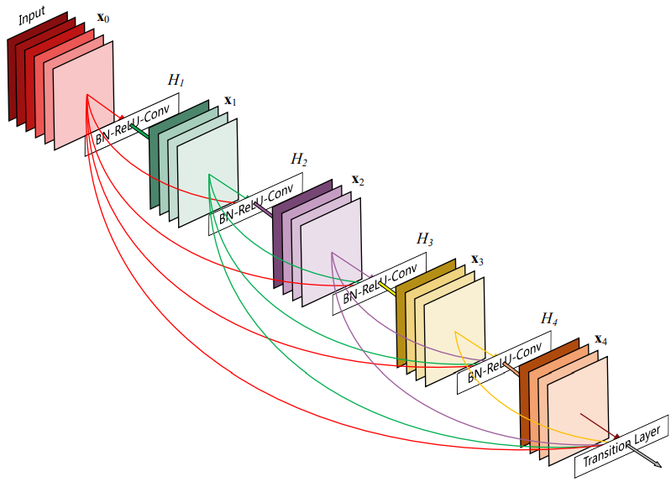
Toward Better Performance
To do:
Try below modifications and check the model performance
Stack more layers You can use more Conv layers (like model/large.py)
(Advanced) Dense connectivity (model/dense.py)
Each Conv takes all features from previous Conv layer(s)
Use torch.cat to collect the features
Find the k value to keep model size or complexity
Is the performance improved?
Input (3 × H × W)
Conv (3 × 3, 3→k)
ReLU
Conv (3 × 3, (3 + k→k)
ReLU
Conv (3 × 3, (3 + 2k→k)
ReLU
Conv (3 × 3, 3 + 3k→3)
Output (3 × H × W)
G. Huang, et al., “Densely Connected Convolutional Networks” In CVPR 2017 (Best Paper Award).

Slide 11
Toward Better Performance
Model complexity (Original)
in_channel × out_channel (× kernel_size)
Model complexity (Dense)
in_channel × out_channel (× kernel_size)
Layer | Complexity
Conv (3 × 3, 3→64) | 192
Conv (3 × 3, (64→64) | 4096
Conv (3 × 3, (64→64) | 4096
Conv (3 × 3, 64→3) | 192
Total | 8576
Layer | Complexity
Conv (3 × 3, 3→k) | 3k
Conv (3 × 3, 3 + k→k) | 3k + k²
Conv (3 × 3, 3 + 2k→k) | 3k + 2k²
Conv (3 × 3, 3 + 3k→3) | 9 + 9k
Total | 9 + 18k + 3k²

Slide 12
Validate Your Approach
Check if your large models are trained well
Do the larger models outperform the simple one?
Why?
It is easy to design a new network architecture
It is not easy to validate the new approach
Especially when there are bugs/mistakes
Good engineers/researchers should quickly analyze the problem

Slide 13
Validate Your Approach
Run large_global.py and compare the result again
Do we need more parameters or more computations for the global skip connection?
Try python main.py --epochs 20 -m large_global -s ablation -u large_global
Can you see any difference?
What can we do? (see model/large_global_init.py)
Try python main.py --epochs 20 -m large_global_init -s ablation -u large_global_init
Small change makes big differences

Slide 14
Validate Your Approach
Still, can we say that simple.py is better than large.py?
Large model usually requires more iterations to converge (Slow-starter)
The number of training samples may affect the performance
We cannot say which one is better at this point
Compare the resnet/dense model with our simple baseline as well
python main.py --epochs 20 -m resnet -s ablation -u resnet
python main.py --epochs 20 -m dense -s ablation -u dense
Do they perform better?
Things to consider:
More difficult debugging
Hardware-level optimization

Slide 15
Blurry Image Generation

Slide 16
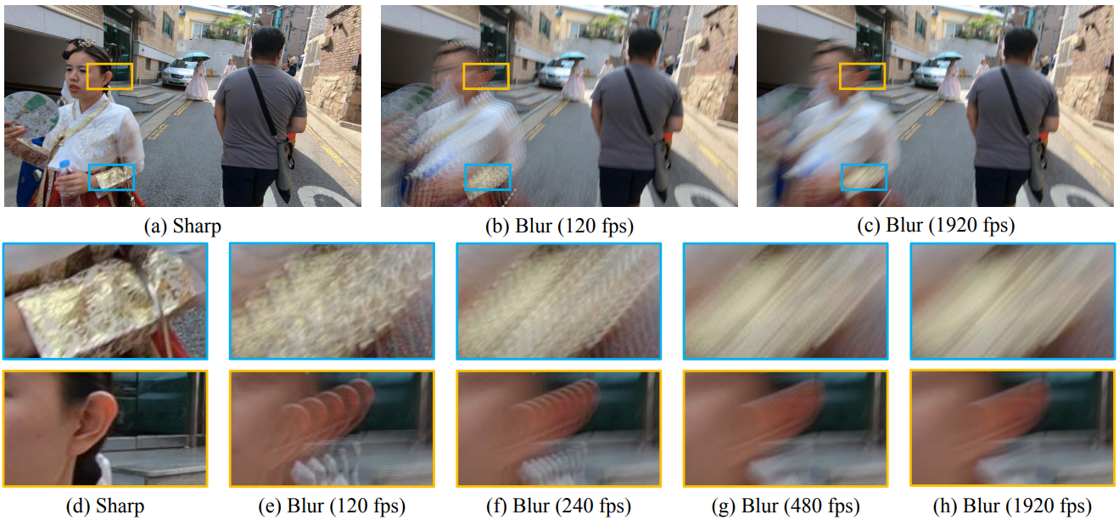
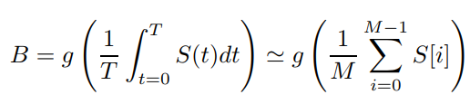
Blurry Image Generation
High-speed video recording
(Optional) Frame interpolation
Gamma correction
Frame averaging

Slide 17
Blurry Image Generation
Challenges in real-world
Large motions should be avoided
The pipeline requires heavy computation
High-speed cameras have significant noise
Challenges in synthesis
Realistic blur kernel is difficult to model
We will use the existing GOPRO dataset
S. Nah, et al., “Deep Multi-scale Convolutional Neural Networks for Dynamic Scene Deblurring” In CVPR 2017.

Slide 18
Train Your Deblur Model
Only the training dataset has been changed
Run python main.py --dataset GOPRO_sub -m [model] -s deblur -u test
Deblurring task is usually more challenging than denoising
Requires more time for training

Slide 19
Checkpointing

Slide 20
Checkpointing
It is another part of logging
Why checkpointing?
To save your final model
To fine-tune the model
For backup
What to store?
Model (parameters)
Optimizer
(Optional) Some descriptions

Slide 21
Checkpointing
How to save your model?
PyTorch has various choices (Use torch.save and torch.load):
Save the model directly (never do that) Ex) torch.save(net)
Save a state_dict Ex) torch.save(net.state_dict())
Save a JIT script

Slide 22
Checkpointing (Supplementary)
Your model (Python object = A reference of the Python code in your disk)
<Some low-level codes>
...
Your model weights
...
<Some low-level codes>
Inside the memory (RAM)
torch.save(net) Problem:
Sanity check fails if the code is changed
Can show unexpected behavior
torch.save(net.state_dict()) Note:
Model structure is not included
OK to change the code
You can easily modify stored weights

Slide 23
Checkpointing
Inside the state_dict:
All parameters and buffers are stored as a dictionary structure s = torch.load(‘[your_state_dict]’) for k, v in s.items(): print(k, v.size()) # v is to big too print
We can easily modify the weights by modifying the saved file directly
Warning: Graph structure is not saved!
You must share the real implementation

Slide 24
Checkpointing
Optimizer has its own state:
Plays an important role when you resume the training
To do:
Implement checkpointing after evaluation (see main.py)
Save {state_dict_{model}, state_dict_{optimizer}, Eval. PSNR} / epoch
Save a JIT script of the latest model

Slide 25
Use Your Model Outside the Framework
This is what checkpointing for
Check test_model.py
You have to keep your model file (e.g., model/simple.py) with the test script!
Example images are provided in example/xxxx.png
Finish test_model.py for test
Run python test_model.py --pretrained [checkpoint-path] -m [model-architecture]
Pre-trained checkpoints can be downloaded from here
Denoised images will be found from output/xxxx.png

Slide 26
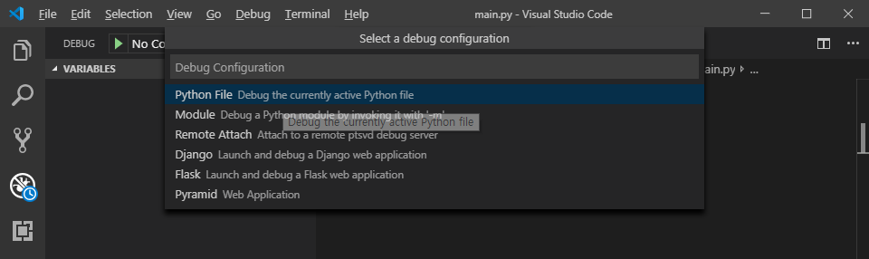
Checkpointing (Supplementary)
If you can use a debugging mode in your IDE (VSCode, PyCharm, …)

Slide 27
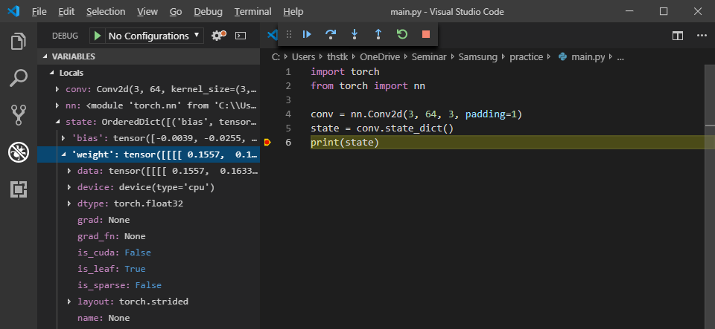
Checkpointing (Supplementary)
You can easily check inside the state_dict by monitoring variables

Slide 28
Checkpointing (Advanced)
JIT scripting
A new way to deploy your model
Graph structure + weights are saved together
No dynamic graph
Should be deterministic
Can be optimized further
Not compatible with complex routings (e.g. RNN) yet...

Slide 29
Day 3: Review
Can implement various model architectures
Understand how to generate synthetic blurry images
Understand basics of PyTorch checkpointing
On day 4…
Try model fine-tuning
Try deep image super-resolution
Try advanced modifications

Slide 30
Thank you!
https://cv.snu.ac.kr
Sanghyun Son: sonsang35@gmail.com

