Slide 1
NPEX Image Restoration Lab.
Lab 4: Deep Image Super-Resolution
September 24th, 2020
Sanghyun Son

Slide 2
Setup
Skeleton code:
https://github.com/thstkdgus35/npex-lab-2020
Let’s start from the day3 branch
git pull origin
day4 branch provide today’s implementations
git fetch origin
git checkout day4

Slide 3
Low-Resolution Image Generation

Slide 4
LR Image Generation
We will assume a simple bicubic downsampling model
I_{low} = D_{s}(I_{high}), where D_{s} is a bicubic downsampling operator of scale s
Unfortunately, there is no reference
MATLAB / OpenCV / PIL have different implementations
Although they are **almost** similar…
Training with MATLAB bicubic -> Test with PIL bicubic does not work well

Slide 5
LR Image Generation
In research area, MATLAB bicubic is mostly preferred
Just because MATLAB was preferred for research, but not now
Several problems with MATLAB:
Commercial software
Difficult to be integrated with python
Will provide python version of MATLAB bicubic image resizing
In src directory:
git submodule add https://github.com/thstkdgus35/bicubic_pytorch.git
git submodule update --init --recursive

Slide 6
LR Image Generation: Evaluation
We can generate low-resolution images on-the-fly
Similar to what we did for denoising model
Downsampling operators are deterministic
It depends on your preference
Sometimes, we only have low-resolution images
Save low-resolution images in a new directory to make your code simpler

Slide 7
LR Image Generation: Training
Can we generate low-resolution training images on-the-fly?
We can… but:
Resizing large images require heavy computational burden
Is it OK to crop first and resize?
Boundary effect is critical
To do:
Write a python script which downsamples high-resolution images and save them in a new directory (both for training and evaluation)
Check and run generate_lr.py
Generated images are saved under dataset/DIV2K_sub/*/input_x2[or 4]

Slide 8
Deep Super-Resolution CNN

Slide 9
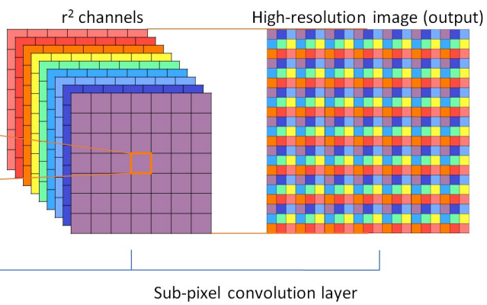
Deep Super-Resolution CNN
Design choice:
Pre-upsampling or Post-upsampling?
Post-upsampling is much more efficient
PyTorch has an efficient implementation:
Use nn.PixelShuffle or nn.functional.pixel_shuffle
W. Shi, et al., “Real-Time Single Image and Video Super-Resolution Using an Efficient Sub-Pixel Convolutional Neural Networks,” In CVPR 2016.

Slide 10
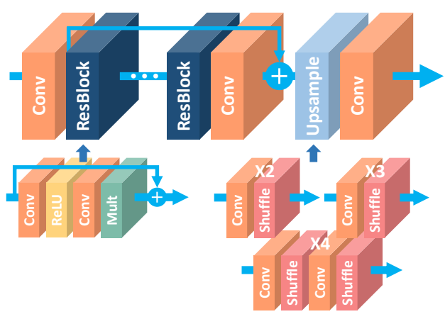
Deep Super-Resolution CNN
To do:
Build a small EDSR model (model/edsr.py)
Input Conv: 3→32
Output Conv: 32→3
Conv before each shuffle: 32→128
4 residual blocks
Scale: 2
Use L1 loss (nn.functional.l1_loss)
If you have more time, compare it with MSE loss
B. Lim, et al., “Enhanced Deep Residual Networks for Single Image Super-Resolution” In CVPRW 2017.

Slide 11
Deep Super-Resolution CNN
To do:
Replace dataset in main.py
Rewrite crop function in data/preprocessing.py
Train your new super-resolution CNN
Run python main.py --scale 2 --model edsr -s sr -u edsr_x2
You may want to train longer: Use --epochs 20
See if evaluation PSNR increases as the training proceeds

Slide 12
Fine-Tuning

Slide 13

Fine-Tuning
Load the state_dict from the checkpoint ckp = torch.load(‘[your_checkpoint]’) model_state = ckp[‘model’] net.load_state_dict(model_state)

Slide 14
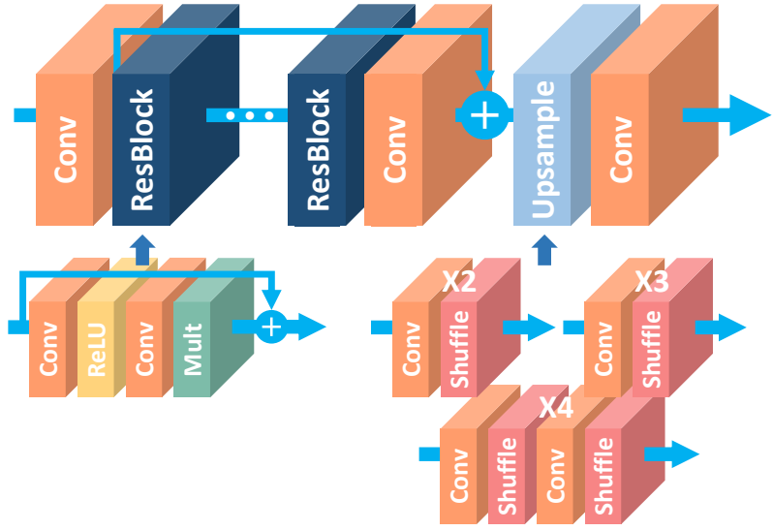
Fine-Tuning
To do:
Train 2x super-resolution model (only for some epochs)
Fine-tune the model for 4x super-resolution
Run python main.py --scale 4 --model edsr_x4 -s sr -u edsr_x4_pt --pretrained [checkpoint-path]
Compare with one without pretraining
Note
Be careful when you are loading the state_dict
Some weights should be ignored!

Slide 15
Adversarial Training

Slide 16
Adversarial Training
What is the adversarial training?
From the paper “Generative Adversarial Nets”
Two networks compete with each other
G (Generator): Generate realistic samples
D (Discriminator): Distinguish real and fake (generated) samples

Slide 17
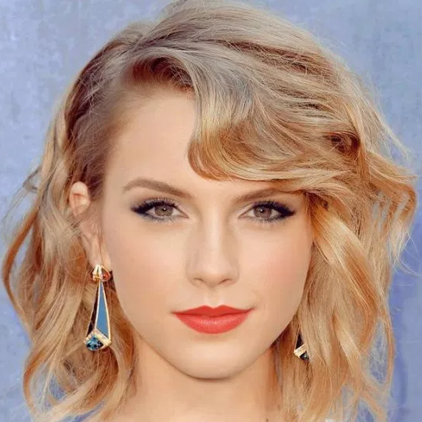
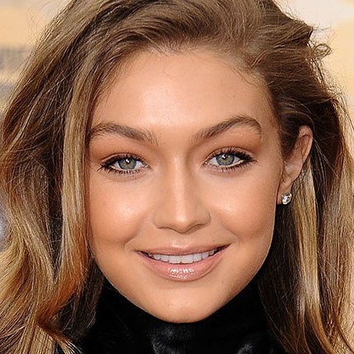
Adversarial Training
Random noise
Generated sample
In general GANs:
Why random noise?
Compact latent space (i.e. 100-dim noise -> 3×64×64 face image)
We don’t know the meaning of z
n₁
n₂
⋮
n_{z}
G
D
Real? Fake?
Generate
Classify
Real sample
Notes:
D(x) = 1 -> Real

Slide 18
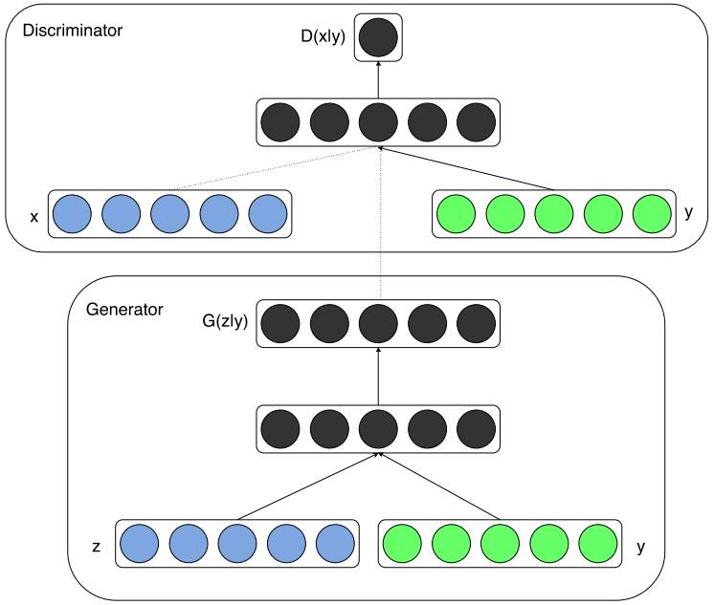
Adversarial Training
In conditional GANs (cGANs):
From the paper “Conditional Generative Adversarial Nets”
Known information (y) is provided to the generator (and the discriminator as well)
We can control the generated sample by changing y (Still with randomness; z is a random noise)

Slide 19
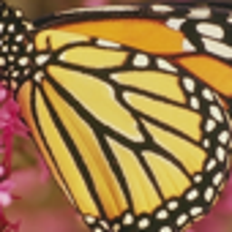
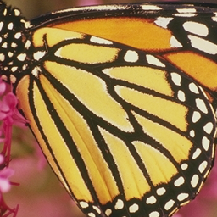
Adversarial Training
Generated SR
In image restoration:
From the paper “SRGAN”
A type of cGANs
y = A low-resolution patch
But
No randomness
Discriminator doesn’t take the conditional variable y
Input LR
G
D
Real? Fake?
SR
Classify
Real HR

Slide 20
Adversarial Training
Life is not easy
We have to add many many things:
A discriminator model (design really matters! - DCGAN)
An optimizer for the discriminator
Adversarial loss calculation + logging (not that difficult for us)
An implementation of VGG loss (optional, but quite important)

Slide 21
Adversarial Training
Check newly included parts in the code
Much longer do_train
Run the adversarial training framework with:
python main.py --scale 4 --model edsr_x4 --epochs 100 -s sr -u edsr_x4_gan --pretrained [checkpoint-x4] --gan
Do you think we can get a better PSNR?

Slide 22
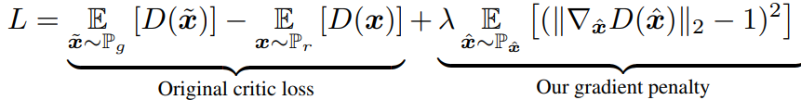
Adversarial Training: Stabilization
Question unveiled
Why did we put our images in [-1, 1]?
Adversarial training is **very** unstable
Loss may diverge
The discriminator may overwhelm the generator
We need additional techniques… Ex) WGAN-GP
Only works well with images in [-1, 1]
Why?
Because many GANs are using tanh output activation (-1, 1) by default
I. Gulrajani, et al., “Improved Training of Wasserstein GANs,” In arXiv:1704.00028.

Slide 23

Adversarial Training: Stabilization
A recommended pick: Spectral normalization
It prevents the discriminator from collapsing
Works very well even with approximations!
3-line coding with PyTorch
Still you need [-1, 1] normalization with your images
T. Miyato, et al., “Spectral Normalization for Generative Adversarial Networks,” In ICLR 2018.

Slide 24
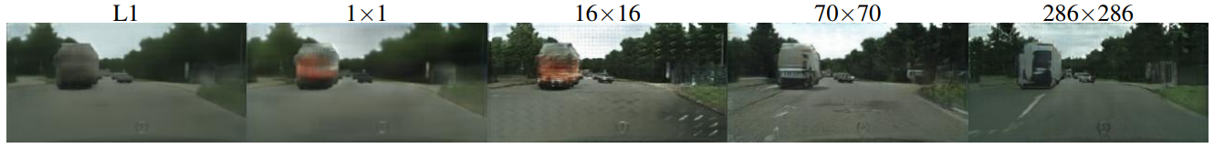
Adversarial Training: Stabilization
Another recommended pick: PatchGAN (pix2pix)
Pixel/Patch/Image GAN - The discriminator calculates the scores for each Pixel/Patch/Image
w/o Adv. Loss
PixelGAN
PatchGAN (16/70)
ImageGAN
P. Isola, et al., “Image-to-Image Translation with Conditional Adversarial Nets,” In CVPR 2017.

Slide 25
Adversarial Training: VGG Loss
Loss function in the feature domain
Optional
Shows better correlation with human perception
See page 41 of the Lecture 4 (Deep Super-Resolution)

Slide 26
Summary

Slide 27
Day 4: Review
Understand how to synthesize low-resolution images
Understand basics of fine-tuning with image restoration models
Understand how the adversarial training can be applied to image restoration problems
Understand Lab 01 ~ 04 and can explain each part of the code

Slide 28
Day 4: Homework (Optional, Challenging!)
Implement WGAN-GP (w/o spectral normalization)
You may need some reference implementations…
See this repository
Feel free to ask me a question if you really want to make it
Read this paper and try:
Implement RRDB model

Slide 29
Take-Home Messages
Running the code ≠ Implementing the code
Logging is all what you need
Add as many arguments as you can
It’s not difficult: Do it yourself!

Slide 30
Thank you!
https://cv.snu.ac.kr
Sanghyun Son: sonsang35@gmail.com

