Slide 1
NPEX Image Restoration Lab.
Lab 5: NAS for Image Restoration
September 25th, 2020
Sanghyun Son

Slide 2
Preparing for Exam
Download a new dataset for exam:
https://cv.snu.ac.kr/dataset/RealSR.tar
Input/target images are all provided (you do not have to synthesize them by yourself)

Slide 3
What is NAS?
Stands for “Neural Architecture Search”
Use deep neural networks to find more efficient architectures
Early works (AlexNet, VGG, ResNet, DenseNet, …)
Manually-designed architectures
Intuition plays an important role
Recent works (AmoebaNet, EfficientNet, …)
Searched by machine
Computing power becomes more important

Slide 4
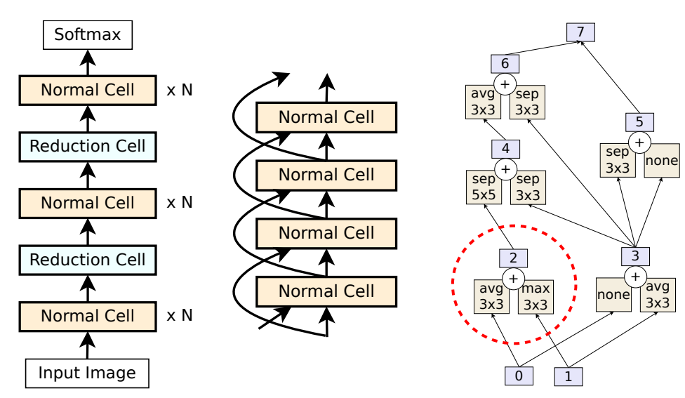
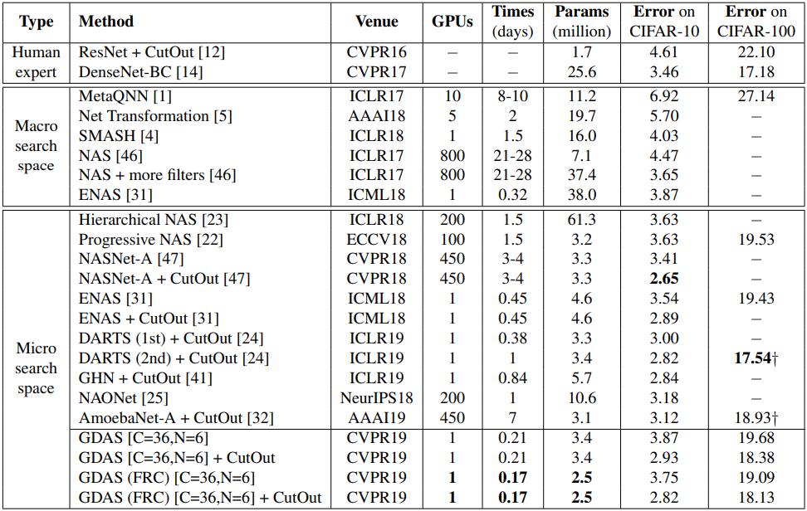
NAS Strategy
It is very challenging to find all possible network architectures
Define “architecture” as a stack of basic cells
Find the cell to search the architecture
Still very expensive to do with small computing power

Slide 5
NAS in Image Restoration
Not explored much yet
Accurate prediction matters
Significantly different from high-level architectures
Large dataset & models
Check FGNAS
You may try with open source:
DARTS (Differentiable ARchiTecture Search)
PNAS (Progressive Neural Architecture Search)
ENAS (Efficient Neural Architecture Search via Parameter Sharing)
H. Kim, et al., “Fine-Grained Neural Architecture Search,” In arXiv 2019.

Slide 6
Some Tips for Your NAS
Start from a small dataset (e.g., DIV2K_sub)
Dataset size also matters
Data and loss are more important the the architecture
Better architecture is just for better fitting
Novel idea usually does not require extreme state-of-the-art performance

Slide 7
Thank you!
https://cv.snu.ac.kr
Sanghyun Son: sonsang35@gmail.com

