Slide 2
FreeRTOS Lecture
Module 00
FreeRTOS
Module role
Real-time vocabulary before API details
FreeRTOS identity, history, and ecosystem
Why an RTOS changes firmware structure
Bridge into Module 01 project boundaries
Course baseline: NUCLEO-F439ZI, STM32CubeIDE, FreeRTOS kernel, CMSIS-RTOS V2 reading path
1 / 22

Slide 3
Orientation
Before Module 01
Position of Module 00
The existing course already has a strong project and API path. This module supplies the conceptual base that makes the rest easier to read.
Concept layer
RTOS meaning
Real-time timing language
Multitasking on a single core
Kernel feature map
FreeRTOS layer
Kernel and modular libraries
Task terminology
MIT license and ecosystem
OpenRTOS and SafeRTOS family context
Course layer
NUCLEO-F439ZI baseline
STM32CubeIDE environment
Self Lab entry point
Module 01 project tree bridge
This module prevents project structure from becoming the first explanation of an RTOS.
2 / 22

Slide 4
Firmware Baseline
Super loop and interrupts
Embedded Firmware Before an RTOS
A small embedded program often begins as one control loop plus a few interrupt handlers.
int main(void) { board_init(); while (1) { read_sensors(); update_control(); service_uart(); refresh_outputs(); check_buttons(); } }
What works at first
Low overhead
Direct execution order
Simple debug path
No scheduler configuration
Slow calls delay unrelated work
Timing dependencies become hidden
Polling wastes CPU time
ISR code can grow too much
The issue is not that the loop is wrong. The issue is that timing responsibilities accumulate inside one control path.
3 / 22

Slide 5
Scaling Pressure
Mixed timing requirements
When a Loop Stops Scaling
RTOS pressure appears when different parts of the firmware need different timing behavior.
Fast event A button, sensor threshold, or packet arrival needs a short response path. Periodic work A control loop or sampling routine needs a stable release interval. Slow work Logging, formatting, flash access, or network work may run for longer than expected. Background Health checks and diagnostics should run when the CPU has slack.
Loop-level symptom
The slowest path controls the response time of unrelated work.
Interrupt handlers start carrying too much application logic.
Adding one feature changes timing behavior elsewhere.
Debug output changes timing enough to hide the original bug.
4 / 22

Slide 6
Real-Time Vocabulary
Predictability over raw speed
Real-Time Means Predictable, Not Fast
A real-time system is evaluated by whether important work completes within meaningful timing constraints.
Latency
Delay between an event and the start or completion of the response that matters.
Jitter
Variation in timing from one execution to the next, even when the same code path runs.
Deadline
A time boundary after which the result becomes degraded, late, or useless.
Determinism
The ability to reason about timing behavior under a defined set of conditions.
A faster MCU can reduce average execution time. It does not automatically make response time predictable when control flow and priority rules are unclear.
FreeRTOS is mostly a way to describe and enforce execution order, waiting, and wakeup conditions.
5 / 22

Slide 7
Timing Classes
Hard and soft real-time
Hard and Soft Real-Time Requirements
The Kernel Book introduces this distinction before any API because it shapes priority and scheduling decisions.
Hard real-time
A missed deadline can mean system failure.
Correctness includes timing, not only the computed value.
Design tends to reserve priority and bounded paths for the critical work.
Example category: protection, emergency response, safety action.
Soft real-time
A missed deadline reduces quality or responsiveness.
The system may remain usable after late completion.
Design can tolerate occasional delay, buffering, or retry.
Example category: user input, display update, status reporting.
Priority assignment is not a moral ranking of code. It is a timing decision made for a specific system behavior.
6 / 22

Slide 8
Multitasking
Single-core MCU model
Multitasking on a Single Core
A Cortex-M4F core executes one instruction stream at a time. The RTOS makes multiple execution contexts manageable.
Task A Own stack, local control flow, waiting points
Scheduler Ready list, priority rule, blocking state
Task B Own stack, state, and execution history
->
->
Not true parallelism
The core still runs one task at a time unless the MCU has multiple cores.
Independent context
Each task has its own stack and scheduler-visible state.
Structured waiting
Tasks can block for time, data, synchronization, or notification.
Multitasking is useful even before parallel hardware appears because it separates timing responsibilities.
7 / 22

Slide 9
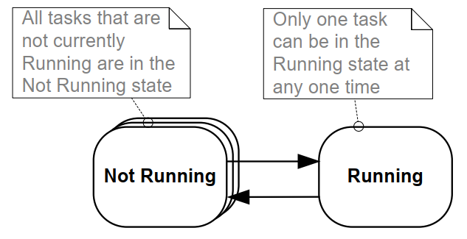
Scheduler Preview
Selection and state
What the Scheduler Decides
The scheduler does not run every task. It selects among tasks that are eligible to run.
Preview vocabulary
Ready : eligible for CPU selection
Running : currently executing on the core
Blocked : waiting for time, data, or an event
Suspended : outside normal scheduling until resumed
8 / 22

Slide 10
FreeRTOS Identity
Kernel and libraries
What FreeRTOS Is
FreeRTOS is not a desktop-style operating system. It is a small real-time kernel and a set of modular C libraries for microcontrollers and small microprocessors.
Application code Tasks, drivers, business logic, protocol decisions, product behavior.
Course framing
FreeRTOS code is linked into the firmware image.
The kernel runs because application code creates tasks and starts the scheduler.
Board-specific details remain visible through the port, HAL, BSP, startup, and linker layers.
STM32CubeIDE can generate a CMSIS-RTOS V2 wrapper path, but the native FreeRTOS concepts remain the foundation.
FreeRTOS kernel Scheduler, task state, queues, semaphores, mutexes, timers, event groups, notifications.
Port and HAL/BSP Cortex-M port code, STM32 HAL, board support, interrupt vector, clock and peripheral setup.
Toolchain Compiler, startup file, linker script, generated firmware image, debug probe.
9 / 22

Slide 11
Firmware Boundary
Library-like kernel integration
FreeRTOS in the Firmware Image
The first source-level idea: FreeRTOS becomes part of the firmware build, not a separate installed OS.
What appears in the project
main.c and application task files
FreeRTOSConfig.h
Kernel sources such as tasks.c and queue.c
Portable layer for ARM Cortex-M
HAL/BSP and startup/linker files
Create objects xTaskCreate() xQueueCreate() -> Start scheduler vTaskStartScheduler() or CMSIS wrapper path -> Run by state Ready, Running, Blocked, interrupt wakeup
Module 01 will turn this map into concrete folders, generated files, and build boundaries.
10 / 22

Slide 12
Terminology
Task, thread, process
Terminology: Task, Thread, Process
FreeRTOS calls each schedulable execution context a task. That choice avoids desktop OS assumptions.
Term
Typical meaning
Course usage
task
FreeRTOS execution unit with its own stack and scheduler-visible state.
The main term for Module 02 onward.
thread
General OS term for a schedulable execution path inside a process.
Used only for analogy when needed.
process
Usually implies an address space and OS-managed resource boundary.
Usually avoided for MCU FreeRTOS explanations.
kernel object
Queue, semaphore, mutex, timer, event group, notification, buffer.
Used to group FreeRTOS APIs by design purpose.
A task is not a separate program. On a typical Cortex-M FreeRTOS system, tasks share the same address space.
11 / 22

Slide 13
Motivation
Why use an RTOS
Why Use an RTOS?
The Kernel Book frames RTOS use as a set of software design benefits, not only a way to chase deadlines.
Timing abstraction
Delay, timeout, periodic release, and event wait become explicit API-level concepts.
Maintainability
Timing details move out of tangled module-to-module control flow.
Modularity
Tasks become independent modules with defined responsibility and interface.
Testing and reuse
Smaller independent execution paths are easier to test and move to another project.
Efficiency
Blocked tasks do not poll. They wake when time, data, or events arrive.
Idle time
The idle task exposes spare CPU capacity and low-power opportunities.
Interrupt discipline
ISRs can stay short by deferring processing to task context.
12 / 22

Slide 14
Design Shift
Event-driven firmware
Event-Driven Firmware
A major RTOS shift is moving from repeated checking to blocked waiting and explicit wakeup.
Polling-heavy loop
Repeated checks even when nothing changed
CPU time spent asking the same question
Long loop path increases response variation
State scattered across flags and timing counters
RTOS event-driven path
Task blocks until data, time, or event is ready
Scheduler runs another Ready task while waiting
Queue, semaphore, notification, or event group encodes the wakeup reason
Timeout policy becomes part of the design
Module 06 through Module 14 are mostly a study of different wakeup and communication objects.
13 / 22

Slide 15
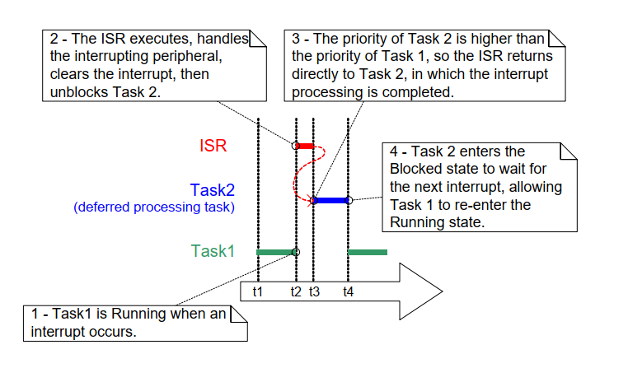
Interrupt Discipline
Deferred processing preview
Interrupts Stay Short
An RTOS does not remove interrupts. It gives the firmware a disciplined way to leave heavy work outside ISR context.
Preview rule
ISR handles the immediate hardware event.
ISR uses a FromISR API when FreeRTOS interaction is needed.
A task completes longer processing in normal task context.
The ISR may request a context switch if a higher priority task becomes Ready.
14 / 22

Slide 16
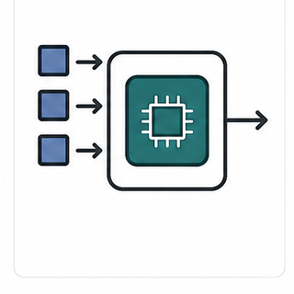
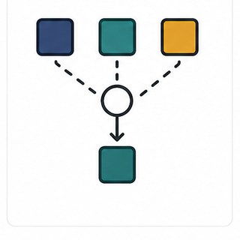
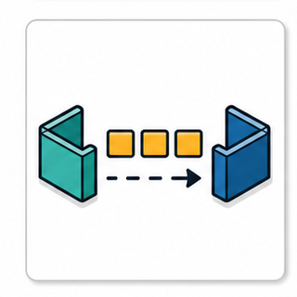


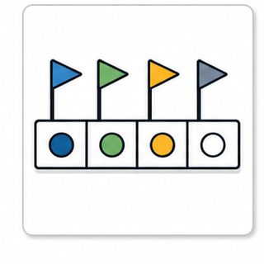

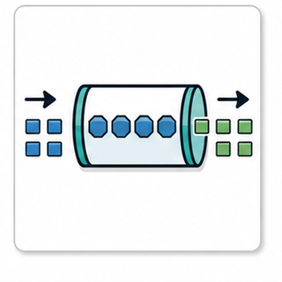
Feature Map
Problem to object
FreeRTOS Kernel Feature Map
Module 00 only names the tools. Later modules explain mechanisms, API details, failure modes, and STM32 checkpoints.
Independent execution context and responsibility boundary.
Priority and state based CPU ownership decision.
Data transfer plus blocking behavior between tasks.
Shared resource ownership with priority inheritance.
Time event callback without application polling loops.
Multiple conditions encoded as waitable bits.
Lightweight direct signal to one task.
Byte stream and message boundary data paths.
Object choice is a design decision about ownership, waiting, data shape, and timing.
15 / 22

Slide 17
Feature Map
Course path
From Feature Names to Course Modules
The full course is organized around the problems each kernel object solves.
Problem
FreeRTOS concept
Detailed module
Separate execution responsibilities
Task, TCB, stack
Module 02
Choose execution order under timing pressure
Priority, tick, scheduler policy
Module 03-04
Move data between tasks
Queue, mailbox, pointer queue
Module 06-07
Signal events and protect resources
Semaphore, mutex, critical section
Module 10-11
Represent time-driven work
Software timer, daemon task
Module 09
Handle many conditions or lightweight signals
Event group, task notification
Module 12-13
Handle serial data and packets
Stream buffer, message buffer
Module 14
Know why the firmware fails
Stack, heap, runtime stats, trace
Module 05 and Module 15
16 / 22

Slide 18

History and Stewardship
Why FreeRTOS is a production choice
FreeRTOS Value Proposition
FreeRTOS is widely used because the technical model is small, portable, commercially usable, and supported by a broad ecosystem.
Creator of FreeRTOS. The course treats FreeRTOS as both a small kernel and a long-lived embedded ecosystem.
Small
17 / 22

Slide 19
License and Family
FreeRTOS, OpenRTOS, SafeRTOS
FreeRTOS, OpenRTOS, and SafeRTOS
The course uses open-source FreeRTOS, but the family context matters for industry discussions.
FreeRTOS
MIT open-source license
Commercial application use allowed
Users retain their own intellectual property
Main target for this course
OpenRTOS
Commercially licensed version
Provided through a third party under license
Useful context for legal and procurement paths
Not the lab target here
SafeRTOS
Related usage model
Developed for safety standard compliance claims
Relevant to safety-critical product domains
Not a shortcut to safety certification
The practical lesson: FreeRTOS learning maps into a larger commercial and safety-aware ecosystem.
18 / 22

Slide 20
Course Platform
NUCLEO-F439ZI baseline
Why NUCLEO-F439ZI for This Course
The board is not the subject of the course, but it gives the RTOS concepts a repeatable execution target.
Core lab value
Cortex-M4F at the right complexity level for FreeRTOS kernel concepts
On-board ST-LINK for flash and debug
User LEDs and user button for scheduling and ISR labs
Virtual COM Port for UART logs and timing observations
STM32CubeIDE and STM32CubeMX project generation path
Boundaries for this course
Use LED, button, UART, ST-LINK, SysTick, and FreeRTOS first.
Keep Ethernet, USB, LCD-TFT, DMA2D, and crypto as later extension topics.
Treat NUCLEO-F429ZI as a close board-family reference, not the main template.
Keep NUCLEO-H755ZI-Q for later TinyML or Edge AI work.
19 / 22

Slide 21
Project Boundary Check
Module 00 Self Lab
Project Boundary Check
This checkpoint is deliberately light. The goal is conceptual readiness before writing FreeRTOS code.
Board and environment
Open STM32CubeIDE and confirm the NUCLEO-F439ZI board or STM32F439ZI MCU path.
List five board features visible in the ST board description.
Mark which features are needed for core FreeRTOS labs.
Mark which features should stay as future extension topics.
RTOS decision sketch
Invent a small firmware scenario with at least four activities.
Classify each activity as periodic, event-driven, continuous, or background.
Identify one timing risk in a super loop version.
Choose which activity would deserve the highest task priority and explain why.
Checkpoint output: a one-page note with workload categories, one timing risk, and a first task-priority hypothesis.
20 / 22

Slide 22
Bridge
Next module
Bridge to Module 01
Module 00 defines the language. Module 01 opens the firmware and shows where the language appears in files.
From concept
Task
Scheduler
Kernel object
Configuration
To source boundary
main.c
FreeRTOSConfig.h
Kernel source files
Portable layer
To STM32 lab
CubeMX-generated project
HAL and BSP boundary
ST-LINK debug
UART observation path
After Module 00, Module 01 should spend less time justifying RTOS use and more time reading the concrete project structure.
21 / 22

