Slide 1


The cost/income values which we want to predict

Slide 2
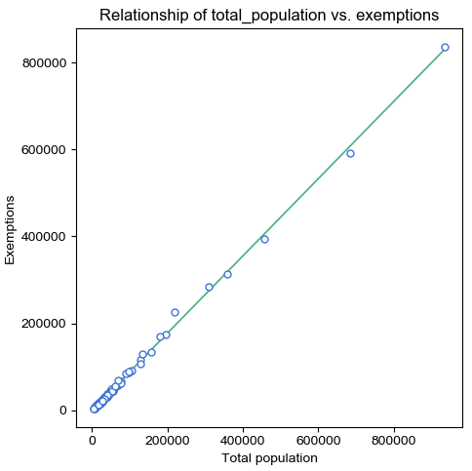

Slide 3
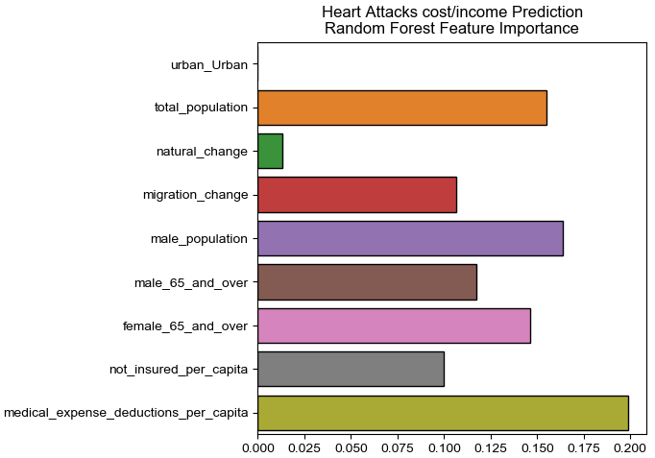
Training Set Accuracy: 73.53%
Test Set Accuracy:
73.91%

Slide 4
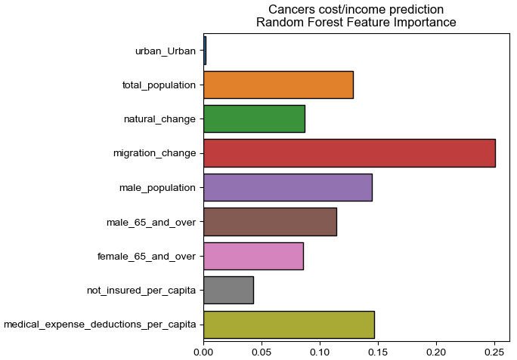
Training Set Accuracy: 77.46%
Test Set Accuracy:
83.33%

Slide 5


Each Factor

Slide 6


Each Factor

Slide 7


Each Factor

Slide 8


Each Factor

Slide 9


Other Factor
It is interesting to notice that in older people (65 and over), there are more male than female.
But these data not helpful in predicting the cost/income values.

