Slide 1
Project Update
RCMES-MCP
Enabling AI-Driven Climate Analysis
with NASA's NEX-GDDP-CMIP6 Data
March 2026

Slide 2
What is RCMES-MCP?
RCMES-MCP
An MCP (Model Context Protocol) server that exposes NASA's climate analysis tools to AI agents
Provides direct access to the NEX-GDDP-CMIP6 dataset — 38 TB of downscaled global climate projections at 0.25° resolution
Enables conversational climate analysis: users ask questions in natural language, AI executes the science
Built on NASA JPL's Regional Climate Model Evaluation System (RCMES) heritage
No data downloads, no coding required — AI handles data access, processing, analysis, and visualization

Slide 3
The Data: NEX-GDDP-CMIP6
RCMES-MCP
38 TB of bias-corrected, downscaled CMIP6 climate projections hosted on AWS Open Data
0.25° resolution (~25 km), daily timestep
Global coverage, 1950–2100
35 CMIP6 climate models
Historical + 4 SSP scenarios
Accessed via S3 in Zarr format — no downloads
9 Climate Variables:
tas / tasmax / tasmin — Temperature
pr — Precipitation
hurs / huss — Humidity
sfcWind — Surface wind speed
rsds / rlds — Radiation (SW & LW)

Slide 4
47+ Climate Analysis Tools
RCMES-MCP
Data Access — Load climate data by model, variable, scenario; region/country selection; multi-model ensemble loading
Processing — Temporal & spatial subsetting, regridding, unit conversion, anomaly & standardized-anomaly, country masking
Statistical Analysis — Climatology, trend with significance, bias, RMSE, correlation, EOF/PCA decomposition
Spatiotemporal Detection — 3D connected-component extreme-event cataloguing, time of emergence
Ensemble & Scenario — Multi-model statistics with IPCC-style agreement maps, scenario-comparison fan charts
Ensemble Weighting — Skill / independence / combined weighting (Knutti 2017) validated against NCEP reanalysis observations
Extreme Indices — 22 ETCCDI indices, heatwave & drought analysis
Visualization — Spatial maps, time series, Hovmöller diagrams, fan charts, ensemble spread plots, Taylor diagrams

Slide 5
How It Works
RCMES-MCP
User asks a climate question in natural language (e.g., "What is the heatwave trend in California?")
AI agent selects and chains appropriate tools via the MCP protocol
Tools access NEX-GDDP-CMIP6 data directly from AWS S3 — no downloads needed
Analysis engine (xarray, Dask, xclim, SciPy) processes the data
Results returned as statistics, maps, time series plots, or derived datasets
Chainable operations: each tool returns a dataset_id for multi-step workflows
User / AI Agent
MCP Server
AWS S3 Data
Analysis Engine
Results

Slide 6
Example: Heatwave Trend Analysis
RCMES-MCP
"What is the heatwave trend in California under the high-emissions scenario?"
1. AI loads data: load_climate_data(tasmax, ACCESS-CM2, ssp585, California, 2015–2100)
2. AI analyzes heatwaves: analyze_heatwaves(dataset_id, threshold_percentile=90)
3. AI computes trend: calculate_trend(heatwave_id) → significant warming trend with p-value
4. AI visualizes: generate_timeseries_plot(dataset_id, show_trend=True) → plot returned to user
All steps executed automatically — the user only asks the question

Slide 7
Advanced Spatiotemporal Analysis
RCMES-MCP
Pillar 1 — Anomaly detection & dominant patterns: standardized z-score anomalies, 3D connected-component extreme-event cataloguing, EOF/PCA decomposition, Hovmöller visualization
Pillar 2 — Multi-model ensembles & scenario comparison: parallel multi-model loading, ensemble statistics with IPCC-style agreement maps, pairwise scenario differences, fan charts and ensemble spread plots, time-of-emergence mapping
10 new tools added to the agent toolkit — chainable through the same dataset_id pattern
Surfaces standard climate-research diagnostics that previously required custom scripting

Slide 8
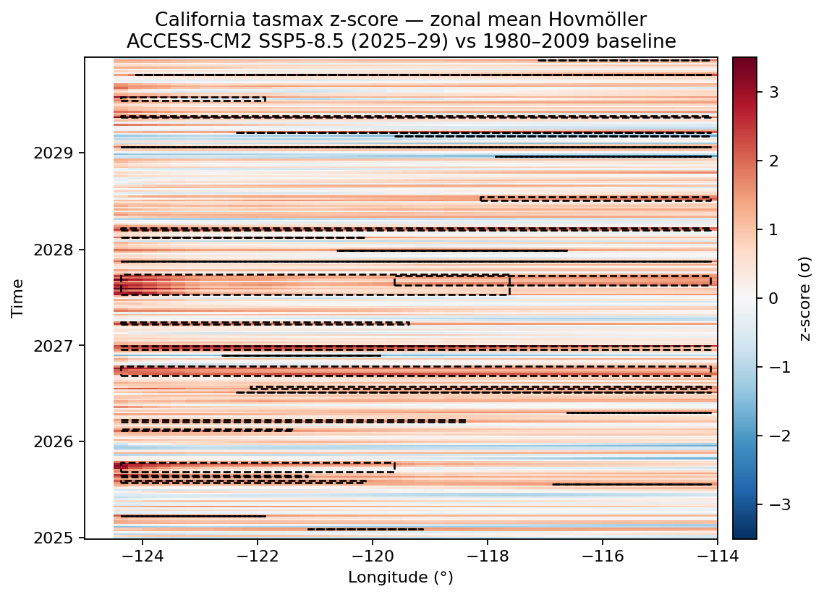
Spatiotemporal Extreme-Event Detection
RCMES-MCP
calculate_standardized_anomaly — z-scores per day-of-year (or month/season) vs a baseline window, comparable across regions and seasons
detect_extreme_events — 3D connected-component labeling on |z| > N·σ; returns an event catalogue (start/end, peak σ, location, footprint, duration)
Use case: heatwave / cold-snap / wet-spell / drought hunting under SSP scenarios
generate_hovmoller — time × lat (or × lon) view that reveals propagating anomalies and persistent regimes at a glance

Slide 9
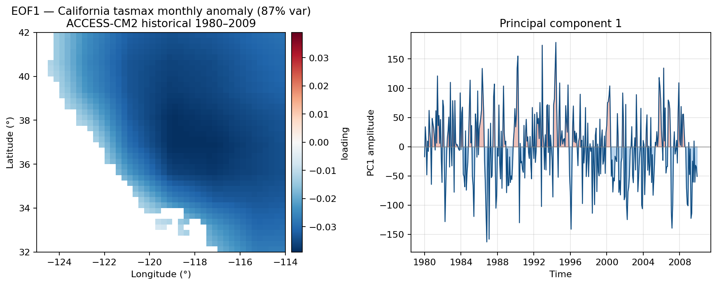
Dominant Variability Patterns (EOF / PCA)
RCMES-MCP
calculate_eof — cosine-latitude-weighted SVD that returns the leading spatial modes plus their principal-component time series
Surfaces dominant patterns of variability (teleconnection-like dipoles, seasonal cycles, regime shifts)
Two chained dataset_ids: spatial modes (mode, lat, lon) and PCs (time, mode) — feed straight into generate_map and generate_timeseries_plot
Reports variance explained per mode and cumulative variance

Slide 10
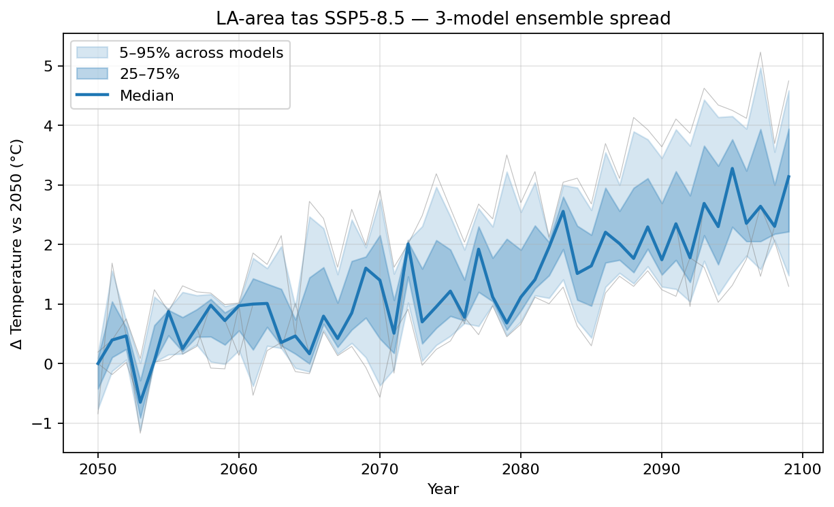
Multi-Model Ensembles — Quantifying Uncertainty
RCMES-MCP
load_multi_model_ensemble — parallel-loads up to 10 CMIP6 models for the same variable/scenario/region into one dataset with a model dimension
generate_ensemble_spread_plot — median + 25–75% inner band + 5–95% outer band across models over time (with optional per-model overlays)
Spread is the answer to "how much do models disagree?" — wide bands signal low confidence, tight bands signal robust signal
Cap of 10 protects RAM; pre-subset region & time before loading

Slide 11
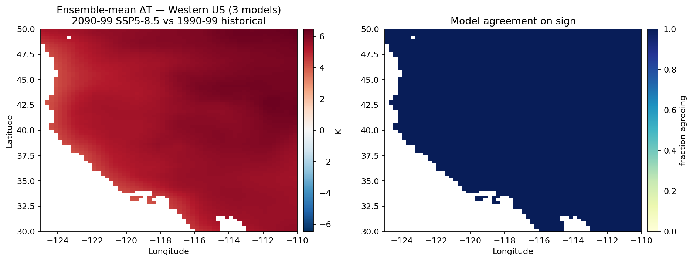
Ensemble Statistics & Model Agreement
RCMES-MCP
calculate_ensemble_statistics — reduces ensemble across the model dimension into ensemble mean, spread (σ), and min/max envelope dataset_ids
With a baseline window, also returns an agreement map: per-cell fraction of models agreeing with the ensemble-mean SIGN of change — IPCC stippling
Left: ensemble-mean ΔT (late-century vs baseline). Right: model agreement (0 = full disagreement, 1 = all models agree)
Standard inputs for confidence-aware climate assessments

Slide 12
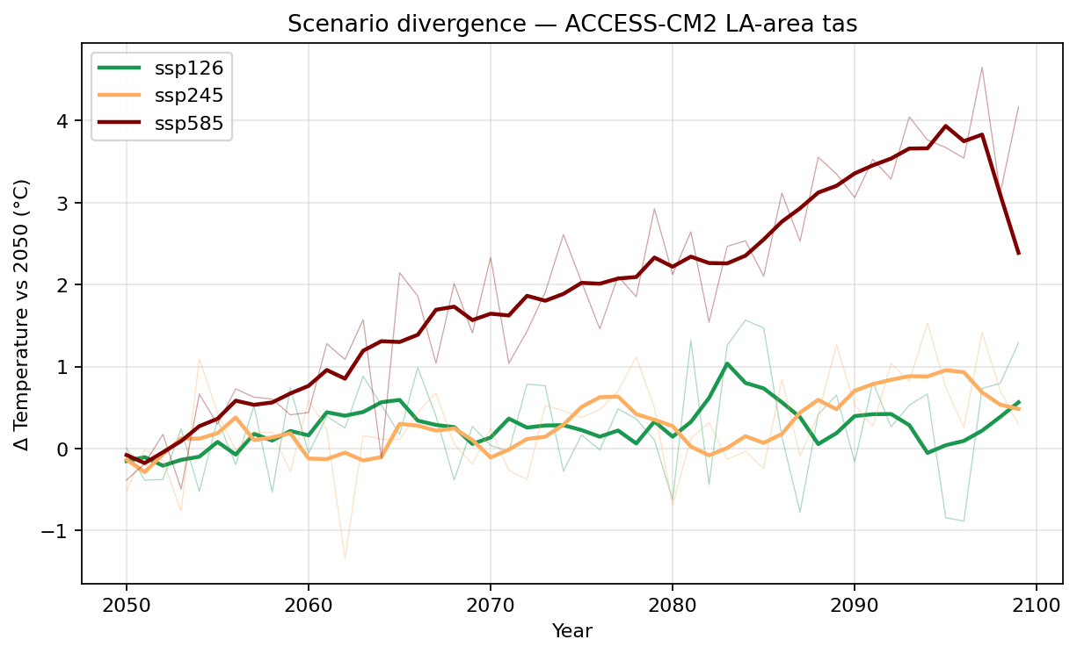
Scenario Comparison Across SSP Pathways
RCMES-MCP
compare_scenarios — loads the same variable/model/region across multiple SSP scenarios (max 5) and computes pairwise time-mean differences
generate_scenario_fan_chart — multi-line projection plot with shaded 5–95% bands per scenario; the canonical IPCC-style figure
Reveals when low- vs high-emission pathways diverge — central to mitigation messaging
Smoothing window option for decadal-scale signals; pairs well with generate_map on each pairwise difference

Slide 13
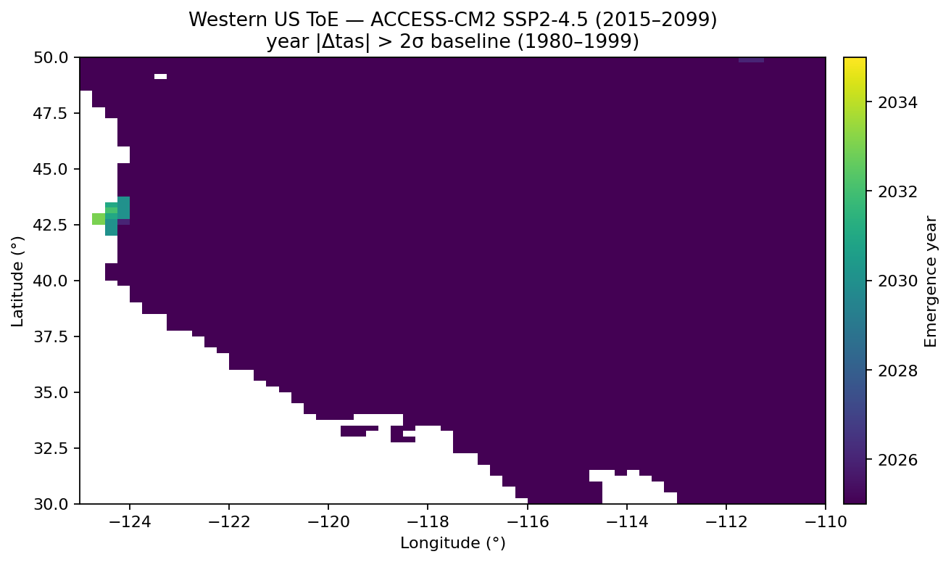
Time of Emergence — When Does Climate Change Arrive?
RCMES-MCP
calculate_time_of_emergence — per grid cell, the first year that the rolling-mean signal exceeds N·σ of baseline natural variability
Returns a 2D (lat, lon) map of emergence years (NaN where the signal never emerges within the window)
Tropics typically emerge first (low natural variability); high latitudes later but with larger absolute change — the colour gradient tells the story
Useful for impact-assessment timelines and adaptation planning

Slide 14
Ensemble Weighting — Beyond Equal Votes
RCMES-MCP
Default IPCC ensemble averaging treats every model as equally credible — but CMIP6 has lots of shared lineage (e.g., CESM2 ↔ NorESM2 share atmosphere)
Four schemes implemented (Knutti et al. 2017; Brunner & Knutti 2020): (1) Equal — democratic baseline; (2) Skill — w ∝ exp(−RMSE² / σ²) against reference observations; (3) Independence — penalise pairs of models with low inter-model RMSE; (4) Combined — skill × independence, AR6 operational style
load_reference_dataset → calculate_model_weights → apply_ensemble_weights → weighted projections; validate_ensemble_weighting splits time into train/test to score generalization against held-out observations
Active collaboration with Elias Massound and Arielle on ensemble calibration paper

Slide 15
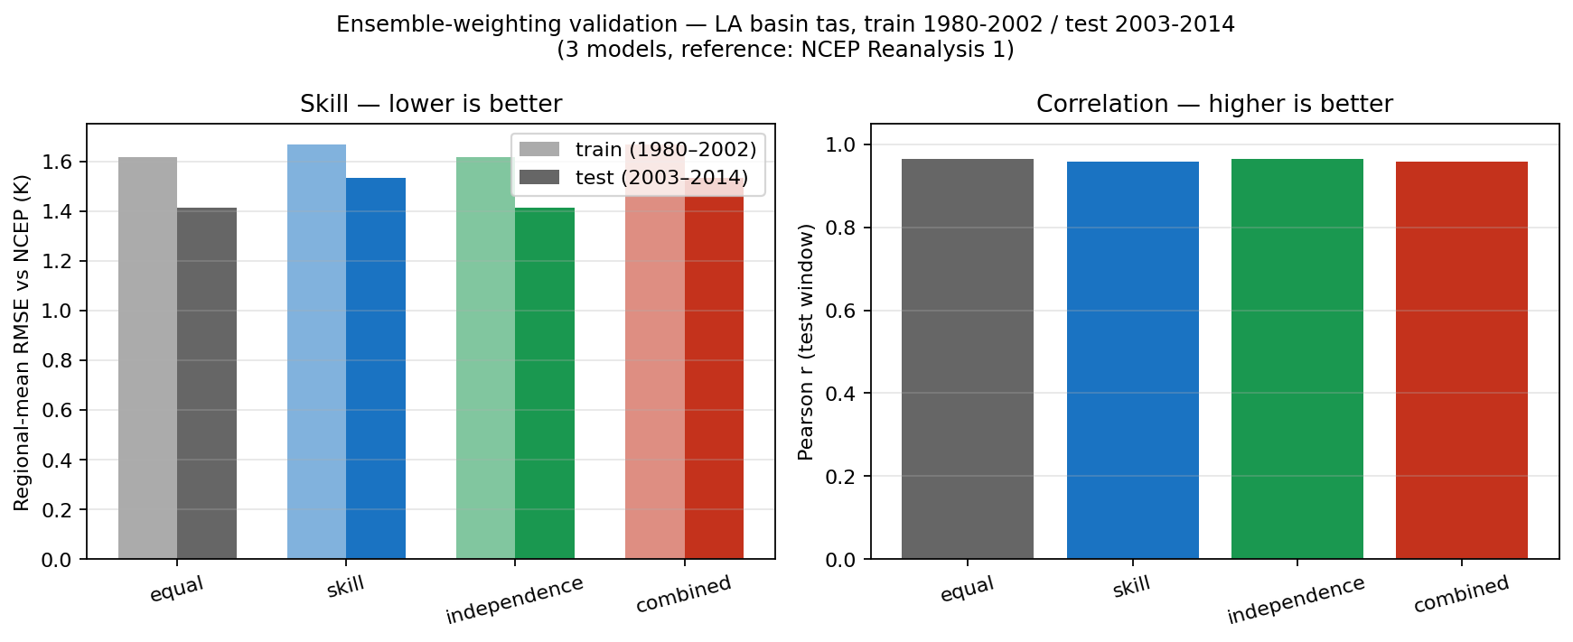
Validating Weighting Schemes Against NCEP Reanalysis
RCMES-MCP
validate_ensemble_weighting trains each scheme on 1980–2002 historical and scores it on the held-out 2003–2014 window against NCEP/NCAR Reanalysis 1
Left: regional-mean RMSE (lower = better); right: Pearson correlation of monthly anomalies (higher = better)
Skill-aware schemes typically beat the equal vote when one model substantially outperforms peers on the regional climatology
Honest framing: only 3 models in this demo — the methodology generalizes to the full 35-model NEX-GDDP-CMIP6 set

Slide 16
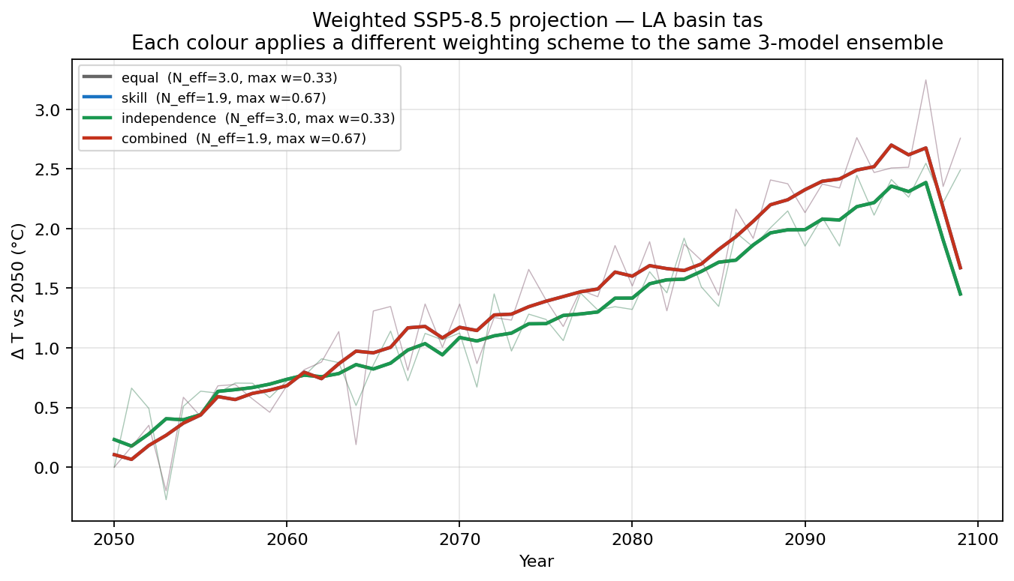
Weighted Future Projections by Method
RCMES-MCP
Each colour applies a different trained weight set to the SAME SSP5-8.5 ensemble (3 models, LA basin, 2050–2099) — the spread between curves is the structural uncertainty introduced by your weighting choice
When weighting methods disagree by ~0.5 °C late-century, that's the ensemble-weighting uncertainty band you'd quote alongside model spread
Skill and combined typically tilt the projection toward the model that best reproduces observations; independence damps clustered-model influence
All four projections are saved as new dataset_ids — feed any into generate_map / calculate_trend / calculate_time_of_emergence as usual

Slide 17
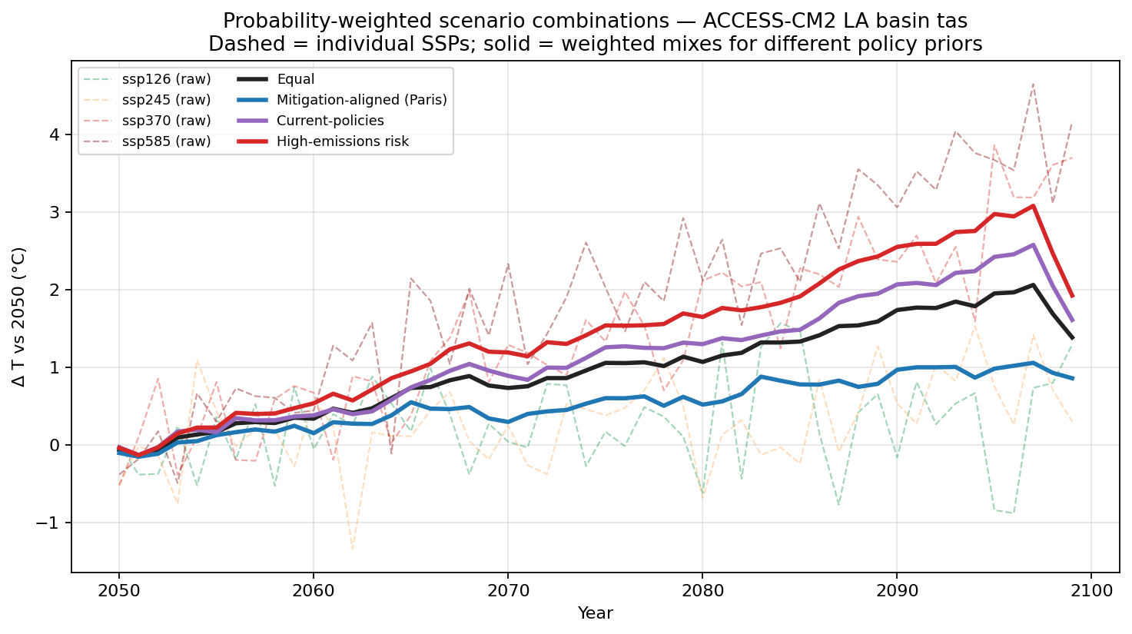
Probabilistic Scenario Combining
RCMES-MCP
combine_scenarios_weighted — assign prior probabilities to each SSP and produce a single weighted-mean projection. Use when the question is "what's the expected warming under our best guess of which pathway society will follow?"
Dashed lines: individual SSPs (raw). Solid lines: 4 different policy weight profiles applied to the same 4-scenario set
Mitigation-aligned (Paris) puts most weight on ssp126/245; Current-policies favours ssp245/370; High-emissions risk loads ssp585
Output is a normal dataset_id — chain into generate_map / generate_timeseries_plot / detect_extreme_events to do downstream analysis on the weighted projection

Slide 18
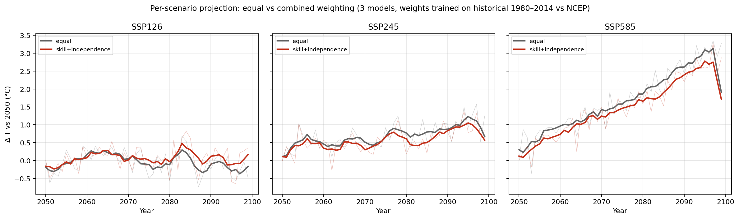
Model Weighting Across Scenarios
RCMES-MCP
Same 3-model ensemble + same historically-trained weights, applied to each SSP scenario independently — does weighting shift each scenario's projection in the same way?
If the skill-favoured model warms faster than the unweighted mean, weighted projections are higher across ALL scenarios (consistent tilt)
Useful diagnostic: lets you carry one trained weight vector through every downstream analysis — no need to re-train per scenario
Pair with combine_scenarios_weighted to first weight models within each scenario, then weight scenarios by policy probability

Slide 19
Current Status
RCMES-MCP
Accomplishments
32+ MCP tools: full climate analysis pipeline
Operational 38 TB data access via AWS S3
22 ETCCDI extreme climate indices
Interactive web UI (React + FastAPI)
Multiple deployment modes (MCP, Web, API, Docker)
Session management with chainable operations
Country-level masking & geographic selection
Technology Stack
Core: Python 3.10+, xarray, Dask, zarr
Climate: xclim, SciPy, NetCDF4
Geospatial: Shapely, GeoPandas, Cartopy
Server: FastMCP, FastAPI, Uvicorn
Frontend: React, TypeScript
Data: AWS S3, NEX-GDDP-CMIP6
AI: MCP Protocol, Azure OpenAI

Slide 20
Path Forward & Continued Support
RCMES-MCP
Growth Opportunities
Expand to additional NASA datasets (MERRA-2, ECCO, GLDAS)
Model evaluation with observational datasets
NASA Earthdata integration for authenticated access
Multi-model ensemble analysis & weighting
Community tool for broader climate science use
Reproducible climate assessments for policy support
What Continued Support Enables
Democratize access to NASA climate data for non-experts
Accelerate climate research by removing data engineering bottlenecks
Enable rapid AI-assisted climate impact assessments
Lower the barrier to entry across disciplines
Position NASA JPL at the forefront of AI-enabled science
Support decision-makers with actionable climate intelligence

