Slide 1

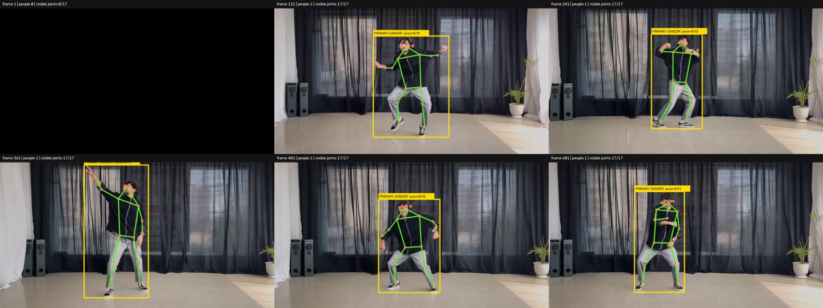
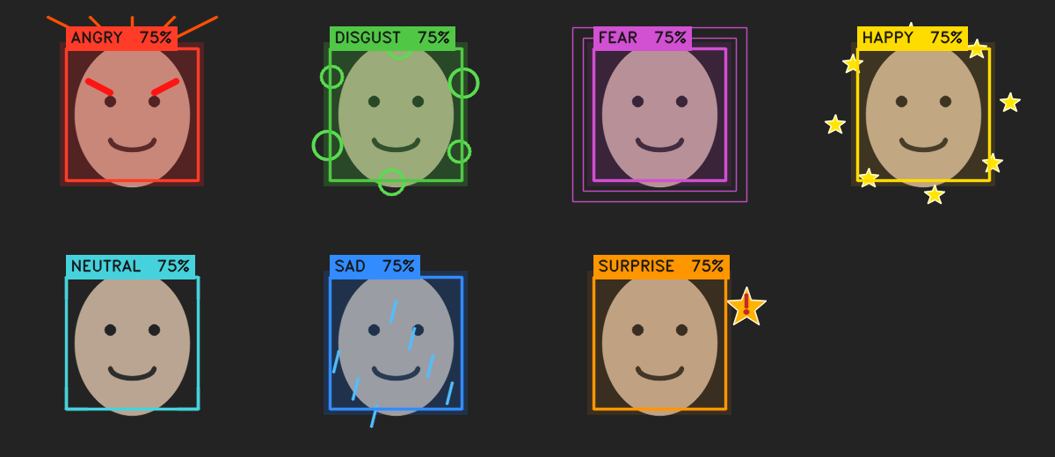
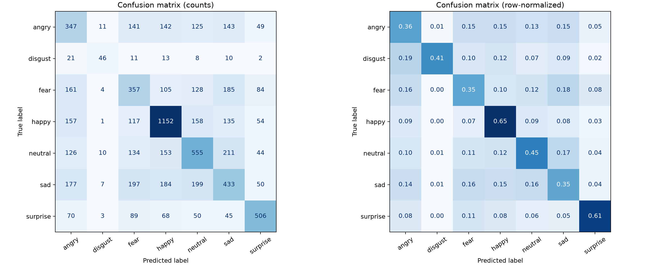
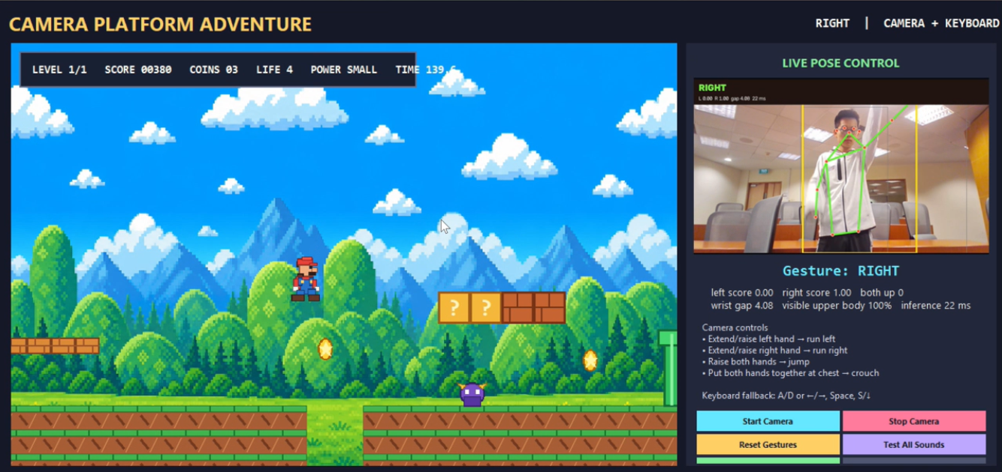
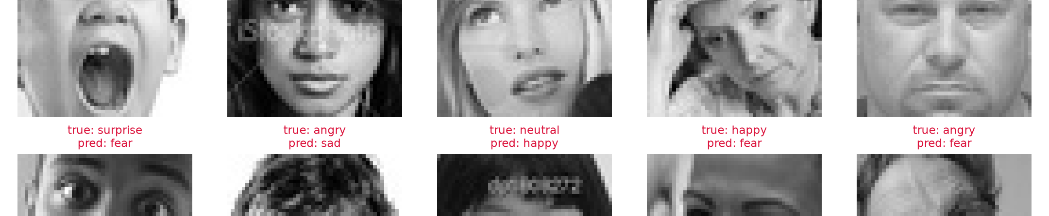
NUS SOC Summer Workshop 2026
Real-time Facial and Body Keypoint Analysis for
Interactive Video Applications
Project Code: SWS3026_08 | Group Members: Zhang Zonghao · Wang Xiaorui · Li Yunzang · Zhang Yunxiang
Abstract
A laptop-first keypoint pipeline powers three live webcam demos: expression effects, reaction-lag-aware dance scoring and gesture-controlled gameplay. The design prioritises real-time response and explainable geometry.
Main Contributions
• Shared face/body keypoint pipeline.
• Expression: 46.33% Macro-F1; 18.08 ms.
• Scale-, mirror- and reaction-lag-aware pose scoring.
Research question
Fig. 1. Webcam or reference video is converted into sparse keypoints, normalised, analysed and mapped to an interactive response.
Can one lightweight keypoint pipeline support several live demos on an ordinary laptop?
1. Facial Landmark Detection
3. Expression Recognition
4. Pose-based Applications
Each webcam frame is processed by Haar/YuNet face detection followed by 68-point LBF landmarks. Models load once; the display reports the face box, landmarks and FPS.
Landmarks are extracted from the official FER-style train/test split. Model selection is restricted to the training split; the official test split is used once for final evaluation.
YOLOv8n Pose provides 17 COCO keypoints for the reference dancer and webcam participant. Metrics below use a 2,680-frame CPU reference run at imgsz=320.
Method
Training and model selection
• Webcam: OpenCV capture.
• Face: Haar cascade; YuNet alternative.
• Landmarks: LBF, 68 points.
• Robustness: CLAHE/gamma, ROI tracking and smoothing.
• Seven classes; 174 keypoint-derived features.
• PCA benchmarked as a controlled comparison.
• Selection prioritises Macro-F1, class balance and latency.
• Final model: class-balanced RBF-SVM.
Robustness observations
Fig. 5. CPU reference run with temporal primary-dancer tracking.
Condition
Observed behaviour
91.16%
31.40 ms
23.09 FPS
Low light
CLAHE restores local contrast.
dancer detected
pose inference
processing rate
Spatial and temporal alignment
Head rotation
Haar/LBF degrade off-frontal.
Fig. 2. Seven live effects with label and confidence.
• Spatial: centre and scale by the torso.
• Temporal: search a short reaction-lag window.
• Similarity: combine pose geometry and motion.
• Mirror: compare reflected left/right joints.
Occlusion
Covered features distort landmarks.
47.31%
46.33%
18.08 ms
Fast motion
Blur and jitter need smoothing.
test accuracy
Macro-F1
prediction time
Active score = 0.55 × Pose + 0.45 × Motion
Practical lesson. A missed face box cannot be recovered by the landmark stage.
Feedback design
2. Why Use Keypoints?
Feedback uses PERFECT / GREAT / GOOD / MISS, plus score and combo. HOLD and MOVE states prevent static poses from earning repeated points.
Normalised landmark geometry replaces raw pixels, reducing input size and background bias while keeping prediction below the 30 ms target.
5. Gesture-controlled Game
Fig. 3. Final confusion matrices; visually similar classes remain difficult to separate.
Feature group
Dimension / role
Failure analysis
Normalised x/y
136 values (68 × x/y)
Geometry features
38 distances, ratios and regional shape cues
Fig. 4. Typical errors under ambiguity, low contrast, pose and occlusion.
Total input
174 keypoint-derived features
Interpretation. Minority and visually similar classes remain the main weakness.
Fig. 6. The same pose stream controls a platform-game demonstration.
Gesture mapping: lean or move → left/right; raise the body → jump; lower the body → crouch.
Discussion and Limitations
Practical lesson. Scale normalisation and lag handling reduce sensitivity to body size and reaction time.
• Pose, blur and occlusion remain difficult.
• Landmark geometry omits texture.
• Partial bodies weaken movement scoring.
Conclusion and Future Work
A keypoint-centred design supports three live applications on a laptop. Next steps are Stratified K-fold confirmation, stronger tracking and a multi-user latency study.
Project and Acknowledgements
NUS School of Computing Summer Workshop (SWS3026). Thanks to the teaching team and contributors.
GitHub Repository ·
github.com/yunli2024/26Summer_NUS_SOC_
Visual_Computing_Project_G8
Real-time Facial and Body Keypoint Analysis
built to work live, not only in screenshots.
Group 8 · NUS SWS3026 Visual Computing
Notes:
[Sources]
docs/course_materials/Visual_Computing_Project.pdf
expert_level/artifacts_svm_geometry/metrics.json
expert_level/LEVEL2_TRAINING_DETAILED_REPORT.md
bonus_level/task2_results/summary.json
bonus_level/TASK2_REPORT.md
bonus_level/dance_scoring.py
[/Sources]

