Slide 1
WORK FROM HOME
Brought to you by colleagues from NUS IT

Slide 2
AGENDA
Brief Overview on 3 Methods to Work from Home
  Bringing home your office machine to work
  Using Virtual Desktop to access NUS resources
  Connecting to office machine from home machine
WORK FROM HOME

Slide 3
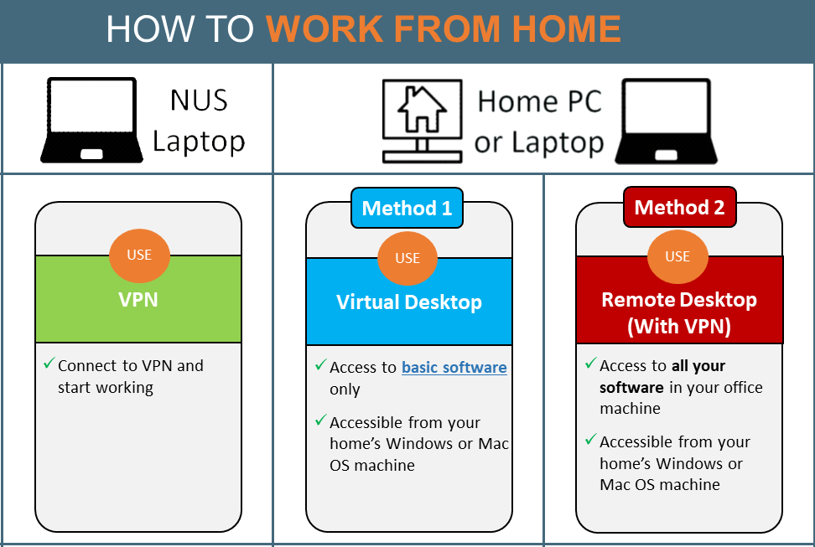
OVERVIEW OF 3 METHODS
https://nusit.nus.edu.sg/home-news/how_to_work_from_home/
WORK FROM HOME

Slide 4
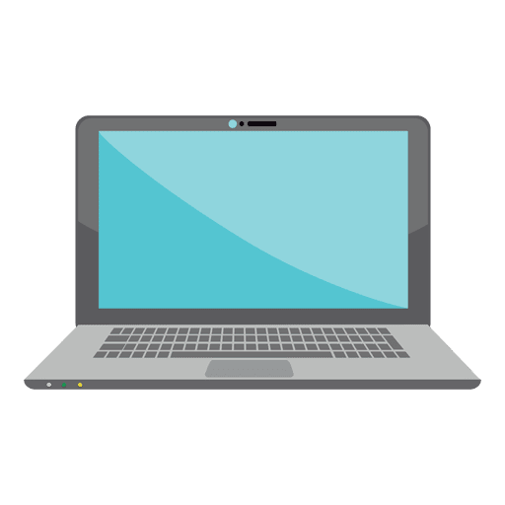
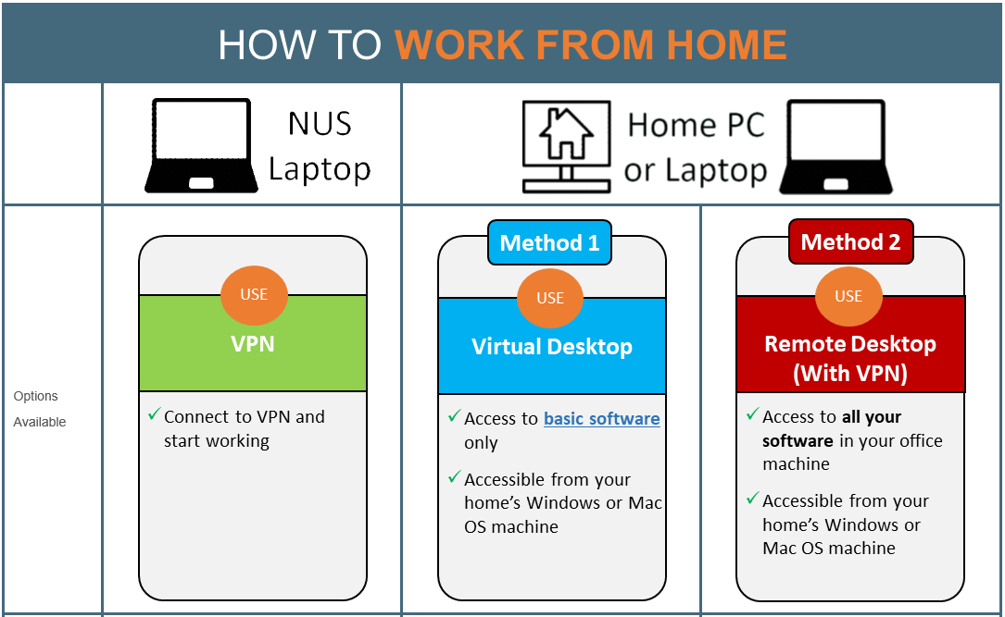
OVERVIEW OF 3 METHODS
Bringing home your office machine to work
NUS machine
Straight-forward where your data and software are inside your machine
Depending on what you need, e.g. access to NUS Staff Portal, SharePoint, etc. you need to connect to nVPN
WORK FROM HOME

Slide 5
OVERVIEW OF 3 METHODS
Using Virtual Desktop to access NUS resources
Home machine
Virtual Desktop – a solution deployed recently
Allows you to access to a standard suites of software and services with no hassle of connecting to nVPN
One-time effort is required to:
  Set up Virtual Desktop
  Move your working documents into nBox
WORK FROM HOME

Slide 6
OVERVIEW OF 3 METHODS
Connecting to office machine from home machine
Home machine
Require nVPN to gain access to your data and software in your office machine
One-time effort is required to:
  Enable remote desktop in office machine
  Install Skype for Business on home machine, if necessary
WORK FROM HOME

Slide 7
THE END

