Slide 2
Remediation Report
Jonson, 1/12/2017

Slide 3
Overview
Remediation Report Background
BeautifulSoup API simple introduction
Excel API simple introduction
Tools Function introduction
Go through main method
Tools demonstration

Slide 4
Remediation Report
It used to collect the information for the owsap scan result

Slide 5
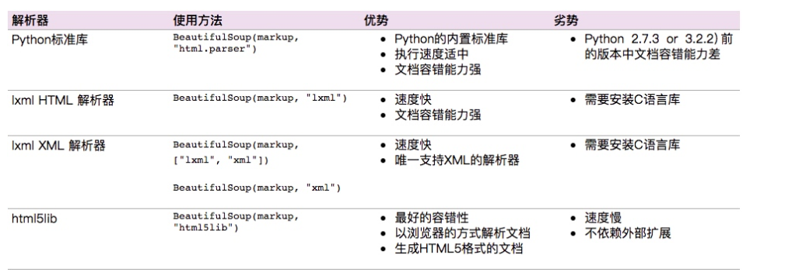
BeautifulSoup API simple introduction
Beautiful Soup API introduction:
Beautiful Soup is a Python library for pulling data out of HTML and XML files. It works with your favorite parser to provide idiomatic ways of navigating, searching, and modifying the parse tree. It commonly saves programmers hours or days of work.

Slide 6
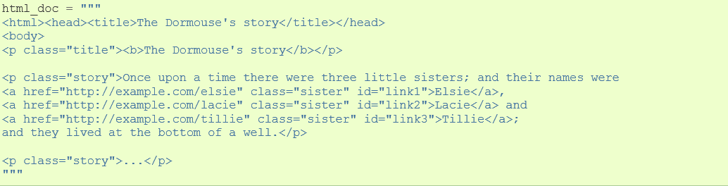
BeautifulSoup API simple introduction
Quick Start:
Html example:
Notes:
html_doc = """ <html><head><title>The Dormouse's story</title></head> <body> <p class="title"><b>The Dormouse's story</b></p> <p class="story">Once upon a time there were three little sisters; and their names were <a href="http://example.com/elsie" class="sister" id="link1">Elsie</a>, <a href="http://example.com/lacie" class="sister" id="link2">Lacie</a> and <a href="http://example.com/tillie" class="sister" id="link3">Tillie</a>; and they lived at the bottom of a well.</p> <p class="story">...</p> """

Slide 7
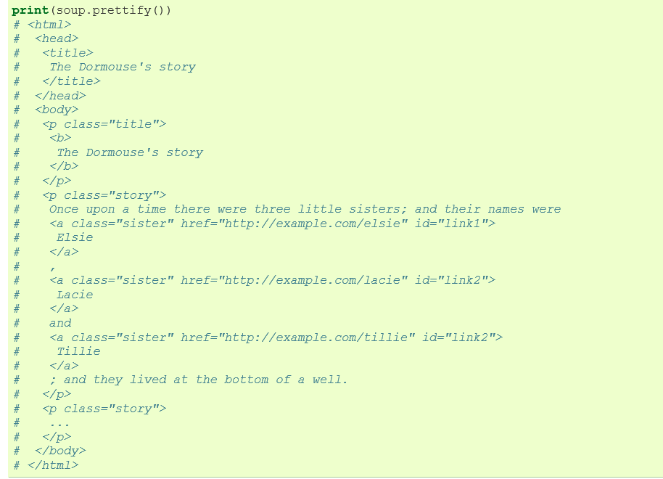
BeautifulSoup API simple introduction
(1)Get the beautiful soup object
from bs4 import BeautifulSoup
soup = BeautifulSoup(html_doc, 'html.parser')

Slide 8
BeautifulSoup API simple introduction
(2)Grab the tag(This one for the first tag)
soup.title
# <title>The Dormouse's story</title>
soup.p
# <p class="title"><b>The Dormouse's story</b></p>
soup.a
# <a class="sister" href="http://example.com/elsie" id="link1">Elsie</a>
(3)Get the tag name:
soup.title.name
# u'title‘
soup.title.parent.name
# u'head‘

Slide 9
BeautifulSoup API simple introduction
(4)Get the tag name:
soup.p.attrs[‘class']
#[u'title'] soup.p[‘class']
#[u'title']
(5)Get the Tag content
soup.p.string(The first tag p)
#u"The Dormouse's story“
soup.head.title.string
#u"The Dormouse's story"

Slide 10
BeautifulSoup API simple introduction
(6)Get the child and grand child of the tag
soup.find_all('p')[1].contents(Because there are two p tag)
[u'Once upon a time there were three little sisters; and their names were ', <a class="sister" href="http://example.com/elsie" id="link1">Elsie</a>, u', ', <a class="sister" href="http://example.com/lacie" id="link2">Lacie</a>, u' and ', <a class="sister" href="http://example.com/tillie" id="link3">Tillie</a>, u'; and they lived at the bottom of a well.']
[i for i in soup.find_all('p')[1].children]
[u'Once upon a time there were three little sisters; and their names were ', <a class="sister" href="http://example.com/elsie" id="link1">Elsie</a>, u', ', <a class="sister" href="http://example.com/lacie" id="link2">Lacie</a>, u' and ', <a class="sister" href="http://example.com/tillie" id="link3">Tillie</a>, u'; and they lived at the bottom of a well.']
Note: children method to get the iterator

Slide 11
BeautifulSoup API simple introduction
(7)Find the related tag group
soup.find_all('p')
[<p class="title"><b>The Dormouse's story</b></p>, <p class="story">Once upon a time there were three little sisters; and their names were <a class="sister" href="http://example.com/elsie" id="link1">Elsie</a>, <a class="sister" href="http://example.com/lacie" id="link2">Lacie</a> and <a class="sister" href="http://example.com/tillie" id="link3">Tillie</a>; and they lived at the bottom of a well.</p>, <p class="story">...</p>]

Slide 12
Excel API simple introduction
(1)Load the excel
from openpyxl import load_workbook
from openpyxl.utils.cell
import get_column_letter
from openpyxl.workbook import Workbook
workbook_ = load_workbook("CIS622.xlsx")
(2)Get the sheet name
sheetnames=workbook_.get_sheet_names()
sheet=workbook_.get_sheet_by_name(sheetnames[1])
sheet=workbook_.get_sheet_by_name('Sheet3')

Slide 13
Excel API simple introduction
(3)Get the cell value or set the value
sheet.cell(column=1,row=1).value
sheet[‘A1'].value
(4)Append the new line(this only after the last line)
sheet.append(self.SumTitleLine)
(5)Get the excel column name
get_column_letter(index)
(6)Get the column or row style(ex: font, width,height)
col = sheet.column_dimensions['A']
row = sheet.row_dimensions[1]
row.font = Font(name='Calibri',size=11,bold=True)

Slide 14
Excel API simple introduction
(7)Get the max row
MaxRow=sheet.max_row
(8)Create the workbook or sheet
wb = Workbook()wb.create_sheet("Sheet2")
(9)Save the excel
workbook_.save("CIS622.xlsx")

Slide 15
Tools Function introduction
This tool is to generate the report automatically for the remediation report

Slide 16
Tools Function introduction
1.It will initial the dictionary at first, including the source html folder, merge folder,backup folder, and saved data folder, and dict files
Note: Both the source folders and the subfolders of the merge folder include each module folders.
When the source folders aren't exist, it needs to run at first to create the module folder, then put the html files manually, and run the tool script again to generate the report.
Though the tool create the standard module folders, it also could create some temporary folders, the step 2 could filter the related folders.

Slide 17
Tools Function introduction
2.According to the merge flag to find the related dictionary folder.
3.If it needs to be mereged, the risk data dict, url dict, hyperlink dict,section dict and description dict
would get the data from the dict files, and create new dictionary for the merged dict,otherwise it would create new dictionary. Then Parse the html data by BeautifulSoup API to add the related dict.

Slide 18
Tools Function introduction
4.If it needs to be merged, it would load the exist report excel, otherwise it would create new excel
5.Update the summary data and create the related risk sheet and hyperlink
6.Update the related risk sheet data from the related dict data.
7.Format all of the sheet

Slide 19
Tools Function introduction
8.Back up the orginal dict and report files,save the report excel, then merge the merged data to the risk dict data, and finial update all of the dict files
9.According to the moveFlag to move the merged html to the related the source module folder.
This tool needs at least to pass two parameters: "BuildVersion","Phase"
The below flags are optional:

Slide 20
Tools Function introduction
(1)mergeFlag default value is None, or put as "", it would according to the merged folder whether exists any html files, then set the mergeFlag True or False.
False: It would do the merge branch.
True: It would do the initial branch.
If the user sets mergeFlag as False manually, it always do the initial report branch even the merge folder has html files.

Slide 21
Tools Function introduction
(2)moveFlag default value is None, means not to move the html files.
It only move the merged flags to then related source module folders only when the moveFlag as True.
When move the files, if the file has same name as the source file name, it would move the source file to the backup folder at first, then continue to move.
(3)cmdFlag default value is True, means print some information in the cmd console.
It only print some information in the cmd console when the cmdFlag as True, otherwise it won't print some information.
No matter the cmdFlag is True or not, it always save the value in the log.txt

Slide 22
Q&A
Thank you!

