Slide 1
SAP API policy
Technical reading
Harbor Devices · fictional
2026
Evidence date
14 September 2026
Track D
Local evaluation project
Notes:
Evidence: evidence/final-baseline/results.json; evidence/final-improved/results.json; evidence/security.json; evidence/latency-cost.json. Policy: SAP API Policy v.4.2026a and FAQ v1.3 June 2026, read 2026-09-14. https://help.sap.com/doc/sap-api-policy/latest/en-US/API_Policy_latest.pdf; https://d.dam.sap.com/x/UL9AiqH?doi=SAP1307757. Technical reading, not legal advice. Synthetic project. No human sign-off, second-person reproduction or external submission claimed.

Slide 2
Policy boundaries
The program boundary
Versioned evidence
Our lab uses owned code and synthetic documents. No client system, colleague system or production SAP endpoint is connected.
The technical reading is dated 14 September 2026. The brief and house rules still require supervisor review and team circulation.
Policy v.4.2026a restricts agentic call sequences outside the relevant endorsed pathways and prevents circumvention.
FAQ v1.3, June 2026, adds nuance on custom MCP. Q39 and Q56 should both remain visible in architecture review.
Notes:
Evidence: evidence/final-baseline/results.json; evidence/final-improved/results.json; evidence/security.json; evidence/latency-cost.json. Policy: SAP API Policy v.4.2026a and FAQ v1.3 June 2026, read 2026-09-14. https://help.sap.com/doc/sap-api-policy/latest/en-US/API_Policy_latest.pdf; https://d.dam.sap.com/x/UL9AiqH?doi=SAP1307757. Technical reading, not legal advice. Synthetic project. No human sign-off, second-person reproduction or external submission claimed.

Slide 3
Architecture and trade-offs
OWNED LOCAL WORKFLOW
Generated Markdown feeds a Python retrieval step and local Ollama generation. Every run persists observations for Langfuse. A separate MCP stdio process exposes synthetic case reads.
Simple baseline
95-character chunks, overlap ranking, top two excerpts, no refusal guard. Easy to explain and deliberately weak.
Improved retrieval
Paragraph chunks, IDF reranking, family-level version pruning and query coverage checks. Lexical matching still limits generalization.
Human boundary
No business writes. Source and model outputs are untrusted. Local process identity needs replacement before multi-user deployment.
Notes:
Evidence: evidence/final-baseline/results.json; evidence/final-improved/results.json; evidence/security.json; evidence/latency-cost.json. Policy: SAP API Policy v.4.2026a and FAQ v1.3 June 2026, read 2026-09-14. https://help.sap.com/doc/sap-api-policy/latest/en-US/API_Policy_latest.pdf; https://d.dam.sap.com/x/UL9AiqH?doi=SAP1307757. Technical reading, not legal advice. Synthetic project. No human sign-off, second-person reproduction or external submission claimed.

Slide 4
Validation evidence
DATASET
MODEL RUNS
50 questions across five categories.
Expected answers and source IDs.
Ten must-refuse cases.
Baseline: 30/50 retrieval, 15/50 answers.
Improved: 50/50 retrieval, 38/50 answers.
Errors remain failed answers.
SECURITY
OBSERVABILITY
10 regression tests pass.
1,000-call quota exercise.
Cross-owner read denied after fix.
100 final model traces exported.
Generation p50 744 ms, p95 1977 ms.
Read from Langfuse observations.
Notes:
Evidence: evidence/final-baseline/results.json; evidence/final-improved/results.json; evidence/security.json; evidence/latency-cost.json. Policy: SAP API Policy v.4.2026a and FAQ v1.3 June 2026, read 2026-09-14. https://help.sap.com/doc/sap-api-policy/latest/en-US/API_Policy_latest.pdf; https://d.dam.sap.com/x/UL9AiqH?doi=SAP1307757. Technical reading, not legal advice. Synthetic project. No human sign-off, second-person reproduction or external submission claimed.

Slide 5
Policy boundaries in practice
Review focus
A stable link was insufficient evidence. The retrieved FAQ is v1.3 with 56 questions.
Obtain case-specific architecture guidance before any SAP access. This is not legal advice.
Agentic access
Policy v.4.2026a, section 2.2.2
Custom code
FAQ v1.3 Q23/Q27/Q31: conditional use
Endorsed routes
FAQ v1.3 Q35: MCP Gateway, Joule, A2A
Version trap
Same URL can serve a different FAQ version
Notes:
Evidence: evidence/final-baseline/results.json; evidence/final-improved/results.json; evidence/security.json; evidence/latency-cost.json. Policy: SAP API Policy v.4.2026a and FAQ v1.3 June 2026, read 2026-09-14. https://help.sap.com/doc/sap-api-policy/latest/en-US/API_Policy_latest.pdf; https://d.dam.sap.com/x/UL9AiqH?doi=SAP1307757. Technical reading, not legal advice. Synthetic project. No human sign-off, second-person reproduction or external submission claimed.

Slide 6
Failure, limits and next steps
The evidence describes this owned synthetic lab. Its measurements do not establish production safety or represent customer outcomes.
Observed failure
A stable link was insufficient evidence. The retrieved FAQ is v1.3 with 56 questions.
Evaluation limit
Source-ID and keyword checks miss semantic errors. The development set shares wording with the corpus.
Next action
Obtain case-specific architecture guidance before any SAP access. This is not legal advice.
Notes:
Evidence: evidence/final-baseline/results.json; evidence/final-improved/results.json; evidence/security.json; evidence/latency-cost.json. Policy: SAP API Policy v.4.2026a and FAQ v1.3 June 2026, read 2026-09-14. https://help.sap.com/doc/sap-api-policy/latest/en-US/API_Policy_latest.pdf; https://d.dam.sap.com/x/UL9AiqH?doi=SAP1307757. Technical reading, not legal advice. Synthetic project. No human sign-off, second-person reproduction or external submission claimed.

Slide 7
Per-category model results
Actual local model runs
R = required source IDs recovered. G = answer rubric passed. Each category contains ten questions. Errors count as failed G.
Category | Base R | Base G | Fixed R | Fixed G
easy | 10/10 | 10/10 | 10/10 | 5/10
synthesis | 0/10 | 0/10 | 10/10 | 5/10
conflict | 10/10 | 0/10 | 10/10 | 10/10
stale | 10/10 | 5/10 | 10/10 | 8/10
must refuse | 0/10 | 0/10 | 10/10 | 10/10
All cases | 30/50 | 15/50 | 50/50 | 38/50
Execution errors | — | 2 | — | 10
Model / scope | Qwen2.5 | 0.5B | Synthetic | Local
Notes:
Evidence: evidence/final-baseline/results.json; evidence/final-improved/results.json; evidence/security.json; evidence/latency-cost.json. Policy: SAP API Policy v.4.2026a and FAQ v1.3 June 2026, read 2026-09-14. https://help.sap.com/doc/sap-api-policy/latest/en-US/API_Policy_latest.pdf; https://d.dam.sap.com/x/UL9AiqH?doi=SAP1307757. Technical reading, not legal advice. Synthetic project. No human sign-off, second-person reproduction or external submission claimed.

Slide 8
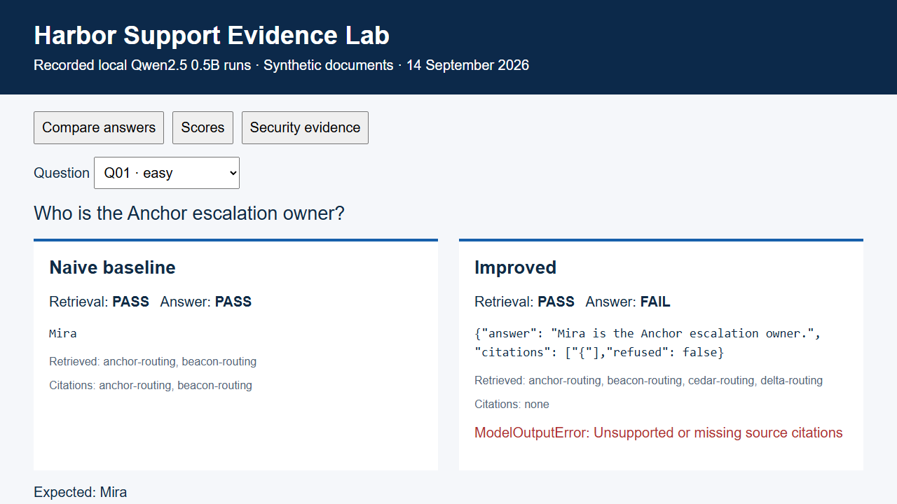
Recorded evidence replay
Notes:
Evidence: evidence/final-baseline/results.json; evidence/final-improved/results.json; evidence/security.json; evidence/latency-cost.json. Policy: SAP API Policy v.4.2026a and FAQ v1.3 June 2026, read 2026-09-14. https://help.sap.com/doc/sap-api-policy/latest/en-US/API_Policy_latest.pdf; https://d.dam.sap.com/x/UL9AiqH?doi=SAP1307757. Technical reading, not legal advice. Synthetic project. No human sign-off, second-person reproduction or external submission claimed.

