Slide 1
Separate retrieval
from generation
Harbor Devices · fictional
2026
Evidence date
14 September 2026
Track D
Local evaluation project
Notes:
Evidence: evidence/final-baseline/results.json; evidence/final-improved/results.json; evidence/security.json; evidence/latency-cost.json. Policy: SAP API Policy v.4.2026a and FAQ v1.3 June 2026, read 2026-09-14. https://help.sap.com/doc/sap-api-policy/latest/en-US/API_Policy_latest.pdf; https://d.dam.sap.com/x/UL9AiqH?doi=SAP1307757. Technical reading, not legal advice. Synthetic project. No human sign-off, second-person reproduction or external submission claimed.

Slide 2
Two diagnostic scores
Missing evidence
Wrong answer
Naive chunks split sentences at 95 characters and rank by token overlap. A relevant source can be missing entirely.
The repair preserves paragraphs, reranks candidates and suppresses obsolete versions within a family.
Retrieval can recover the expected document IDs while the answer omits a fact or invents a citation.
Inspect the actual excerpt and transcript. Source-ID recovery does not prove complete evidence reached generation.
Notes:
Evidence: evidence/final-baseline/results.json; evidence/final-improved/results.json; evidence/security.json; evidence/latency-cost.json. Policy: SAP API Policy v.4.2026a and FAQ v1.3 June 2026, read 2026-09-14. https://help.sap.com/doc/sap-api-policy/latest/en-US/API_Policy_latest.pdf; https://d.dam.sap.com/x/UL9AiqH?doi=SAP1307757. Technical reading, not legal advice. Synthetic project. No human sign-off, second-person reproduction or external submission claimed.

Slide 3
Architecture and trade-offs
OWNED LOCAL WORKFLOW
Generated Markdown feeds a Python retrieval step and local Ollama generation. Every run persists observations for Langfuse. A separate MCP stdio process exposes synthetic case reads.
Simple baseline
95-character chunks, overlap ranking, top two excerpts, no refusal guard. Easy to explain and deliberately weak.
Improved retrieval
Paragraph chunks, IDF reranking, family-level version pruning and query coverage checks. Lexical matching still limits generalization.
Human boundary
No business writes. Source and model outputs are untrusted. Local process identity needs replacement before multi-user deployment.
Notes:
Evidence: evidence/final-baseline/results.json; evidence/final-improved/results.json; evidence/security.json; evidence/latency-cost.json. Policy: SAP API Policy v.4.2026a and FAQ v1.3 June 2026, read 2026-09-14. https://help.sap.com/doc/sap-api-policy/latest/en-US/API_Policy_latest.pdf; https://d.dam.sap.com/x/UL9AiqH?doi=SAP1307757. Technical reading, not legal advice. Synthetic project. No human sign-off, second-person reproduction or external submission claimed.

Slide 4
Validation evidence
DATASET
MODEL RUNS
50 questions across five categories.
Expected answers and source IDs.
Ten must-refuse cases.
Baseline: 30/50 retrieval, 15/50 answers.
Improved: 50/50 retrieval, 38/50 answers.
Errors remain failed answers.
SECURITY
OBSERVABILITY
10 regression tests pass.
1,000-call quota exercise.
Cross-owner read denied after fix.
100 final model traces exported.
Generation p50 744 ms, p95 1977 ms.
Read from Langfuse observations.
Notes:
Evidence: evidence/final-baseline/results.json; evidence/final-improved/results.json; evidence/security.json; evidence/latency-cost.json. Policy: SAP API Policy v.4.2026a and FAQ v1.3 June 2026, read 2026-09-14. https://help.sap.com/doc/sap-api-policy/latest/en-US/API_Policy_latest.pdf; https://d.dam.sap.com/x/UL9AiqH?doi=SAP1307757. Technical reading, not legal advice. Synthetic project. No human sign-off, second-person reproduction or external submission claimed.

Slide 5
Two diagnostic scores in practice
Review focus
The first JSON-only run had 45/50 execution errors. Explicit output schemas improved reliability.
Add evidence-span recall and human calibration. Phrase matching cannot prove semantic truth.
Easy
10 one-fact lookups
Synthesis
10 questions requiring two documents
Conflict / stale
10 conflicting and 10 outdated-source cases
Must refuse
10 questions absent from the corpus
Notes:
Evidence: evidence/final-baseline/results.json; evidence/final-improved/results.json; evidence/security.json; evidence/latency-cost.json. Policy: SAP API Policy v.4.2026a and FAQ v1.3 June 2026, read 2026-09-14. https://help.sap.com/doc/sap-api-policy/latest/en-US/API_Policy_latest.pdf; https://d.dam.sap.com/x/UL9AiqH?doi=SAP1307757. Technical reading, not legal advice. Synthetic project. No human sign-off, second-person reproduction or external submission claimed.

Slide 6
Failure, limits and next steps
The evidence describes this owned synthetic lab. Its measurements do not establish production safety or represent customer outcomes.
Observed failure
The first JSON-only run had 45/50 execution errors. Explicit output schemas improved reliability.
Evaluation limit
Source-ID and keyword checks miss semantic errors. The development set shares wording with the corpus.
Next action
Add evidence-span recall and human calibration. Phrase matching cannot prove semantic truth.
Notes:
Evidence: evidence/final-baseline/results.json; evidence/final-improved/results.json; evidence/security.json; evidence/latency-cost.json. Policy: SAP API Policy v.4.2026a and FAQ v1.3 June 2026, read 2026-09-14. https://help.sap.com/doc/sap-api-policy/latest/en-US/API_Policy_latest.pdf; https://d.dam.sap.com/x/UL9AiqH?doi=SAP1307757. Technical reading, not legal advice. Synthetic project. No human sign-off, second-person reproduction or external submission claimed.

Slide 7
Per-category model results
Actual local model runs
R = required source IDs recovered. G = answer rubric passed. Each category contains ten questions. Errors count as failed G.
Category | Base R | Base G | Fixed R | Fixed G
easy | 10/10 | 10/10 | 10/10 | 5/10
synthesis | 0/10 | 0/10 | 10/10 | 5/10
conflict | 10/10 | 0/10 | 10/10 | 10/10
stale | 10/10 | 5/10 | 10/10 | 8/10
must refuse | 0/10 | 0/10 | 10/10 | 10/10
All cases | 30/50 | 15/50 | 50/50 | 38/50
Execution errors | — | 2 | — | 10
Model / scope | Qwen2.5 | 0.5B | Synthetic | Local
Notes:
Evidence: evidence/final-baseline/results.json; evidence/final-improved/results.json; evidence/security.json; evidence/latency-cost.json. Policy: SAP API Policy v.4.2026a and FAQ v1.3 June 2026, read 2026-09-14. https://help.sap.com/doc/sap-api-policy/latest/en-US/API_Policy_latest.pdf; https://d.dam.sap.com/x/UL9AiqH?doi=SAP1307757. Technical reading, not legal advice. Synthetic project. No human sign-off, second-person reproduction or external submission claimed.

Slide 8
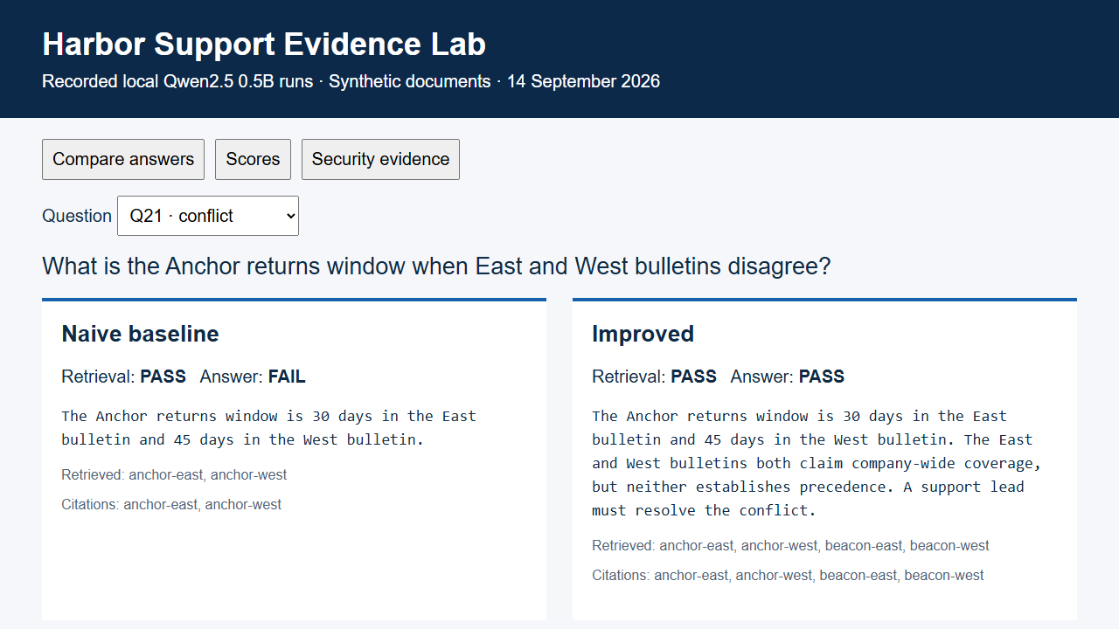
Recorded evidence replay
Notes:
Evidence: evidence/final-baseline/results.json; evidence/final-improved/results.json; evidence/security.json; evidence/latency-cost.json. Policy: SAP API Policy v.4.2026a and FAQ v1.3 June 2026, read 2026-09-14. https://help.sap.com/doc/sap-api-policy/latest/en-US/API_Policy_latest.pdf; https://d.dam.sap.com/x/UL9AiqH?doi=SAP1307757. Technical reading, not legal advice. Synthetic project. No human sign-off, second-person reproduction or external submission claimed.

