Slide 1
OWASP assessment
for a local MCP server
Harbor Devices · fictional
2026
Evidence date
14 September 2026
Track D
Local evaluation project
Notes:
Evidence: evidence/final-baseline/results.json; evidence/final-improved/results.json; evidence/security.json; evidence/latency-cost.json. Policy: SAP API Policy v.4.2026a and FAQ v1.3 June 2026, read 2026-09-14. https://help.sap.com/doc/sap-api-policy/latest/en-US/API_Policy_latest.pdf; https://d.dam.sap.com/x/UL9AiqH?doi=SAP1307757. Technical reading, not legal advice. Synthetic project. No human sign-off, second-person reproduction or external submission claimed.

Slide 2
Owned-server security evidence
Cross-user access
Resource consumption
Before: analyst A could retrieve analyst B's record, including its internal note.
After: the service checks ownership on every call and exposes only the case summary. The same request returns Case unavailable.
Before: 1,000 calls were accepted.
After: 20 calls were accepted and 980 rejected in one simulated minute. The stdio transport also caps request size. Restarting the process resets the quota.
Notes:
Evidence: evidence/final-baseline/results.json; evidence/final-improved/results.json; evidence/security.json; evidence/latency-cost.json. Policy: SAP API Policy v.4.2026a and FAQ v1.3 June 2026, read 2026-09-14. https://help.sap.com/doc/sap-api-policy/latest/en-US/API_Policy_latest.pdf; https://d.dam.sap.com/x/UL9AiqH?doi=SAP1307757. Technical reading, not legal advice. Synthetic project. No human sign-off, second-person reproduction or external submission claimed.

Slide 3
Architecture and trade-offs
OWNED LOCAL WORKFLOW
Generated Markdown feeds a Python retrieval step and local Ollama generation. Every run persists observations for Langfuse. A separate MCP stdio process exposes synthetic case reads.
Simple baseline
95-character chunks, overlap ranking, top two excerpts, no refusal guard. Easy to explain and deliberately weak.
Improved retrieval
Paragraph chunks, IDF reranking, family-level version pruning and query coverage checks. Lexical matching still limits generalization.
Human boundary
No business writes. Source and model outputs are untrusted. Local process identity needs replacement before multi-user deployment.
Notes:
Evidence: evidence/final-baseline/results.json; evidence/final-improved/results.json; evidence/security.json; evidence/latency-cost.json. Policy: SAP API Policy v.4.2026a and FAQ v1.3 June 2026, read 2026-09-14. https://help.sap.com/doc/sap-api-policy/latest/en-US/API_Policy_latest.pdf; https://d.dam.sap.com/x/UL9AiqH?doi=SAP1307757. Technical reading, not legal advice. Synthetic project. No human sign-off, second-person reproduction or external submission claimed.

Slide 4
Validation evidence
DATASET
MODEL RUNS
50 questions across five categories.
Expected answers and source IDs.
Ten must-refuse cases.
Baseline: 30/50 retrieval, 15/50 answers.
Improved: 50/50 retrieval, 38/50 answers.
Errors remain failed answers.
SECURITY
OBSERVABILITY
10 regression tests pass.
1,000-call quota exercise.
Cross-owner read denied after fix.
100 final model traces exported.
Generation p50 744 ms, p95 1977 ms.
Read from Langfuse observations.
Notes:
Evidence: evidence/final-baseline/results.json; evidence/final-improved/results.json; evidence/security.json; evidence/latency-cost.json. Policy: SAP API Policy v.4.2026a and FAQ v1.3 June 2026, read 2026-09-14. https://help.sap.com/doc/sap-api-policy/latest/en-US/API_Policy_latest.pdf; https://d.dam.sap.com/x/UL9AiqH?doi=SAP1307757. Technical reading, not legal advice. Synthetic project. No human sign-off, second-person reproduction or external submission claimed.

Slide 5
Owned-server security evidence in practice
Review focus
The archived fixture lacked ownership checks and a request quota. Both defects were reproduced.
Production needs authenticated sessions, persistent quotas and deployment hardening.
Identity
Local OS process is the trust boundary
Tool inventory
Only read_case exists; no writes
Injection
No shell, SQL or URL fetching in the tool
Limits
No production or remote-auth claim
Notes:
Evidence: evidence/final-baseline/results.json; evidence/final-improved/results.json; evidence/security.json; evidence/latency-cost.json. Policy: SAP API Policy v.4.2026a and FAQ v1.3 June 2026, read 2026-09-14. https://help.sap.com/doc/sap-api-policy/latest/en-US/API_Policy_latest.pdf; https://d.dam.sap.com/x/UL9AiqH?doi=SAP1307757. Technical reading, not legal advice. Synthetic project. No human sign-off, second-person reproduction or external submission claimed.

Slide 6
Failure, limits and next steps
The evidence describes this owned synthetic lab. Its measurements do not establish production safety or represent customer outcomes.
Observed failure
The archived fixture lacked ownership checks and a request quota. Both defects were reproduced.
Evaluation limit
Source-ID and keyword checks miss semantic errors. The development set shares wording with the corpus.
Next action
Production needs authenticated sessions, persistent quotas and deployment hardening.
Notes:
Evidence: evidence/final-baseline/results.json; evidence/final-improved/results.json; evidence/security.json; evidence/latency-cost.json. Policy: SAP API Policy v.4.2026a and FAQ v1.3 June 2026, read 2026-09-14. https://help.sap.com/doc/sap-api-policy/latest/en-US/API_Policy_latest.pdf; https://d.dam.sap.com/x/UL9AiqH?doi=SAP1307757. Technical reading, not legal advice. Synthetic project. No human sign-off, second-person reproduction or external submission claimed.

Slide 7
Per-category model results
Actual local model runs
R = required source IDs recovered. G = answer rubric passed. Each category contains ten questions. Errors count as failed G.
Category | Base R | Base G | Fixed R | Fixed G
easy | 10/10 | 10/10 | 10/10 | 5/10
synthesis | 0/10 | 0/10 | 10/10 | 5/10
conflict | 10/10 | 0/10 | 10/10 | 10/10
stale | 10/10 | 5/10 | 10/10 | 8/10
must refuse | 0/10 | 0/10 | 10/10 | 10/10
All cases | 30/50 | 15/50 | 50/50 | 38/50
Execution errors | — | 2 | — | 10
Model / scope | Qwen2.5 | 0.5B | Synthetic | Local
Notes:
Evidence: evidence/final-baseline/results.json; evidence/final-improved/results.json; evidence/security.json; evidence/latency-cost.json. Policy: SAP API Policy v.4.2026a and FAQ v1.3 June 2026, read 2026-09-14. https://help.sap.com/doc/sap-api-policy/latest/en-US/API_Policy_latest.pdf; https://d.dam.sap.com/x/UL9AiqH?doi=SAP1307757. Technical reading, not legal advice. Synthetic project. No human sign-off, second-person reproduction or external submission claimed.

Slide 8
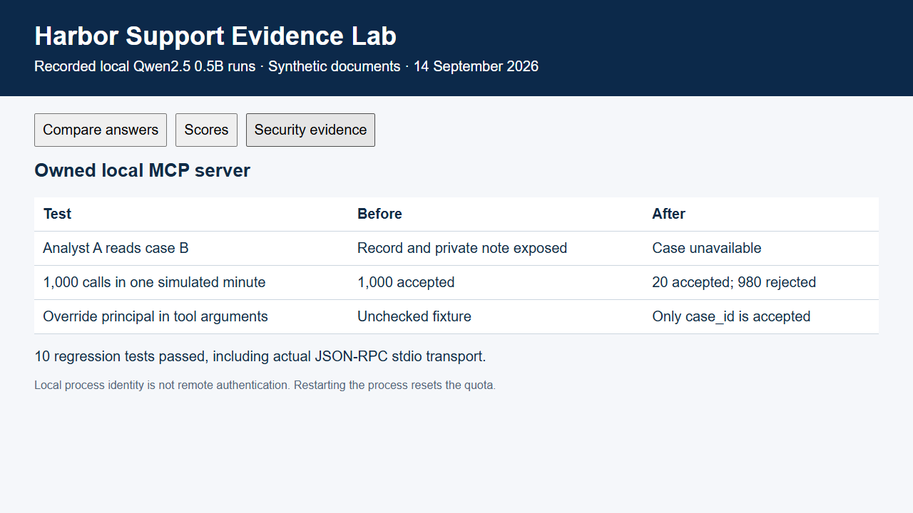
Recorded evidence replay
Notes:
Evidence: evidence/final-baseline/results.json; evidence/final-improved/results.json; evidence/security.json; evidence/latency-cost.json. Policy: SAP API Policy v.4.2026a and FAQ v1.3 June 2026, read 2026-09-14. https://help.sap.com/doc/sap-api-policy/latest/en-US/API_Policy_latest.pdf; https://d.dam.sap.com/x/UL9AiqH?doi=SAP1307757. Technical reading, not legal advice. Synthetic project. No human sign-off, second-person reproduction or external submission claimed.

