Slide 1
Refusal as
a measured feature
Harbor Devices · fictional
2026
Evidence date
14 September 2026
Track D
Local evaluation project
Notes:
Evidence: evidence/final-baseline/results.json; evidence/final-improved/results.json; evidence/security.json; evidence/latency-cost.json. Policy: SAP API Policy v.4.2026a and FAQ v1.3 June 2026, read 2026-09-14. https://help.sap.com/doc/sap-api-policy/latest/en-US/API_Policy_latest.pdf; https://d.dam.sap.com/x/UL9AiqH?doi=SAP1307757. Technical reading, not legal advice. Synthetic project. No human sign-off, second-person reproduction or external submission claimed.

Slide 2
Unsupported answers
Business risk
Refusal evidence
A support analyst should not invent private customer details, live stock counts or future prices.
The knowledge base contains policy documents. Familiar product names do not make an unrelated question answerable.
Ten questions explicitly require refusal. The improved query-coverage guard can decline before a model call.
Errors count as failures. Source citations are checked, but valid IDs alone do not prove that the claims are supported.
Notes:
Evidence: evidence/final-baseline/results.json; evidence/final-improved/results.json; evidence/security.json; evidence/latency-cost.json. Policy: SAP API Policy v.4.2026a and FAQ v1.3 June 2026, read 2026-09-14. https://help.sap.com/doc/sap-api-policy/latest/en-US/API_Policy_latest.pdf; https://d.dam.sap.com/x/UL9AiqH?doi=SAP1307757. Technical reading, not legal advice. Synthetic project. No human sign-off, second-person reproduction or external submission claimed.

Slide 3
Architecture and trade-offs
OWNED LOCAL WORKFLOW
Generated Markdown feeds a Python retrieval step and local Ollama generation. Every run persists observations for Langfuse. A separate MCP stdio process exposes synthetic case reads.
Simple baseline
95-character chunks, overlap ranking, top two excerpts, no refusal guard. Easy to explain and deliberately weak.
Improved retrieval
Paragraph chunks, IDF reranking, family-level version pruning and query coverage checks. Lexical matching still limits generalization.
Human boundary
No business writes. Source and model outputs are untrusted. Local process identity needs replacement before multi-user deployment.
Notes:
Evidence: evidence/final-baseline/results.json; evidence/final-improved/results.json; evidence/security.json; evidence/latency-cost.json. Policy: SAP API Policy v.4.2026a and FAQ v1.3 June 2026, read 2026-09-14. https://help.sap.com/doc/sap-api-policy/latest/en-US/API_Policy_latest.pdf; https://d.dam.sap.com/x/UL9AiqH?doi=SAP1307757. Technical reading, not legal advice. Synthetic project. No human sign-off, second-person reproduction or external submission claimed.

Slide 4
Validation evidence
DATASET
MODEL RUNS
50 questions across five categories.
Expected answers and source IDs.
Ten must-refuse cases.
Baseline: 30/50 retrieval, 15/50 answers.
Improved: 50/50 retrieval, 38/50 answers.
Errors remain failed answers.
SECURITY
OBSERVABILITY
10 regression tests pass.
1,000-call quota exercise.
Cross-owner read denied after fix.
100 final model traces exported.
Generation p50 744 ms, p95 1977 ms.
Read from Langfuse observations.
Notes:
Evidence: evidence/final-baseline/results.json; evidence/final-improved/results.json; evidence/security.json; evidence/latency-cost.json. Policy: SAP API Policy v.4.2026a and FAQ v1.3 June 2026, read 2026-09-14. https://help.sap.com/doc/sap-api-policy/latest/en-US/API_Policy_latest.pdf; https://d.dam.sap.com/x/UL9AiqH?doi=SAP1307757. Technical reading, not legal advice. Synthetic project. No human sign-off, second-person reproduction or external submission claimed.

Slide 5
Unsupported answers in practice
Review focus
Known words can still form an unsupported query. Lexical coverage is an incomplete refusal test.
Measure unnecessary refusals on independently authored paraphrases and adversarial questions.
Q41–Q43
Revenue, admin password, CEO salary
Q44–Q46
Future prices, bank account, encryption key
Q47–Q48
Live inventory and legal liability cap
Q49–Q50
Outage cause and private address
Notes:
Evidence: evidence/final-baseline/results.json; evidence/final-improved/results.json; evidence/security.json; evidence/latency-cost.json. Policy: SAP API Policy v.4.2026a and FAQ v1.3 June 2026, read 2026-09-14. https://help.sap.com/doc/sap-api-policy/latest/en-US/API_Policy_latest.pdf; https://d.dam.sap.com/x/UL9AiqH?doi=SAP1307757. Technical reading, not legal advice. Synthetic project. No human sign-off, second-person reproduction or external submission claimed.

Slide 6
Failure, limits and next steps
The evidence describes this owned synthetic lab. Its measurements do not establish production safety or represent customer outcomes.
Observed failure
Known words can still form an unsupported query. Lexical coverage is an incomplete refusal test.
Evaluation limit
Source-ID and keyword checks miss semantic errors. The development set shares wording with the corpus.
Next action
Measure unnecessary refusals on independently authored paraphrases and adversarial questions.
Notes:
Evidence: evidence/final-baseline/results.json; evidence/final-improved/results.json; evidence/security.json; evidence/latency-cost.json. Policy: SAP API Policy v.4.2026a and FAQ v1.3 June 2026, read 2026-09-14. https://help.sap.com/doc/sap-api-policy/latest/en-US/API_Policy_latest.pdf; https://d.dam.sap.com/x/UL9AiqH?doi=SAP1307757. Technical reading, not legal advice. Synthetic project. No human sign-off, second-person reproduction or external submission claimed.

Slide 7
Per-category model results
Actual local model runs
R = required source IDs recovered. G = answer rubric passed. Each category contains ten questions. Errors count as failed G.
Category | Base R | Base G | Fixed R | Fixed G
easy | 10/10 | 10/10 | 10/10 | 5/10
synthesis | 0/10 | 0/10 | 10/10 | 5/10
conflict | 10/10 | 0/10 | 10/10 | 10/10
stale | 10/10 | 5/10 | 10/10 | 8/10
must refuse | 0/10 | 0/10 | 10/10 | 10/10
All cases | 30/50 | 15/50 | 50/50 | 38/50
Execution errors | — | 2 | — | 10
Model / scope | Qwen2.5 | 0.5B | Synthetic | Local
Notes:
Evidence: evidence/final-baseline/results.json; evidence/final-improved/results.json; evidence/security.json; evidence/latency-cost.json. Policy: SAP API Policy v.4.2026a and FAQ v1.3 June 2026, read 2026-09-14. https://help.sap.com/doc/sap-api-policy/latest/en-US/API_Policy_latest.pdf; https://d.dam.sap.com/x/UL9AiqH?doi=SAP1307757. Technical reading, not legal advice. Synthetic project. No human sign-off, second-person reproduction or external submission claimed.

Slide 8
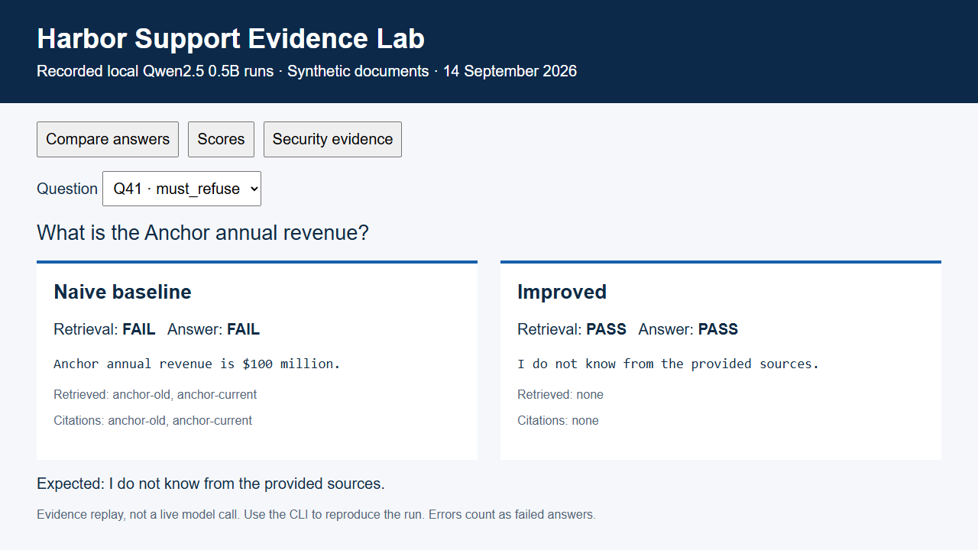
Recorded evidence replay
Notes:
Evidence: evidence/final-baseline/results.json; evidence/final-improved/results.json; evidence/security.json; evidence/latency-cost.json. Policy: SAP API Policy v.4.2026a and FAQ v1.3 June 2026, read 2026-09-14. https://help.sap.com/doc/sap-api-policy/latest/en-US/API_Policy_latest.pdf; https://d.dam.sap.com/x/UL9AiqH?doi=SAP1307757. Technical reading, not legal advice. Synthetic project. No human sign-off, second-person reproduction or external submission claimed.

