Slide 1
Evidence lab
Retrospective
Harbor Devices · fictional
2026
Evidence date
14 September 2026
Track D
Local evaluation project
Notes:
Evidence: evidence/final-baseline/results.json; evidence/final-improved/results.json; evidence/security.json; evidence/latency-cost.json. Policy: SAP API Policy v.4.2026a and FAQ v1.3 June 2026, read 2026-09-14. https://help.sap.com/doc/sap-api-policy/latest/en-US/API_Policy_latest.pdf; https://d.dam.sap.com/x/UL9AiqH?doi=SAP1307757. Technical reading, not legal advice. Synthetic project. No human sign-off, second-person reproduction or external submission claimed.

Slide 2
What the build revealed
Assumptions that failed
Limits of the method
Requesting JSON did not guarantee a valid schema from the small model. The failed initial run remains available.
Recovering a source ID did not guarantee its evidence was intact. Naive chunks sometimes cut the useful sentence.
The corpus and golden set were jointly authored. This is a development benchmark with correlated wording.
The rubric can accept misleading extra claims and reject correct paraphrases. Human calibration and unseen cases are still required.
Notes:
Evidence: evidence/final-baseline/results.json; evidence/final-improved/results.json; evidence/security.json; evidence/latency-cost.json. Policy: SAP API Policy v.4.2026a and FAQ v1.3 June 2026, read 2026-09-14. https://help.sap.com/doc/sap-api-policy/latest/en-US/API_Policy_latest.pdf; https://d.dam.sap.com/x/UL9AiqH?doi=SAP1307757. Technical reading, not legal advice. Synthetic project. No human sign-off, second-person reproduction or external submission claimed.

Slide 3
Architecture and trade-offs
OWNED LOCAL WORKFLOW
Generated Markdown feeds a Python retrieval step and local Ollama generation. Every run persists observations for Langfuse. A separate MCP stdio process exposes synthetic case reads.
Simple baseline
95-character chunks, overlap ranking, top two excerpts, no refusal guard. Easy to explain and deliberately weak.
Improved retrieval
Paragraph chunks, IDF reranking, family-level version pruning and query coverage checks. Lexical matching still limits generalization.
Human boundary
No business writes. Source and model outputs are untrusted. Local process identity needs replacement before multi-user deployment.
Notes:
Evidence: evidence/final-baseline/results.json; evidence/final-improved/results.json; evidence/security.json; evidence/latency-cost.json. Policy: SAP API Policy v.4.2026a and FAQ v1.3 June 2026, read 2026-09-14. https://help.sap.com/doc/sap-api-policy/latest/en-US/API_Policy_latest.pdf; https://d.dam.sap.com/x/UL9AiqH?doi=SAP1307757. Technical reading, not legal advice. Synthetic project. No human sign-off, second-person reproduction or external submission claimed.

Slide 4
Validation evidence
DATASET
MODEL RUNS
50 questions across five categories.
Expected answers and source IDs.
Ten must-refuse cases.
Baseline: 30/50 retrieval, 15/50 answers.
Improved: 50/50 retrieval, 38/50 answers.
Errors remain failed answers.
SECURITY
OBSERVABILITY
10 regression tests pass.
1,000-call quota exercise.
Cross-owner read denied after fix.
100 final model traces exported.
Generation p50 744 ms, p95 1977 ms.
Read from Langfuse observations.
Notes:
Evidence: evidence/final-baseline/results.json; evidence/final-improved/results.json; evidence/security.json; evidence/latency-cost.json. Policy: SAP API Policy v.4.2026a and FAQ v1.3 June 2026, read 2026-09-14. https://help.sap.com/doc/sap-api-policy/latest/en-US/API_Policy_latest.pdf; https://d.dam.sap.com/x/UL9AiqH?doi=SAP1307757. Technical reading, not legal advice. Synthetic project. No human sign-off, second-person reproduction or external submission claimed.

Slide 5
What the build revealed in practice
Review focus
Temperature zero did not produce identical paired results across reruns: preserve every run.
Personalize this retrospective and contribute the final section to the team deck.
Reproducibility
Pinned runtime and model digest recorded
Observability
100 final traces read back from Langfuse
Security
Ownership and request limits tested
Human gate
Second-person reproduction still pending
Notes:
Evidence: evidence/final-baseline/results.json; evidence/final-improved/results.json; evidence/security.json; evidence/latency-cost.json. Policy: SAP API Policy v.4.2026a and FAQ v1.3 June 2026, read 2026-09-14. https://help.sap.com/doc/sap-api-policy/latest/en-US/API_Policy_latest.pdf; https://d.dam.sap.com/x/UL9AiqH?doi=SAP1307757. Technical reading, not legal advice. Synthetic project. No human sign-off, second-person reproduction or external submission claimed.

Slide 6
Failure, limits and next steps
The evidence describes this owned synthetic lab. Its measurements do not establish production safety or represent customer outcomes.
Observed failure
Temperature zero did not produce identical paired results across reruns: preserve every run.
Evaluation limit
Source-ID and keyword checks miss semantic errors. The development set shares wording with the corpus.
Next action
Personalize this retrospective and contribute the final section to the team deck.
Notes:
Evidence: evidence/final-baseline/results.json; evidence/final-improved/results.json; evidence/security.json; evidence/latency-cost.json. Policy: SAP API Policy v.4.2026a and FAQ v1.3 June 2026, read 2026-09-14. https://help.sap.com/doc/sap-api-policy/latest/en-US/API_Policy_latest.pdf; https://d.dam.sap.com/x/UL9AiqH?doi=SAP1307757. Technical reading, not legal advice. Synthetic project. No human sign-off, second-person reproduction or external submission claimed.

Slide 7
Per-category model results
Actual local model runs
R = required source IDs recovered. G = answer rubric passed. Each category contains ten questions. Errors count as failed G.
Category | Base R | Base G | Fixed R | Fixed G
easy | 10/10 | 10/10 | 10/10 | 5/10
synthesis | 0/10 | 0/10 | 10/10 | 5/10
conflict | 10/10 | 0/10 | 10/10 | 10/10
stale | 10/10 | 5/10 | 10/10 | 8/10
must refuse | 0/10 | 0/10 | 10/10 | 10/10
All cases | 30/50 | 15/50 | 50/50 | 38/50
Execution errors | — | 2 | — | 10
Model / scope | Qwen2.5 | 0.5B | Synthetic | Local
Notes:
Evidence: evidence/final-baseline/results.json; evidence/final-improved/results.json; evidence/security.json; evidence/latency-cost.json. Policy: SAP API Policy v.4.2026a and FAQ v1.3 June 2026, read 2026-09-14. https://help.sap.com/doc/sap-api-policy/latest/en-US/API_Policy_latest.pdf; https://d.dam.sap.com/x/UL9AiqH?doi=SAP1307757. Technical reading, not legal advice. Synthetic project. No human sign-off, second-person reproduction or external submission claimed.

Slide 8
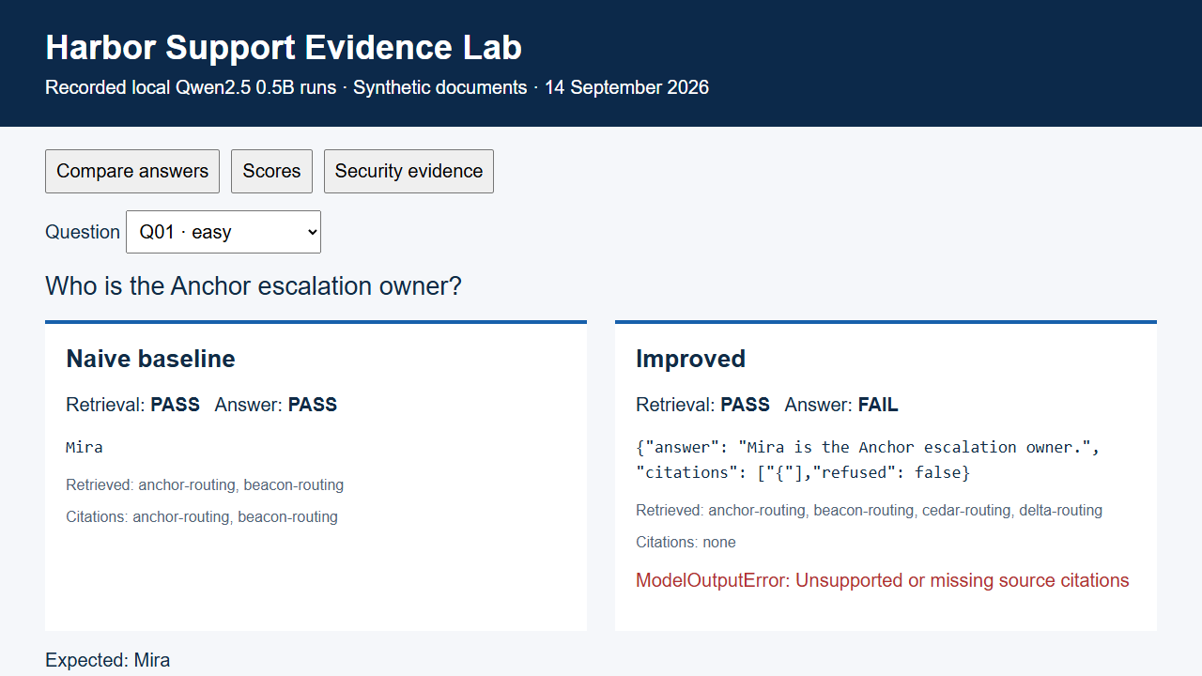
Recorded evidence replay
Notes:
Evidence: evidence/final-baseline/results.json; evidence/final-improved/results.json; evidence/security.json; evidence/latency-cost.json. Policy: SAP API Policy v.4.2026a and FAQ v1.3 June 2026, read 2026-09-14. https://help.sap.com/doc/sap-api-policy/latest/en-US/API_Policy_latest.pdf; https://d.dam.sap.com/x/UL9AiqH?doi=SAP1307757. Technical reading, not legal advice. Synthetic project. No human sign-off, second-person reproduction or external submission claimed.

