Slide 1
Harbor Support
Evidence Lab
Harbor Devices · fictional
2026
Evidence date
14 September 2026
Track D
Local evaluation project
Notes:
Evidence: evidence/final-baseline/results.json; evidence/final-improved/results.json; evidence/security.json; evidence/latency-cost.json. Policy: SAP API Policy v.4.2026a and FAQ v1.3 June 2026, read 2026-09-14. https://help.sap.com/doc/sap-api-policy/latest/en-US/API_Policy_latest.pdf; https://d.dam.sap.com/x/UL9AiqH?doi=SAP1307757. Technical reading, not legal advice. Synthetic project. No human sign-off, second-person reproduction or external submission claimed.

Slide 2
Final project review
Customer and workflow
What is delivered
Fictional Harbor Devices support analysts search policy, escalation and regional bulletin files. Old versions and conflicting rules undermine trust.
The target is zero unsupported answers on ten must-refuse cases, paired with useful-answer coverage.
A local RAG implementation, 50-question golden set, reusable grading adapter, MCP security checks and persisted Langfuse traces.
All examples use synthetic data. The project has no SAP connection and exposes no business writes.
Notes:
Evidence: evidence/final-baseline/results.json; evidence/final-improved/results.json; evidence/security.json; evidence/latency-cost.json. Policy: SAP API Policy v.4.2026a and FAQ v1.3 June 2026, read 2026-09-14. https://help.sap.com/doc/sap-api-policy/latest/en-US/API_Policy_latest.pdf; https://d.dam.sap.com/x/UL9AiqH?doi=SAP1307757. Technical reading, not legal advice. Synthetic project. No human sign-off, second-person reproduction or external submission claimed.

Slide 3
Architecture and trade-offs
OWNED LOCAL WORKFLOW
Generated Markdown feeds a Python retrieval step and local Ollama generation. Every run persists observations for Langfuse. A separate MCP stdio process exposes synthetic case reads.
Simple baseline
95-character chunks, overlap ranking, top two excerpts, no refusal guard. Easy to explain and deliberately weak.
Improved retrieval
Paragraph chunks, IDF reranking, family-level version pruning and query coverage checks. Lexical matching still limits generalization.
Human boundary
No business writes. Source and model outputs are untrusted. Local process identity needs replacement before multi-user deployment.
Notes:
Evidence: evidence/final-baseline/results.json; evidence/final-improved/results.json; evidence/security.json; evidence/latency-cost.json. Policy: SAP API Policy v.4.2026a and FAQ v1.3 June 2026, read 2026-09-14. https://help.sap.com/doc/sap-api-policy/latest/en-US/API_Policy_latest.pdf; https://d.dam.sap.com/x/UL9AiqH?doi=SAP1307757. Technical reading, not legal advice. Synthetic project. No human sign-off, second-person reproduction or external submission claimed.

Slide 4
Validation evidence
DATASET
MODEL RUNS
50 questions across five categories.
Expected answers and source IDs.
Ten must-refuse cases.
Baseline: 30/50 retrieval, 15/50 answers.
Improved: 50/50 retrieval, 38/50 answers.
Errors remain failed answers.
SECURITY
OBSERVABILITY
10 regression tests pass.
1,000-call quota exercise.
Cross-owner read denied after fix.
100 final model traces exported.
Generation p50 744 ms, p95 1977 ms.
Read from Langfuse observations.
Notes:
Evidence: evidence/final-baseline/results.json; evidence/final-improved/results.json; evidence/security.json; evidence/latency-cost.json. Policy: SAP API Policy v.4.2026a and FAQ v1.3 June 2026, read 2026-09-14. https://help.sap.com/doc/sap-api-policy/latest/en-US/API_Policy_latest.pdf; https://d.dam.sap.com/x/UL9AiqH?doi=SAP1307757. Technical reading, not legal advice. Synthetic project. No human sign-off, second-person reproduction or external submission claimed.

Slide 5
Final project review in practice
Review focus
Improved generation still fails cases despite full source-ID retrieval. This is not production-ready.
Validate a stronger model and unseen questions before making a release decision.
Model
Local Qwen2.5 0.5B, exact digest saved
Retrieval
Paragraphs, lexical reranking, version pruning
Evidence
Per-question scores, transcripts and traces
Next gate
Human review and GitHub publication
Notes:
Evidence: evidence/final-baseline/results.json; evidence/final-improved/results.json; evidence/security.json; evidence/latency-cost.json. Policy: SAP API Policy v.4.2026a and FAQ v1.3 June 2026, read 2026-09-14. https://help.sap.com/doc/sap-api-policy/latest/en-US/API_Policy_latest.pdf; https://d.dam.sap.com/x/UL9AiqH?doi=SAP1307757. Technical reading, not legal advice. Synthetic project. No human sign-off, second-person reproduction or external submission claimed.

Slide 6
Failure, limits and next steps
The evidence describes this owned synthetic lab. Its measurements do not establish production safety or represent customer outcomes.
Observed failure
Improved generation still fails cases despite full source-ID retrieval. This is not production-ready.
Evaluation limit
Source-ID and keyword checks miss semantic errors. The development set shares wording with the corpus.
Next action
Validate a stronger model and unseen questions before making a release decision.
Notes:
Evidence: evidence/final-baseline/results.json; evidence/final-improved/results.json; evidence/security.json; evidence/latency-cost.json. Policy: SAP API Policy v.4.2026a and FAQ v1.3 June 2026, read 2026-09-14. https://help.sap.com/doc/sap-api-policy/latest/en-US/API_Policy_latest.pdf; https://d.dam.sap.com/x/UL9AiqH?doi=SAP1307757. Technical reading, not legal advice. Synthetic project. No human sign-off, second-person reproduction or external submission claimed.

Slide 7
Per-category model results
Actual local model runs
R = required source IDs recovered. G = answer rubric passed. Each category contains ten questions. Errors count as failed G.
Category | Base R | Base G | Fixed R | Fixed G
easy | 10/10 | 10/10 | 10/10 | 5/10
synthesis | 0/10 | 0/10 | 10/10 | 5/10
conflict | 10/10 | 0/10 | 10/10 | 10/10
stale | 10/10 | 5/10 | 10/10 | 8/10
must refuse | 0/10 | 0/10 | 10/10 | 10/10
All cases | 30/50 | 15/50 | 50/50 | 38/50
Execution errors | — | 2 | — | 10
Model / scope | Qwen2.5 | 0.5B | Synthetic | Local
Notes:
Evidence: evidence/final-baseline/results.json; evidence/final-improved/results.json; evidence/security.json; evidence/latency-cost.json. Policy: SAP API Policy v.4.2026a and FAQ v1.3 June 2026, read 2026-09-14. https://help.sap.com/doc/sap-api-policy/latest/en-US/API_Policy_latest.pdf; https://d.dam.sap.com/x/UL9AiqH?doi=SAP1307757. Technical reading, not legal advice. Synthetic project. No human sign-off, second-person reproduction or external submission claimed.

Slide 8
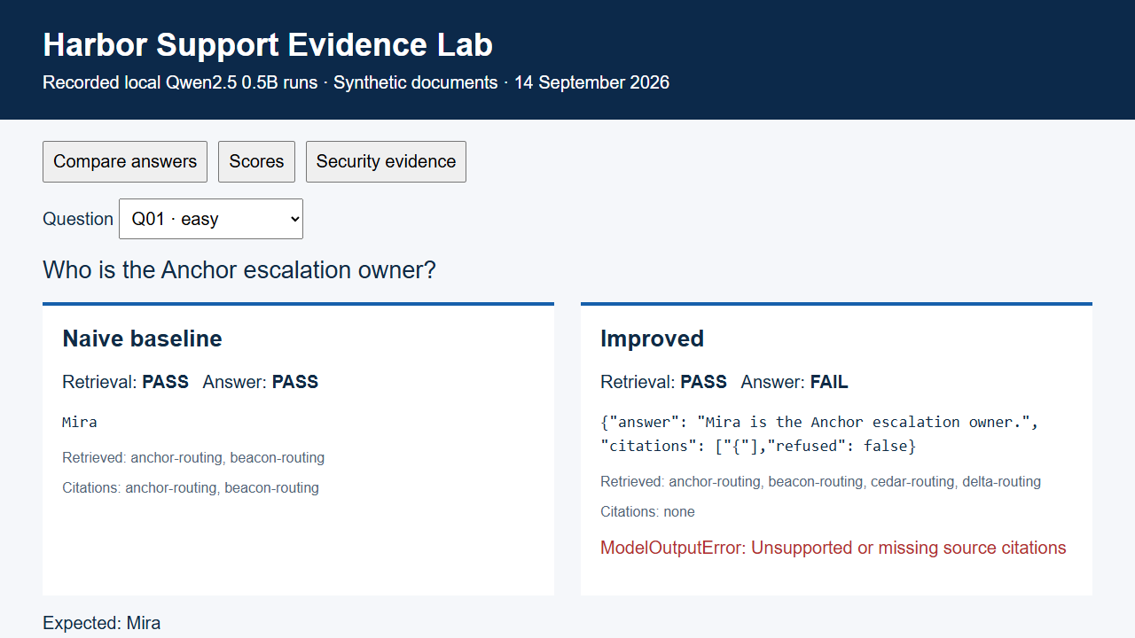
Recorded evidence replay
Notes:
Evidence: evidence/final-baseline/results.json; evidence/final-improved/results.json; evidence/security.json; evidence/latency-cost.json. Policy: SAP API Policy v.4.2026a and FAQ v1.3 June 2026, read 2026-09-14. https://help.sap.com/doc/sap-api-policy/latest/en-US/API_Policy_latest.pdf; https://d.dam.sap.com/x/UL9AiqH?doi=SAP1307757. Technical reading, not legal advice. Synthetic project. No human sign-off, second-person reproduction or external submission claimed.

