Slide 1
Customer Retention Analytics
Team Modeler
Yunong Liu, Pei-ju lee, Hui huang

Slide 2
Agenda
Business Problem
Data Exploration
Data Preprocessing & Feature Engineering
Model(Xgboost)
Recommendation

Slide 3
Business Problem
Predictive Retention Models for an insurance company’s homeowner insurance policies
Key drivers that cause policy cancellations

Slide 4
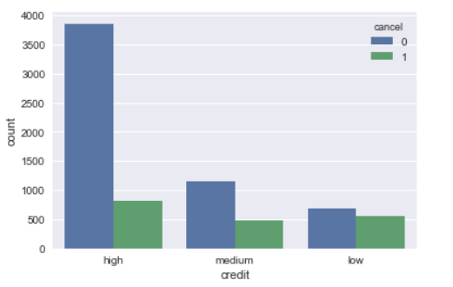
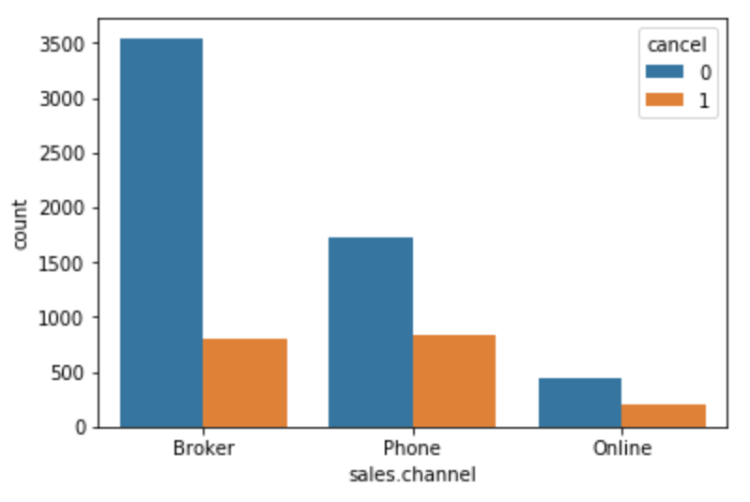
Data Exploration—Important Features
Credit: high credit customers
Sales Channel: customers from Broker

Slide 5
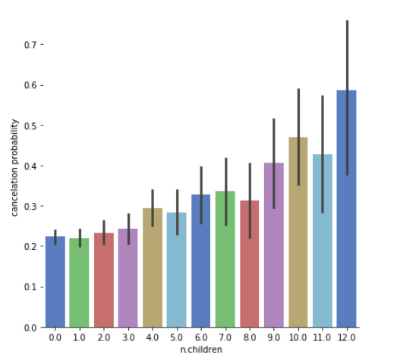
Data Exploration—Important Features
Number of Children: correlation with cancellations

Slide 6
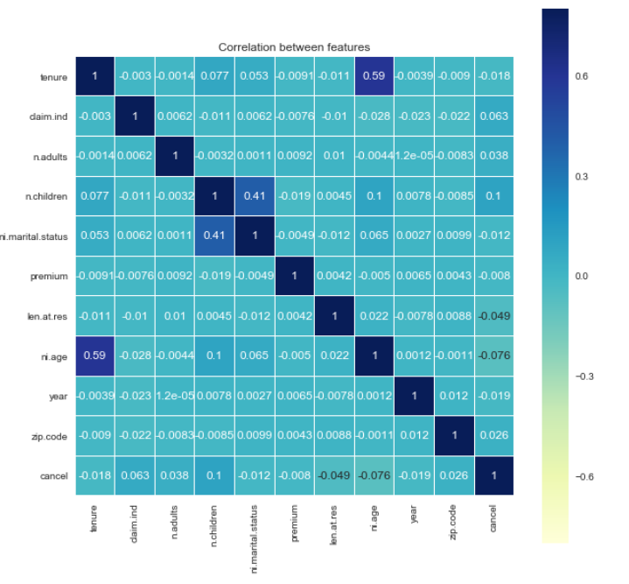
Data Exploration—Correlation Matrix
n.children and ni.marital.status
tenure and ni.age

Slide 7
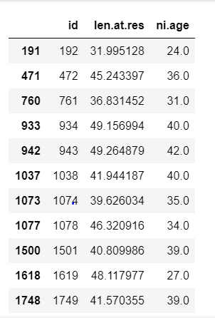
Data Processing—Unreasonable Variables
40 records len.at.res > ni.age
——Filled them with NA
Delete records where cancel = -1

Slide 8
Data Processing—Missing Values
Numerical Variables: Filled with median
n.adults, premium, tenure, len.at.res, ni.age
Categorical Variables: Filled with ‘Other’
claim.ind, ni.gender, ni.marital.status, credit, sales.channel, coverage.type, dwelling.type, house.color, zip.code
n.children: Filled with 0(according to ni.marital.status)

Slide 9
Feature Engineering
One Hot Encoding for Categorical Variables
Extracted first three digits of zip.code
Created New Features
familysize = n.children + n.adults
affordable_price = premium * n.children / n.adults
tenure_ratio= tenure / ni.age

Slide 10
Feature Selection
Methods:
Data Exploration, Correlation Matrix, Xgboost Feature Importance,
Logistic Regression Coefficient, Google Reviews
Deleted Features:
'ni.marital.status_0.0','ni.marital.status_1.0',
'ni.marital.status_Other', 'zip.code_Other'
'ni.gender_F', 'ni.gender_M', 'ni.gender_Other‘

Slide 11
Model—Xgboost
Model Details: Classification and Regression Trees-CART
Objective Function: Binary Logistic Function
Additive Training: Start from constant prediction and add a new tree function each time to optimize the objective

Slide 12
Model—Parameters
Methods: Grid search, CV function
Steps
Set initial parameter
Adjust and optimize max_depth and min_child_weight
Adjust gamma
Adjust subsample and colsample_bytree
Adjust regularization parameters, including alpha and lambda
Adjust learning rate

Slide 13
Model—AUC score
Data Split | Training Set | Testing Set
Random Split | 0.742049 | 0.743876
Split by Year | 0.753732 (Year: 2013,2014,2015) | 0.703973 (Year: 2016)
Final Results : 0.686042(first submission)
0.7022462(final submission)

Slide 14
Recommendations
Customer Life Time Value —Market Segmentation
Invest most marketing resources on policyholders with high credit, from broker, fewer children family, higher tenure ratio
Price Strategy:
Set affordable premium indicator considering the number of working family members and number of Children.

