Slide 1
Skin Cancer Classification: With Machine Learning & Deep Learning
Group members:
Demarcus Wirsing (dwirsin1@umbc.edu)
Drishti Arora (darora1@umbc.edu)
Nigist Woldeeyesus (nwoldee1@umbc.edu)
Sai Kumar Kanuru (saikumk1@umbc.edu)
Yunpeng Li (yli4@umbc.edu)

Slide 2
Project Goal
The aim this project is to study the problem of classification of dermoscopic images of skin cancer, including lesions by using various of machine learning and deep learning techniques.
The hypothesis of this project is that combining skin lesion image data with more tabular descriptions or patient data may improve skin lesion classifications and skin cancer diagnosis.

Slide 3
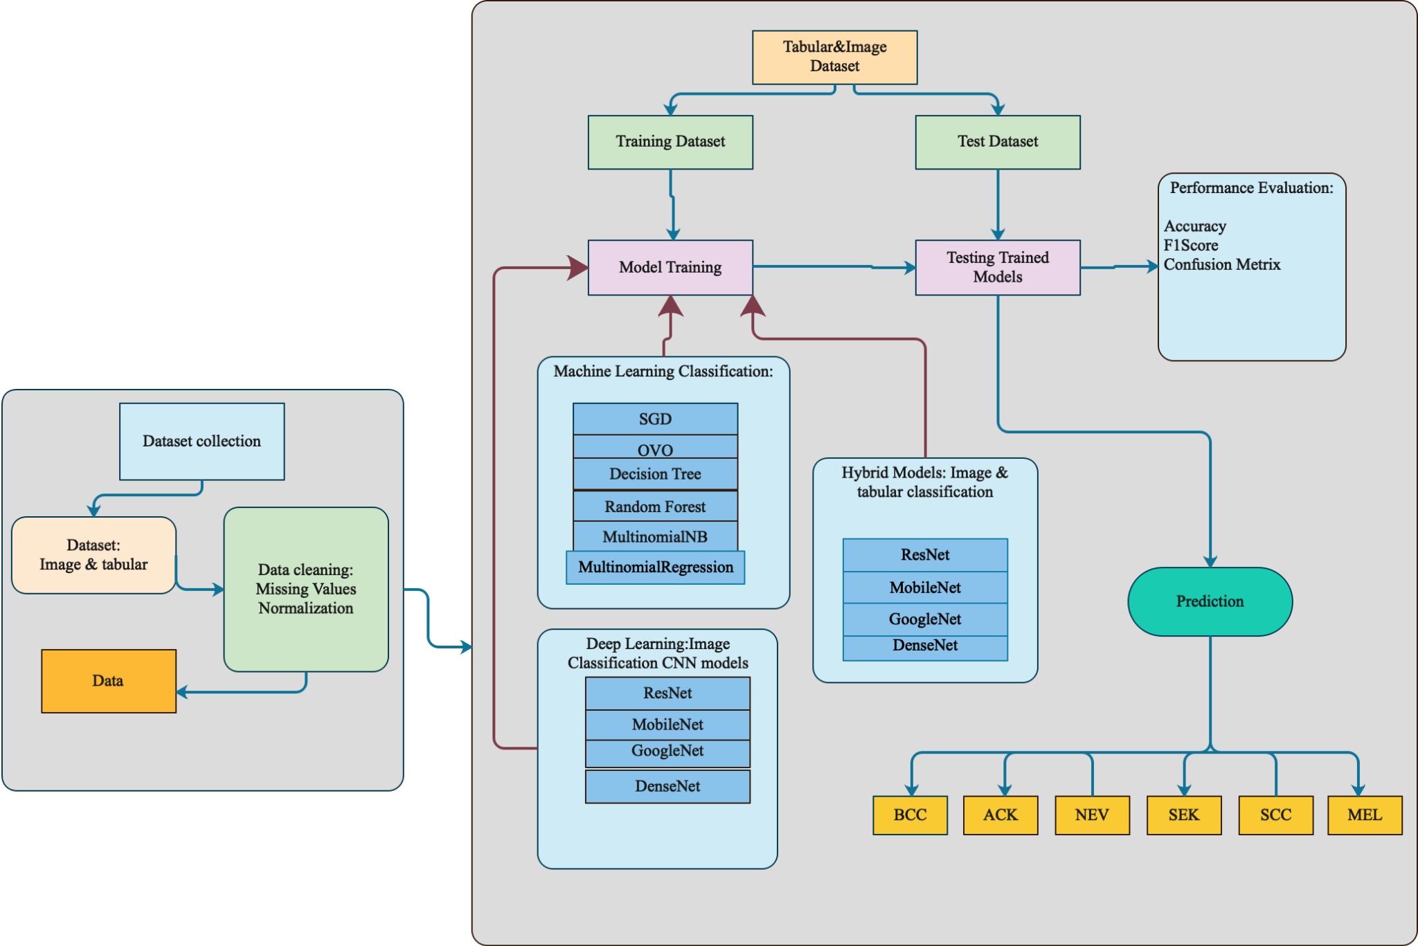
Project Main Process
overall techniques we used to predict skin cancer classification for this project

Slide 4
Project Methodology
To achieve the goal of this project we have applied both machine learning and deep learning methodologies consisting of several phases or steps as follows:
Preprocess and analyze the metadata and construct various machine learning models to predict and evaluate the results of skin lesion classifications.
Use image processing techniques and experiment with various prebuilt deep learning models on skin image data to evaluate the results of skin lesion classifications.
Use prebuilt Convolutional Neural Networks (CNN) to inference missing values in columns of clinic tabular data.
Construct a customized hybrid model that can take both image and tabular data and uses a deep learning approach to do skin lesion classifications.
Evaluate the accuracy and performance of various models and find the best model for skin lesion classifications.
Construct a data web application using streamlit to overtake our Google Colab notebooks, for a more uniform/seamless experience when presenting our project and findings.

Slide 5
Machine Learning
Multiple statistical test techniques Correlation coefficient, Chi square test and Stepwise regression used to identify best predictor.
Final list of variables trained in ML: ‘region’,’itch’,’grew’,’changed’,’bleed’,’elevation’,’biopsed’,’age’,’smoke’,’drink’,’background_father’,’pesticide’,’skin_cancer_history’,’cancer_history’,’has_swage_system’ and ’fitspatrick’.

Slide 6
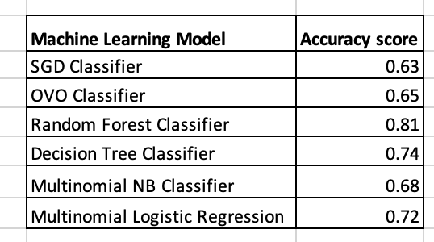
ML Accuracy

Slide 7
Deep Learning
Data Preprocessing
Prebuilt CNN Model Selection
Tabular Column Inferencing by Prebuilt CNN Models
Hybrid Models

Slide 8
Data Preprocessing
Six types of skin lesion images are programmatically copied into six image sub-folders to comply with the directory structure that Pytorch’s torchvision.datasets.ImageFolder favors.
To deal with imbalanced data:
Apply weight sampling on training data
Apply augmentation techniques: resizing, random flipping, random rotation, cropping, and color jittering transformations on the image data when data is being loaded for training.

Slide 9
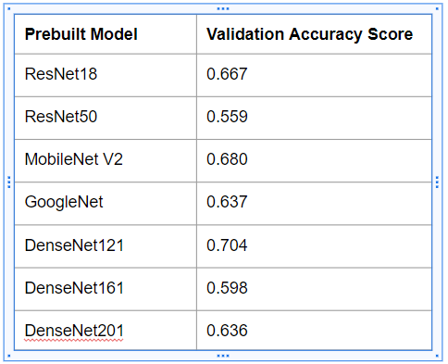
Prebuilt CNN Model Selection
Experiment with training the prebuilt CNN models, such as ResNet18, ResNet50, GoogleNet, DenseNet121, DenseNet161, DenseNet201, and MobileNet V2.
Input: Skin lesion image data
Output: Skin lesion types
The best 4 prebuilt models, Resnet18, GoogleNet, DenseNet121, and MobileNet V2, are selected for further usages.

Slide 10
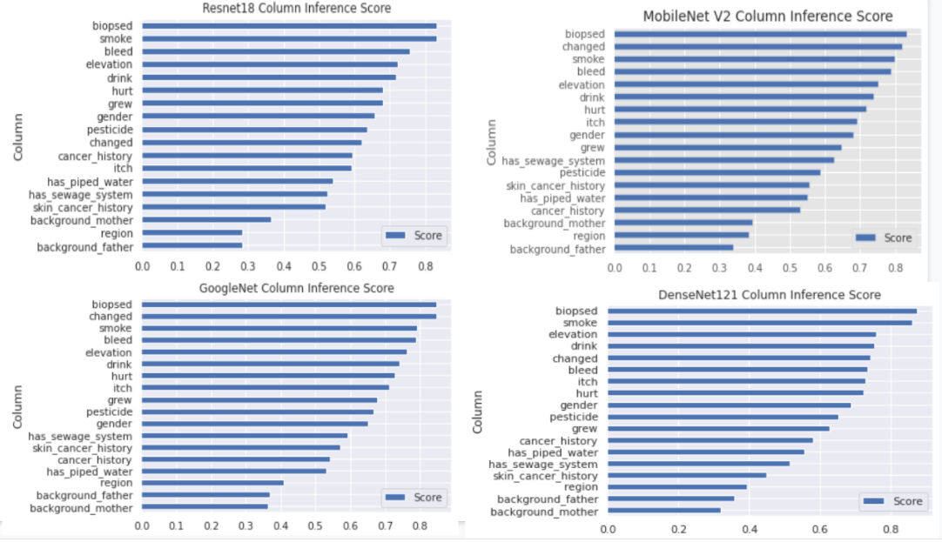
Tabular Column Inferencing by Prebuilt CNN Models
Consider score 0.7 and higher
ResNet18: 5 cols, MobileNet V2: 7 cols, GoogleNet: 8 cols, DenseNet121: 8 cols
Notes:
Column “biopsed” has strong correlation with skin lesion types. A possible explanation is that a doctor may intend to order a skin biopsy when the patient is suspected to have skin cancer after viewing the patient’s skin image.

Slide 11
Hybrid Models
Encoded patient clinic and cancer attribute categorical data in the metadata.csv file
Keep the img_id column in the csv file so that the model knows where to load the image.
Defined a class named SkinImageTabularDataset, which knows how to access both tabular and image data.
Constructed a class named ImageTabularHybridModel, which extends Pytorch nn.Module and can combine both image data and tabular data for deep learning. User can specify “image-only”, “tabular-only”, or “combined” parameters.

Slide 12
ImageTabularHybridModel
Image
Hijacked Pre-built CNN Model
Fully Connected Layers
Image tensor output
Six Classes
Fully Connected Layers
Tabular tensor output
Tabular
Fully Connected Layers
Fully Connected Layers
Concatenated
The “Hijacked” Pre-built CNN Models: Resnet, MobileNet, GoogleNet, DenseNet…

Slide 13
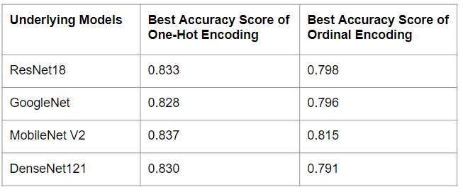
One-Hot Encoding vs. Ordinal Encoding
Apply One-hot Encoding and Ordinal Encoding on tabular columns.
One-hot Encoding has significantly better accuracy scores than the accuracy scores of Ordinal Encoding yielded by all the 4 hybrid models.

Slide 14
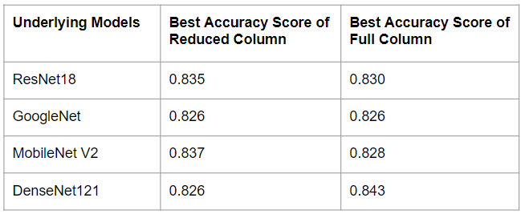
Full Tabular Columns vs. Reduced Tabular Columns
We assume some tabular columns may contribute more than others to the classifications, so we compare results of reduced columns with full columns, but there is no significant improvement.
Deep learning can figure out what features are important and ignore what are less important after a sufficiently big number of epochs of training. So, the original clinic columns may all have some contributions to the classification.
Notes:
Exclude several tabular columns, such as “backgroud_mother”, “gender”, “cancer_history”, “has_piped_water”, “diameter_1”, and “diameter_2”, which we think have relatively low correlations to the target column during EDA and machine learning phase

Slide 15
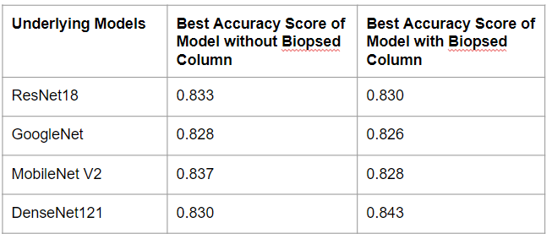
With “Biopsed” Column vs. Without “Biopsed” Column
Although we suspect the “biopsed” column may introduce bias to skin lesion classifications, the results do not show the missing “biopsed” column has significant influence on our hybrid validation accuracy scores.
A possible explanation is that other clinic tabular columns could make up for the missing influence of “biopsed” columns and still contribute significantly to the classifications during deep learning.

Slide 16
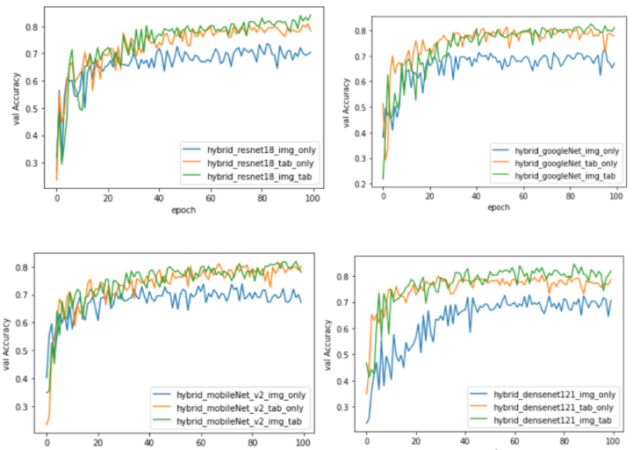
Image Data Only vs. Tabular Data Only vs. Image Tabular Data Combined
Regardless of whether including or excluding certain clinic tabular columns, after training the 4 hybrid models, all results consistently show that models trained by image tabular combined data have higher validation accuracy scores than the scores of the models only trained by tabular data or only trained by image data.

Slide 17
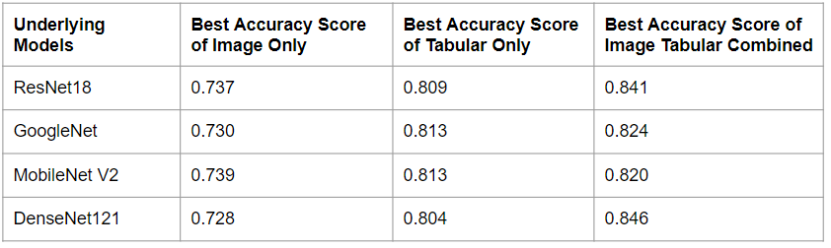
Best Hybrid Models
We have applied up-sampling to balance underrepresented skin lesion types in the training dataset and kept recording the best validation accuracy score of each hybrid model in each training epoch.
The highest accuracy score is 0.846 of the hybrid models that utilize DenseNet121

Slide 18
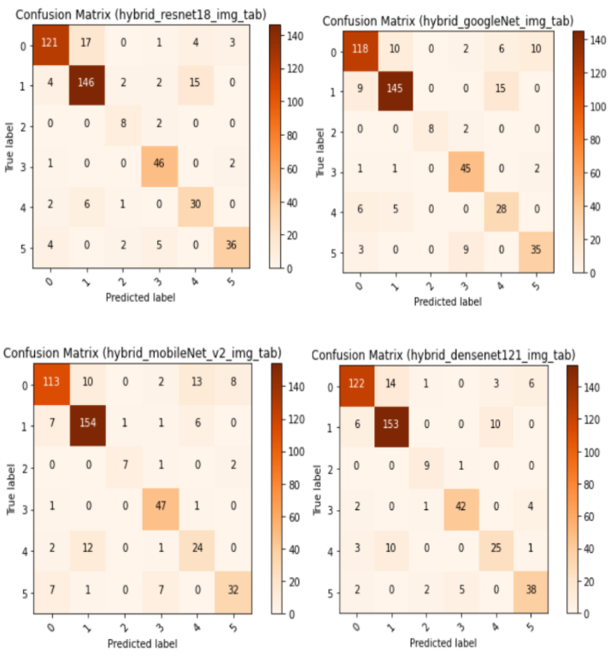
Confusion Matrices of the Best Hybrid Models
ACK: 0, BCC: 1, MEL: 2, NEV: 3, SCC 4, SEK: 5

Slide 19
Conclusion and Future Study
Our hybrid models that are capable of taking combined clinic tabular data and image data outperforms all other models we have experienced.
In a practical clinic situation, doctors not only examine skin images but also consider other formats of clinic data before a diagnosis is made. Our hybrid models can simulate such clinic situations because they take both image data and clinic data in tabular format to make relatively good predictions for cancer diagnosis.
Besides skin cancer classifications, our concept of combining tabular data with image data in deep learning can also be extended to other fields where both tabular data and image data play important roles.
We can plan to build a more advanced model that not only can combine tabular data and image data but also be able to integrate with unstructured text data, where Natural Language Processing can be applied to extract other essential information, to further assist skin cancer diagnosis.

Slide 20
Data App Demo

Slide 21
Github Repository
https://github.com/yunpengliDataScience/Skin_Cancer_ML_DL

