Slide 1
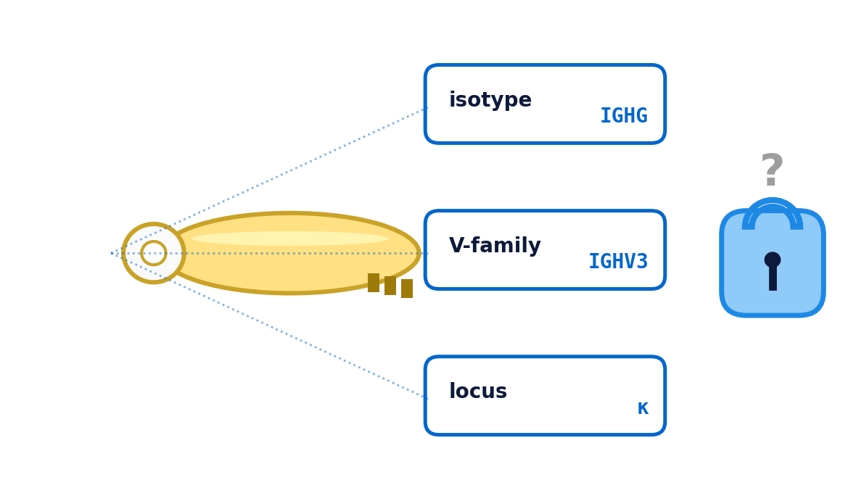
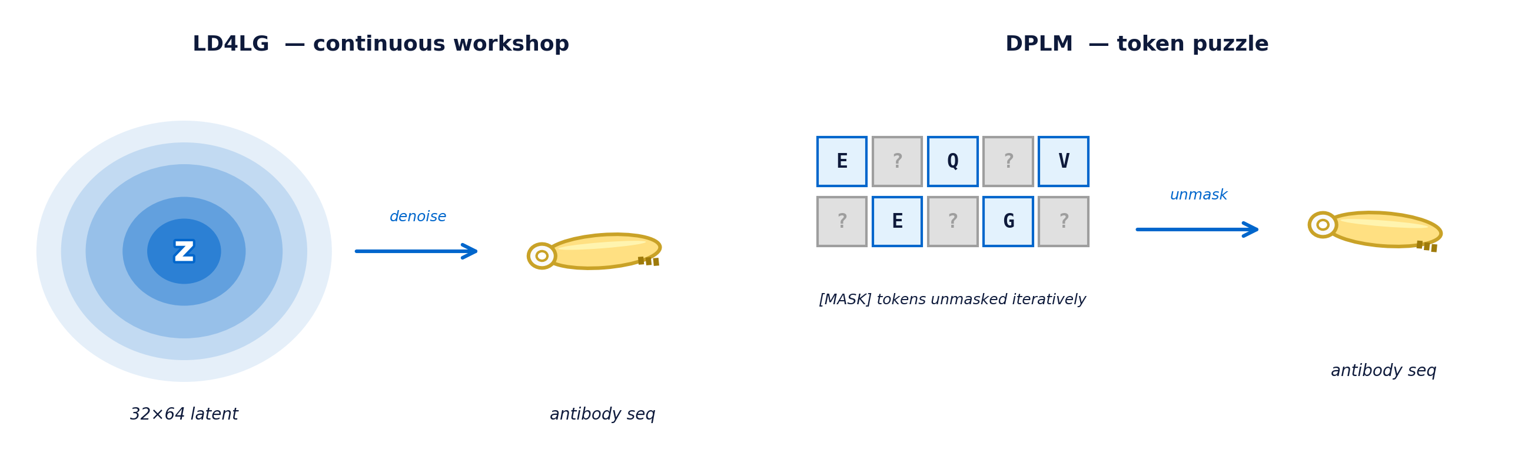
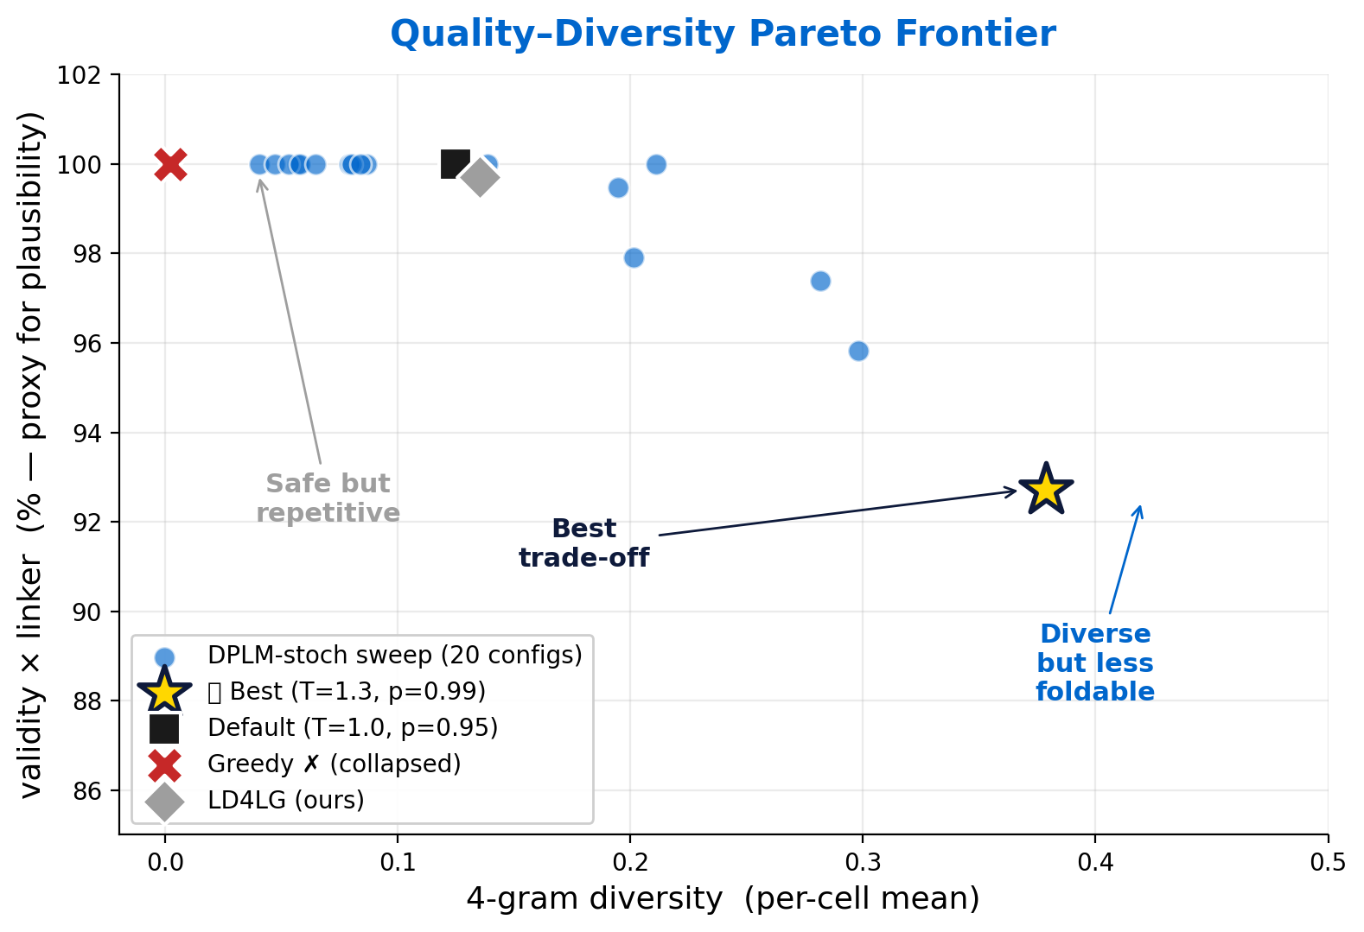
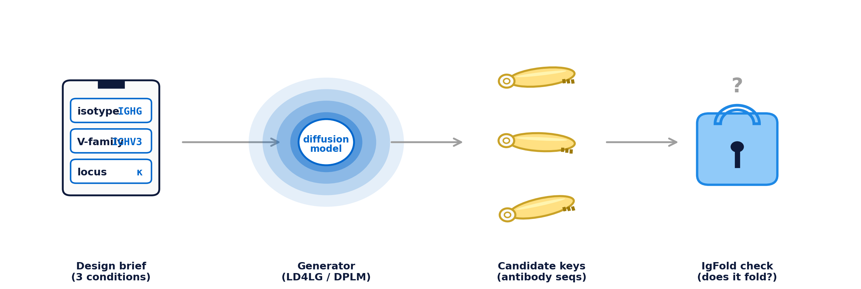
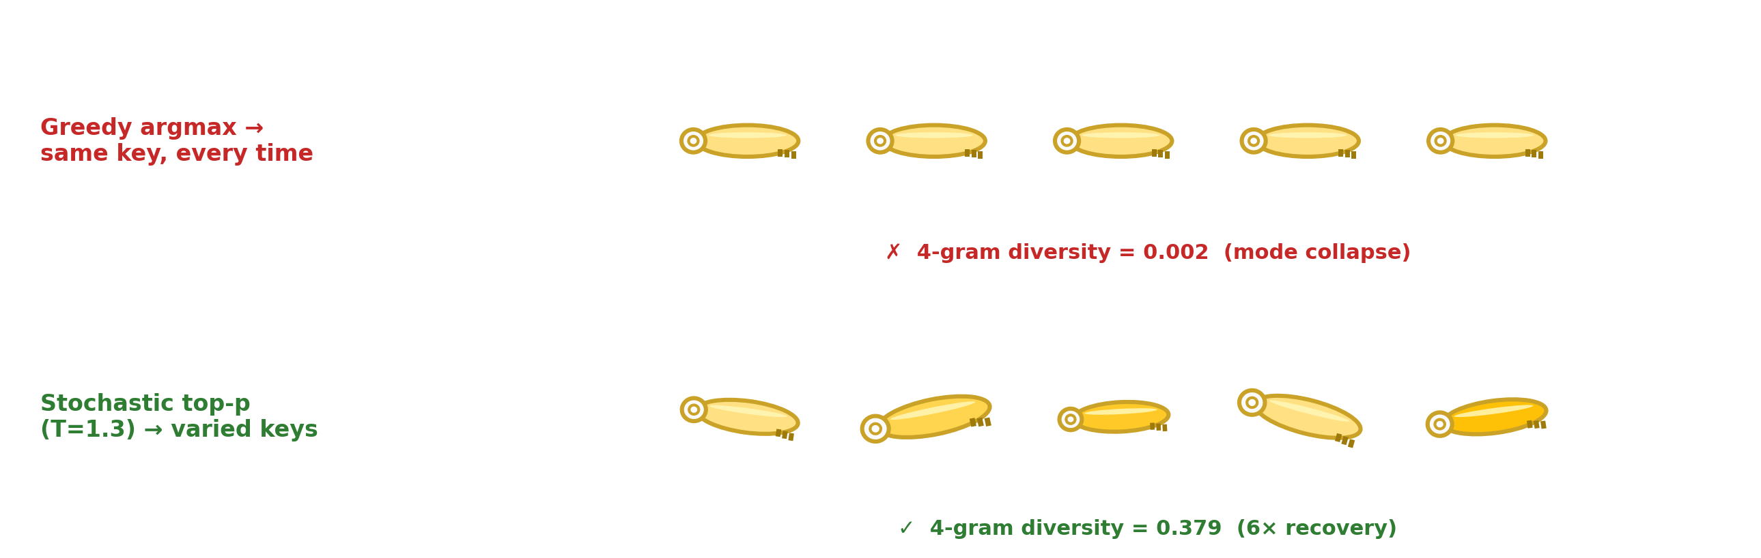
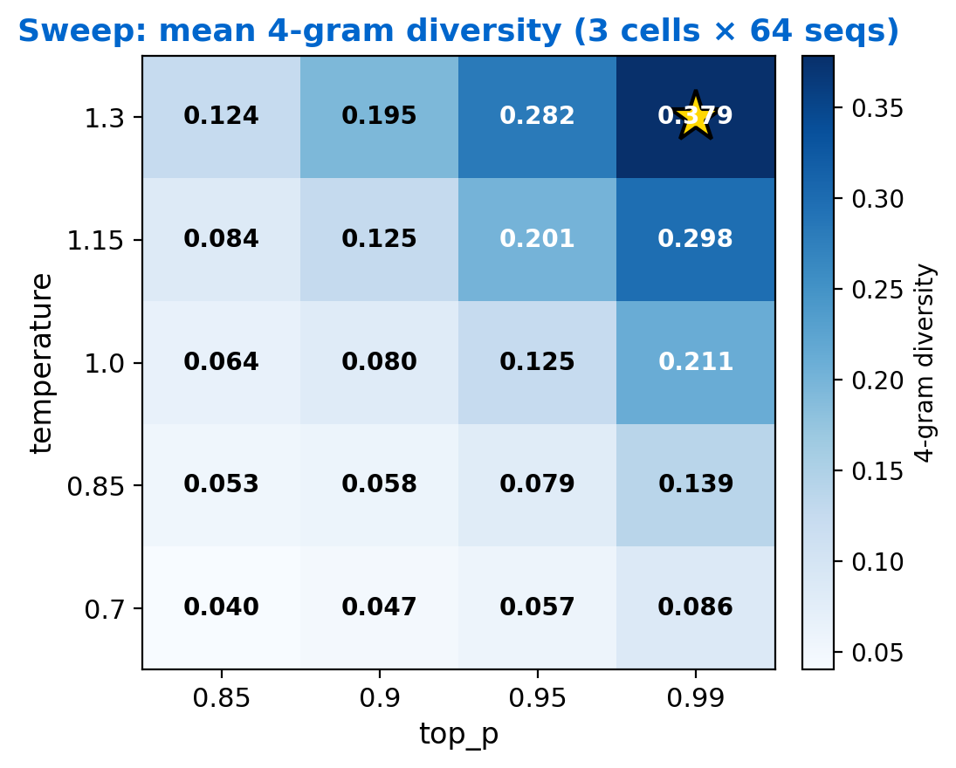
Multi-Condition Latent Diffusion for Paired Antibody Sequences
Sampling controls the novelty–foldability trade-off in multi-condition antibody diffusion.
Yunqi Li · Yonglin Zhang · Cornell University · CS 4782 Spring 2026
■ matches paper ■ our extension
§1 Why antibody generation is hard
§3 Two diffusion paradigms, one task
§5 Three findings
Need: valid, diverse, non-memorized paired sequences. Design brief = 3 biological conditions: • isotype → key handle • V-gene family → main groove • light-chain locus → side notch Question: can continuous (LD4LG) and discrete (DPLM) diffusion produce useful variation under the same brief?
✓ Reproduction works
100% validity · 0% memorize · 100% V-gene fid
✗ Greedy DPLM collapsed
4-gram diversity = 0.002 all keys nearly identical
Fig 2. LD4LG denoises a continuous latent. DPLM unmasks tokens iteratively.
⭐ Diversity has a cost (our key finding)
div 0.067 → 0.379 (×6 ↑) foldable share 97% → 26% (intrinsic, not a bug)
LD4LG (continuous workshop)
DPLM (token puzzle)
• Encoder → 32×64 latent • Cosine schedule + v-pred loss • 12-layer denoiser w/ AdaLN(t,c) • 250-step DDPM • AR decoder → AA tokens
• 1-stage bidirectional Transformer • Mask schedule γ(t) • CE loss on masked positions • 100-step iterative unmask • top-p stochastic fix (our extension)
§2 Running example: IGHG · IGHV3 · κ
We trace one antibody-key from brief → generated sequence → folded structure. The same example reappears in §3 and §4.
§4 The sampling fix (our extension)
Fig 4. Pareto frontier — each marker is one sweep config. Novelty starts costing structural plausibility around T=1.15.
Fig 1. Design brief → diffusion generator → candidate antibody-keys → IgFold check.
§2.1 Why this matters (ML framing)
Token-space Gaussian diffusion (Diffusion-LM) gets MAUVE 0.04 — discrete-noise mismatch. LD4LG pushes that boundary into a continuous latent (MAUVE 0.72). DPLM instead avoids it via absorbing-state mask noise. We compare both, on the same data.
Fig 3. Greedy keeps minting the same key; top-p sampling unlocks variation. 20-config sweep on top of this.
Fig 5. Sampling is a control knob, not an implementation detail.
Diffusion model choice matters, but sampling strategy decides whether the model produces clones, useful variants, or biologically risky sequences.
Greedy → mode collapse
DDP self-cond → rank divergence
More diversity → less foldability
Future: antigen-conditional · structure-aware diffusion · active selection on Pareto
Lovelace et al. LD4LG NeurIPS 2023 · Wang et al. DPLM ICLR 2024 · Ho & Salimans CFG 2022 · Salimans & Ho v-pred ICLR 2022 · Sahoo et al. MDLM 2024 · Ruffolo et al. IgFold Nat. Comms 2023

