Slide 1
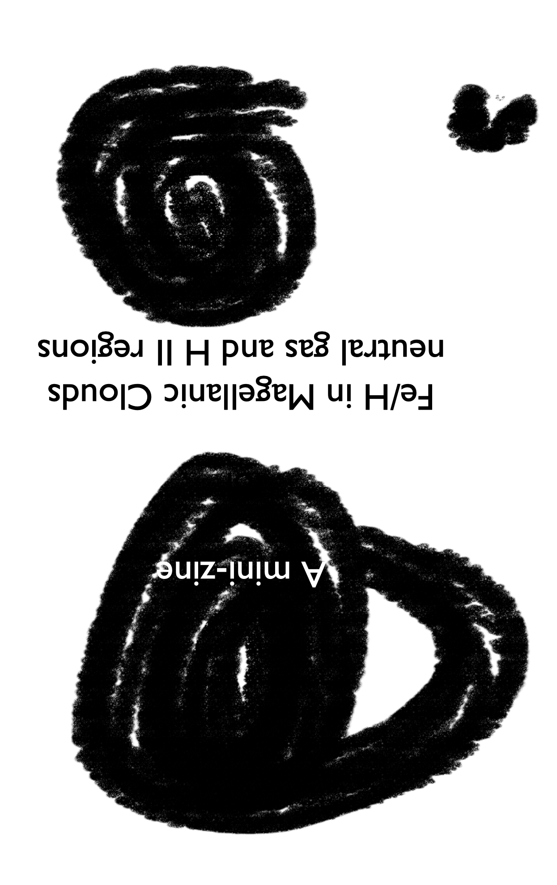
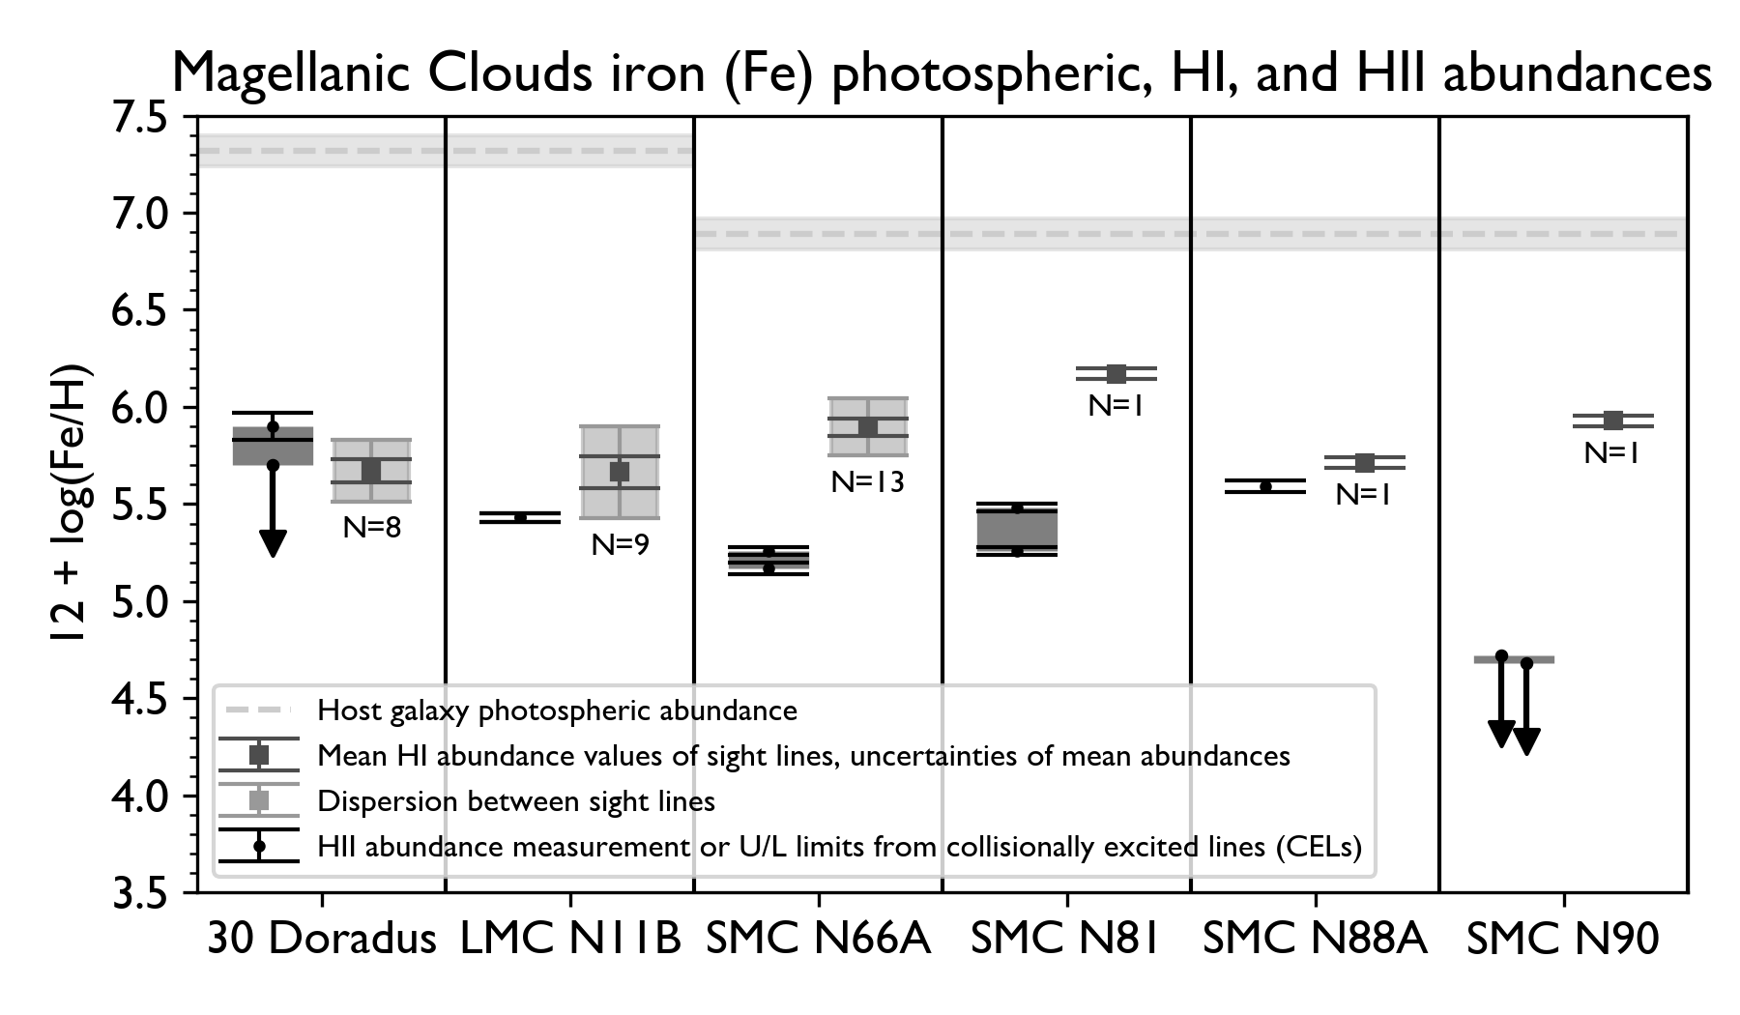
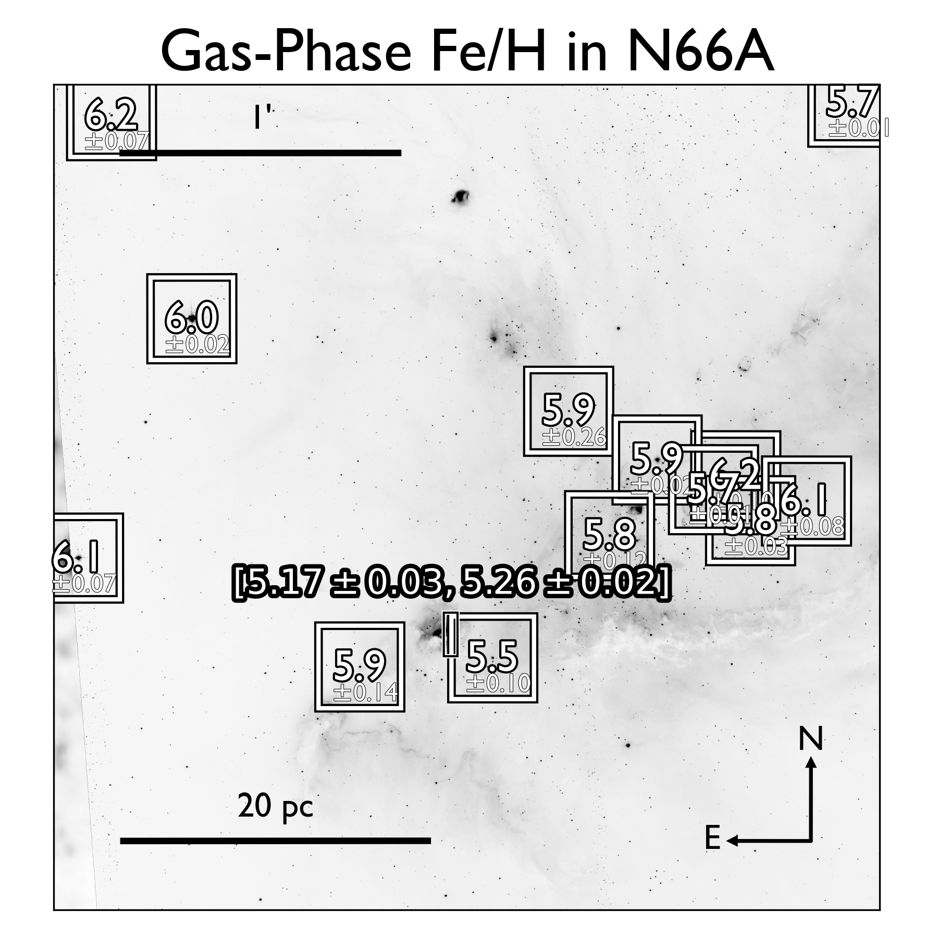
Fe abundance/depletion comparisons for six H II regions and neutral gas sightlines in their vicinity. The number of available neutral gas sightlines are labelled with N. The Fe abundance of SMC N88A (5th column) is the ionic sum of Fe III and Fe IV, while the other H II Fe abundances are ionization corrected from only Fe III measurements. The upper and lower limits represent two different ionization correction schemes.
I’m interested to learn about the current understandings on how Fe is incorporated into dust, and into which Fe-bearing species?
Slack me at Billy Li in PanDust2025
billyli@uw.edu
Neutral gas-phase Fe abundances along sightlines, shown in the squares as 12 + log(Fe/H) compared to the ionized gas-phase Fe abundance in the compact SMC H II region N66A. We measured the neutral gas-phase abundances from HST/COS and HST/STIS UV absorption spectra with stars as background continua. The Fe abundance of N66A is adopted from a VLT/UVES study by Domínguez-Guzmán et al. (2022); the small vertical rectangle in the bottom-middle indicates the position of the slit.

