Slide 1
CS 4476 Project 2
Yunqing Jia
yjia67@gatech.edu
903256707

Slide 2
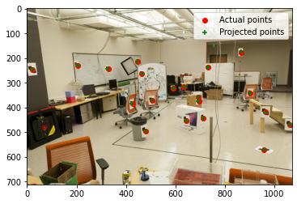
Part 1.5: Projection Matrix for provided image
<insert visualization of projected 3D points and actual 2D points for image provided by us here [1]>
<What is the minimum number of 3D-2D point correspondences needed to estimate the projection matrix? Why? [2]>
A minimum of 6 point-correspondences are needed because there are 11 unknown parameters in the projection matrix and each correspondence yields 2 equations (6x2 = 12 equations).

Slide 3
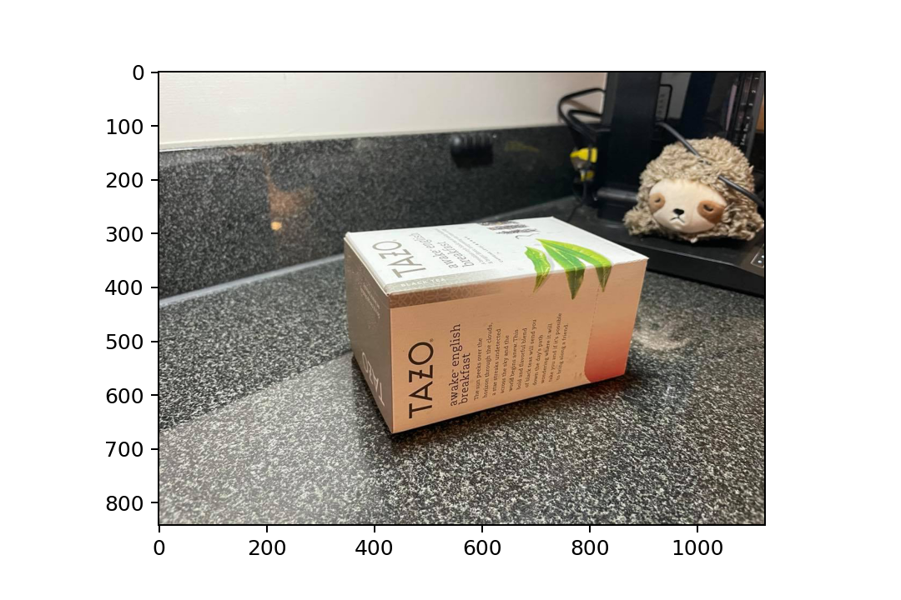
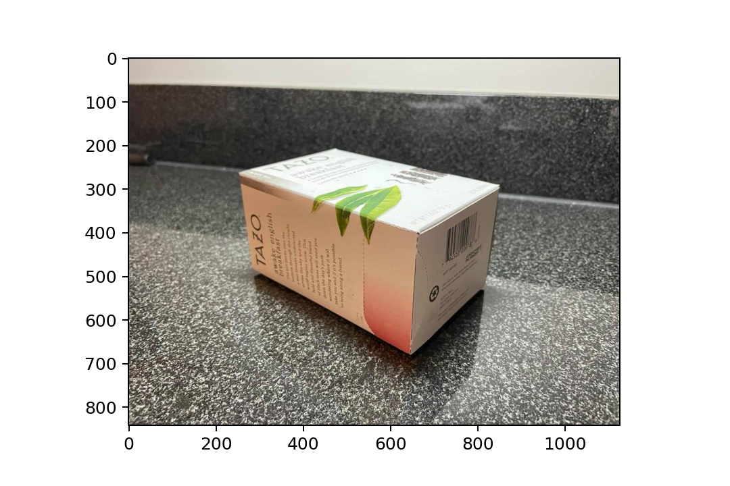
Part 2.1: Projection Matrix for custom images
<Copy two images of your fiducial object here [2]>
box_img1.jpg box_img2.jpg

Slide 4
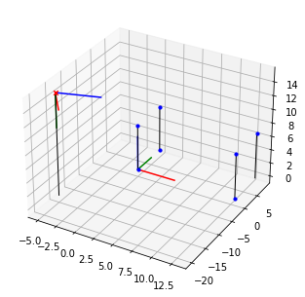
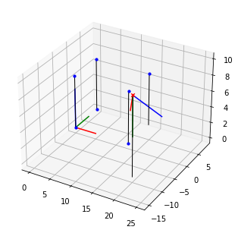
Part 2.2: Pose init for custom images
<Insert visualization for the initialized camera pose for 1st image> [1]
<Insert visualization for the initialized camera pose for 2nd image> [1]

Slide 5
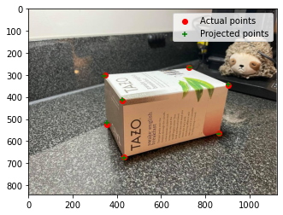
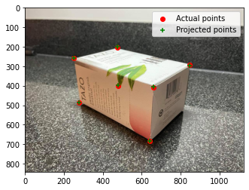
Part 2.2: Optimized results for custom images
<Insert visualization for projected 3D points and actual 2D points for 1st image> [1.5]
<Insert visualization for projected 3D points and actual 2D points for 2nd image> [1.5]

Slide 6
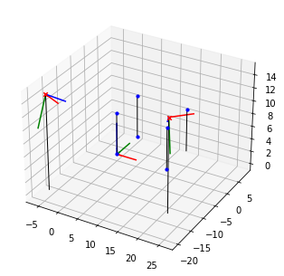
Part 2.3: Optimized Camera Poses
<Insert pose with world and optimized camera’s coordinate systems [1]>

Slide 7
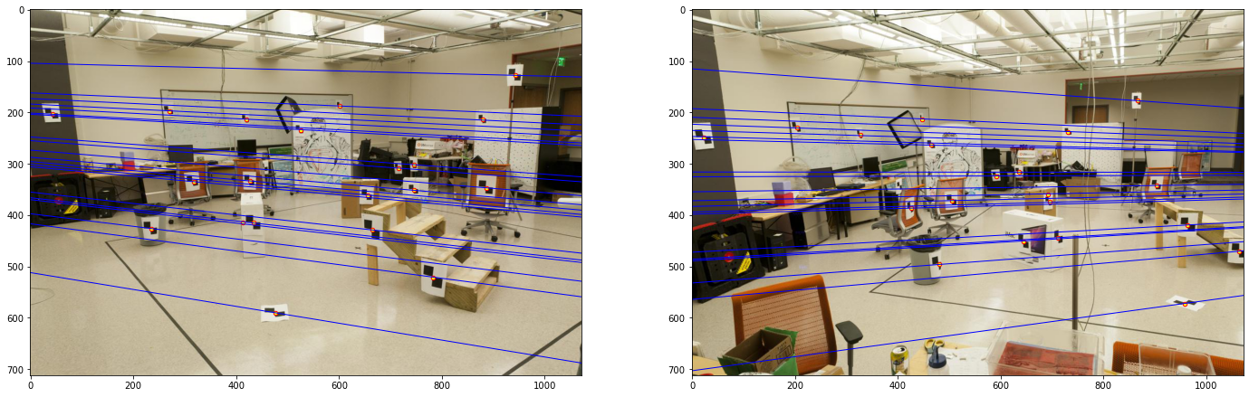
Part 3.2: Optimized Epipolar Lines (given images)
<Insert left image with epipolar lines> [1]
<Insert right image with epipolar lines> [1]

Slide 8
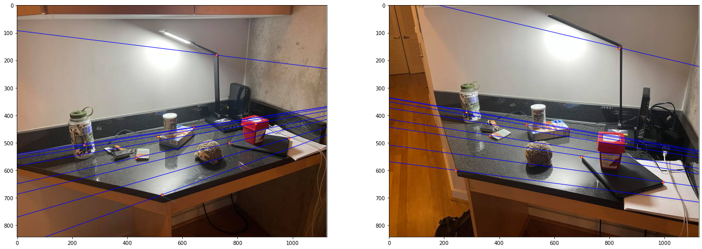
Part 3.3: Optimized Epipolar Lines (custom images)
<Insert left image with epipolar lines> [1.5]
<Insert right image with epipolar lines> [1.5]

Slide 9
Part 3.4: Reflection Questions [1x3]
1.
2.
3.

Slide 10
Part 3.4: Reflection Questions [1x3]
4.
5.
6.

Slide 11
Part 4.2: RANSAC Iterations Questions [1x3]
Type your answers to the three RANSAC Iterations questions from the jupyter notebook below:

Slide 12
Part 4.4: RANSAC Inlier Matches
<Paste the inlier matches found by Ransac [2]>

Slide 13
Part 4.4: RANSAC Epipolar Lines
<Paste the left image with epipolar lines> [1]
<Paste the right image with epipolar lines> [1]

Slide 14
Local Unit tests results
<Paste the screenshot when you run all provided unit tests using `pytest`> [1]

Slide 15
Conclusions
<Describe what you have learned in this project. Feel free to include any challenges you ran into.> [2]

