Slide 1
CS 4476 PS3
Yunqing Jia
yjia16@gatech.edu
yjia67
903256707

Slide 2
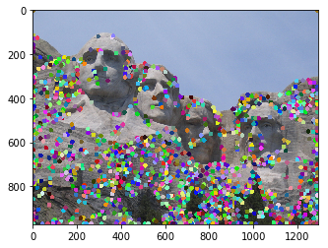
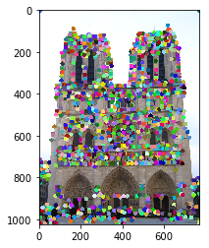
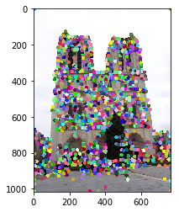
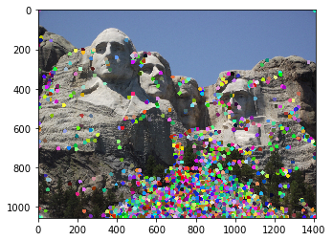
1.1: Harris Corner Detector

Slide 3
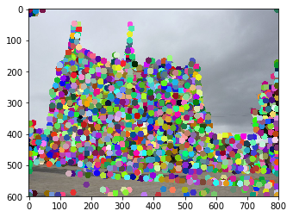
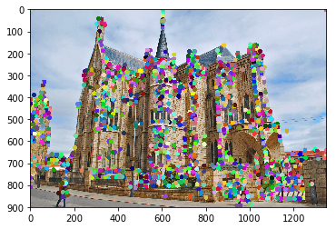
1.1: Harris Corner Detector

Slide 4
1.1: Harris Corner Detector
The Harris corner detector searches for potential corner pixels in an image through multiple layers of convolution. The algorithm computes the grayscale pixel gradients with respect to x and with respect to y using sobel filters, and then the second moments to ensure that the corner detection is rotational invariant, and then computes the corner score by subtracting the alpha*trace of the matrix from the determinant of the second moment matrix. Non-maximum suppression and removal of border values were also applied to remove pixels that are not local maximums or are too close to the edge.
The second_moments() helper function convolves the image gradients with respect to x and with respect to y with a Gaussian kernel and computes the Ix^2, Iy^2, and IxIy terms in each image slice’s principal components (directions with maximum variation), such that the corner detection is rotational invariant.
The corner_response() helper function essentially computes the (lambda_1*lambda_2)/(lambda_1+lambda_2) term for each pixel by applying the formula: R = det(M) – alpha*trace(M)^2 (done by numpy array broadcasting). The function outputs corner response score that is large only in the case where the gradient is large in both directions (i.e. large pixel variation in both x and y direction).

Slide 5
1.3: Feature Matching
<insert feature matching visualization of Notre Dame from proj3.ipynb>
<insert feature matching visualization of Rushmore from proj3.ipynb >

Slide 6
1.3: Feature Matching
<insert feature matching visualization of Gaudi from proj3.ipynb >
<Describe your implementation of feature matching.>

Slide 7
Results: Ground Truth Comparison
<Insert visualization of ground truth comparison with Notre Dame from proj3.ipynb here>
<Insert visualization of ground truth comparison with Rushmore from proj3.ipynb here>

Slide 8
Results: Ground Truth Comparison
<Insert visualization of ground truth comparison with Gaudi from proj3.ipynb here>
<Insert numerical performances on each image pair here. Also discuss what happens when you change the 4x4 subgrid to 2x2, 5x5, 7x7, 15x15 etc?>

Slide 9
1.4(a): Hyperparameter Tuning part 1 [Extra credit]
<Insert images of the ground truth correspondence and their corresponding accuracies for varying sigma in the second moments [3, 6, 10, 30] >
When changing the values for large sigma (>20), why are the accuracies generally the same?

Slide 10
1.4(a): Hyperparameter Tuning part 2 [Extra credit]
<Insert images of the ground truth correspondence and their corresponding accuracies for varying feature width in the SIFT [8, 16, 24, 32] >
What is the significance of changing the feature width in SIFT?

Slide 11
1.4(c): Accelerated Matching [Extra credit]
<Insert Runtime/Accuracy of your faster matching implementation. What did you try and why is it faster?>

