Slide 1
CS 4476 Project 4
Yunqing Jia
yjia16@gatech.edu
yjia67
903256707

Slide 2
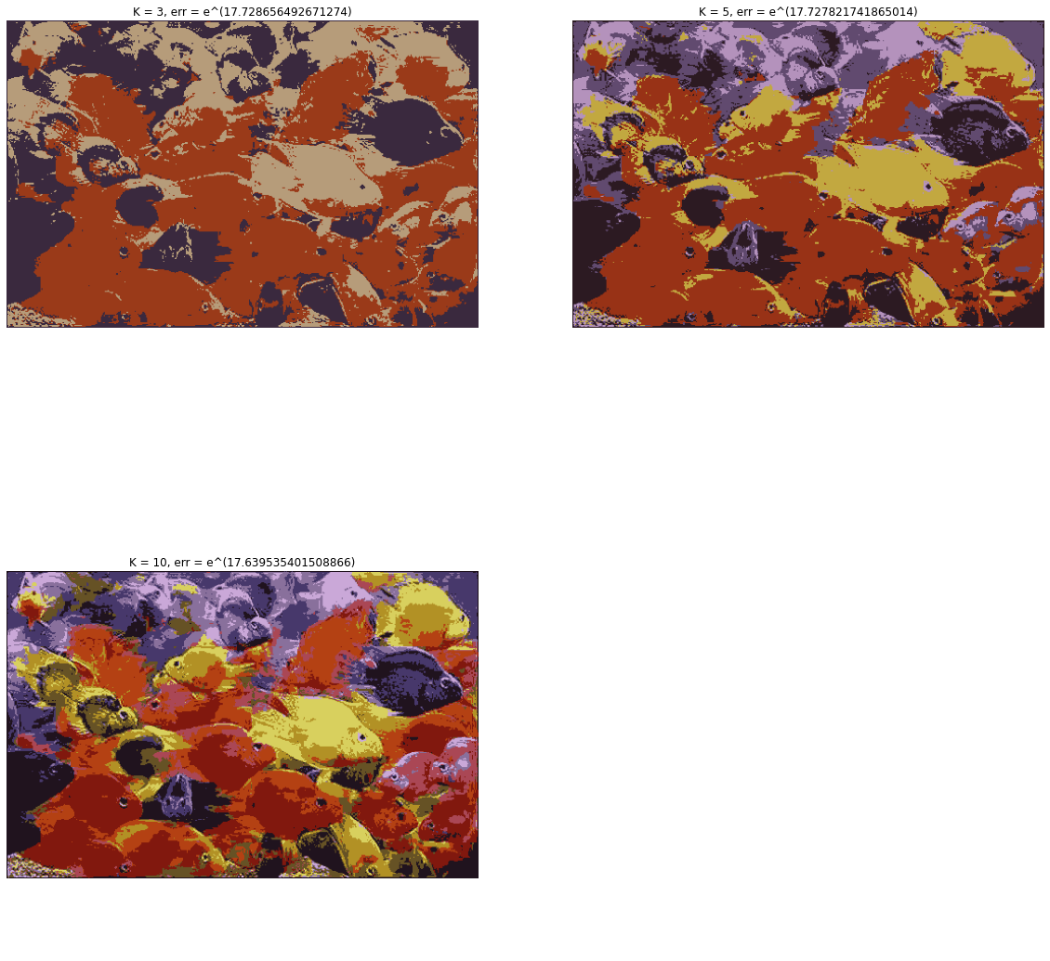
1.1 Color Quantization of RGB Images

Slide 3
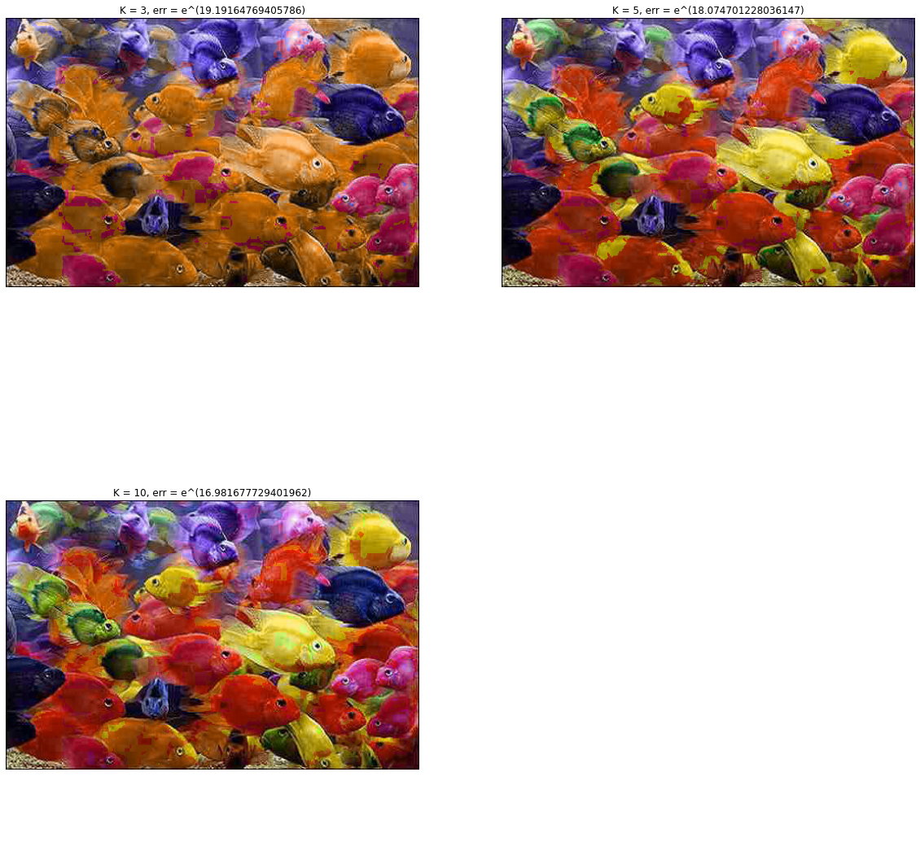
1.2 Color Quantization of HSV Images

Slide 4
1.3 Logarithmic Quantization Error
k | RGB | HSV
3 | 17.729 | 19.192
5 | 17.728 | 18.075
10 | 17.640 | 16.982

Slide 5
1.4 Brief Answers
a) Generally, the quantization error decreases with increasing number of bins. The decrease is more evident / drastic when clustering using hue values compared to clustering using RGB pixel values directly.
b) The RGB quantization was highly blurred where fish with similar colors blended together and the details such as texture are not preserved. The HSV quantization, though using the same number of bins (n = [3, 5, 10]), preserves most of the original image because only the hue channel are being reassigned to cluster centers whereas the saturation and the value channels remain the same as the original image.
c) Euclidiean distance or Manhattan distance can also be used as evaluation metrics

Slide 6
2.1 Circle Detection with Hough Transform
< Briefly explain implementation in concise steps (bullet points / listed steps preferred)>

Slide 7
2.2(a) Circle Detection on Synthetic Images
< Insert useGradient = True images here>
< Insert useGradient = False images here>

Slide 8
2.2(b) Circle Detection on Synthetic Images
< Insert low threshold images and hough accumulator array here>

Slide 9
2.2(b) Circle Detection on Synthetic Images
< Insert mid-range threshold images and hough accumulator array here>

Slide 10
2.2(b) Circle Detection on Synthetic Images
< Insert high-range threshold images and hough accumulator array here>

Slide 11
2.2(b) Circle Detection on Synthetic Images
< Explain how results vary with increasing thresholds>

Slide 12
2.3 Circle Detection on Real Images
< Include image showing detected circles here >

Slide 13
3 Unknown Radii Circle detection
< Include image showing detected circles here >

