Slide 1
Lecture 18: Sensors 1
ME/AE 6705
Introduction to Mechatronics
Dr. Jonathan Rogers

Slide 2
Lesson Objectives
Be able to interpret a sensor performance specification
Be able to explain meaning of static sensor characteristics including accuracy, resolution, sensitivity, etc
Be able to explain meaning of dynamic sensor characteristics including time constant, rise time, etc.

Slide 3
Sensors in Mechatronic Systems
Sensors are critical devices in any mechatronic system that enable actuator feedback control
  Without sensors, all actuator control would need to be open-loop
Sensors enable system to respond to external stimuli
Open Loop Operation
Actuators
Plant

Slide 4
Sensors in Mechatronic Systems
Sensors are critical devices in any mechatronic system that enable actuator feedback control
  Without sensors, all actuator control would need to be open-loop
Sensors enable system to respond to external stimuli
Controller
Closed Loop Operation
Sensors
Actuators
Plant

Slide 5
Transducers
Transducer is active element of a sensor that converts physical quantity into electrical signal
  Oftentimes requires signal conditioning for electrical signal to be useful
Many sensors are transducers, but not all
  i.e., mercury thermometer, spring scale force sensor
Physical quantity to be measured (force, acceleration, etc)
Transducer
Signal Conditioning
Display, DAQ, etc.

Slide 6
Sensor Characteristics
Understanding sensor characteristics is extremely important during design of Mechatronic systems.
Example:
  You wish to measure the speed of an elderly person walking (1-2 mph)
  You decide to use a MEMS accelerometer attached to the person’s body, and integrate output to measure speed.
  Will this work?

Slide 7
Sensor Characteristics
Understanding sensor characteristics is extremely important during design of Mechatronic systems.
Example:
  You wish to measure the speed of an elderly person walking (1-2 mph)
  You decide to use a MEMS accelerometer attached to the person’s body, and integrate output to measure speed.
  Will this work?
    No. Signal to noise ratio of sensor outputs is not high enough to achieve desired accuracy when integrating outputs.

Slide 8
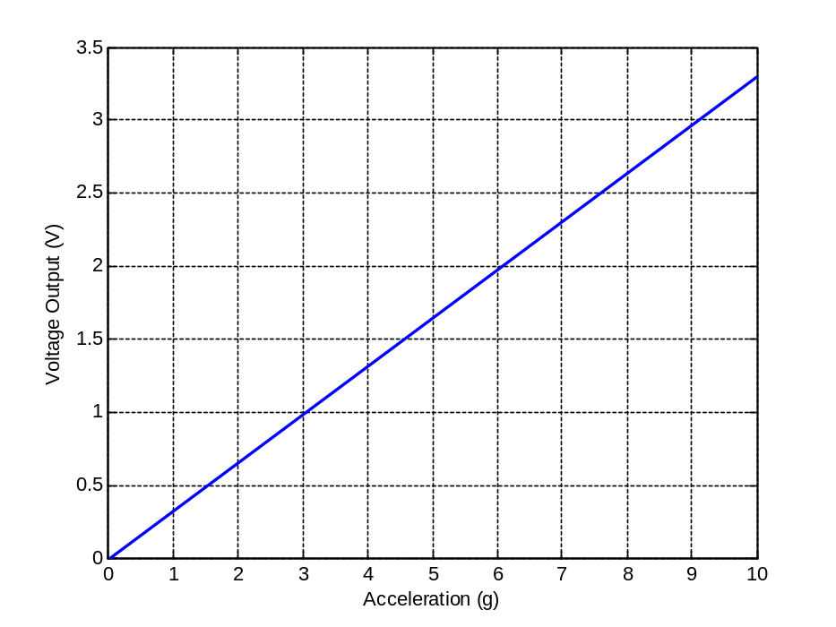
Range
Sensor Range: Range of physical quantity that can be detected by sensor.
  Related to output range of sensor by sensitivity
Example: Accelerometer with range of 0-10 g and sensitivity of 330 mv/g.
Range

Slide 9
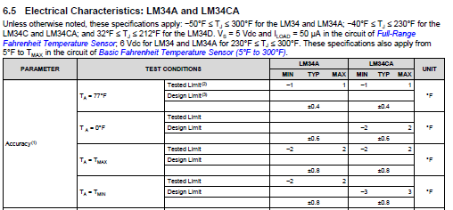
Accuracy
Sensor Accuracy: Difference between true and measured value is sensor accuracy
  Usually expressed as percentage of full-scale (maximum) value
  Can be improved by calibration
Example 1: Temp sensor has range of 0 to 200 deg and accuracy of +/-0.5% FS value. Then temp read by sensor is within +/- 1 deg of actual temperature.
Example 2: LM34A has accuracy that varies as a function of the temperature. It is most accurate in middle of its operating range (77 deg F).

Slide 10
Sensitivity
Sensor Sensitivity: Relationship between measured input and output of sensor
  For instance, if sensor response is linear, then sensitivity is slope of line
  Can also be used to describe sensitivity to external disturbances
Sensitivity of this notional accelerometer is 330 mV/g.

Slide 11
Sensitivity
Sensitivity is sometimes called scale factor or sensor gain for sensors that exhibit linear response
  Scales inputs to outputs
Linear Measurement Equation
Transducer output in V, A, Ω, etc.
For example, in V/g or mV/°F
Physical value, for example in °F
Accounts for nonzero output when Input is zero (sometimes called offset)
From LM34 datasheet

Slide 12
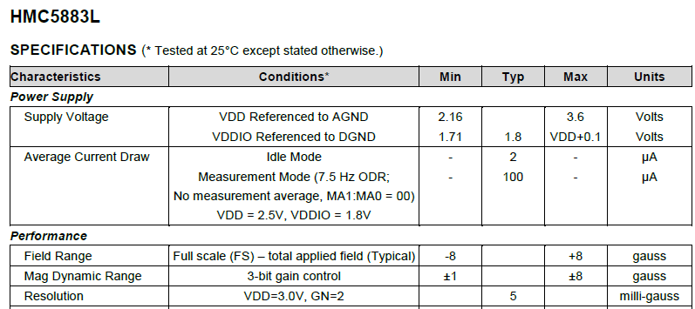
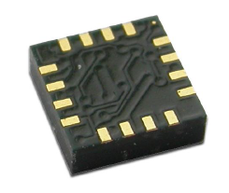
Resolution
Sensor Resolution: Smallest change in input value that will produce observable change in output value
  Most analog sensors don’t really have resolution. Resolution depends on ADC you read sensor with.
  Sensors with digital outputs will always list resolution.
Honeywell 3-axis MEMS Digital Compass
Can detect changes in magnetic field of 5 mGauss

Slide 13
Hysteresis
Sensor Hysteresis: Maximum difference in sensor output for same input quantity, with one measurement taken while input is increasing from 0 and other taken while input is decreasing from max
Hysteresis Loop
Output
Hysteresis error
Input

Slide 14
Hysteresis
Sensor Hysteresis: Maximum difference in sensor output for same input quantity, with one measurement taken while input is increasing from 0 and other taken while input is decreasing from max
Hysteresis Loop
Output
Why does hysteresis always exist for physical sensors?
Hysteresis error
Input

Slide 15
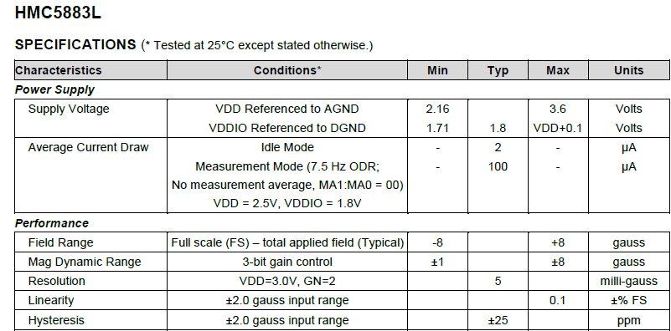
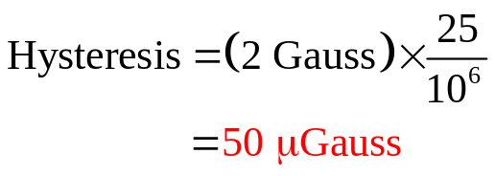
Hysteresis
Find the hysteresis (in Gauss) of the HMC5883L digital compass sensor

Slide 16
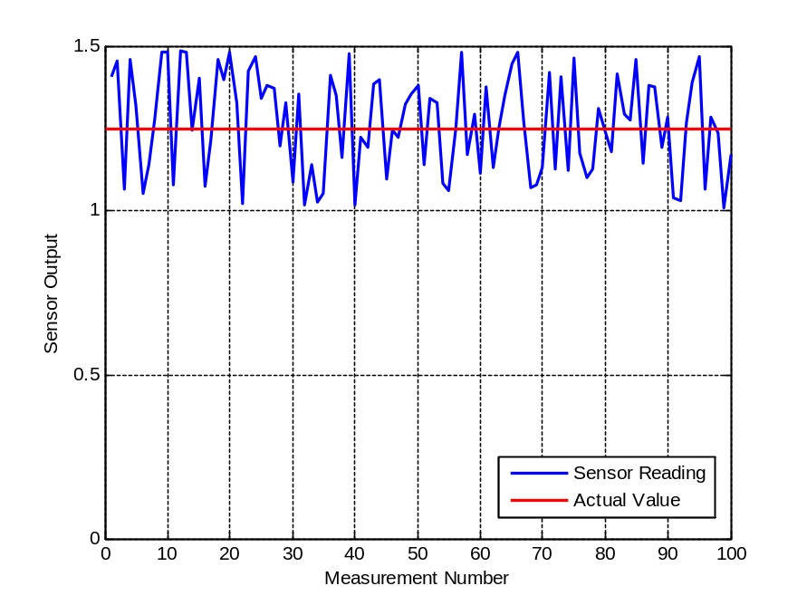
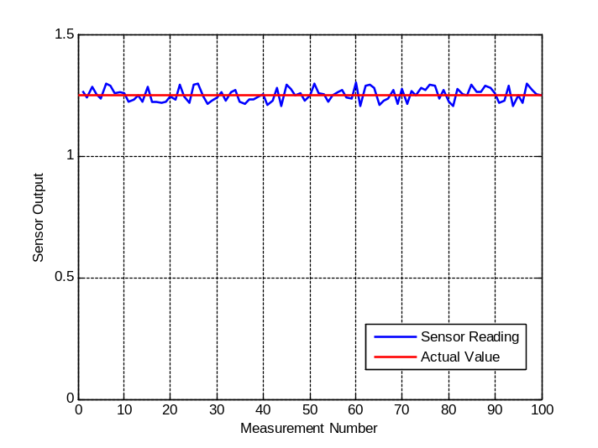
Repeatability
Sensor Repeatability: Error in output value for repeated application of same input
  Also called precision
  Repeatability is affected by noise/external disturbances
  Repeatability cannot be improved through calibration
Sensor with lower precision
Sensor with higher precision

Slide 17
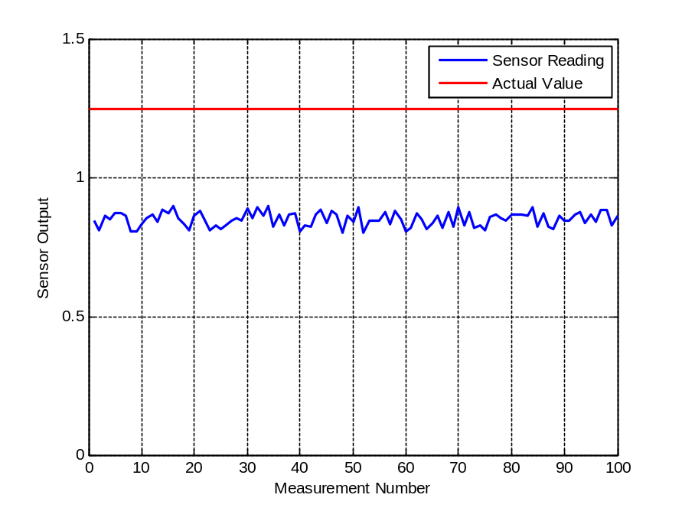
Accuracy vs Precision
Which of the below sensors has high precision?
Which of the below sensors has high accuracy?

Slide 18
Accuracy vs Precision
Which of the below sensors has high precision?
Which of the below sensors has high accuracy?
Sensor with lower precision, higher accuracy
Sensor with lower accuracy, higher precision

Slide 19
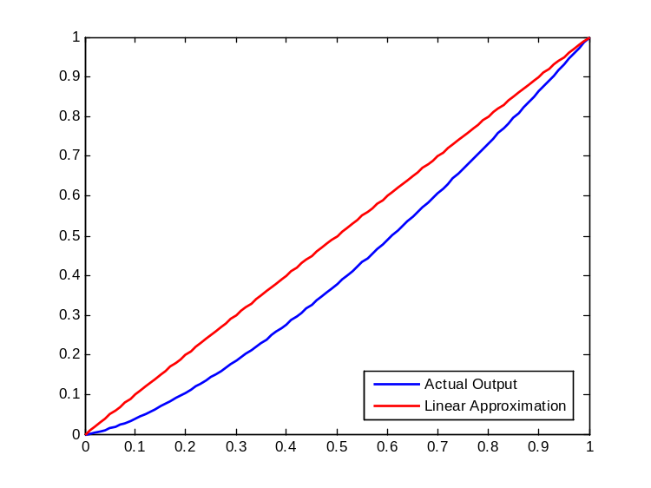
Nonlinearity
Most sensors designed to have linear input-output relationship
Sensor Nonlinearity: Maximum error caused by difference between actual sensor output and straight line fit
  Usually specified as percentage of full-scale output
Output
Nonlinearity Error
Input

Slide 20
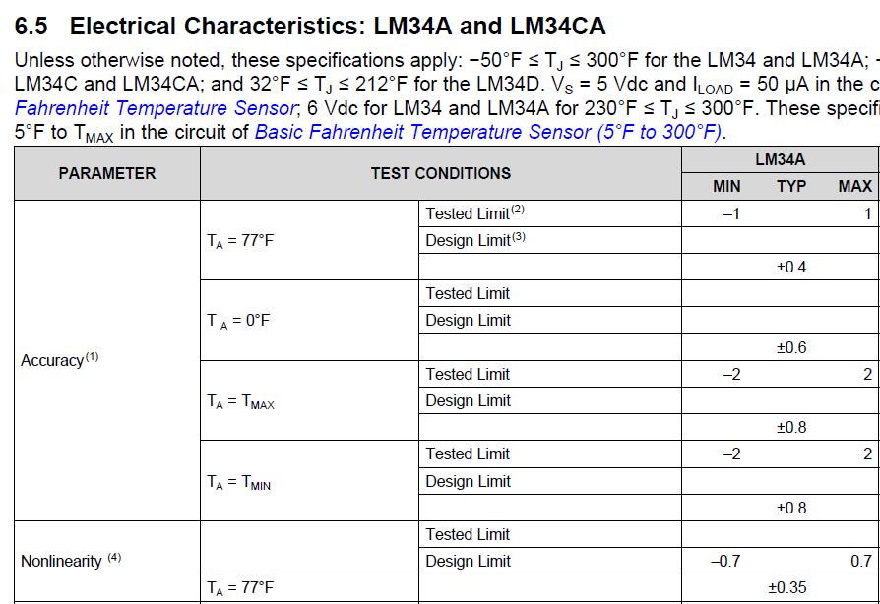
Nonlinearity
Example: LM34A nonlinearity error

Slide 21
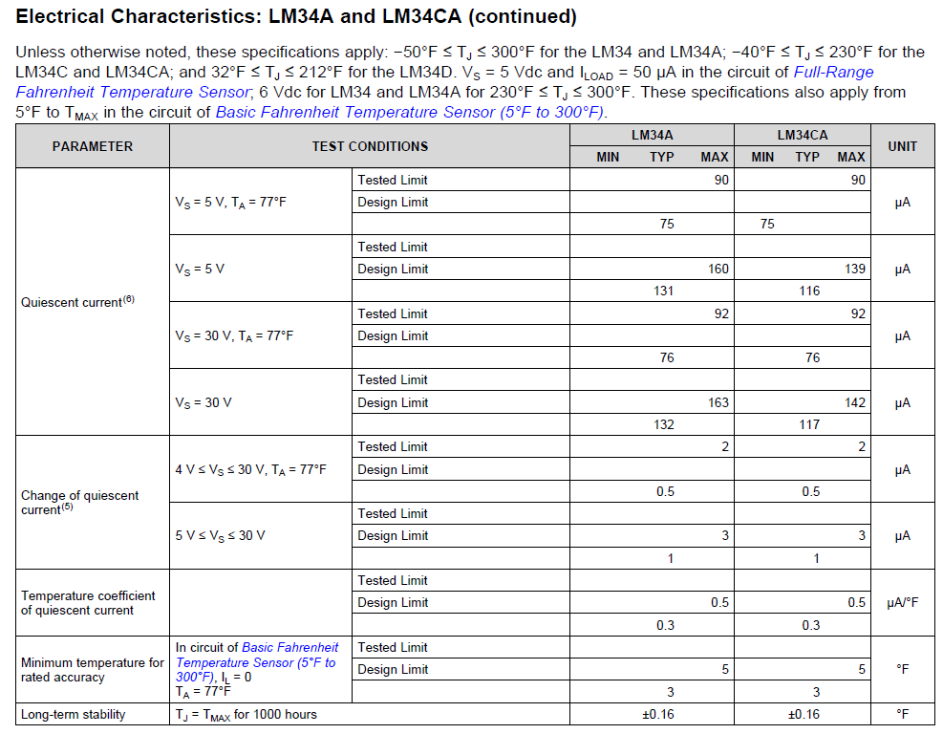
Stability (Drift)
Sensor Stability (Drift): Variation of output with time when input quantity is not changing
  When zero input is applied, output variation is called zero drift
  Affects repeatability of measurement
Example: LM34A output will fluctuate ±0.16°F when exposed to 300°F for 1000 hours

Slide 22
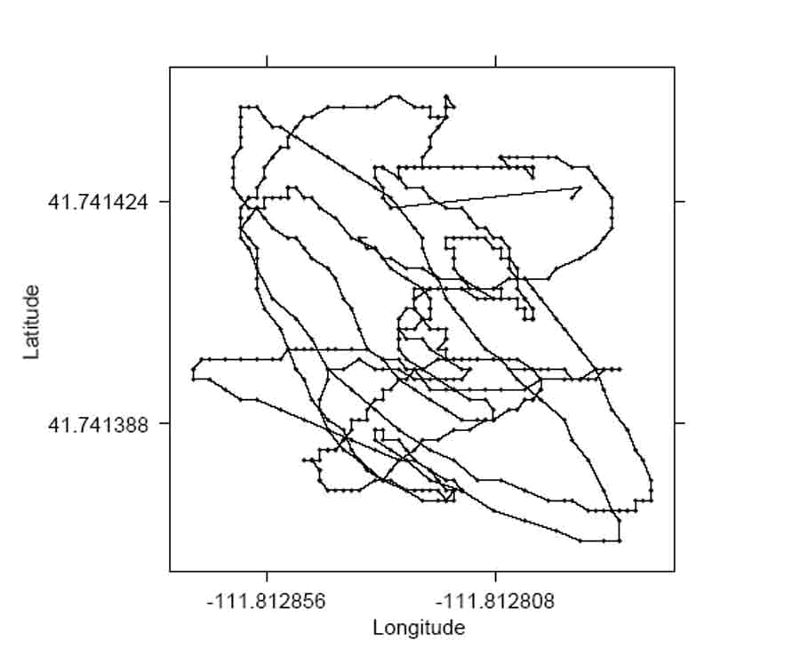
Stability (Drift)
GPS is common sensor that exhibits drift
If you stand still with a GPS receiver, position output by receiver will fluctuate
  Behavior known as “random walk”
For GPS sensors, drift is caused by fluctuations in the atmosphere which affect the GPS signal. Can cause up to 30 ft of error.
13 ft
17 ft

Slide 23
Noise
In practice, Repeatability or Precision of sensor is characterized through sensor noise specification
Noise is similar to drift, except is zero mean and affects sensor on short timescales
  Caused by disturbances in environment or electronics
Sensor with higher noise
Sensor with lower noise

Slide 24
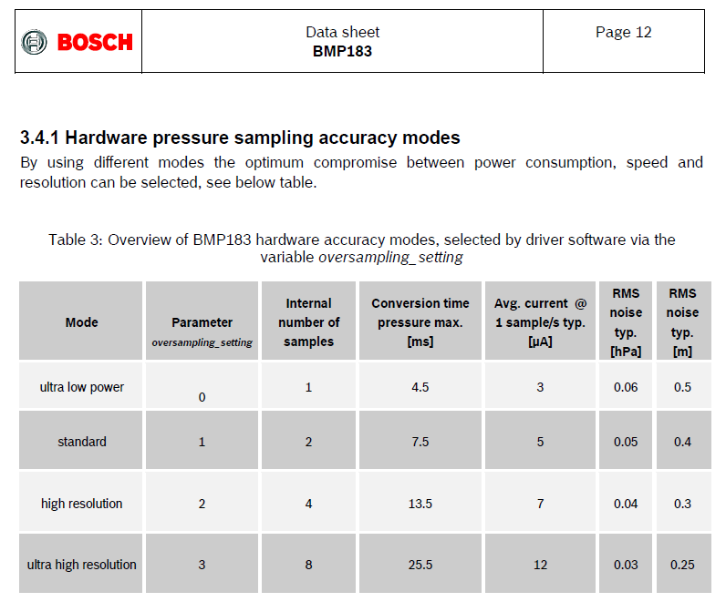
Noise

Slide 25
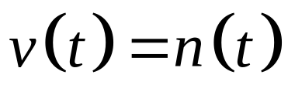
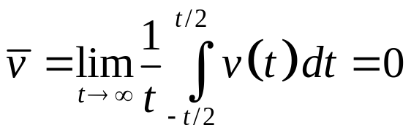
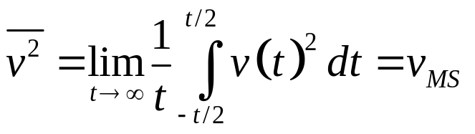
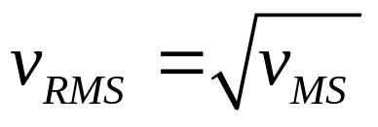
RMS Noise
Noise is a random, zero mean disturbance
  Thus, average value of zero-mean noise is zero
Mean Signal
Sensor Output
Zero-mean random process
Mean Square Signal
Root Mean Square Signal (Noise)
Average of square of voltage
not zero
RMS noise is measure of noise amplitude, computed as square root of mean square value of noise signal.

Slide 26
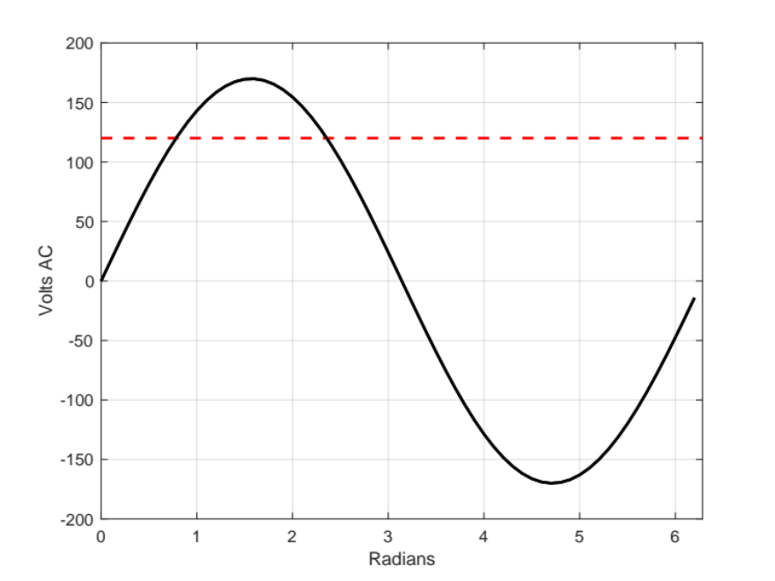
RMS (side note)
Even though average value of AC signals are zero, RMS value of signals are not zero
  Example: 120 VAC power from wall outlet is actually sine wave with amplitude 170V, but has RMS value of 120V
RMS = 120.04 V

Slide 27
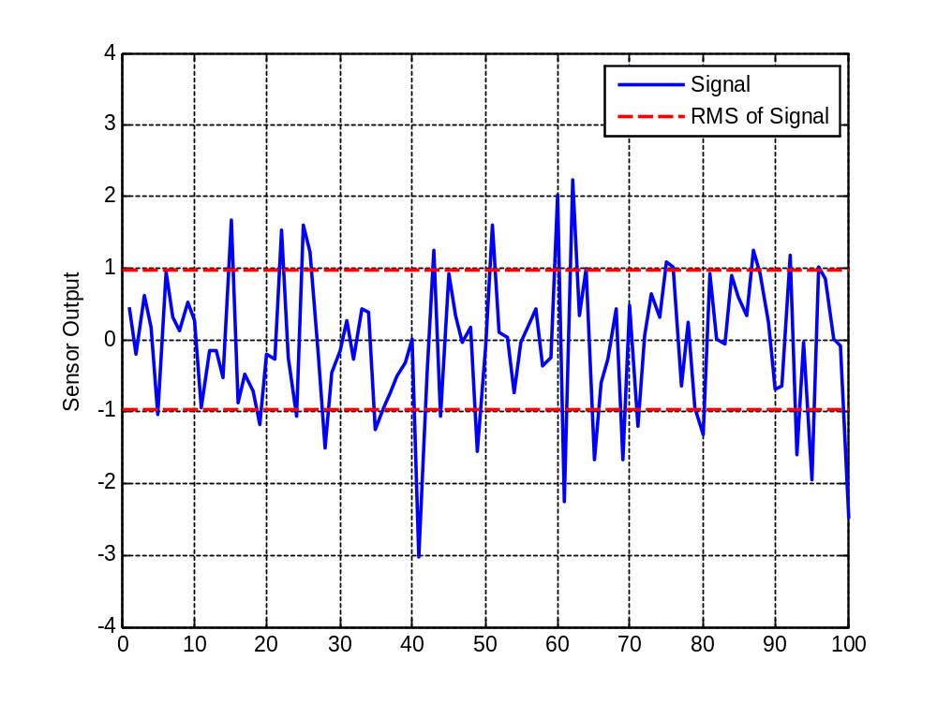
RMS Noise
Example: Sensor with Gaussian noise (σ = 1)
  Standard deviation of ~1. (RMS = standard deviation for Gaussian distribution)

Slide 28
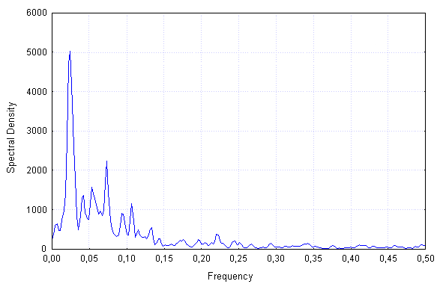
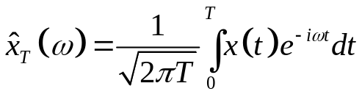
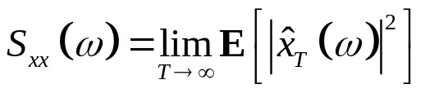
Noise in the Frequency Domain
Amplitude of noisy signals often decomposed using a spectral density function
  Spectral density defines how variance of data is distributed over frequency domain
Truncated Fourier Transform of Random Process x(t)
Power Spectral Density of x(t)
Expectation operator

Slide 29
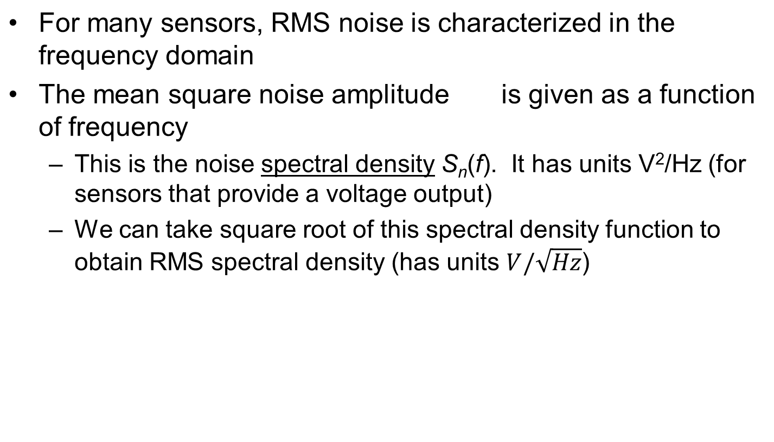

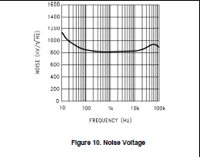
Noise in the Frequency Domain
Noise RMS spectral density from LM34 Temperature Sensor Datasheet

Slide 30
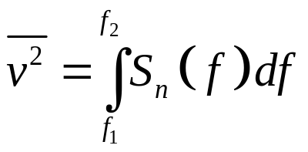
Noise in the Frequency Domain
If we integrate noise spectral density over frequency range of interest, we get mean square noise amplitude
  We can then take square root of this value to obtain v_{RMS}
Noise mean square amplitude
Integral of spectral density
For instance, depending on the sampling rate we are using, we may only care about noise levels below a certain frequency.
Frequency range of interest is called Bandwidth
BW = f₂ – f₁

Slide 31
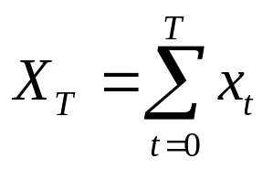
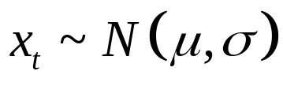
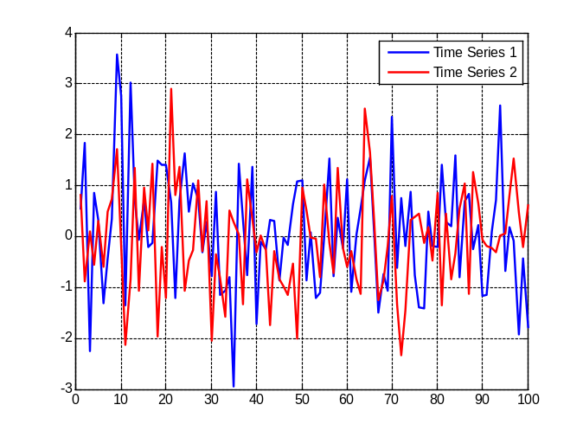
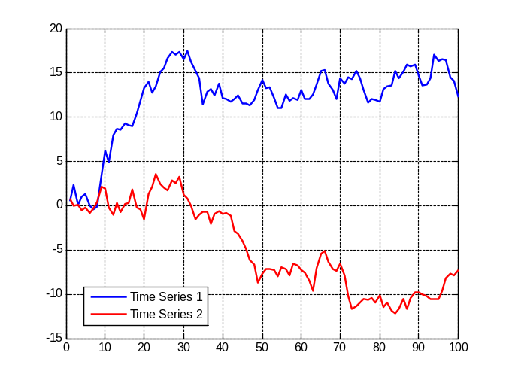
Random Walk
Sometimes we want to integrate sensor outputs to obtain value used in feedback control
  For instance, integrate velocity measurements to obtain position
When we integrate Gaussian noise, we get so-called “random walk” signal
Gaussian random process
First-order random walk
Integrate

Slide 32
Dynamic Characteristics
So far, all the characteristics we have discussed apply to sensor output during steady-state
  “Static characteristics”
Dynamic characteristics describe behavior of sensor outputs when physical stimulus has changed
Dynamic characteristics:
  Rise Time
  Time Constant
  Settling Time

Slide 33
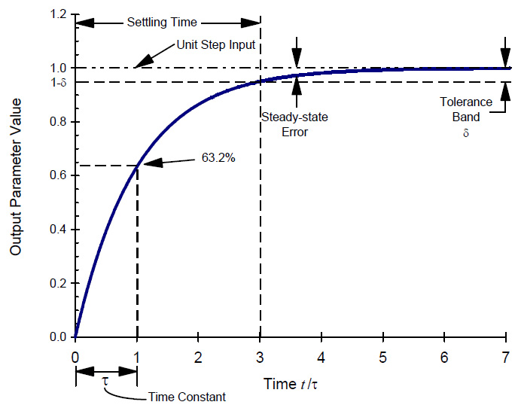
Dynamic Characteristics
Dynamic Characteristics of Sensor with 1st Order Response
Rise Time: Time it takes for output to change from 10% to 90% of final steady-state value.
Time Constant: Time it takes for output to reach 63.2% of final output. For 1st order sensor, it takes 4 time constants to reach final value.
Settling Time: Time it takes to reach 2% of final steady-state value.
Rise Time

Slide 34
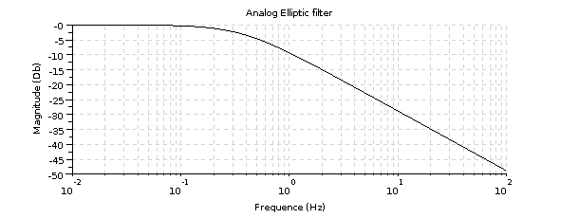
Bandwidth
  All sensors are dynamic systems with a break (cutoff) frequency
Bandwidth defines frequency range for which sensor is designed to operate
  Bandwidth frequency is where sensor output will be 70.7% of DC level (-3 dB)
Bode Plot for Sensor with 1st Order Response
Above bandwidth frequency, sensors can provide output just at diminished amplitude
If sensor used in feedback loop, sensor bandwidth should be much larger than controller bandwidth
Bandwidth freq.

Slide 35
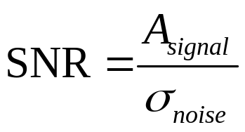
Signal to Noise Ratio
Very important when dealing with sensors to be aware of possible interference in surrounding environment
Signal to Noise Ratio (SNR) is common tool for evaluating whether signal can be identified in background noise
True Signal Amplitude
Noise Standard Deviation
In general, signal to noise ratio can be improved by taking multiple measurements and averaging them together so noise gets averaged out (called ensemble averaging).

Slide 36
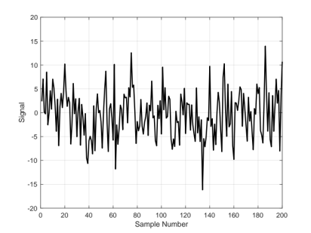

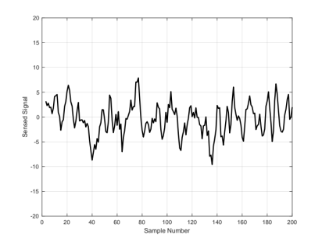
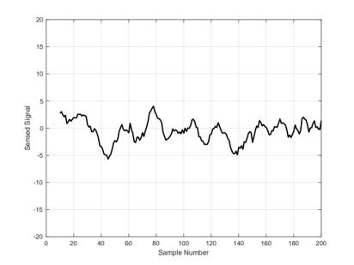
Bandwidth
Sensor bandwidth is essentially the frequency response of the sensor
  Indicates the signal frequency range over which the sensor will be able to measure
BW = f₂ – f₁
≈ f₂
Actual Stimulus
High Bandwidth Sensor
Low Bandwidth Sensor
Medium Bandwidth Sensor

Slide 37
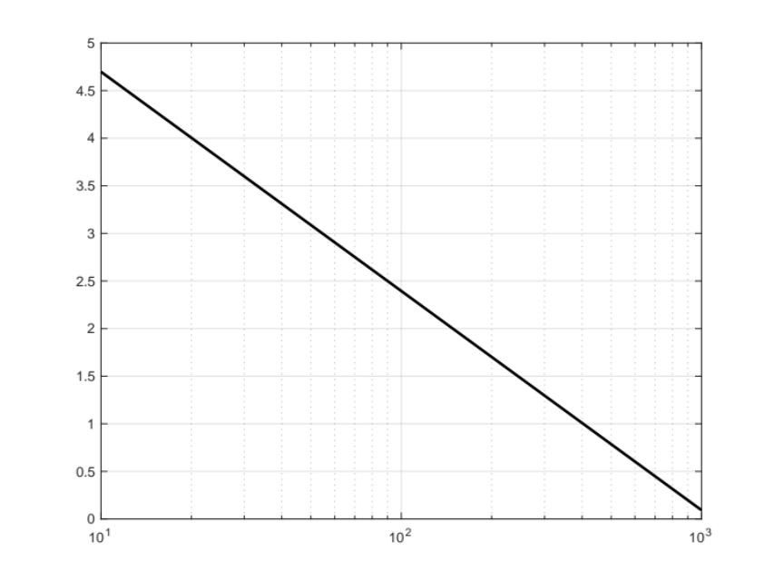
Bandwidth vs Signal-to-Noise
By lowering the bandwidth of the sensor, the signal-to-noise ratio can be improved
Bandwidth (update rate)
Signal to Noise

Slide 38
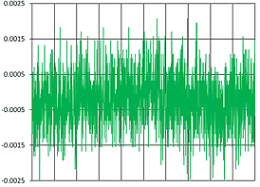
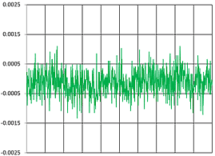
Bandwidth vs Resolution
Lower bandwidth means higher resolution
  With higher signal-to-noise ratio, we will be able to see smaller displacements of the signal (won’t be confused with noise)
  Comes at expense of smaller frequency range
Noise of Sensor with 15 KHz bandwidth
Noise of Sensor with 100 Hz bandwidth

Slide 39
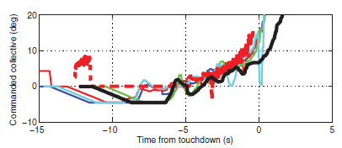
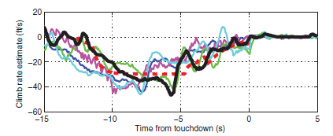
Sensor Interference
When designing mechatronic systems, need to be aware of nearby signals that interfere with sensors
  Emitted by actuators or surrounding environment
Examples:
  Use of magnetometers near motors
  Use of ultrasonic proximity sensors near motors
  Use of pressure sensors near rotors
Sunberg, Z., Miller, N., Rogers, J., “A Real-Time Expert Control System for Helicopter Autorotation,” Journal of the American Helicopter Society, Vol. 60, 2015.

Slide 40
Sensor Interference
Video from example flight
https://www.youtube.com/watch?v=mAFeDq9ZdH4

