Slide 1
Lecture 22: Feedback Control 2
ME/AE 6705
Introduction to Mechatronics
Dr. Jonathan Rogers

Slide 2
Lesson Objectives
Be able to set PID gains through analysis of closed-loop transfer function
Be able to implement a PID controller on the MSPM0 using understanding of control implementation
Be able to compensate for saturation by implementing integrator anti-windup
Be able to explain performance of and implement on-off control for systems with binary control inputs

Slide 3
Setting PID Gains
Common methods:
  Trial and error using “shotgun” approach (bad idea!)
  Trial and error using sequential approach:
    Proportional first to generate reasonable rise time
    Derivative second to add damping as needed
    Integral to remove any steady-state error
    Final adjustment of all three
  Analysis of closed-loop transfer function
    Set PID gains to achieve desired closed-loop poles
In cases where trials take a very long time, simulation is necessary!

Slide 4



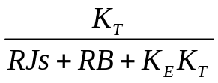
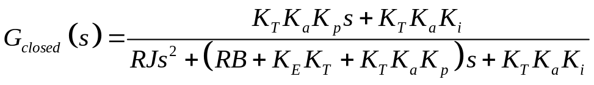
Setting Gains
There is a methodical way to set the gains of a PID controller through analysis of closed loop transfer function
To show how this works, let’s revisit our example PI speed controller for a DC motor
V_{e}(s)
V_{c}(s)
V_{in}(s)
ω_{desired}(s)
ω(s)

Slide 5
Example: Setting Gains
Suppose we want to set the proportional and integral gains such that:
  System has critical damping (ζ = 1)
  System has desired time constant τ_{d}
How should we go about this?

Slide 6

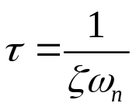
Example: Setting Gains
Suppose we want to set the proportional and integral gains such that:
  System has critical damping (ζ = 1)
  System has desired time constant τ_{d}
Characteristic equation for closed loop system is:
Characteristic equation for an underdamped 2nd order system is:
When 2nd order system is critically damped, time constant and natural frequency are related by:

Slide 7
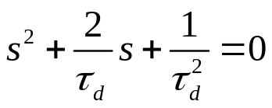

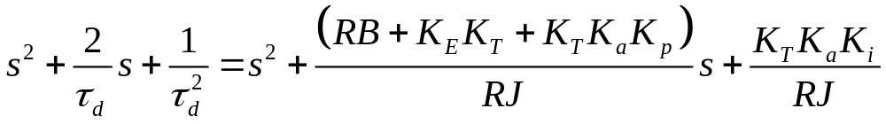
Example: Setting Gains
Suppose we want to set the proportional and integral gains such that:
  System has critical damping (ζ = 1)
  System has desired time constant τ_{d}
Substitute time constant relationship in characteristic equation:
Setting characteristic equation for our system equal to generic characteristic equation:
Equate terms corresponding to powers of s:
LinearTerm
Constant Term
LinearTerm
Constant Term

Slide 8
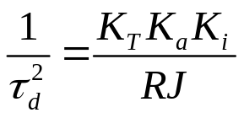
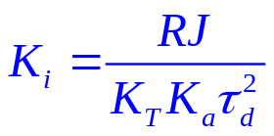
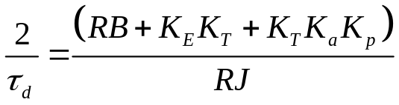
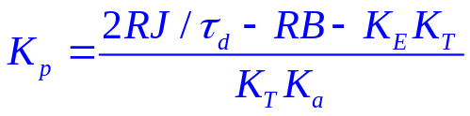
Example: Setting Gains
Suppose we want to set the proportional and integral gains such that:
  System has critical damping (ζ = 1)
  System has desired time constant τ_{d}
Solving for K_{p} and K_{i}:
Takeaway: When tuning PID gains to given performance specification, should perform mathematical analysis if possible. Trial and error may be too difficult and may not provide adequate result.

Slide 9
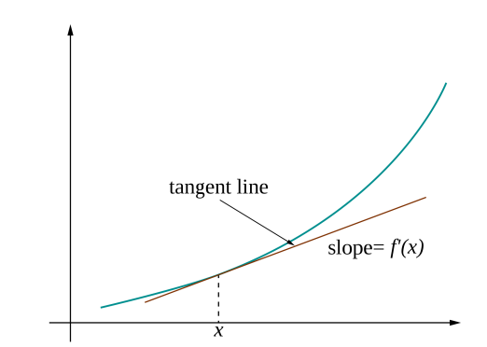
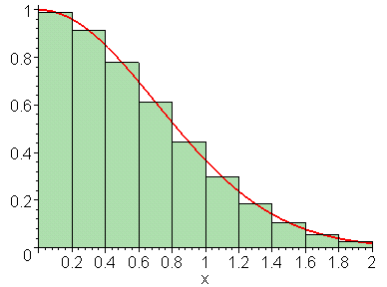
Digital Implementation of PID
So far we have discussed theory behind PID control and run simulation examples
All systems so far have assumed we have access to integral and derivative of error signal
How is this done in practice on a digital system?
  Two issues: Approximating integral and approximating derivative

Slide 10
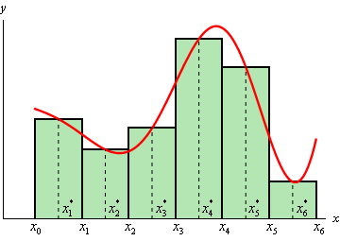
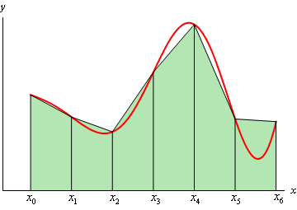
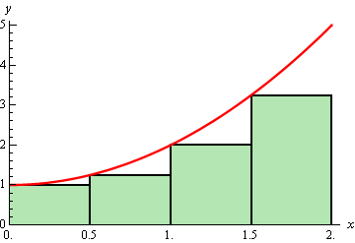
Integral Approximation
Microcontroller computes control signal at discrete instances k = 0, 1, 2,... at an interval of T
Must approximate integral of error signal at each of these discrete times
  Common methods of integral approximation
Midpoint Approximation Method
Trapezoidal Approximation Method
Forward Rectangular Approx. Method

Slide 11
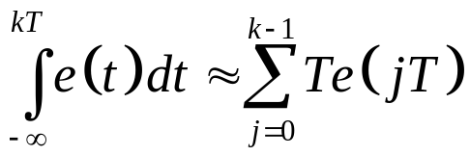
Integral Approximation
In practice, most implementations use forward rectangular method to approximate integral error
  Accurate enough as long as sampling period is relatively small compared to change in signal
e(t)
Exact integral error at time
t = kT
Sum of rectangular areas of height e(jT) and width T
k
1
2
3
4
At each control cycle, error is sampled, multiplied by sampling period, and added to cumulative sum.

Slide 12
Integral Approximation
Example source code for integral computation:
float integral_error = 0.0 ;
float theta_des = 1.0 ;
float timestep = 0.001 ; // 1 KHz control frequency
...
void compute_control(float* state){
// Unpack state vector
float theta = state[0] ; // angular position
float thetadot = state[1] ; // angular speed
// Compute integral error
integral_error = integral_error + timestep*(theta_des – theta) ;
// Compute PID control
...
}

Slide 13
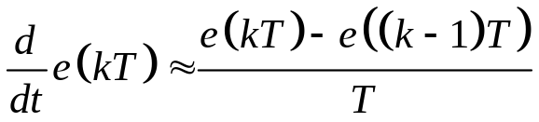
Derivative Approximation
Likewise, we must have a method to approximate the time derivative of the error signal at each discrete control cycle
To do this, we make use of finite difference approximations
  Finite differencing is common method used to approximate time derivative from discrete data
Finite Difference for First Derivative (1st order)
e(t)
Requires that we store previous values of e(t)
k-1
k

Slide 14
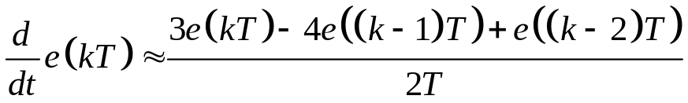
Derivative Approximation
As T → 0, it can be shown that finite difference approximations converge to exact value of derivative
  Thus, for this approximation to be accurate, control update rate must be much faster than change in error signal
  Higher-order finite differencing schemes can be used which allow for (slightly) slower sampling rates
Finite Difference for First Derivative (2nd order)
Requires that we store last 2 previous values of e(t)

Slide 15
Derivative Approximation
Example source code for derivative computation:
float last_error = 0.0 ;
float theta_des = 1.0 ;
float timestep = 0.001 ; // 1 KHz control frequency
...
void compute_control(float* state){
// Unpack state vector
float theta = state[0] ; // angular position
float thetadot = state[1] ; // angular speed
// Compute error
float error = theta_des – theta ;
// Compute derivative
float error_dot = (error – last_error)/timestep ;
// Compute PID control
...
// Store for next control cycle
last_error = error ;
}

Slide 16


Derivative Approximation
CAUTION: Using first-order finite differencing on noisy signals will cause problems!
  Finite differencing actually amplifies noise in signal – i.e., it makes noise problems worse
In case of noisy signals, should first filter error signal using low-pass filter (or similar) to reduce noise content before differentiating
Low-pass filter
Note: Doing this actually changes closed loop dynamics of system and introduces lag
Must be careful since this can cause instability
E(s)
U(s)
R(s)
G_{p}(s)
Y(s)

Slide 17
PID Implementation on MSPM0
PID can be implemented on the MSP432 using all the features we already know:
Features:
  TIMG (interrupt) – used to initiate control cycle
  Analog to Digital Converter (ADC) – used to generate feedback from analog sensors
  Pulse Width Modulation (PWM) – used to generate analog (variable voltage) output signal
  Serial Communication – used to provide information to user on system state

Slide 18

PID Implementation on MSPM0
Consider very simple control problem in which we try to control the temperature of a device by applying a voltage signal
  Assume the device has a first-order response
E(s)
V(s)
T_{des}(s)
G_{p}(s)
T (s)
Input to system is desired temperature
PID controller computes output voltage based on error signal
Plant exhibits first order relationship between input voltage and output temperature

Slide 19
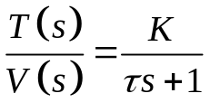

PID Implementation on MSPM0
Implementation on MCU:
MSPM0
V(s)
Plant
PWM Output
(input voltage)
T(s)
ADC Input
(output temperature)
PID loop runs at each Timer A interrupt:
In our example during lecture, plant is simulated by an RC circuit

Slide 20
PID Implementation on MSPM0
Let’s take a look at an example implementation of this PID controller

Slide 21
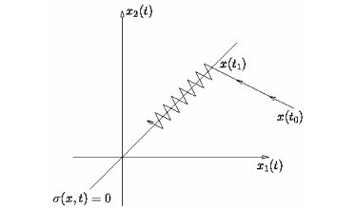
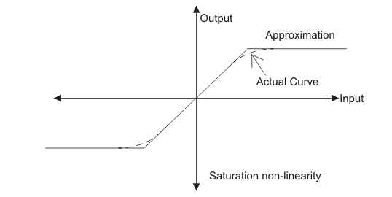
Control Nonlinearities
So far we have discussed control of linear systems
  Most analysis done in the Laplace domain
In practice, many systems we want to control in the real world are nonlinear
  Control inputs subject to saturation
  External forces acting on system are nonlinear functions of state
  System state dynamics are nonlinear

Slide 22
Saturation
In real systems the output of a controller is limited
  Amplifiers may have limited output
  Actuators may have force or torque limits
Consider our previous example of inertia control using a brushed DC motor
Inertia J
Motor can only apply limited torque to inertia, regardless of what controller asks for
How do we determine how much torque the motor can exert? What does this saturation limit depend on?
Torque T
Motor
Damping B

Slide 23
Saturation
Saturation nonlinearity (“saturation function”)
m
Let u be the controller output, and m be the amplifier output (which is sent to plant)
Between u- and u+, amplifier response is linear
Above u+ or below u-, amplifier output saturates at either m_{max} or m_{min}
m_{max}
u-
u+
u
m_{min}
u(s)
m(s)
e(s)
Controller
Amplifier
Plant
y(s)

Slide 24
Saturation
Usually in block diagrams saturation is shown as separate block after control block
  Shows that control signal is put through saturation function before being sent to amplifier/plant
Saturation block
E(s)
U(s)
R(s)
G_{p}(s)
Y(s)

Slide 25
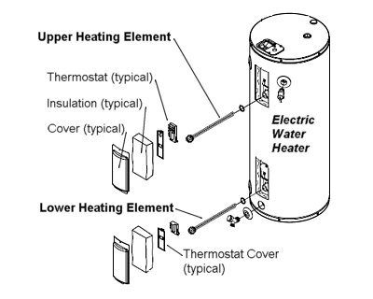
Saturation
Example 1: Heating control system using heating elements to control temperature
  Controller cannot apply negative heat → m_{min} is zero
  Controller can only apply finite amount of heat (limited by max current/voltage → sets m_{max} value
What happens if closed loop control results in overshoot (meaning temperature goes higher than desired value)?
How is controller able to achieve desired output value in this case?

Slide 26
Saturation
Example 2: Motor speed control of inertia. Suppose we can only generate voltage in one direction
  Controller can only produce positive torque → m_{min} is zero
  Controller can only produce limited torque (defined by torque speed curve) → m_{max} value depends on current speed
Inertia J
What happens if closed loop control results in overshoot (meaning motor speed goes higher than desired value)?
How is controller able to achieve desired output value in this case?
Torque T
Motor
Damping B

Slide 27
Saturation
Saturation is a nonlinear effect – means that closed loop system is nonlinear
  Cannot model such a system in Laplace domain anymore
  One practical way to analyze such a system is through simulation
  Analysis may be possible but requires more advanced methods
Saturation effects usually result in:
  Larger overshoot
  Delay in control response
Basically because controller actions become limited compared to ideal case

Slide 28

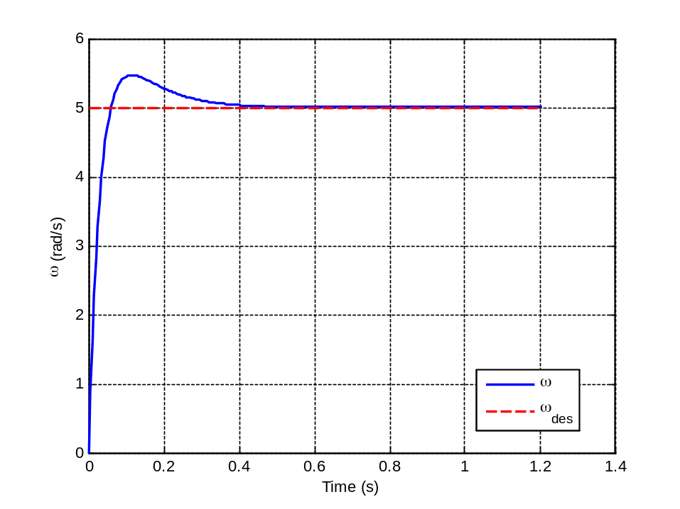
Effects of Saturation
Recall our example from last lecture where we used a PI controller to control the speed of a Pittman 9237 brushed DC motor
PI Control Response with No Saturation Limits
Looks good, right?
Inertia J
Torque T
Motor
K_{p} = 0.5, K_{i} = 1.0
Damping B

Slide 29
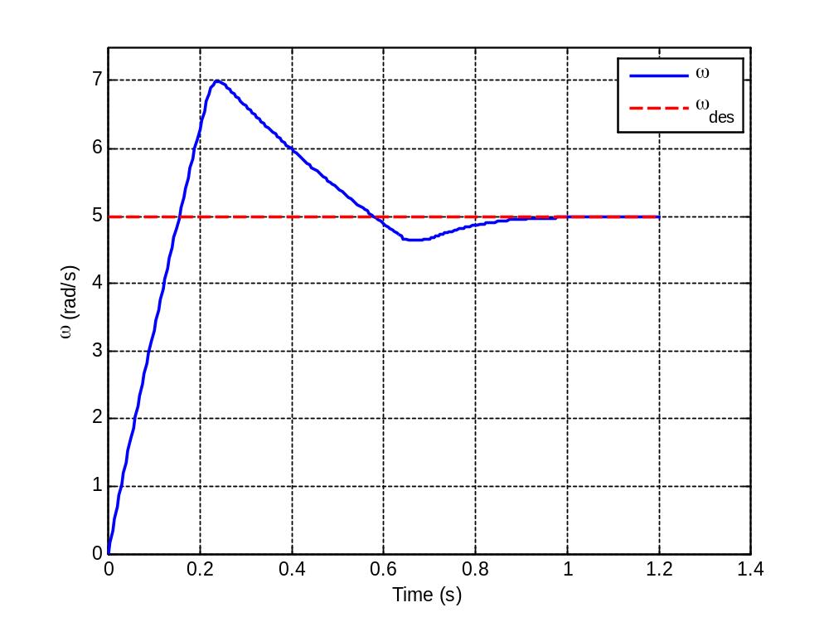
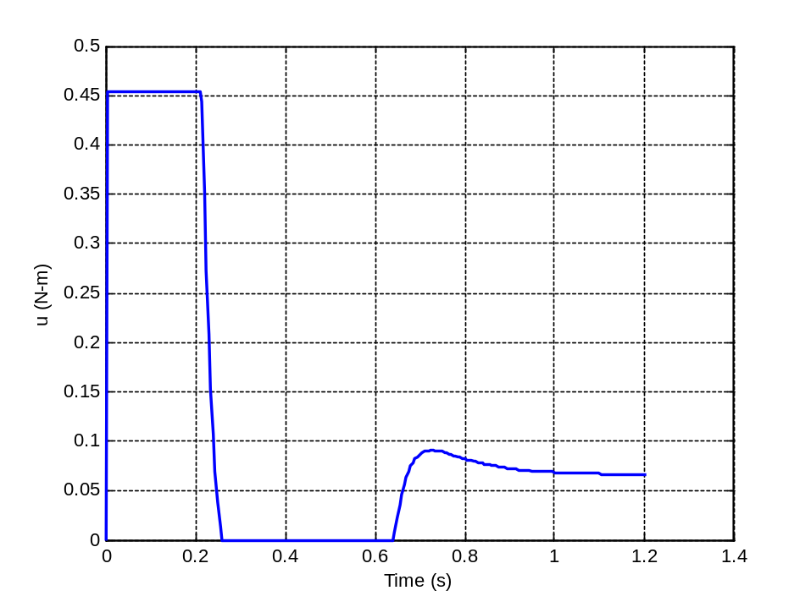
Effects of Saturation
Now let’s enforce two saturation constraints
  Max torque controller can ask for: 0.454 N-m (from datasheet)
  Min torque controller can ask for: 0 N-m
Response exhibits much more overshoot and slower rise time
Controller is in saturation most of the time!

Slide 30
Effects of Saturation
Comparing responses of ideal case and saturation case:
No Saturation Limits (Ideal)
With Saturation Limits (Actual)
Control response is subject to higher overshoot and slower rise time.

Slide 31
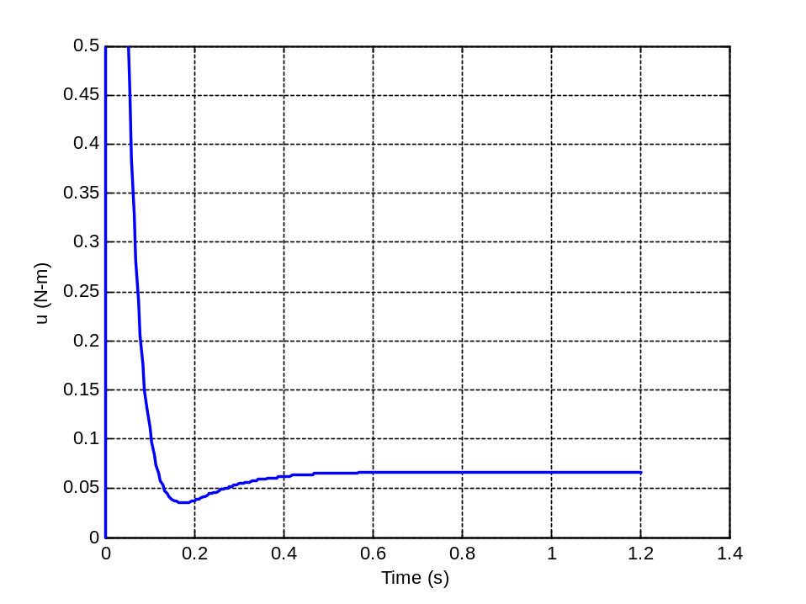
Effects of Saturation
Control inputs for ideal case and saturation case:
No Saturation Limits (Ideal)
With Saturation Limits (Actual)
Motor max starting torque
Ideal case asks for much more initial torque than motor can provide. Thus simulated response is not physically correct.

Slide 32
Integrator Windup
Let’s analyze the saturation case a little more closely
Control action is made up of sum of proportional component and integral component (PI control)
Initially, the control output is saturated due to proportional control only
With K_{p} = 0.5 and max torque of ~0.45 N-m, proportional control saturates torque value anytime speed error is > 0.9 rad/s
This is the case during first 120 ms of control. During this time, integral error is building up, but having no impact on control since it is already saturated.

Slide 33
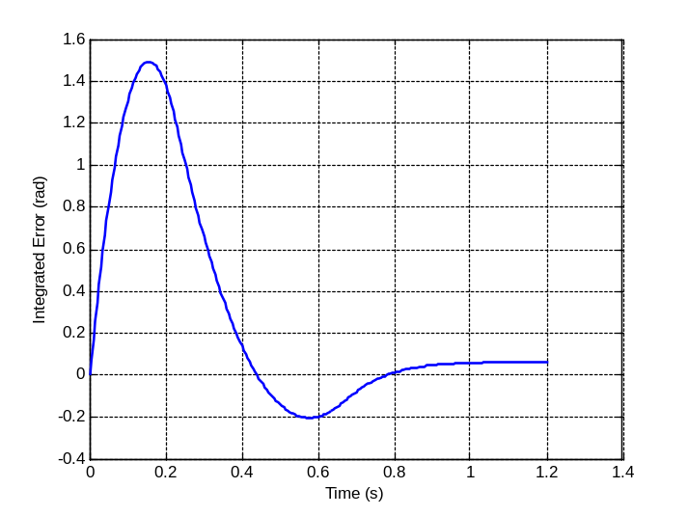
Integrator Windup
Let’s analyze the saturation case a little more closely
This can be seen more clearly in the integrated error plot below
Proportional control saturates control outputs until ~0.12 sec
P control causing saturation
During this time, integral error continues to build but has no impact on control since it is already saturated from P
This is known as integrator windup

Slide 34
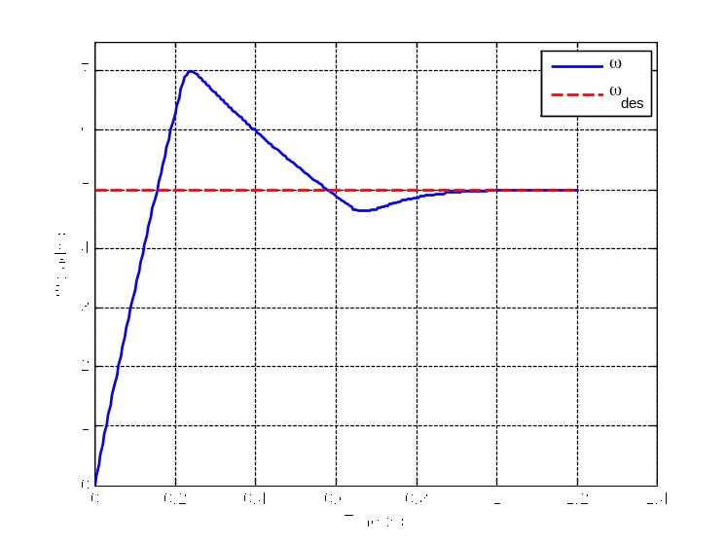
Integrator Windup
The problem with windup is that it causes error to overshoot for longer than needed
  Integral control keeps overshoot from decreasing because it is trying to regulate integrated error to zero
Integrated error during initial speed increase is shown in green region
After overshoot, integral controller tries to ensure that speed stays above ω_{des} for long enough for orange region to cancel with green region
This is not desired behavior – it ends up prolonging overshoot longer than necessary

Slide 35
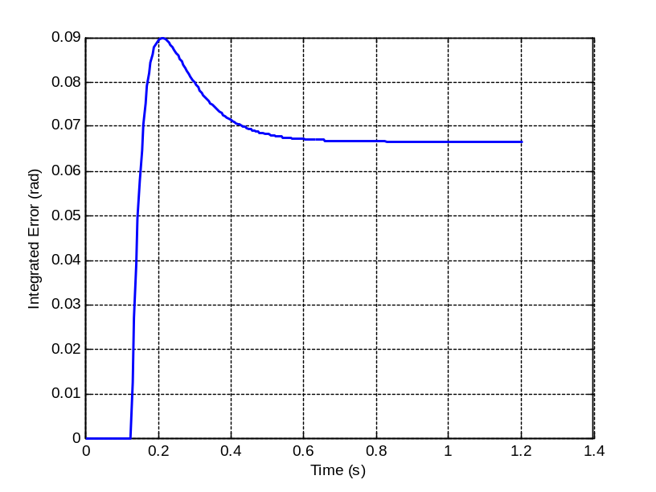
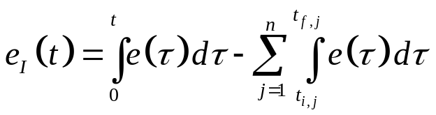

Integrator Windup
Several anti-windup methods have been developed to solve this issue
Clamping Method:
  Error integration is paused whenever control input is saturated and integrator control output has same sign as error
Mathematical description:
where intervals [t_{i,j}, t_{f,j}] are when:
u > u_{max} or u < u_{min}
and
Clamping invoked at beginning of trajectory when control saturated

Slide 36
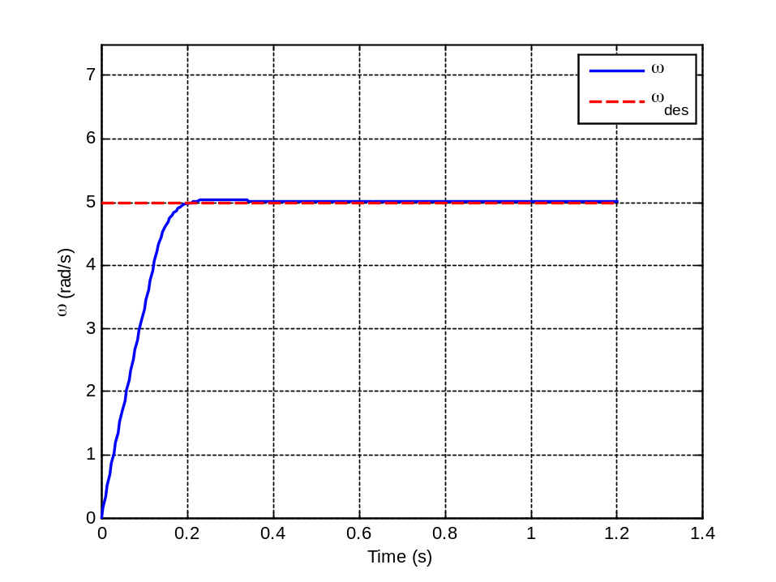
Integrator Windup
Let’s apply clamping method to our PI control problem with input saturation
  And compare with case with no anti-windup routine
No Anti-Windup
With Clamping Anti-Windup
Much better!

Slide 37

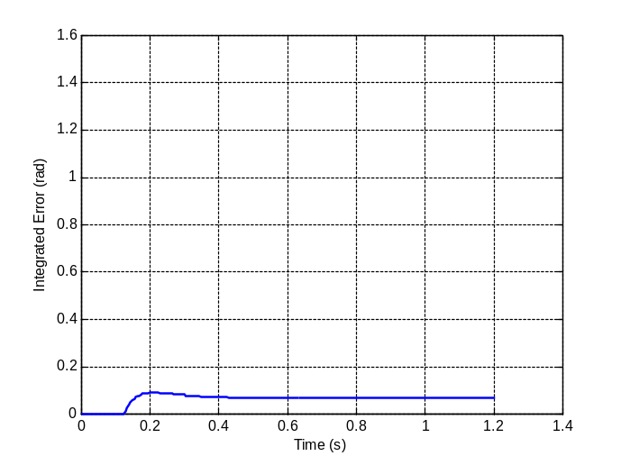
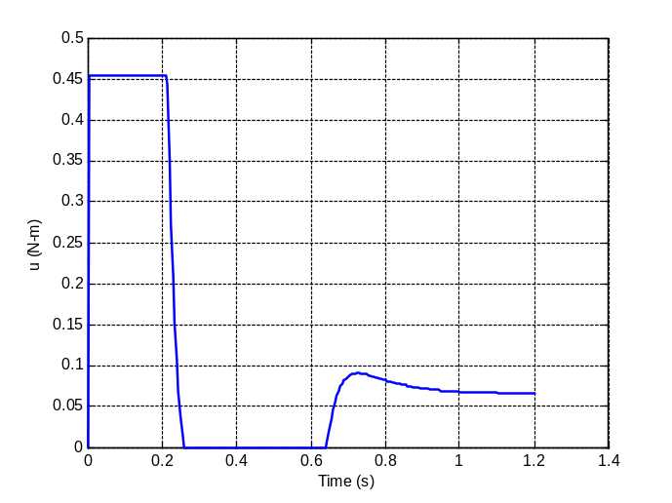
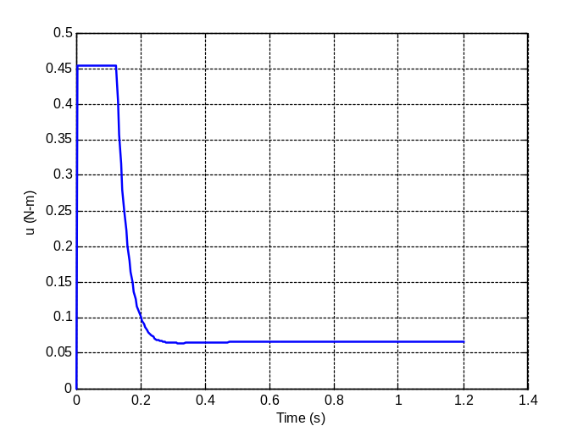
Integrator Windup
No Anti-Windup
With Clamping Anti-Windup
Including anti-windup drastically reduces integrated error throughout trajectory
Control inputs are saturated for much less time (this is a good thing) when anti-windup is included.

Slide 38
Integrator Windup
Example code that implements clamping anti-windup routine:
void compute_control(float* state){
...
// Compute control
u = Kp*error + Kd*error_dot + Ki*int_error ;
// Clamping anti-windup: If control is saturated and error is same sign as // integrated error, leave integrated error unchanged.
if(((u > umax) || (u < umin)) && (sign(error) == sign(int_error))){
integral_error = integral_error ; // Clamp error
}
else{
integral_error = integral_error + timestep*error ; // Update integral error
}
}

Slide 39
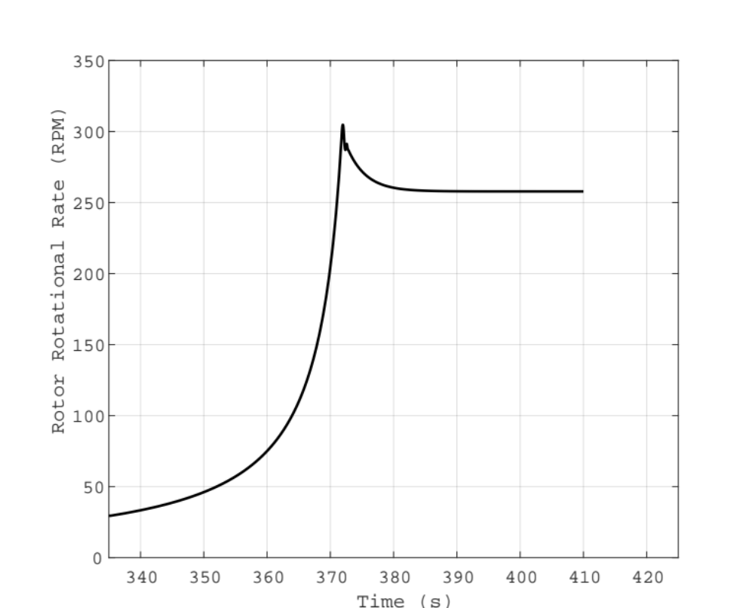
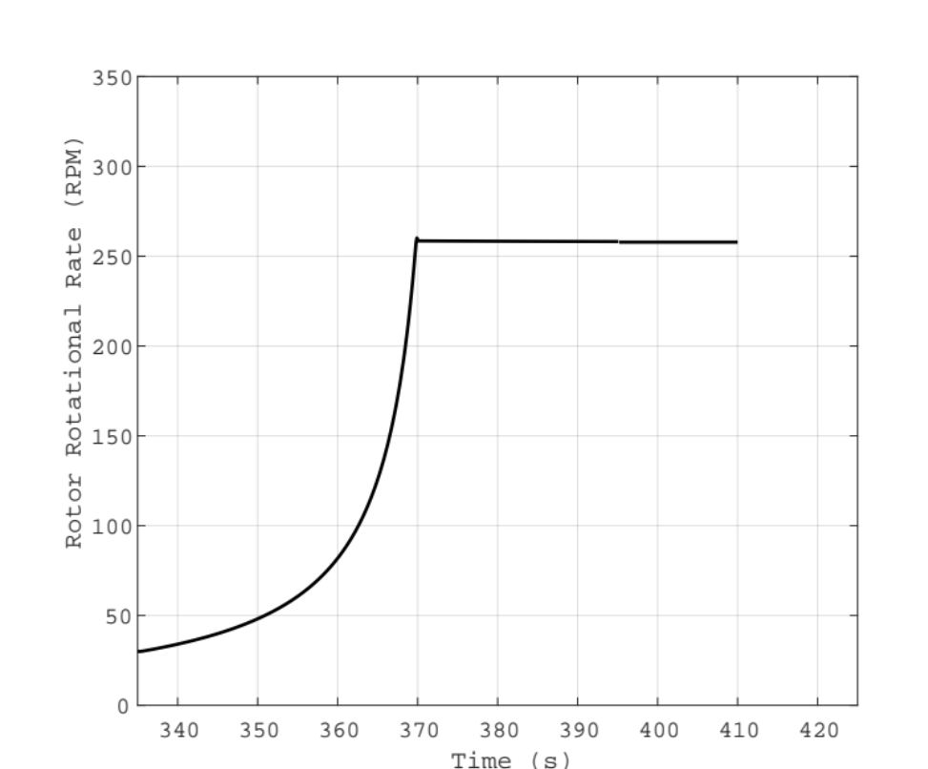
Integrator Windup – Real-World Example
Rotor start for UH-60 Blackhawk helicopter
  Torque control used to maintain speed setpoint
Without Windup Guard
With Windup Guard

Slide 40
Conclusions: Saturation and Windup
Major takeaways from this discussion:
  All physical systems are subject to some saturation constraints. Ignoring these during control design may lead to bad control performance or instability

Slide 41
Conclusions: Saturation and Windup
Major takeaways from this discussion:
  All physical systems are subject to some saturation constraints. Ignoring these during control design may lead to bad control performance or instability
  When simulating systems, should be sure to include saturation constraints in simulation during control design

Slide 42
Conclusions: Saturation and Windup
Major takeaways from this discussion:
  All physical systems are subject to some saturation constraints. Ignoring these during control design may lead to bad control performance or instability
  When simulating systems, should be sure to include saturation constraints in simulation during control design
  Implementing an effective anti-windup routine can greatly enhance performance when system is subject to saturation constraints. You should include anti-windup when implementing PID in practice.

Slide 43
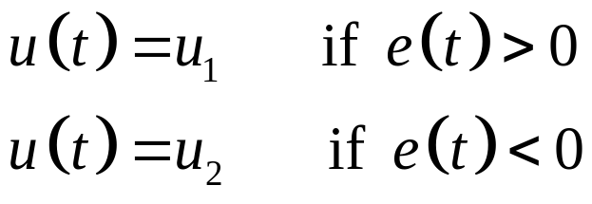
On-Off Control
While PID is popular (and relatively simple) control scheme, it does require an analog control signal
  Usually generated from MCU via PWM
A simpler control law that can be implemented just with digital I/O is on-off control
  Two position control – depends on sign of error
On-Off Control Algorithm
Also called a “bang bang” controller
u₁, u₂ are constants. Usually u₂ = 0 or u₂ = -u₁.

Slide 44
On-Off Control
On-off control (also known as bang bang or flip-flop control) is a nonlinear control algorithm
  Output is not proportional to error, it is fixed to one of two values
Therefore we cannot obtain the closed-loop transfer function for such a system and analyze it like we did for PID
Analysis tools for nonlinear controllers exist, but in general simulation is used to characterize performance

Slide 45
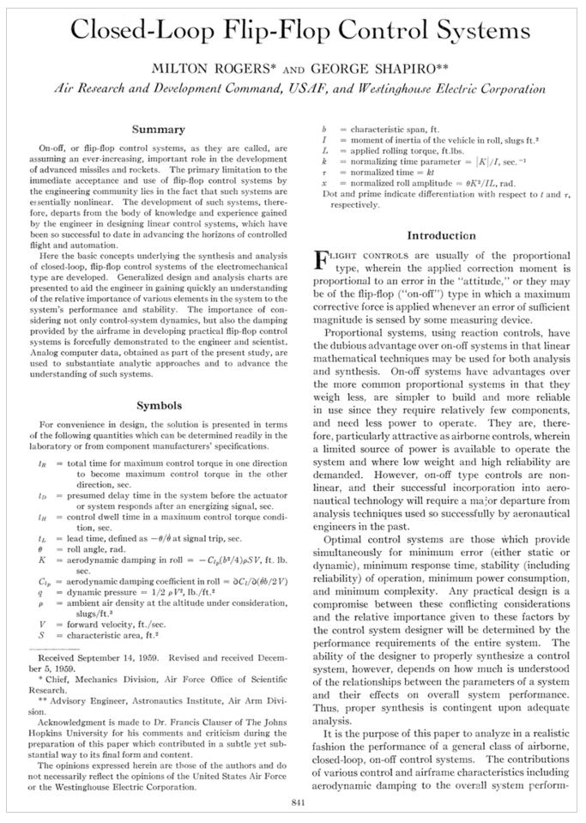
On-Off Control
Journal paper from 1960 that established analysis tools for on-off controllers.
(Written by my grandfather)

Slide 46
On-Off Control
Let’s implement an on-off controller for our motor to perform speed control
On-Off control block
E(s)
u₁
U(s)
R(s)
G_{p}(s)
Y(s)
u₂
Inertia J
For motor control, set:
u₂ = 0 u₁ = 1 N-m
Torque T
Motor
Damping B

Slide 47
On-Off Control Implementation
Implementing this on MCU is easy!
  Just connect digital I/O pin to gate of MOSFET
  No PWM needed – we either apply 0V or +V_{dd} to motor
  We can only apply torque in one direction though – to slow motor down we will have to rely on damping and back EMF
Motor
D
+V_{dd}
MSP432
3.3V
G
P1.5
S

Slide 48
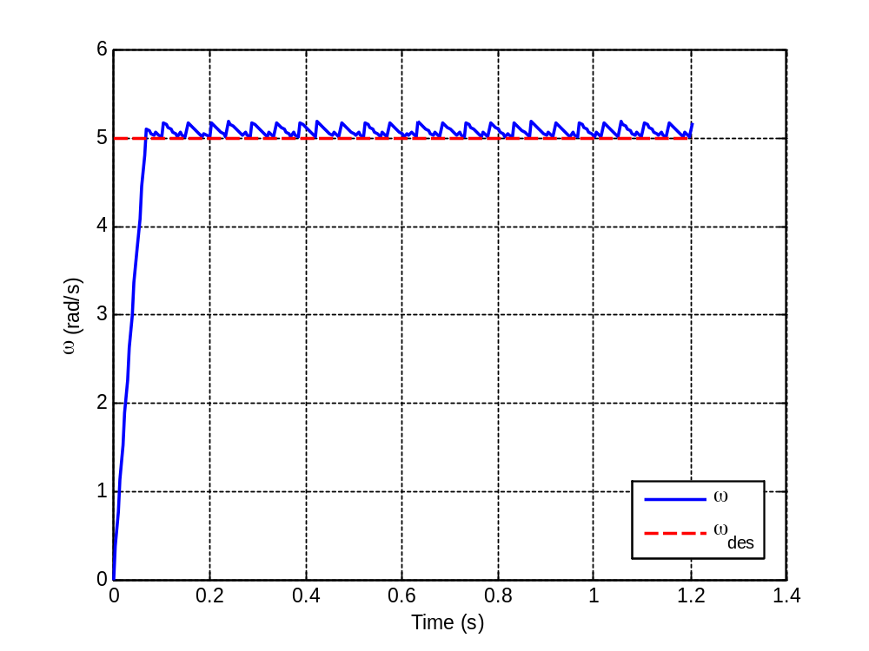
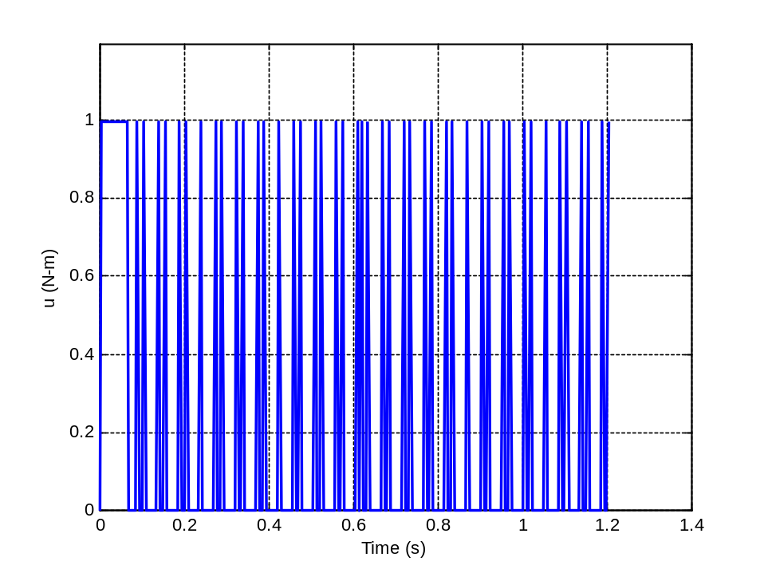
On-Off Control Simulation Results
Simulating this system with ω_{des} = 5 rad/s
Note control “chattering” in system response. This is typical of on-off controllers.

Slide 49
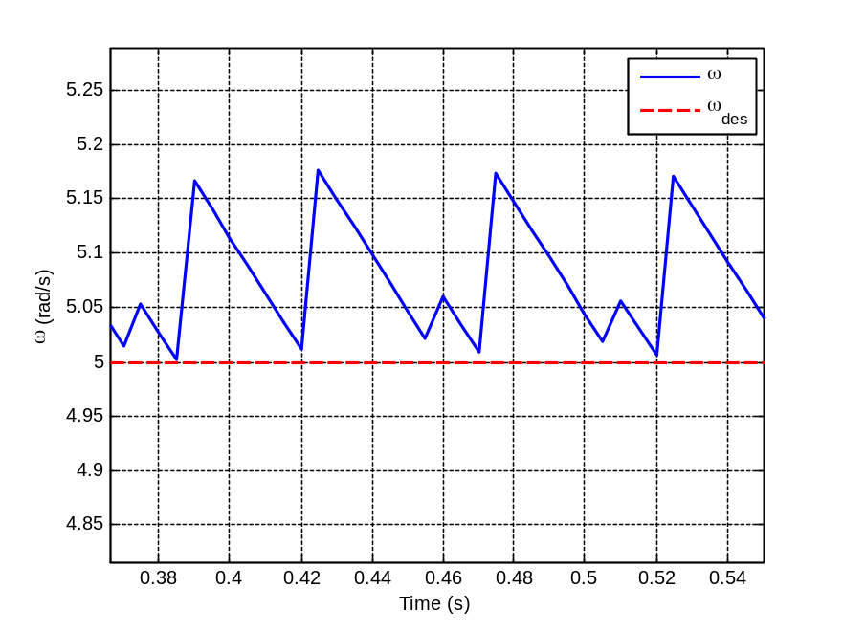
On-Off Control Simulation Results
Analyzing the response more closely:
When error goes slightly negative, “on” torque is given which causes fast increase in speed
Error becomes negative again and control is set to zero
Since controller can’t exert negative torque, it must wait for system to slow down to decrease error
This is why decreases in speed take longer than increases in speed. This is typical behavior for controller that can only give input in one direction.

Slide 50
On-Off Control – Differential Gap
Chattering can be very taxing on actuators and may reduce useful life of components
To mitigate this, a differential gap is usually introduced
  Differential gap is how far error signal must move before switching occurs
On-Off block with differential gap
E(s)
u₁
U(s)
R(s)
G_{p}(s)
Y(s)
u₂

Slide 51
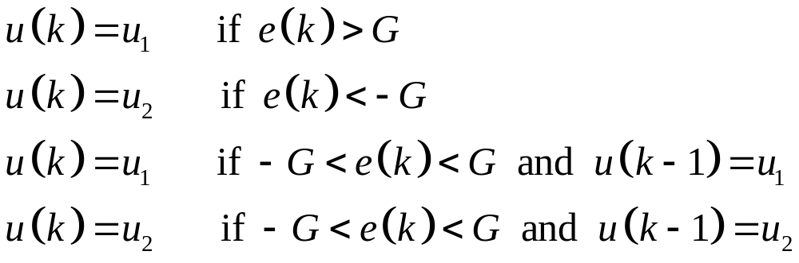
On-Off Control – Differential Gap
On-off control algorithm using differential gap:
If error is within +/- G of zero, hold control constant until is crosses either +G or –G threshold.
where G is differential gap (usually small) and k denotes control timestep (k = 1, 2, 3, ...)
What effect do you think this differential gap will have on the response, and why?

Slide 52
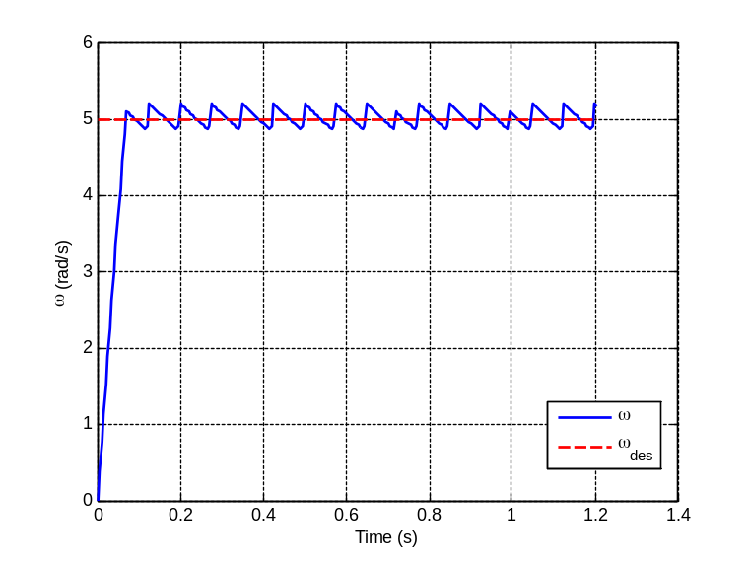
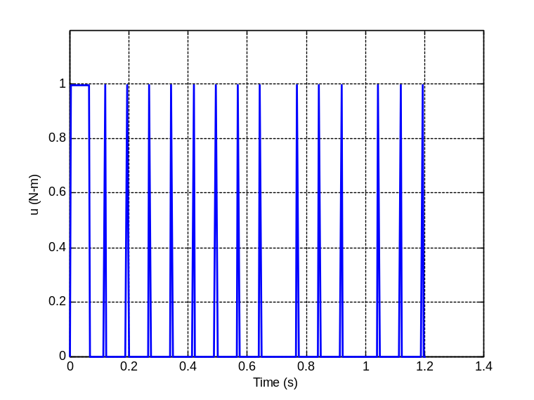
Differential Gap – Simulation Results
G = 0 (no gap)
G = 0.15
By introducing gap, we make oscillations about ω_{des} larger, but lower in frequency
Gap reduces the amount of on-off switching that occurs (good for actuator life) at expense of larger amplitude oscillations in the response.

Slide 53

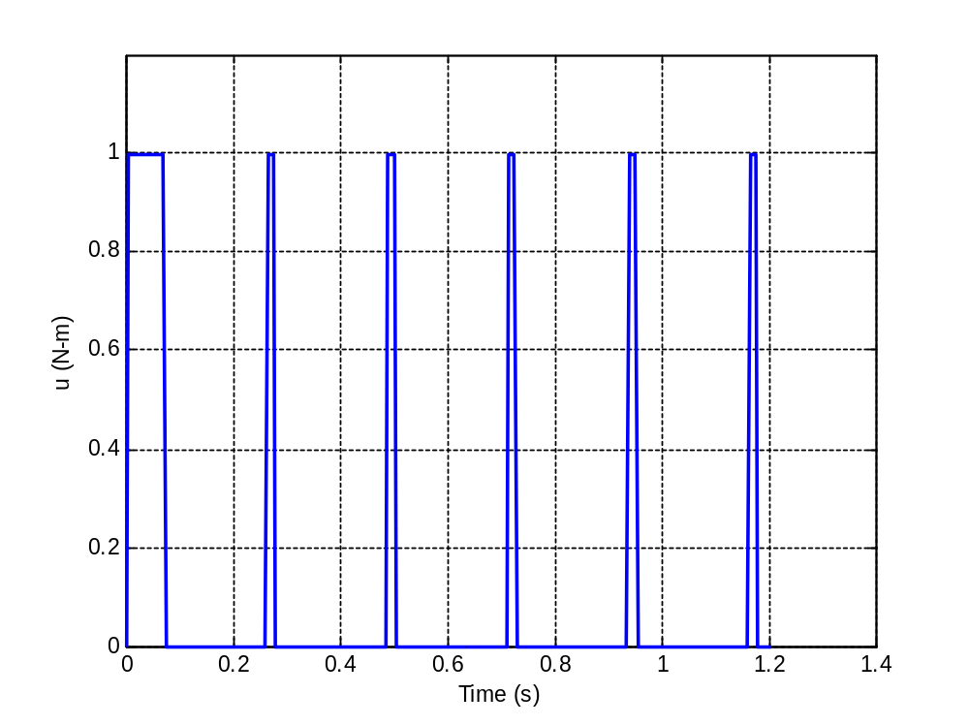
Differential Gap – Simulation Results
Increasing gap even further to G = 0.5 reinforces trends seen in previous slides

Slide 54
Differential Gap – Implementation
Example code implementing on-off control with differential gap
float u = 0 ;
void compute_control(float* state){
float gap = 0.15 ;
...
// Compute error
error = wdes - w ;
// On-off control
if( error > gap ){
u = 1 ; // On
}else if( error < gap ){
u = 0 ; // Off
}else if( (error > -gap) && (error < gap)){
if(u == 1){
u = 1 ; // On
}else{
u = 0 ; // Off
}
}
}

Slide 55
On-Off Control – Conclusions
On-off control is used widely for many appliances and industrial machines
Easy to implement and can be controlled using simple actuator (usually solenoid or similar)
Differential gap should be used to mitigate problems with rapid switching
  Size of differential gap depends on accuracy requirements, component lifetime, and possibly other factors

