Slide 1
Lecture 23: Modeling and Simulation of Dynamic Systems
ME/AE 6705
Introduction to Mechatronics
Dr. Jonathan Rogers

Slide 2
Lesson Objectives
Be able to implement basic simulation models for simple mechatronic systems
Be able to use modeling and simulation to facilitate and inform control design
Be able to implement simple simulation models in Matlab and/or Simulink
Become familiar with basic system identification methods

Slide 3
Modeling and Simulation: Motivation
Modeling and Simulation (M&S) is necessary part of mechatronics system design
M&S assists in system design process by characterizing how performance changes as different components are used
Engineering Problem
Design Concept
High Risk Path
Build and Test
Final Design
Mechatronics
Low risk path
Engineering Tools
Mathematics
Control Theory
Heat Transfer
Fluid Dynamics
Mechanics
Dynamics
Model, Analyze, and Verify
Learn about system
M&S assists in control design process by predicting closed-loop performance of the system (facilitates gain tuning, etc.).
Course work

Slide 4
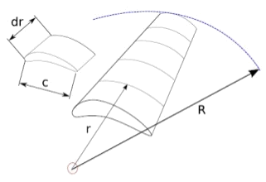
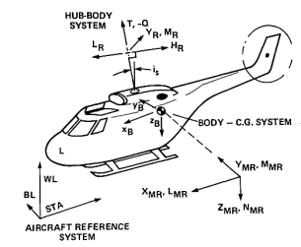

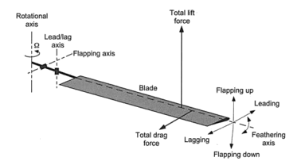
Modeling and Simulation: Motivation
Ability to both model a system, and actually construct it, is very powerful skill
  Very unique among engineers – most cannot do both
Many companies that build complex systems have entire groups dedicated to M&S
  It is becoming increasingly important skill set to have as an engineer as systems become more complicated and expensive

Slide 5


Overview of a Simulation Model
Almost all simulation models have the same basic structure
Initial Conditions
System Parameters
Equations of motion are numerically integrated forward in time from an initial condition.
Equations of Motion
Controller
Numerical Integration
Why do you think we use numerical vs analytical integration?
State Time History

Slide 6
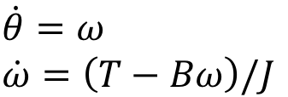
Equations of Motion
Any mechatronic system whose state changes with time can be modeled as a dynamic system
Behavior can be described by ordinary differential equations
Example: Motor-driven inertia
What are states of this system?
Inertia J
Equations of Motion
What is control variable?
Torque T
How many degrees of freedom does this system have?
Motor
Damping B

Slide 7
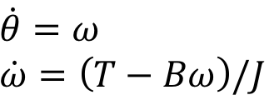

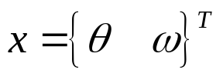

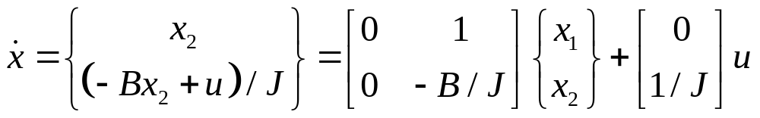

Equations of Motion
Example: Motor-driven inertia
Inertia J
Equations of Motion
Control Law
Torque T
Motor
(h can be PID or other control law)
Damping B
State space representation of system (linear)

Slide 8


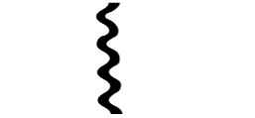
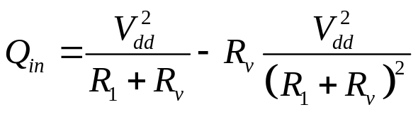
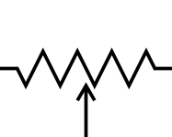
Equations of Motion
Example: Thermal heating system
Equation of Motion
R₁
where
R_{v}
What are states of this system?
What is control variable?
-
+
How many degrees of freedom does this system have?
What order system is this?
V_{dd}
(potentiometer)
R_{T} and C are thermal resistance and capacitance of system.

Slide 9


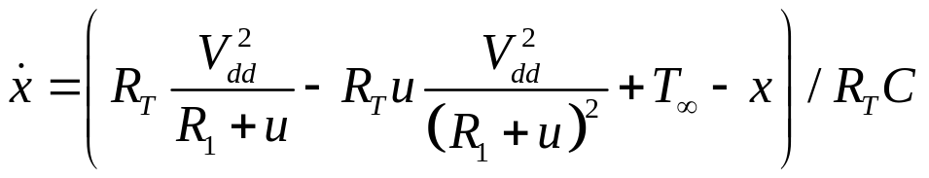

Equations of Motion
Example: Thermal heating system
Equation of Motion
R₁
where
R_{v}
-
Define:
+
V_{dd}
Cannot write in matrix-vector form since system is nonlinear in u.

Slide 10
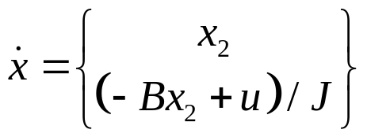
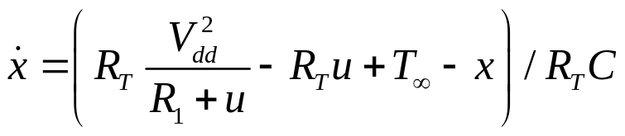


System Parameters
System parameters are values in your equations of motion which are neither states nor controls
  Usually, but not always, constant with respect to time
System parameters describe the physical quantities of your system
  Same model can be used for multiple devices just by switching out system parameters
System parameters (B, J)
System parameters (R_{T}, R₁, C)

Slide 11
Dynamic Equations – Summary
Dynamic equations are usually derived from physical laws
  Rigid body dynamics (Newton’s Law, Euler’s equation, etc)
  Thermodynamics (Fourier’s Law, Heat equation, etc)
  Fluid dynamics (Bernoulli’s equation, Euler’s equation, etc)
  Etc...
Sometimes dynamic equations are derived strictly from experimental data
  “Black box” approach, sometimes called System ID models
  Do not derive these models from physical laws, but rather fit them to data

Slide 12
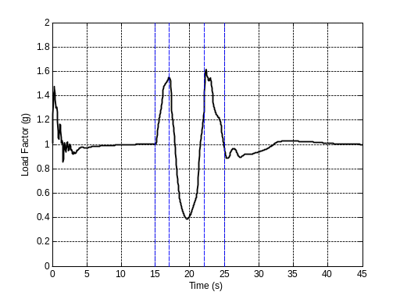
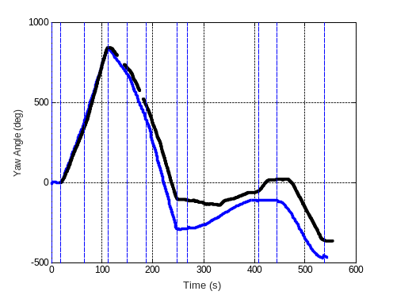
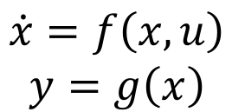
Numerical Integration
We would like to solve equations of motion to obtain time history of system states
  For instance, to evaluate control response to certain input
We do this numerically using an appropriate numerical integration routine

Slide 13
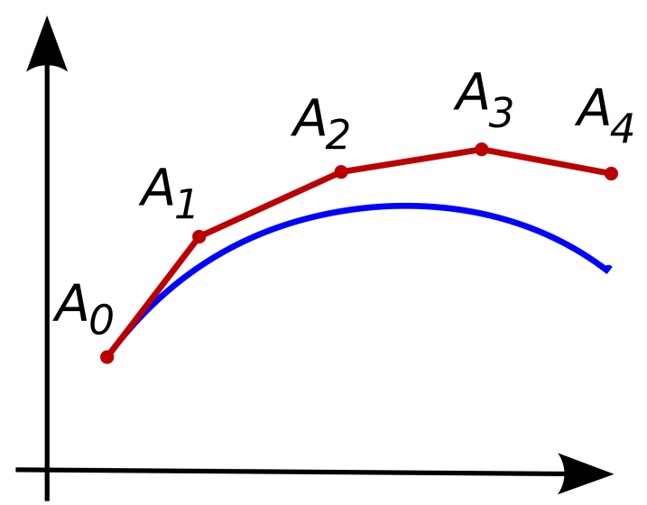


Numerical Integration – Euler
Euler integration
  At each simulation timestep, compute derivative
  Process then repeats for k = 1,...T to obtain time history of x
Derivative at timestep k
State at timestep k+1 (depends on state at time k)
where Δt is simulation timestep
Euler integration is 1st order accurate in Δt. What is the problem with using this scheme is practice?

Slide 14
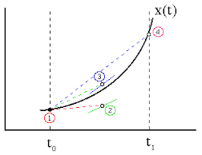




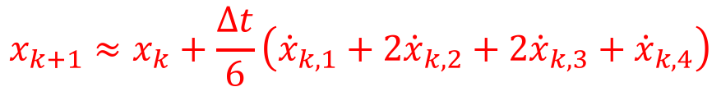
Numerical Integration – RK4
Runge-Kutta 4th Order Integration (RK4)
  At each simulation timestep, compute multiple derivatives
RK4 is 4th order accurate in Δt. It is considered the de facto standard in M&S community.

Slide 15
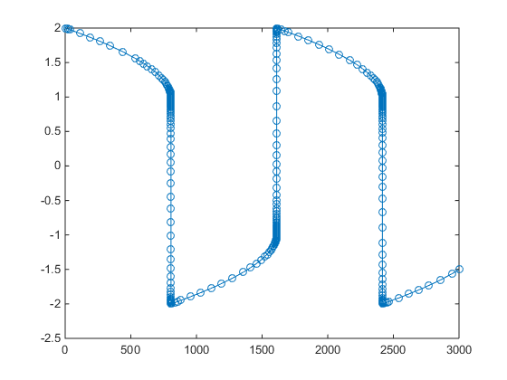
Numerical Integration – Variable Timestep
Variable timestep integrators were created to speed up simulations
  Adaptively increase timestep when dynamics are “slow”, reduce timestep when dynamics are “fast”
Basic Idea
At each timestep, 4th order integration performed
Also, 5th order integration performed
Results are compared. If error between them is low, timestep is increased.
If error is very high, timestep is decreased.
MATLAB’s ode45 is widely used variable timestep integrator.

Slide 16
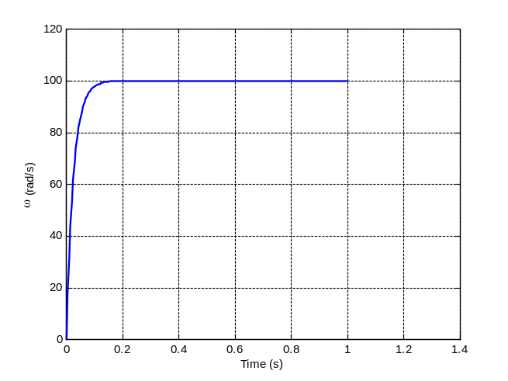
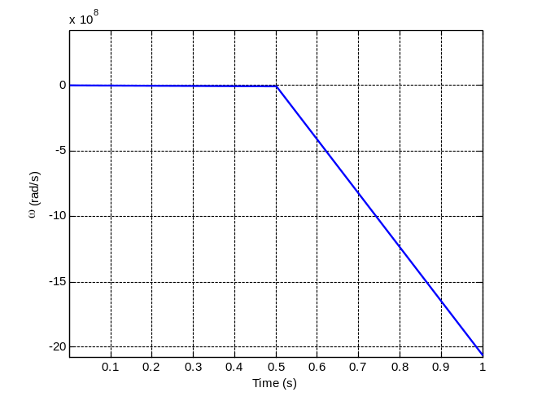
Numerical Integration – Choosing the Timestep
Choosing your timestep can make a huge difference in the outcome of your simulation
  Too small – simulation will take forever to run
  Too big – system may go unstable or results may be inaccurate
Trial and error usually used to find acceptable timestep
Simulation with appropriate timestep (well behaved)
Simulation with timestep that is too large (unstable)

Slide 17





Simulation Model Structure
Structure of simulation model that uses RK4 numerical integration
Initial Conditions
System Parameters
Controller
Main function
while(...){
rk4(state) ;
record_state(state);
}
Derivative Function
RK4 Function
State Time History

Slide 18
Implementing Control Algorithms
Controller in simulation is just a function
  Input: State (and maybe other values)
  Output: Control value
Oftentimes we want controller to run at different update rate than our timestep provides
Example:
To simulate motor-driven inertia you may use step size of Δt = 0.001 sec (1 kHz sim update rate)
Controller implemented on MCU only updates once every 0.1 sec (10 Hz controller update rate)
If control is updated every timestep, performance in simulation will not match what actually happens in reality!
Torque T
Motor

Slide 19
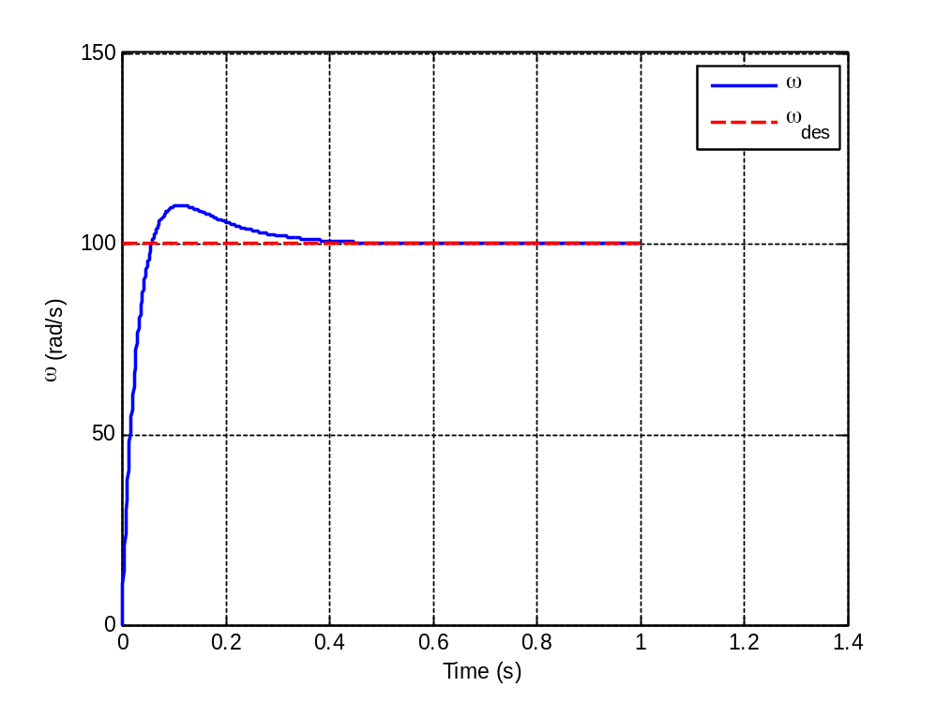
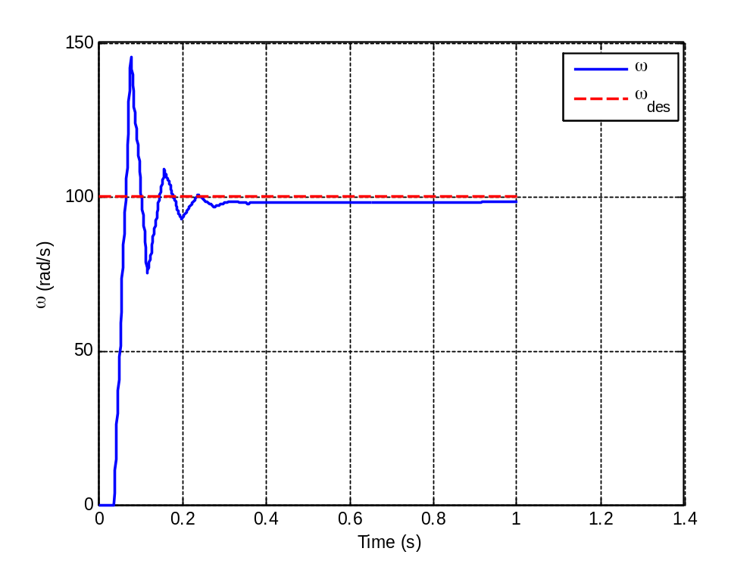
Implementing Control Algorithms
As an example, consider PI control of a motor
  Simulate using timestep of 0.001 sec (1 kHz)
Response with control update rate 1 kHz
Response with control update rate 25 Hz

Slide 20
Implementing Control Algorithms
In our simulation, we use the modulus function to skip timesteps between control updates
  Control inputs are held constant during that period
int main(){
int counter = 0 ;
double u ;
double x[2] ;
double timestep = 0.001 ; // Update simulation at 1000 Hz
int skip_param = 100 ; // Update controller 100 times slower than sim
while(time < 10){
if(counter % skip_param == 0){ // % is modulus operator
u = updateControl(x) ; // u only updated every skip_param timesteps
}
RK4(x, u) ; // Increment state vector
time = time + timestep ;
counter++ ;
}
}

Slide 21
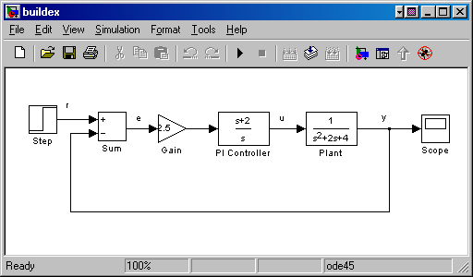

Simulink
Many tools are available for modeling dynamic systems
One common tool is Simulink (part of Matlab)
  Strengths:
    Graphical programming language
    Huge number of pre-made “blocks” / functions
    Seamless integration with Matlab
  Weaknesses:
    Can be difficult to add custom functionality
    Complex systems may be very difficult or tedious to model

Slide 22
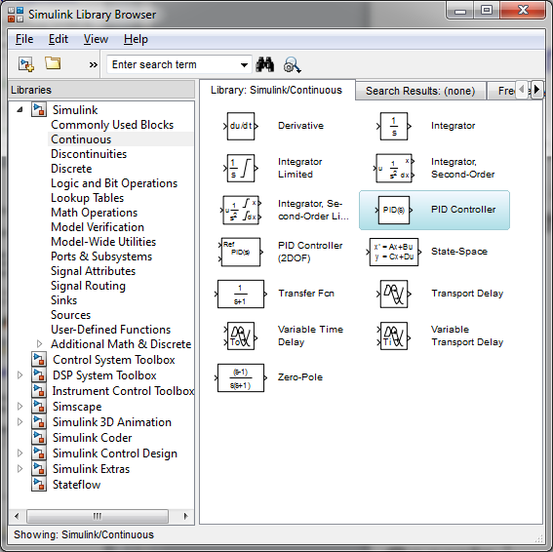
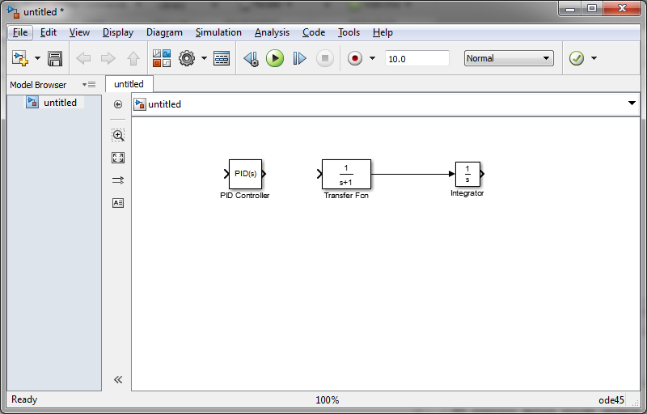
Constructing a Simulink Model
Simulink models are constructed as block diagrams
  Drag and drop function blocks, and connect them together

Slide 23
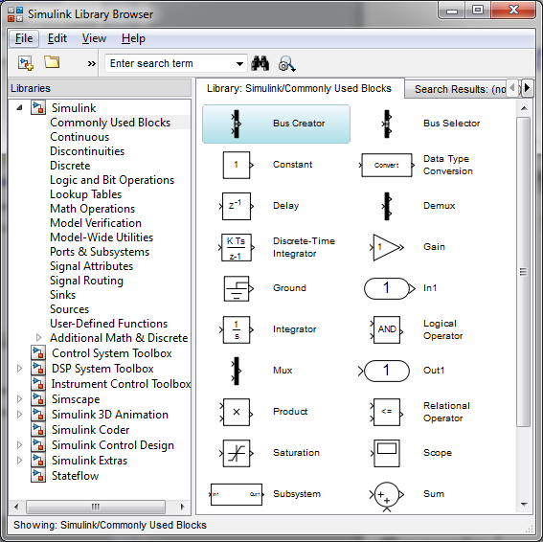
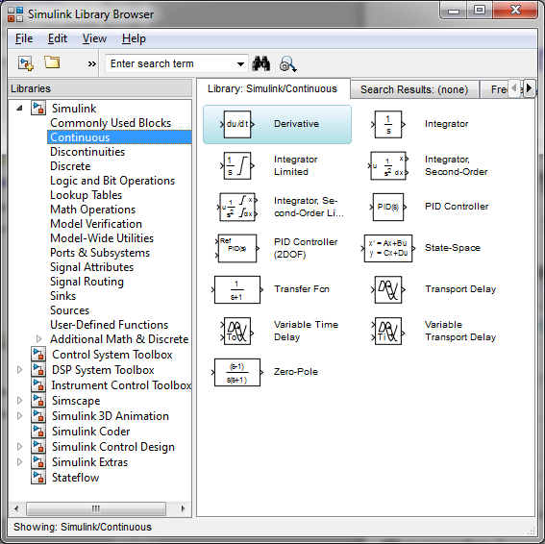
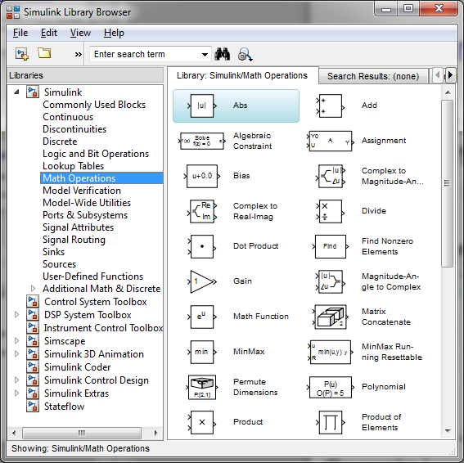
Constructing a Simulink Model
Simulink has a huge number of pre-constructed blocks/functions
  Rare that you need to write your own

Slide 24


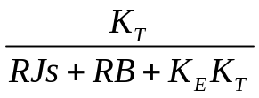
Constructing a Simulink Model
To create model of a dynamic system, just drag and drop components and connect them together
Simulink takes care of numerical integration for you
  Simply press the “run” button and Simulink integrates model forward in time
Let’s take a look at a Simulink model of a motor-controlled inertia with PI speed control
V_{e}(s)
V_{c}(s)
V_{in}(s)
ω_{desired}(s)
ω(s)

Slide 25
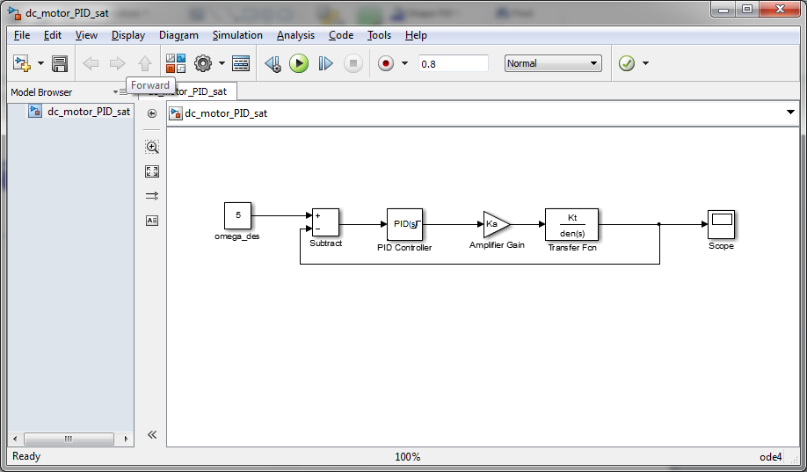
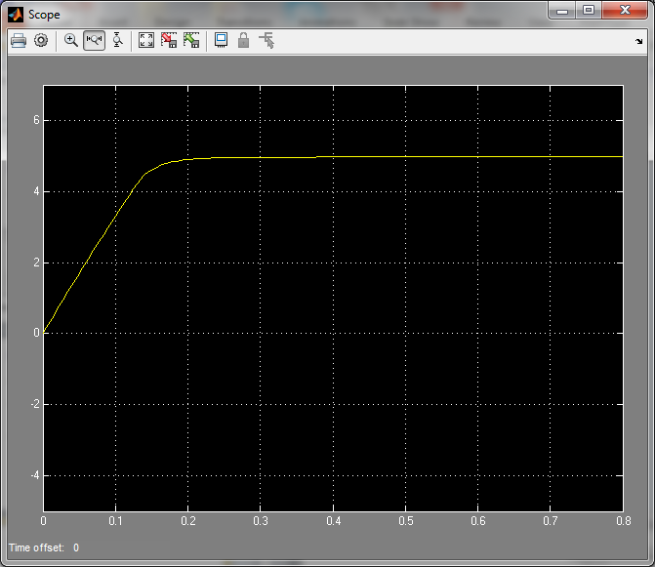
Simulink Model: Example 1
Block diagram of motor-inertia with PI control
Saturation selected in parameters of PID block

Slide 26
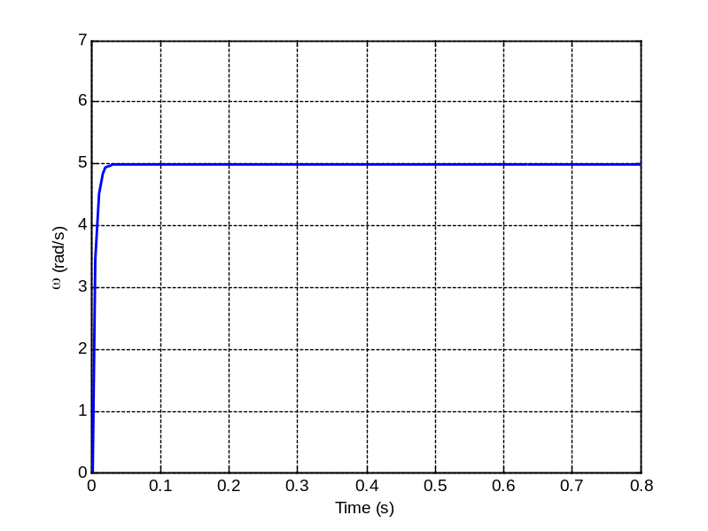
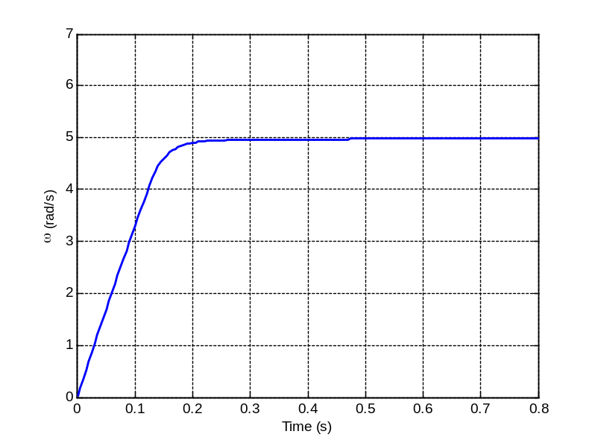
Simulink Model: Example 1
System and controller parameters are set in options for each block
  These can be either entered as parameters in block, or tied to variables in Matlab workspace
Output with and without saturation activated:
Without saturation
With saturation

Slide 27
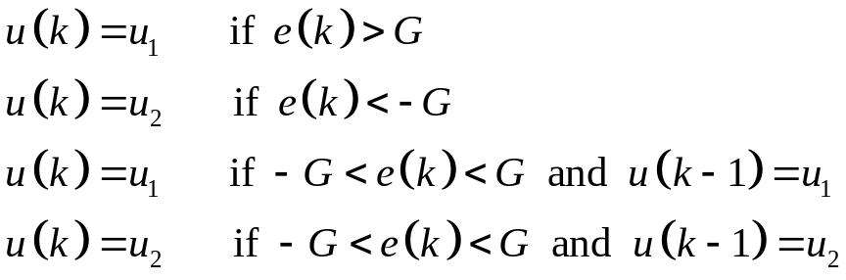
Simulink Model: Example 2
Let’s look at another example where we use on-off control to regulate the speed of a motor-driven inertia
V_{e}(s)
u₁
V_{c}(s)
V_{in}(s)
ω_{desired}(s)
ω(s)
u₂
Recall – we use the “differential gap” G to mitigate the switching behavior seen with on-off controllers.

Slide 28
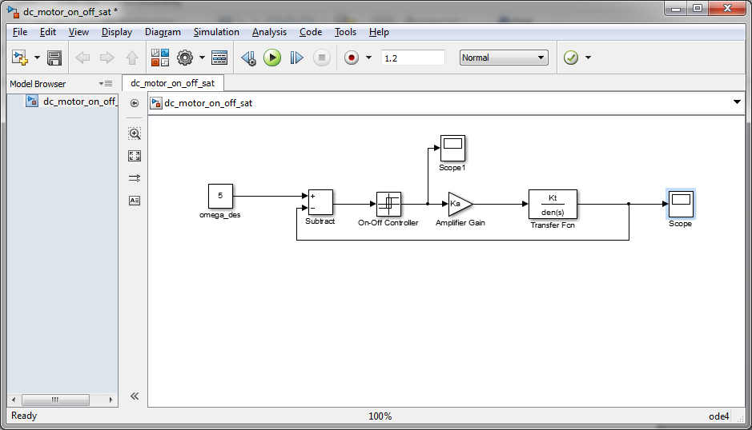
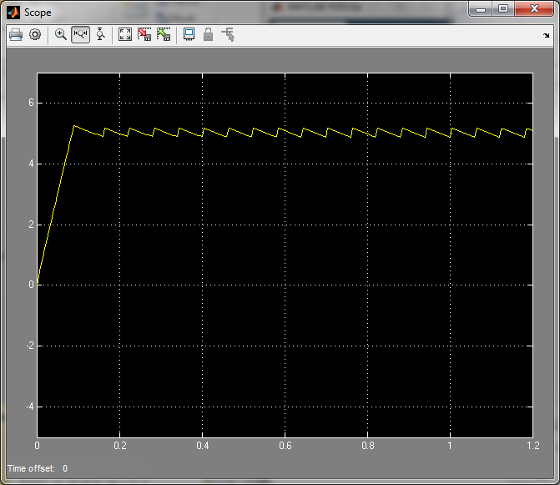
Simulink Model: Example 2

Slide 29
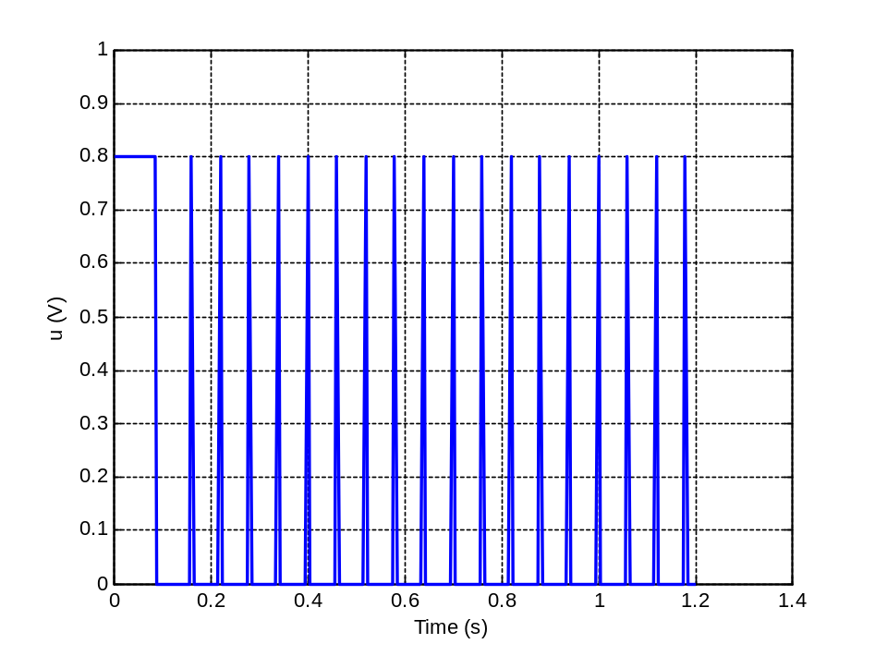
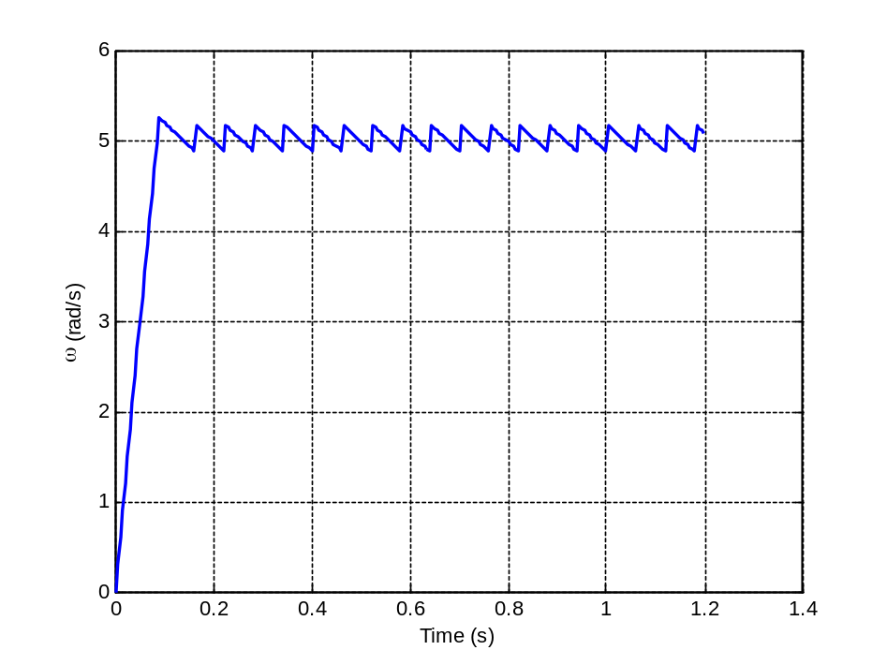
Simulink Model: Example 2
Let’s use this Simulink model to determine what differential gap size should be
  We desire on-off switching to occur at less than 5 Hz
G = 0.1

Slide 30
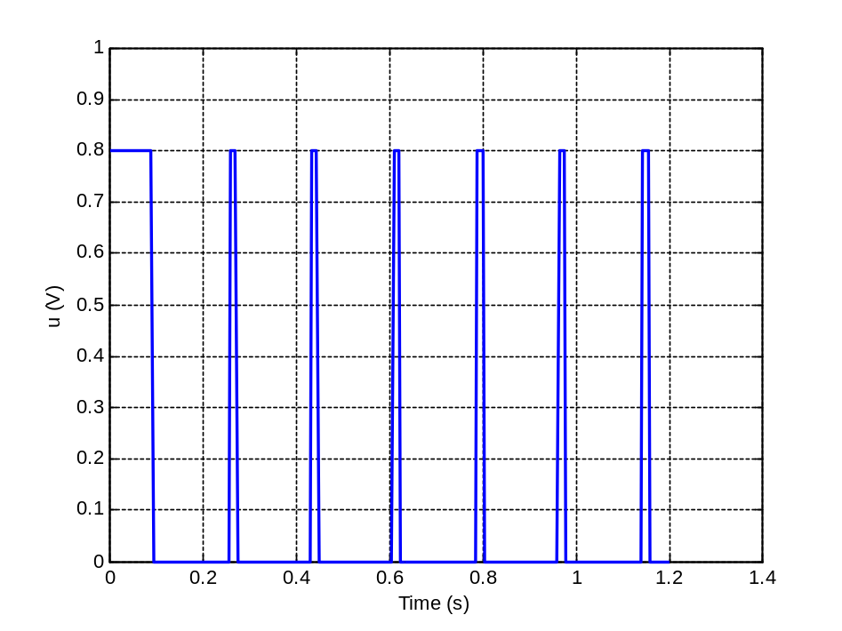
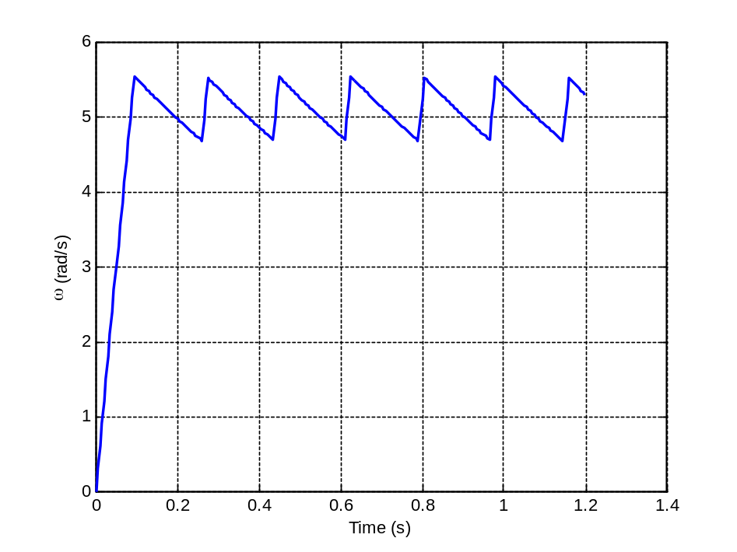
Simulink Model: Example 2
Setting G = 0.25
We are closer to our < 5 Hz goal, but switching behavior is still slightly above 5 Hz.

Slide 31
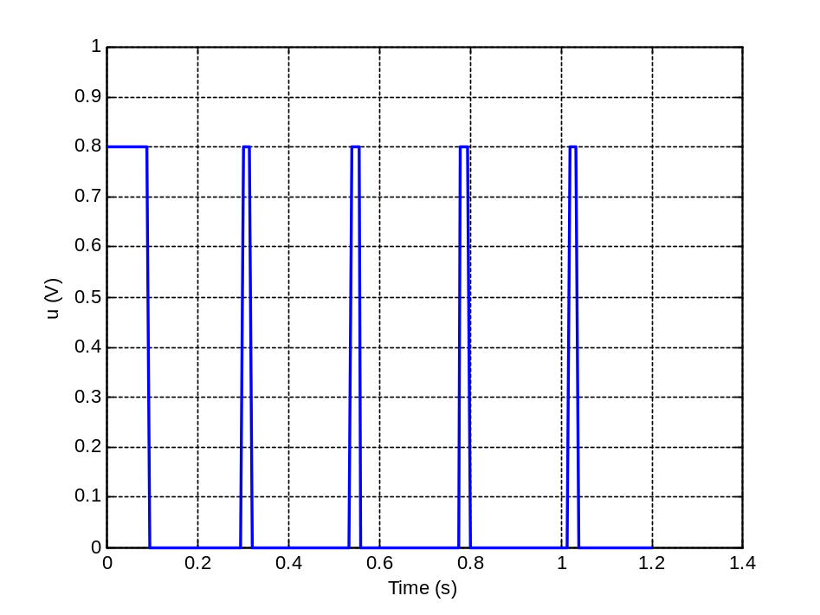
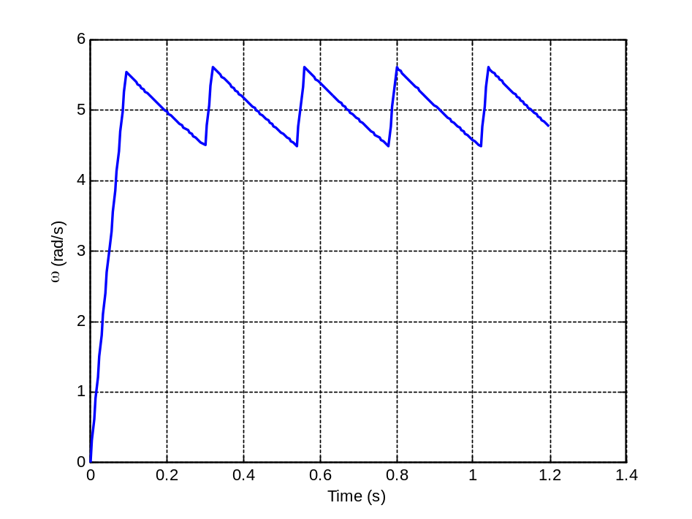
Simulink Model: Example 2
Setting G = 0.5
This result meets < 5 Hz goal for switching behavior
We derived this value through simulation – much easier than trial and error with actual hardware!

Slide 32
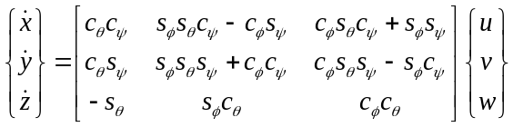
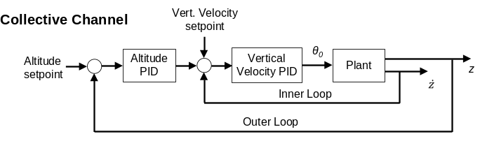
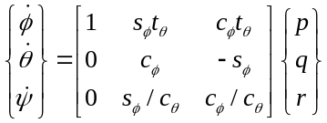
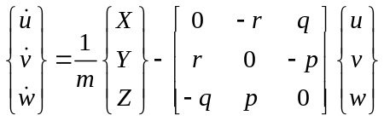
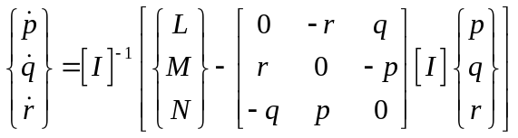
Modeling and Simulation in Matlab
Oftentimes, dynamic systems with feedback control can get quite complicated
Example: Helicopter
Cannot feasibly model the entire system using a Simulink block diagram
Must write simulation directly in software (Matlab, C/C++, Fortran, etc.

Slide 33

Modeling and Simulation in Matlab
To model a system in Matlab, we must write software implementation for each of the steps in our simulation flowchart
Initial Conditions
System Parameters
Controller
Main function
while(...){
rk4(state) ;
record_state(state);
}
Derivative Function
RK4 Function
State Time History

Slide 34

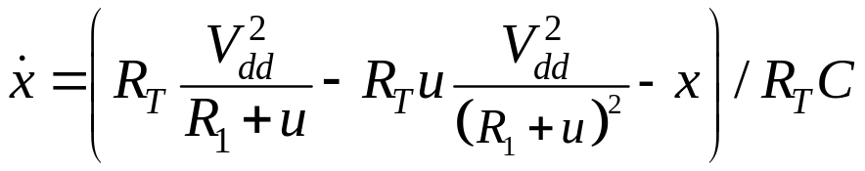

Modeling and Simulation in Matlab
Let’s explore a simple example using our previous thermal system
Define:
R₁
R_{v}
-
+
V_{dd}

Slide 35


Matlab Simulation: Thermal Example
Note: Given our system and PID control law, what sign should our gains have?

Slide 36

Matlab Simulation: Thermal Example
Note: Given our system and PID control law, what sign should our gains have?
Increasing variable resistor value (u) acts to provide less heat to the system
If temperature is too low (error value is positive), we want to add heat to system → decrease u
If temperature is too high (error value is negative), we want to remove heat from the system → increase u
So error value and control value have opposite signs – gains should be negative.

Slide 37
Matlab Simulation: Thermal Example
Simulation setup
function PID_control_thermal_system()
% System Parameters
RT = 13 ;
C = 13 ;
Vdd = 12 ;
R1 = 100 ;
% Desired temperature (difference from ambient)
xdes = 10 ;
% Controller parameters
Kp = -100 ;
Kd = 0 ;
Ki = -1 ;
skip_param = 5 ; % Update control every 0.5 sec
global ts u
% Simulation setup
i = 2 ;
ts = 0.1 ; % Timestep - update simulation at 10 Hz
params = [RT C R1 Vdd Kp Kd Ki xdes skip_param i] ;
timerec = 0 ;
xrec = 0 ;
urec = 0 ;

Slide 38
Matlab Simulation: Thermal Example
Main function loop
% Main loop - simulate to 300 sec
while(t < 300)
% Compute state at next timestep
[ts x] = RK4(t, @derivative, x, params) ;
% Update time
t = t + ts ;
% Record time, state, and control
timerec = [timerec ; t];
xrec = [xrec; x] ;
urec = [urec; u] ;
% Update iteration counter
i = i + 1 ;
params(10) = i ;
end

Slide 39
Matlab Simulation: Thermal Example
RK4 Integration Routine
function [ts, nextstate] = RK4(time, derivative, x, params)
% RK4 integration
% given time, derivative function handle, x(state vector and params (vector of
% parameter values)
%
% returns timestep and x (state vector)
global ts
timestep = ts ;
xdot1 = feval(derivative, time, x, params);
xdot2 = feval(derivative, time + (.5*timestep), x + (xdot1*.5*timestep), params);
xdot3 = feval(derivative, time + (.5*timestep), x + (xdot2*.5*timestep), params);
xdot4 = feval(derivative, time + timestep, x + (xdot3*timestep), params);
% Increment to add to state
xdotRK4 = (1/6) * (xdot1 + (2*xdot2) + (2*xdot3) + xdot4);
% State at next timestep
nextstate = x + (timestep * xdotRK4) ;
end

Slide 40
Matlab Simulation: Thermal Example
Derivative routine
function [f] = derivative(t, x, params)
% Unpack parameters vector
...
% Compute error
error = xdes-x(1) ;
% Compute control only at appropriate update rate
if(mod(i,skip_param) == 0)
% Compute control
u = Kp*error + Kd*(error-lasterror)/(ts*skip_param) + Ki*interror ;
...

Slide 41
Matlab Simulation: Thermal Example
Derivatives routine (continued)
% Saturation and anti-windup routine
if(u > 1000)
u = 1000 ;
if( sign(xdes-x)==sign(interror))
interror = interror - ts*skip_param*(xdes-x(1)) ;
end
end
if(u < 0)
u = 0 ;
if( sign(xdes-x)==sign(interror))
interror = interror - ts*skip_param*(xdes-x(1)) ;
end
end
% Compute integral error
interror = interror + ts*skip_param*(xdes-x(1)) ;
end
Q = Vdd^2/(R1+u) - u*(Vdd^2/(R1+u)^2) ; % Heat generated by control input
f = (-x + Rt*Q)/(Rt*C) ; % Compute state derivative
...
end

Slide 42


Matlab Simulation: Thermal Example
Let’s look at the code and some example results:
K_{p} = -100
K_{d} = 0
K_{i} = -1

Slide 43


Matlab Simulation: Thermal Example
Using a different set of gains:
K_{p} = -40
K_{d} = 0
K_{i} = 0
Simulation is the most efficient way to tune control law prior to building actual system.

Slide 44
System Identification
For many systems, it is difficult to derive system parameters from physical principles
  Even when we have physical laws, they often only apply to ideal conditions
System identification is process of determining system parameters from experimental data
  We use system identification to build a simulation model for a physical device
Improved Model Parameters
Experimental Data
HW Device
System ID
Simulation
Improved Device Design

Slide 45




System Identification
Given model parameters:
Given experimental data (time history of discrete data) from series of control inputs:
Given parameterized simulation model:
x is a vector of dimension N

Slide 46


Output Error Method
Common method to estimate system parameters from data is output error method
  Send same control inputs into physical system and simulation model
  Compare resulting simulated and actual state
  Adjust (optimize) parameters until they are as close as possible in least squares sense
Least squares cost
Simulated state
Find a vector p that minimizes cost function J

Slide 47

Output Error – Thermal System
Consider our thermal system. This model is parameterized by:
  R_{T} (thermal resistance)
  C (thermal capacitance)
As these parameters change, system response changes
Suppose actual parameters are R_{T} = 13, C = 13
Let’s run model at various different R_{T} and C values and compute cost function J
(sum of squared difference between actual measurements and simulation predictions)

Slide 48

Output Error – Thermal System
Responses with different sets of parameters:
As we change the system parameters (and leave everything else the same), system response changes noticeably
The square error cost J is computed by computing error at discrete time points between measured and actual system

Slide 49


Output Error – Thermal System
Cost function J for various system parameters
Minimum value of this cost function occurs at R_{T} = 13, C = 13
These are the parameter values for our actual system!

Slide 50
Output Error – Thermal System
In practice, it may be impractical to compute simulation responses at lots of different points and create cost function plot in last slide
Better way is to use an optimization routine such as:
  Newton iteration
  Conjugate gradient (Levenberg-Marquardt)
  Genetic algorithms
  Simulated annealing
  etc.
Given initial guess at parameters, these algorithms generate solutions until they find the optimal one.

Slide 51



Output Error
Example results for helicopter system identification
System Identification
*B. Taylor, J. Rogers “Experimental Investigation of Real-Time Helicopter Weight Estimation,” Journal of Aircraft, Vol. 51, No. 3, 2014, pp. 1047-1051.

Slide 52
Modeling and Simulation Summary
Modeling and simulation is an integral part of Mechatronics design
Important in:
  Predicting system performance
  Designing control system
  Evaluating sensor options
  Designing filters for feedback signals
Understanding, and being able to implement, M&S process has become crucial engineering skill

