Slide 1
Lecture 24: Digital Control 1
ME/AE 6705
Introduction to Mechatronics
Dr. Jonathan Rogers

Slide 2
Lesson Objectives
Be able to explain the need for digital controller analysis and synthesis tools
Be able to explain the meaning behind the z-transform and compute z-transform of simple signals
Be able to explain the effect of sampling rate, quantization, and zero-order-hold on closed-loop performance
Be able to use basic rules of thumb for implementing controllers on digital devices

Slide 3
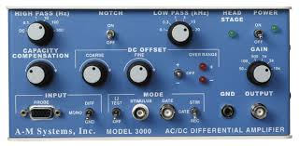
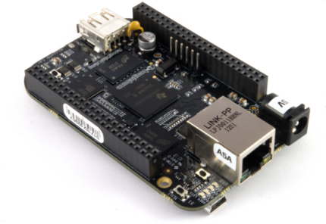
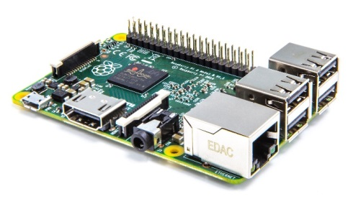
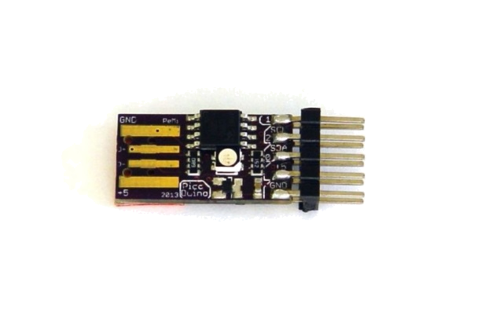

Continuous vs Discrete Time Control
Analog (Continuous) Controllers
Digital (Discrete) Controllers
Difficult to design
Everything must be implemented in physical hardware (limits complexity)
Difficult to reconfigure
Expensive
Easily reconfigurable
More complex controllers can be implemented (in software)
Less sensitive to noise
Low cost
Non-continuous outputs
Sidewinder air-to-air missile – uses proportional control with heat-seeking sensor ($600k)
$0.40 microcontroller can be used to implement closed-loop controller

Slide 4


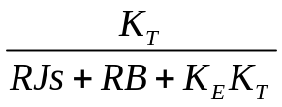

Continuous vs Discrete Time Control
Consider our previous PID controller for positioning a rotating inertia
  When we implement this on the microcontroller, the above diagram is actually incorrect
  Diagram assumes we have infinite control update rate and read angular position sensor continuously
D(t)
V_{c}(t)
ω(t)
θ_{des}(t)
θ(t)
Encoder
Diagram represents analog, not digital controller!

Slide 5



Continuous vs Discrete Time Control
When we implement this PID controller on digital device (MSP432), what we actually have is this:
Sampler
Zero order hold
u(kT)
u(t)
D(t)
T
e(kT)
ω(t)
θ_{des}(t)
Controller
ZOH
θ(t)
θ_{des}(kT)
θ(kT)
T
Encoder
Digital Microcontroller
Set via a potentiometer
ADC = Analog to Digital Converter
DAC = Digital to Analog Converter
ZOH = Zero order hold
T = Sampling Timestep

Slide 6
Continuous vs Discrete Time Control
When we implement this PID controller on digital device (MSP432), what we actually have is this:
Sampler
Zero order hold
u(kT)
u(t)
D(t)
T
e(kT)
ω(t)
θ_{des}(t)
Controller
ZOH
θ(t)
θ_{des}(kT)
θ(kT)
T
Encoder
Digital Microcontroller
Set via a potentiometer
Insight: If T → 0, then we can ignore the ADC, DAC, and ZOH components with negligible loss of performance.
What do we do if that is not the case?
ADC = Analog to Digital Converter
DAC = Digital to Analog Converter
ZOH = Zero order hold
T = Sampling Timestep

Slide 7
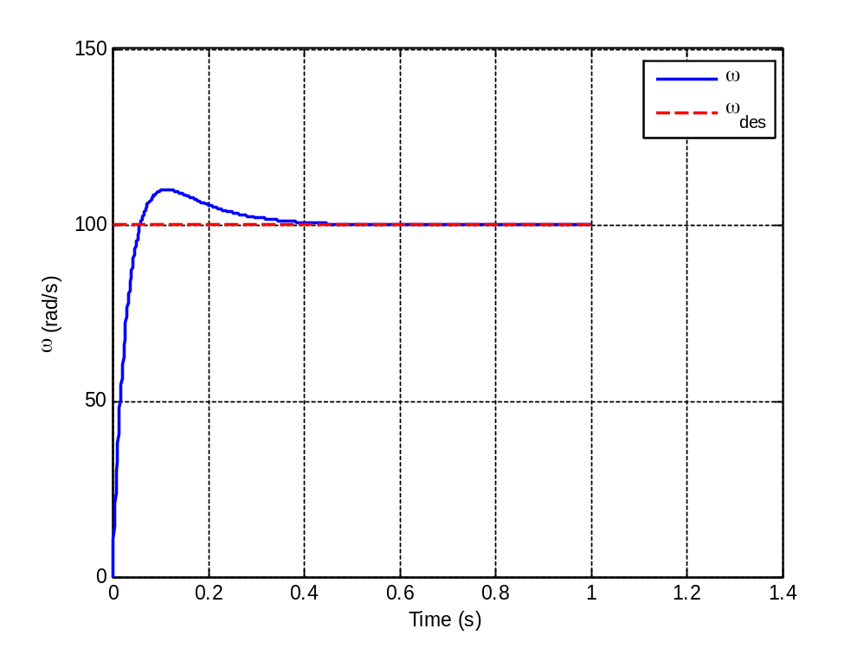
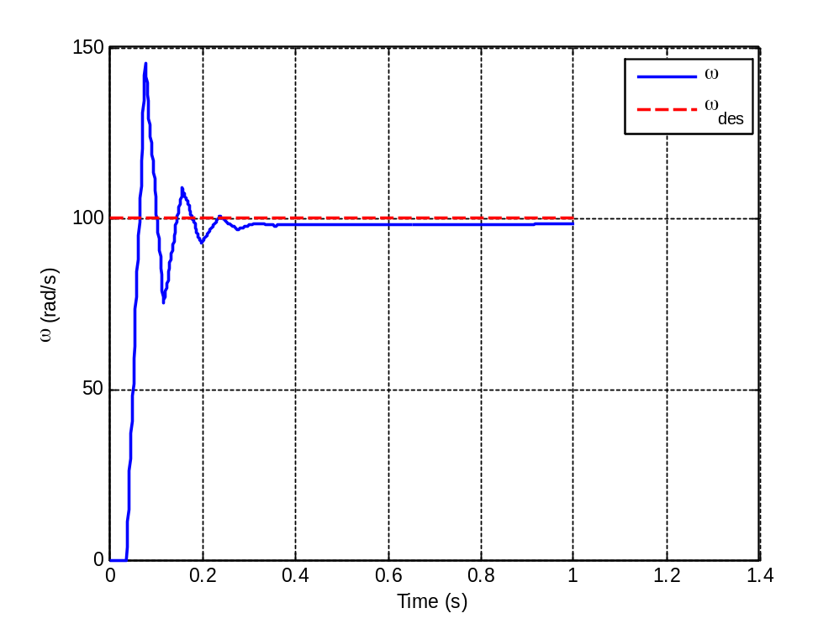
Continuous vs Discrete Time Control
Recall from last class regarding the control update rate
Response with control update rate 1 kHz
Response with control update rate 25 Hz
Closed loop response matches theoretical response since T = 0.001 sec
Closed loop response very different from theoretical response since T = 0.04 sec
Must use analysis tools that can analyze discrete-time elements of block diagram!

Slide 8
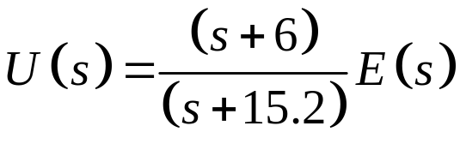
Digital Control Background
Consider the following controller (defined in Laplace domain):

Slide 9


Digital Control Background
Consider the following controller (defined in Laplace domain):

Slide 10
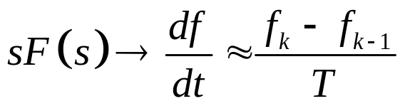
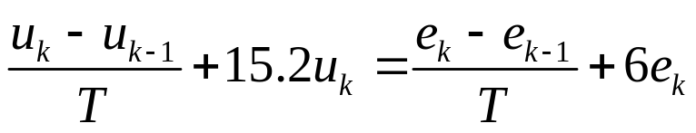
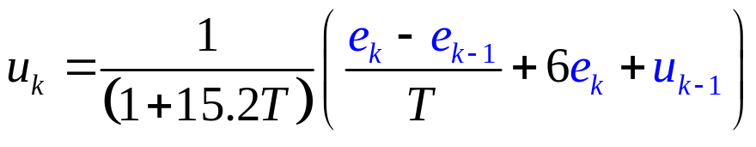
Digital Control Background
Consider the following controller (defined in Laplace domain):
Differentiation operator
On a digital device, we can implement differentiation operator using 1st order finite difference.
where f_{k} is value of f(t) at time t = kT
Difference Equation
(control inputs directly depend on T)

Slide 11
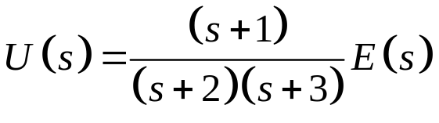

Digital Control Background
Consider a second-order system:

Slide 12
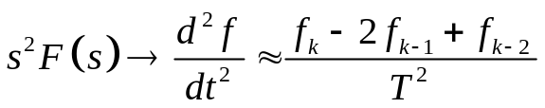
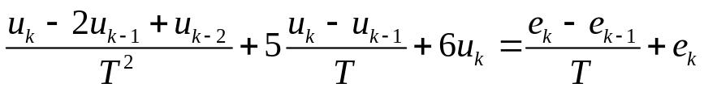
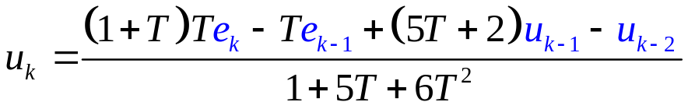
Digital Control Background
Consider a second-order system:

Slide 13
Digital Control Background
What do these expressions mean?
  This is how control should be calculated using our discrete-time implementation
  Note control is direct function of T – it will change as T increases or decreases
  How do we analyze stability for these control laws?
    Cannot use standard Laplace-domain tools
    This is the field of digital control
First Order Example
Second Order Example

Slide 14
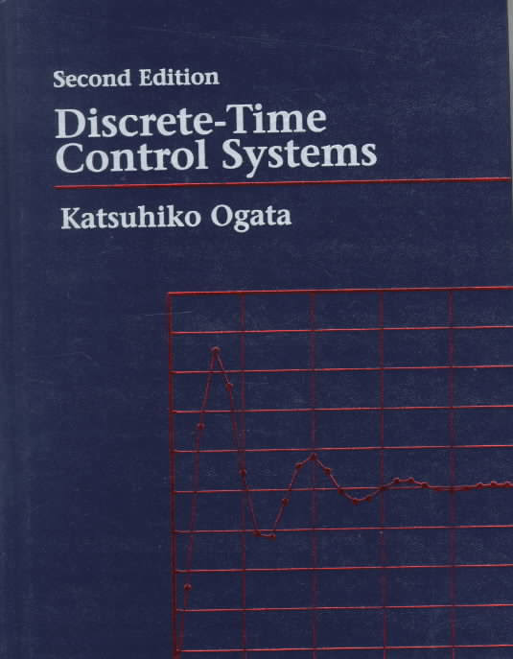
Digital Control Background
Digital Control Theory covers analysis and synthesis of discrete-time control systems
  Analysis – analyzing system stability, transient response, etc.
  Synthesis – designing controllers
Basic topics in Digital Control
  z-transform, inverse z-transform
  Analysis of samplers, ZOH
  Stability analysis of discrete systems
  Digital control design

Slide 15
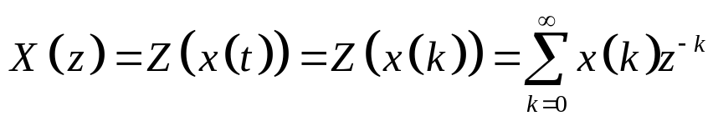
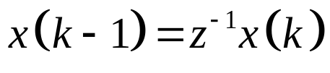

z Transform
Suppose we have a sequence of sampled values:
Then z transform is defined as follows:
…
T is sampling period
or
…
(shorthand notation)
z⁻¹ is known as the “shift” operator

Slide 16
z Transform
Suppose we have a sequence of sampled values:
Then z transform is defined as follows:
…
T is sampling period
or
…
(shorthand notation)
Very handy notation for analyzing discrete-time systems!
z⁻¹ is known as the “shift” operator

Slide 17
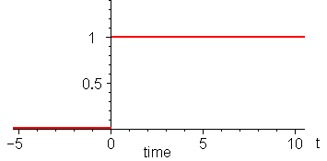
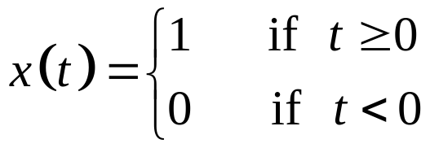
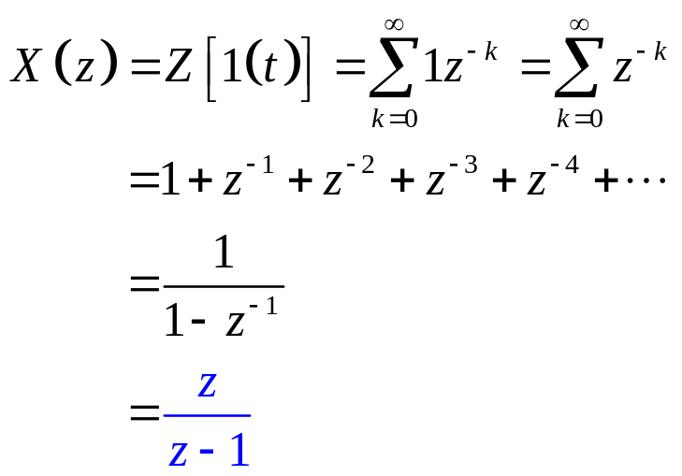
z Transform
z Transform of unit step function
…
Just like Laplace domain has transform of step input (1/s), z transform does as well.

Slide 18
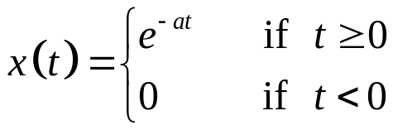

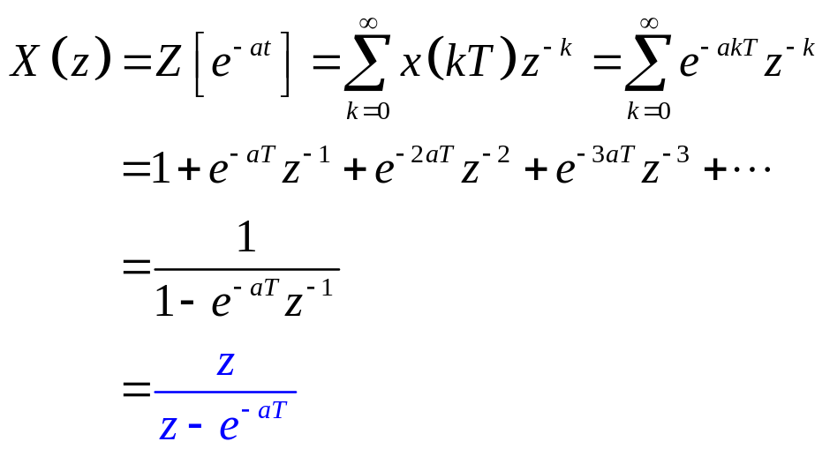
z Transform
z transform of exponential function
…
sampled version
…
Note that z transform of a function generally depends on the sampling time T.

Slide 19
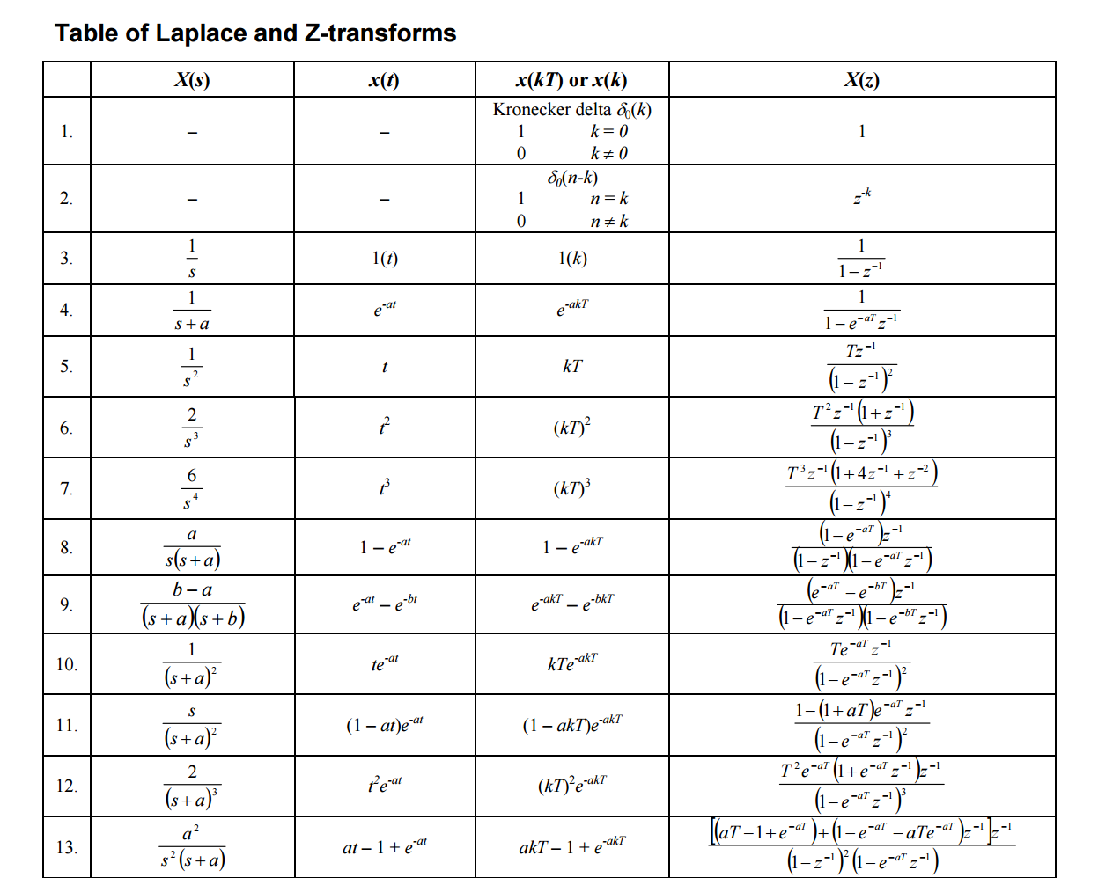
z Transform
Just like Laplace transform tables, z transform tables exist to facilitate rapid analysis/calculation
Laplace transform of function
z transform of function

Slide 20
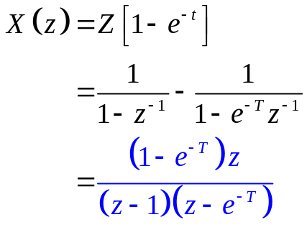
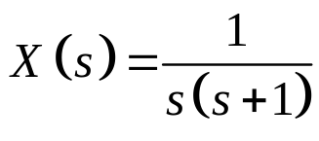

Conversion from Laplace to z Domain
All functions in the Laplace domain have an equivalent representation in the z domain
One method to convert from s to z is to convert from s to t, then from t to z
Example:
Laplace Domain
Time Domain
z Domain

Slide 21
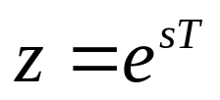
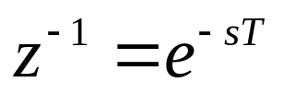



Conversion from Laplace to z Domain
The shift operator and the Laplace variable s are actually related by:
This is derived by considering a sampled signal output from an ideal sampler
(this is actually delay operator in the Laplace domain)
T
Continuous Time Signal
Discrete Time Signal

Slide 22
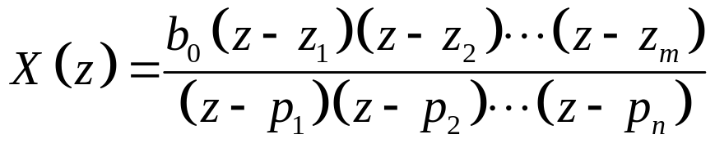
Discrete-Time Transfer Functions
Just like in Laplace domain, we can write transfer functions of discrete-time systems using z transform
  Note that z is a complex variable (like s)
  Locations of poles and zeros in complex plane determine system response
  Locations of poles in complex plane determine system stability!
…
…

Slide 23
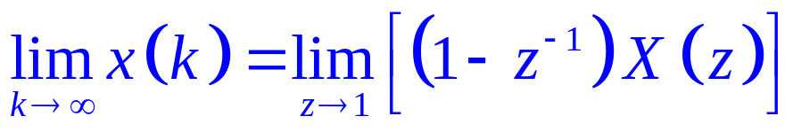
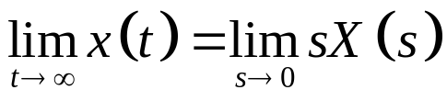
Analytical Methods in the z Domain
In the z domain (discrete-time), the Final Value Theorem is given by:
  Compare this to continuous-time Final Value Theorem:
  We can use this discrete-time version to analyze steady-state error for systems in the z domain

Slide 24
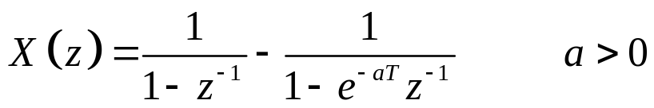
Analytical Methods in the z Domain
Example: Given the discrete time system described by X(z), find the final value x(∞) using the FVT.

Slide 25
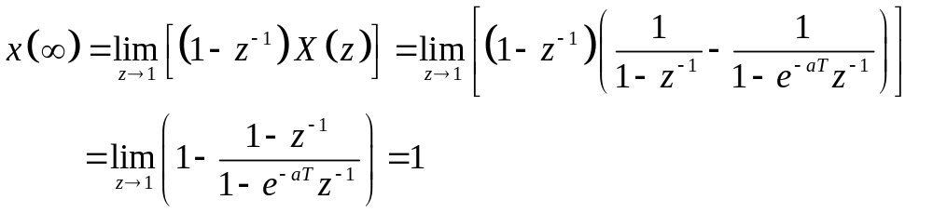

Analytical Methods in the z Domain
Example: Given the discrete time system described by X(z), find the final value x(∞) using the FVT.
Recall that X(z) is actually the z transform of:
As t → ∞ this function clearly goes to 1.

Slide 26
Analytical Methods in the z Domain
Discrete time systems are stable if their poles are located within the unit circle
  Poles on unit circle are equivalent to poles on imaginary axis in Laplace domain (marginally stable)
Im
Im
s domain
z domain
Re
Re
Stable Region
Stable Region
Unit Circle

Slide 27
Analytical Methods in the z Domain
Poles in the s plane have an equivalent location in the z plane using the relationship
  Consider a few test cases
Im
Im
s domain
z domain
Re
Re
Stable Region
Stable Region
Mapping changes lines in s domain to circles in z domain.

Slide 28
Zero Order Hold
Now that we know a little about analysis tools in the z domain, let’s discuss most important discrete control system component
Zero order hold (ZOH)
ZOH samples a continuous time signal and holds it constant between sampling times.
Signal
Time

Slide 29
Zero Order Hold
Anytime we have a digital control system, we use ZOH on our output control signal
  Control output maintained to system continuously, but only updated at discrete intervals
u(kT)
u(t)
D(t)
ω(t)
θ_{des}(t)
Controller
ZOH
θ(t)
Encoder
Remember that our controller only updates its output signal at intervals of T sec
But control signal must be maintained to plant at all times (continuously)

Slide 30
Zero Order Hold
What do you notice about ZOH signal below?
  Think: as sampling intervals become longer...

Slide 31
Zero Order Hold
What do you notice about ZOH signal below?
  Think: as sampling intervals become longer...
  The red signal is phase-delayed (lags original signal)
  This reduces stability of closed-loop system!

Slide 32
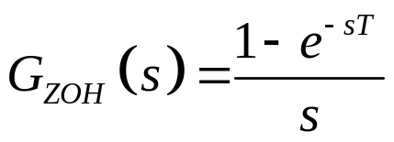
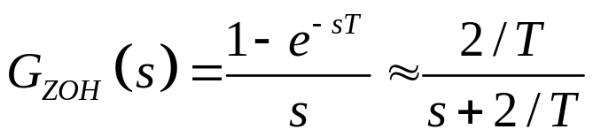

Zero Order Hold
Transfer function of zero order hold
When we include this in the closed-loop system, we introduce a new pole in the system located at:
As T → 0, pole moves to -∞ (more stable)
Taylor series approximation
As T → ∞, pole moves to 0 (less stable)

Slide 33
Example Stability Analysis
Let’s revisit our first order system from earlier
  This is a dynamic system where u changes in response to the forcing function e. Is this system stable?

Slide 34
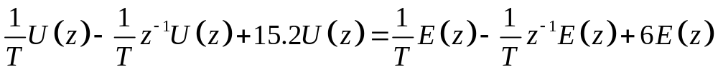
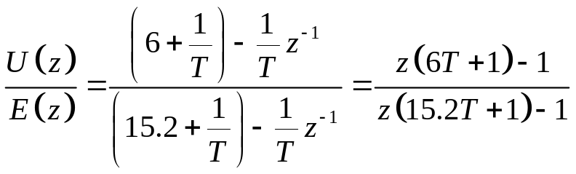
Example Stability Analysis
Let’s revisit our first order system from earlier
  This is a dynamic system where u changes in response to the forcing function e. Is this system stable?
Rewrite in terms of z transform:

Slide 35
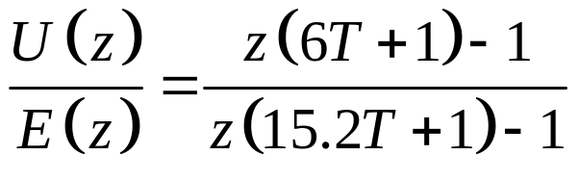

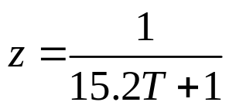
Example Stability Analysis
This is actually called the pulse transfer function of the system
  Poles of this transfer function determine system stability
Thus for any choice of sampling time T > 0 the system remains stable, since the pole is always within the unit circle.

Slide 36
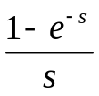
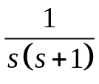
Example Stability Analysis
Consider feedback control of 2nd order system using digital controller
ZOH
(T = 1 sec)
Proportional Controller
Plant
Sampler
R(s)
K
C(s)
Determine whether the closed-loop system is stable. Is the system stable for all values of K?

Slide 37
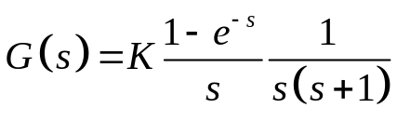
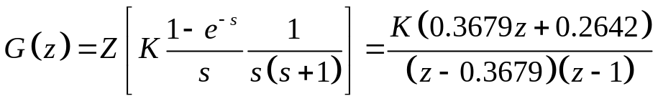
Example Stability Analysis
ZOH
(T = 1 sec)
Proportional Controller
Plant
Sampler
R(s)
K
C(s)
Open-loop transfer function:
Take the z transform:

Slide 38



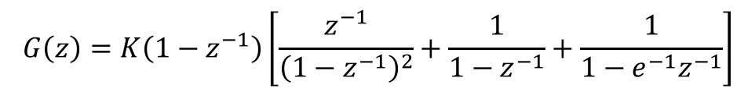
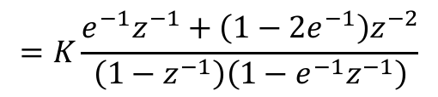
Example Stability Analysis
Here is how we got this:
Partial fraction expansion
From table of Z transforms

Slide 39
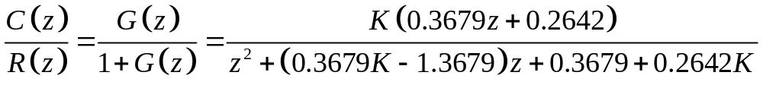

Example Stability Analysis
ZOH
(T = 1 sec)
Proportional Controller
Plant
Sampler
R(s)
K
C(s)
Closed-loop transfer function:
Roots of the denominator polynomial are inside unit circle when:
System is closed-loop unstable otherwise!
(stable range of gain)

Slide 40
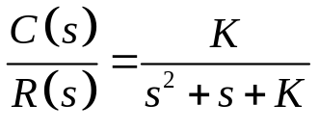

Example Stability Analysis
Takeaway: Adding discrete elements to a stable system can destabilize it!
Continuous (analog) Feedback System
Closed-loop TF:
R(s)
K
C(s)
Stable for all values of K!
Discrete (digital) Feedback System
Closed-loop TF:
R(z)
K
C(z)
Stable for only some values of K! Now proportional control can drive this system unstable.

Slide 41
Rules of Thumb
A digital controller can be modeled as a continuous (analog) system if the controller sampling rate is > 30 times faster than the closed loop time constant of system.
If not, the discrete system components need to be modeled to account for zero order holds and sampling.
Other digital implementation aspects discussed previously may also need to be included
  ADC resolution (quantization error)
  ADC and DAC conversion rate
  etc...

Slide 42
Digital Control Conclusions
It is easy to implement a simple PID difference equation on a microcontroller
  Can lead to trouble if you don’t understand what you are doing.
To be proficient in digital control implementation, we must be able to:
  Design an appropriate control algorithm accounting for discrete elements
  Calculate optimal gain values
  Model and simulate system performance and stability
ME 6403 Digital Controls Class (graduate) covers this subject in significant depth.

