Slide 1
Lecture 25: Digital Control 2
ME/AE 6705
Introduction to Mechatronics
Dr. Jonathan Rogers

Slide 2
Lesson Objectives
Derive the pulse transfer function of PID controller (transfer function of PID in z domain)
Be able to simulate discrete-time systems including feedback control elements
Simulate several discrete feedback systems and examine control performance
As a function of controller gains
As a function of sampling time
Examine tradeoffs
Discuss effects of control saturation

Slide 3
Review: Pulse Transfer Functions
Recall from last lecture that pulse transfer function is the z-domain transfer function for a system
ZOH
(T = 1 sec)
Proportional Controller
Plant
Sampler
R(s)
K
C(s)
Transfer Function
Pulse Transfer Function

Slide 4
Review: Pulse Transfer Function
PTF provides the z-domain poles and zeros for the system
Important: Both s and z domain representations of system are equally valid!
For systems involving samplers, it is easier to analyze system stability, response, etc in z domain than s domain
…
…

Slide 5
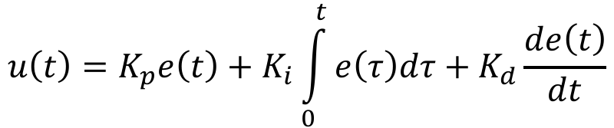
Pulse Transfer Function of PID
Analog (continuous time) form of PID controller:
Before we can compute the PTF, need to specify how we are going to implement discretization
This can of course be done in multiple ways
Does more than one PTF exist for the above PID controller?

Slide 6
Pulse Transfer Function of PID
Analog (continuous time) form of PID controller:
Before we can compute the PTF, need to specify how we are going to implement discretization
This can of course be done in multiple ways
Does more than one PTF exist for the above PID controller?
Yes. Various integral approximations may be used (rectangular, trapazoidal, etc) and various derivative approximations may be used (1st order backward, 2nd order backward, etc.)

Slide 7


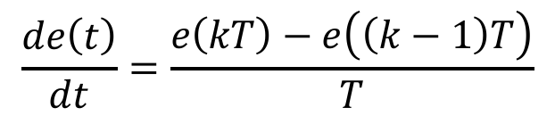
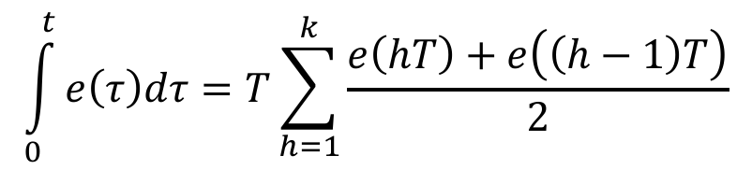
Pulse Transfer Function of PID
Proportional error is sampled:
Select:
First-order finite difference:
Trapazoidal integral approximation:

Slide 8
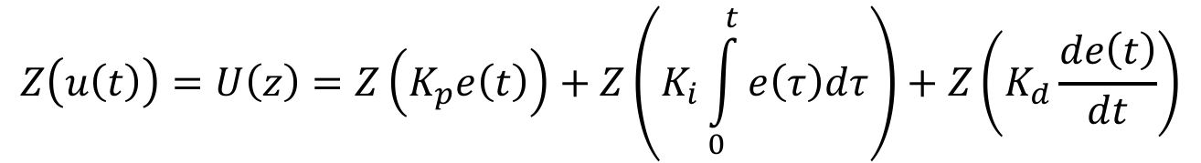

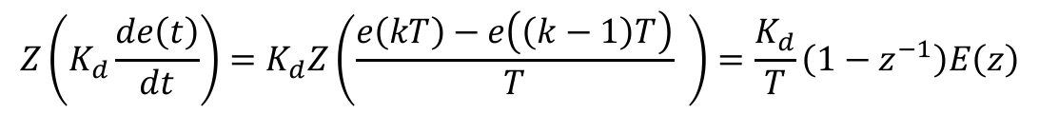
Pulse Transfer Function of PID
Taking the z transform:

Slide 9
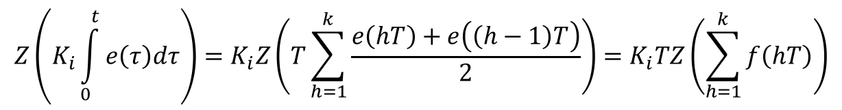
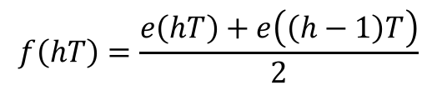

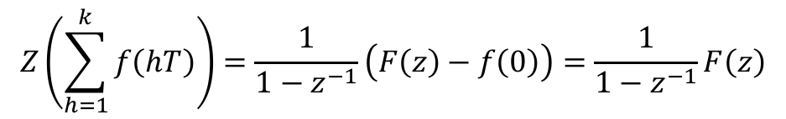

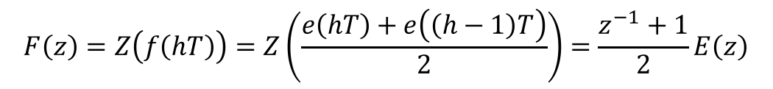
Pulse Transfer Function of PID
Computing integral term:
where
and
From table of z Transforms:
where

Slide 10
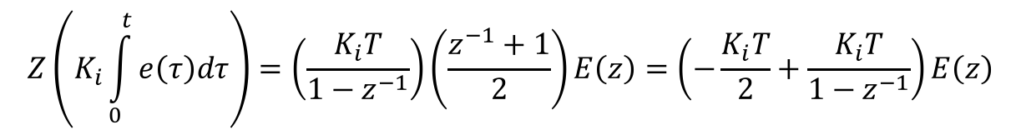
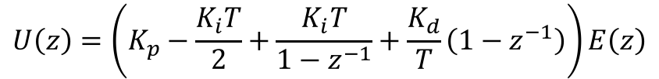
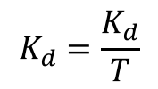
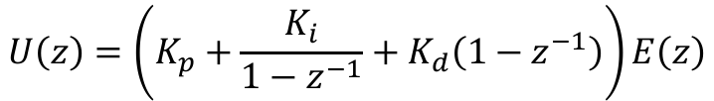
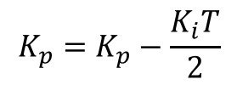

Pulse Transfer Function of PID
Thus z transform of integral controller is:
Putting it all together:
Some algebra involved here.
Redefining:

Slide 11
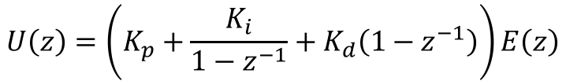



Digital PID Controllers
This is digital PID controller PTF. We can change gains to affect closed-loop system response.
G_{D}(z) Digital PID Controller
G(z) PTF of Plant
X(z)
Y(z)

Slide 12
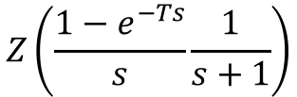

Digital PID Controllers: Example 1
Consider first order system controlled using (digital) integrator only
Simulate system
Determine integral gain needed for desirable response.
Explore stability tradeoffs (T vs K_{I})
Digital integrator
First-order plant with ZOH input
X(z)
$$\frac{K_{I}}{1−z^{−1}}$$
$$Z\left(\frac{1−e^{−Ts}}{s}\frac{1}{s+1}\right)$$
Y(z)

Slide 13

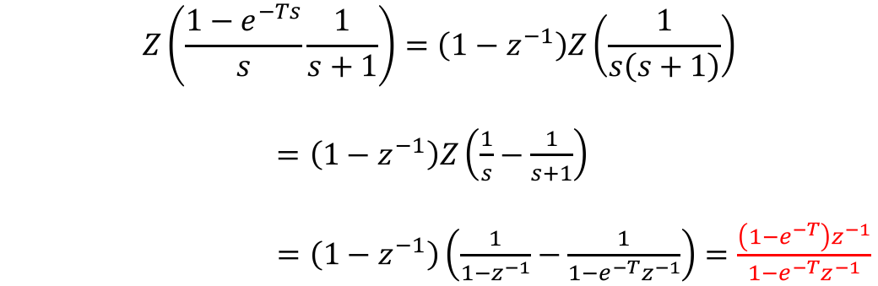

Digital PID Controllers: Example 1
Step 1: Derive PTF of plant.
$$Z\left(\frac{1−e^{−Ts}}{s}\frac{1}{s+1}\right)=\left(1−z^{−1}\right)Z\left(\frac{1}{s\left(s+1\right)}\right)$$
$=\left(1−z^{−1}\right)Z\left(\frac{1}{s}−\frac{1}{s+1}\right)$
$=\left(1−z^{−1}\right)\left(\frac{1}{1−z^{−1}}−\frac{1}{1−{e^{−T}z}^{−1}}\right)=\frac{\left(1−e^{−T}\right)z^{−1}}{1−e^{−T}z^{−1}}$
E(z)
$$\frac{K_{I}}{1−z^{−1}}$$
U(z)
$$\frac{\left(1−e^{−T}\right)z^{−1}}{1−e^{−T}z^{−1}}$$
X(z)
Y(z)

Slide 14





Digital PID Controllers: Example 1
Step 2: Write out difference equations for controller and plant.
$$\frac{U\left(z\right)}{E\left(z\right)}=\frac{K_{I}}{1−z^{−1}}$$
$$U\left(z\right)\left(1−z^{−1}\right)=K_{I}E\left(z\right)$$
$$k=kT$$
$$u\left(k\right)=K_{I}e\left(k\right)+u\left(k−1\right)$$
$$\frac{Y\left(z\right)}{U\left(z\right)}=\frac{\left(1−e^{−T}\right)z^{−1}}{1−e^{−T}z^{−1}}$$
$$Y\left(z\right)\left(1−e^{−T}z^{−1}\right)=U\left(z\right)\left(1−e^{−T}\right)z^{−1}$$
$$y\left(k\right)=e^{−T}y\left(k−1\right)+u\left(k−1\right)−e^{−T}u\left(k−1\right)$$
What is the (continuous-time) alternative to difference equations?

Slide 15
Digital PID Controllers: Example 1
Simulation code
y = 0 ;
T = 0.5 ;
r = 1 ;
ki = 2 ;
e = r-y ;
t = 0;
u = ki*e ;
tf = 8;
i=2 ;
while(t(end)<tf);
% Calculate state dynamics
y(i) = exp(-T)*y(i-1) + u(i-1) - exp(-T)*u(i-1) ;
% Compute error
e(i) = r-y(i) ;
% Compute control
u(i) = ki*e(i) + u(i-1) ;
t(i) = t(i-1)+T ;
i = i + 1;
end
Simulating discrete-time systems is a lot easier than continuous-time systems.

Slide 16
Digital PID Controllers: Example 1
T = 1 sec
K_{I} = 0.5
T = 1 sec
K_{I} = 1.5
Gains clearly have effect on system stability.
T = 1 sec
K_{I} = 3.0
T = 1 sec
K_{I} = 6.0

Slide 17
Digital PID Controllers: Example 1
Timestep clearly has effect on system stability.
T = 0.4 sec
K_{I} = 5.0
T = 0.6 sec
K_{I} = 5.0
Increasing T decreases stability of system.
T = 0.8 sec
K_{I} = 5.0
T = 1 sec
K_{I} = 5.0

Slide 18
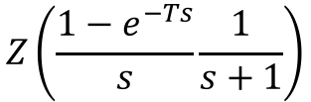



Effects of Saturation
Like in continuous-time systems, control saturation typically slows down system response
Consider PI control of same system:
X(z)
$$K_{P}+\frac{K_{I}}{1−z^{−1}}$$
$$Z\left(\frac{1−e^{−Ts}}{s}\frac{1}{s+1}\right)$$
Y(z)
$$\frac{U\left(z\right)}{E\left(z\right)}=K_{P}+\frac{K_{I}}{1−z^{−1}}$$
$$U\left(z\right)\left(1−z^{−1}\right)=K_{P}{\left(1−z^{−1}\right)E\left(z\right)+K}_{I}E\left(z\right)$$
$$k=kT$$
$$u\left(k\right)=K_{P}e\left(k\right)+K_{P}e\left(k−1\right)+K_{I}e\left(k\right)+u\left(k−1\right)$$

Slide 19
Effects of Saturation
Using K_{P} = 1.5, K_{I} = 1, T = 0.5 sec:
Without Saturation
With Control Saturation
Saturation limit

Slide 20
Effects of Saturation
Using K_{P} = 1.5, K_{I} = 1, T = 0.5 sec:
Without Saturation
With Control Saturation

Slide 21
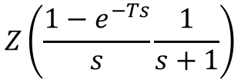

Digital Controllers: Compensators
PID controllers only allow you to place closed-loop poles in specific area
Digital compensators allow you to place pole(s) in specific desired locations
Digital Compensator
Plant with ZOH input
X(z)
$$K\frac{z−a}{z−b}$$
$$Z\left(\frac{1−e^{−Ts}}{s}\frac{1}{s+1}\right)$$
Y(z)

Slide 22




Digital Controllers: Compensators
Compensators allow you to shape frequency response of system
Lead Compensators
Used for improving stability margins
Increases system bandwidth – system responds faster
May increase sensitivity to noise though
$$G_{D}\left(z\right)=K\frac{1+τz}{1+ατz}$$
$$0<α<1$$
Lag Compensators
Reduces system gain at higher frequencies without reducing it at lower frequencies
Slows down system response, but less susceptibility to noise
$$G_{D}\left(z\right)=K\frac{1+τz}{1+βτz}$$
$$β>1$$

Slide 23


Digital Controllers: Compensators
Compensators allow you to shape frequency response of system
Lead-Lag Compensators
$$G_{D}\left(z\right)=K\frac{1+τz}{1+ατz}\frac{1+τz}{1+βτz}$$
Formed by cascading lead and lag compensators together in series
Low-frequency gain can be increased (leads to reduction of steady-state error) while also allowing increases in system bandwidth and stability margins
$0<α<1$, $β>1$
PID controller is actually special case of phase lead-lag compensator.

Slide 24


Example: Digital Compensators
Let’s look at a Mechatronic system which can be controlled through lead-lag compensation
Euler’s Rotational Dynamics Equation:
$$J\frac{d^{2}\ddot{θ}}{dt^{2}}+C\frac{dθ}{dt}+Kθ=K_{i}i$$
J = inertia of head assembly
C = viscous damping coeff. of bearings
K = return spring constant
K_{i} = motor torque constant
𝜃 = angular position of read head
i = input current
Transfer function from i(s) to 𝜃(s)
$$H\left(s\right)=\frac{K_{i}}{Js^{2}+Cs+K}$$

Slide 25






Example: Digital Compensators
Let’s look at a Mechatronic system which can be controlled through lead-lag compensation
$$J\frac{d^{2}\ddot{θ}}{dt^{2}}+C\frac{dθ}{dt}+Kθ=K_{i}i$$
Open-Loop Transfer Function
J = 0.01 kg-m²
C = 0.004 N-m/(rad/s)
K = 10 N-m/rad
K_{i} = 0.05 N-m/mA
$$\frac{θ\left(s\right)}{i\left(s\right)}=\frac{0.05}{0.01s^{2}+0.004s+10}$$
R(s)
$$\frac{z+α}{z+β}$$
$$\frac{1−e^{−Ts}}{s}$$
$$\frac{0.05}{0.01s^{2}+0.004s+10}$$
Y(s)
Digital Compensator
Zero Order Hold
Plant
$$K_{F}$$

Slide 26


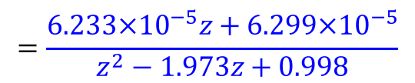
Example: Digital Compensators
Let compute the PTF for this system with T = 0.005 sec
U(s)
$$\frac{1−e^{−Ts}}{s}$$
$$\frac{0.05}{0.01s^{2}+0.004s+10}$$
Y(s)
G(z)
$$G\left(z\right)=Z\left(\frac{1−e^{−Ts}}{s}\frac{0.05}{0.01s^{2}+0.004s+10}\right)=\left(1−z^{−1}\right)Z\left(\frac{0.05}{s\left(0.01s^{2}+0.004s+10\right)}\right)$$
Partial fractions expansion, etc…
$$=\frac{6.233×{10}^{−5}z+6.299×{10}^{−5}}{z^{2}−1.973z+0.998}$$

Slide 27



Example: Digital Compensators
Computing difference equations:
$$\frac{U\left(z\right)}{E\left(z\right)}=\frac{1+αz^{−1}}{1+βz^{−1}}$$
$$U\left(z\right)\left(1+{βz}^{−1}\right)=\left(1+{αz}^{−1}\right)E\left(z\right)$$
$$u\left(k\right)=e\left(k\right)+αe\left(k−1\right)−βu\left(k−1\right)$$
$$\frac{Y\left(z\right)}{U\left(z\right)}=\frac{6.233×{10}^{−5}z^{−1}+6.299×{10}^{−5}z^{−2}}{1−1.973z^{−1}+0.998z^{−2}}$$
$$Y\left(z\right)\left(1−1.973z^{−1}+0.998z^{−2}\right)=U\left(z\right)\left(6.233×{10}^{−5}z^{−1}+6.299×{10}^{−5}z^{−2}\right)$$
$$y\left(k\right)=1.973y\left(k−1\right)−0.998y\left(k−2\right)+6.233×{10}^{−5}u\left(k−1\right)+6.299×{10}^{−5}u\left(k−2\right)$$

Slide 28
Example: Digital Compensators
Simulating this system:
r = 1 ;
T = 0.005 ;
alpha = -0.85 ; %-.85
beta = 0 ; %0
b = -1.973 ;
c = 0.998 ;
A = 6.233e-05 ;
B = 6.229e-05 ;
t(1) = 0;
t(2) = T ;
y(1) = 0 ;
e(1) = r-y ;
u(1) = e(1) ;
y(2) = -b*y(1) + A*u(1) ;
e(2) = r-y(2) ;
u(2) = alpha*e(1) + e(2) -beta*u(1) ;
tf = 0.12;
i=3 ;
while(t(end)<tf);
% Calculate state dynamics
y(i) = -b*y(i-1) - c*y(i-2) + A*u(i-1) + B*u(i-2) ;
% Compute error
e(i) = r-y(i)*4.07e3 ;
% Compute control
u(i) = alpha*e(i-1) + e(i) -beta*u(i-1) ;
t(i) = t(i-1)+T ;
i = i + 1;
end

Slide 29

Example: Digital Compensators
Let’s apply a step input to the open loop system and examine response
Response is highly oscillatory
Indicates the system is very underdamped
Need to design compensator that adds more damping
U(z)
$$\frac{6.233×{10}^{−5}z+6.299×{10}^{−5}}{z^{2}−1.973z+0.998}$$
Y(z)

Slide 30

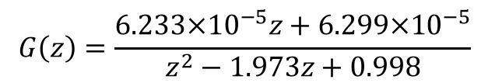
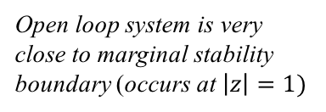

Example: Digital Compensators
To understand this, examine the poles of the open loop PTF
Roots of denom. polynomial
$$G\left(z\right)=\frac{6.233×{10}^{−5}z+6.299×{10}^{−5}}{z^{2}−1.973z+0.998}$$
$$z=0.987±0.158i$$
Imag.
$$\left|z\right|=0.999$$
Open loop system is very close to marginal stability boundary (occurs at $\left|z\right|=1)$
Real
Open loop pole locations

Slide 31






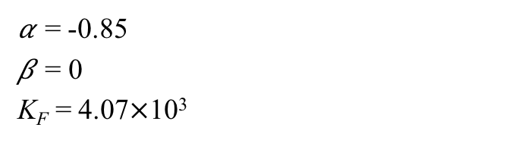

Example: Digital Compensators
Closing the loop:
G_{D}(z)
G(z)
R(s)
$$\frac{z+α}{z+β}$$
$$\frac{6.233×{10}^{−5}z+6.299×{10}^{−5}}{z^{2}−1.973z+0.998}$$
Y(s)
$$K_{F}$$
𝛼 = -0.85
𝛽 = 0
K_{F} = 4.07$×$10³
$$\frac{Y\left(z\right)}{R\left(z\right)}=\frac{G_{D}\left(z\right)G\left(z\right)}{1+K_{F}G_{D}\left(z\right)G\left(z\right)}$$
Closed Loop PTF:
Characteristic Equation:
$$z^{3}−1.7193z^{2}+1.0359z−0.2155=0$$
Roots of Characteristic Eq.
$$z=0.5897±0.2266i$$
$$z=0.5400$$
$$\left|z\right|=0.6317$$
Poles shifted farther from unit circle!
$$\left|z\right|=0.5400$$

Slide 32
Example: Digital Compensators
Closed loop step response
Read Head Response
Motor Current Required
Settling time ~60 ms. Slow for this application but much better than open-loop response.

Slide 33
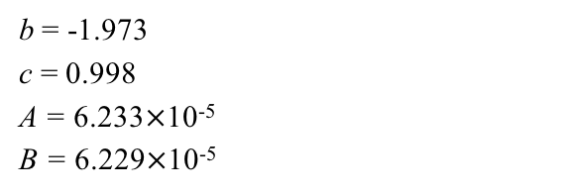
Example: Digital Compensators
Suppose we want to reduce settling time still more. This will allow us to read from disk faster.
How should we set our gains: 𝛼, 𝛽, and K_{F}?
One way is to examine the closed loop poles for a wide range of gains
Select gains that move poles closest to origin
Form of characteristic equations for closed loop PTF:
$$z^{3}−\left(β+b+K_{F}A\right)z^{2}+\left(c+βb+K_{F}B+K_{F}αA\right)z−K_{F}αB+βc=0$$
b = -1.973
c = 0.998
A = 6.233$×$10⁻⁵
B = 6.229$×$10⁻⁵
Select a loop gain K_{F}
Create array of different candidate 𝛼’s and 𝛽’s
Solve for roots of above equation, pick root with highest magnitude. This is “best” gains for this K_{F}
Repeat for various K_{F} values until desired performance achieved

Slide 34


Example: Digital Compensators
Loop gain K_{F} = 4070
$\left|z\right|$_{max}= 0.63
𝛼 = -0.85
𝛽 = 0
This is a plot of max$\left|z\right|$
Optimal Gains:

Slide 35

Example: Digital Compensators
Loop gain K_{F} = 9000
$\left|z\right|$_{max}= 0.51
𝛼 = -0.75
𝛽 = 0.3
Significant reduction in settling time (~30%).
Optimal Gains:

Slide 36

Example: Digital Compensators
Loop gain K_{F} = 20000
$\left|z\right|$_{max}= 0.38
𝛼 = -0.65
𝛽 = 0.8
Further reduction in settling time (total of ~40%). Now have large overshoot though.
Optimal Gains:

Slide 37
Digital Control: Conclusions
The field of digital control allows us to explicitly model and analyze the effects of implementing controllers with digital devices
Basic trends that emerge:
Sampling time has a big effect on 1) stability, and 2) performance
Design of digital control systems involves tradeoffs!
Sampling Rate
Gain Selection
Saturation Limits

