Slide 1
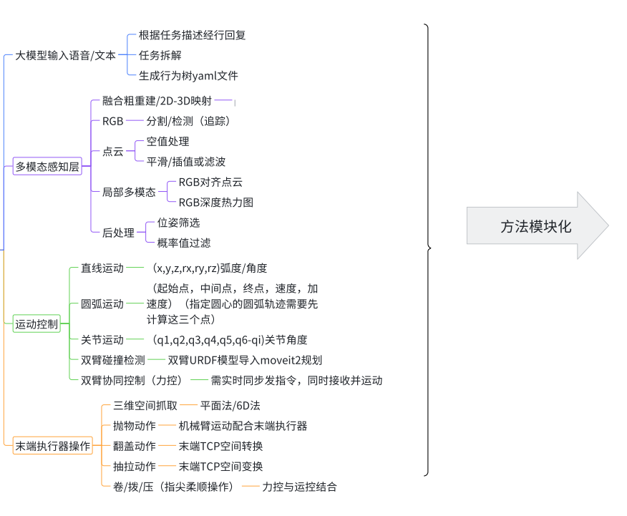
System architecture noteapiSystem architecture noteSystem architecture note System architecture noteSystem architecture noteSystem architecture note
System architecture noteSystem architecture noteSystem architecture note
System architecture note6dSystem architecture noteSystem architecture noteSystem architecture note

Slide 2
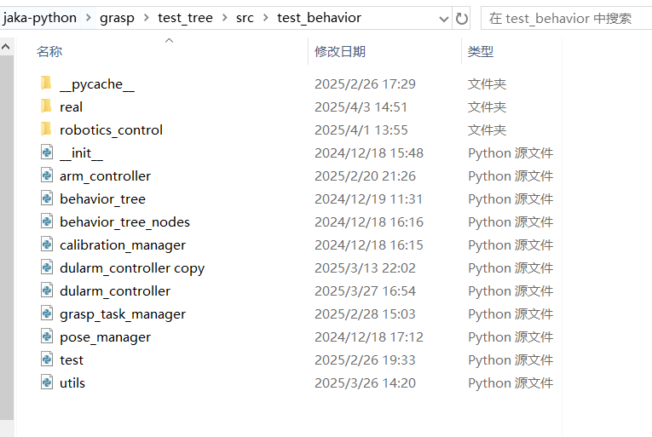
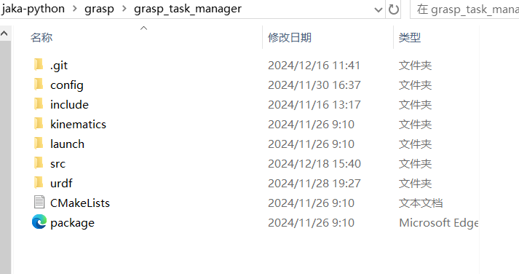
System architecture noteSystem architecture note
srcSystem architecture noteC++
System architecture notepythonSystem architecture notedemoSystem architecture noteSystem architecture note

Slide 3
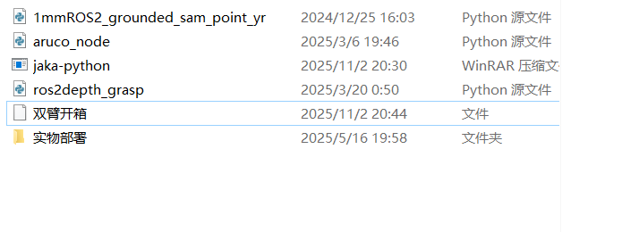
System architecture noteSystem architecture note
1mmros2System architecture note
aruco_nodeSystem architecture noteSystem architecture note
ros2depth_grasp System architecture notezSystem architecture noteHGGD,System architecture note6DSystem architecture note

