Slide 1
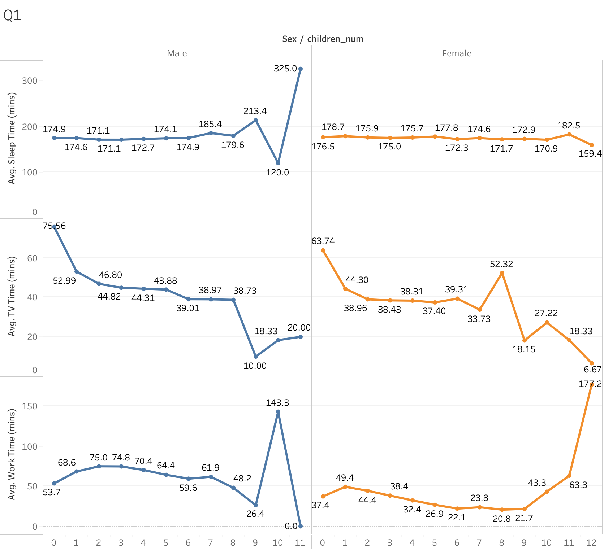
The Trend Between the Number of Household Children and
the Time Spent on Sleeping, Watching TV, and Work
Male
Female
Avg. Sleep Time (mins)
Avg. TV Time (mins)
Avg. Work Time (mins)
Number of Household Children

Slide 2
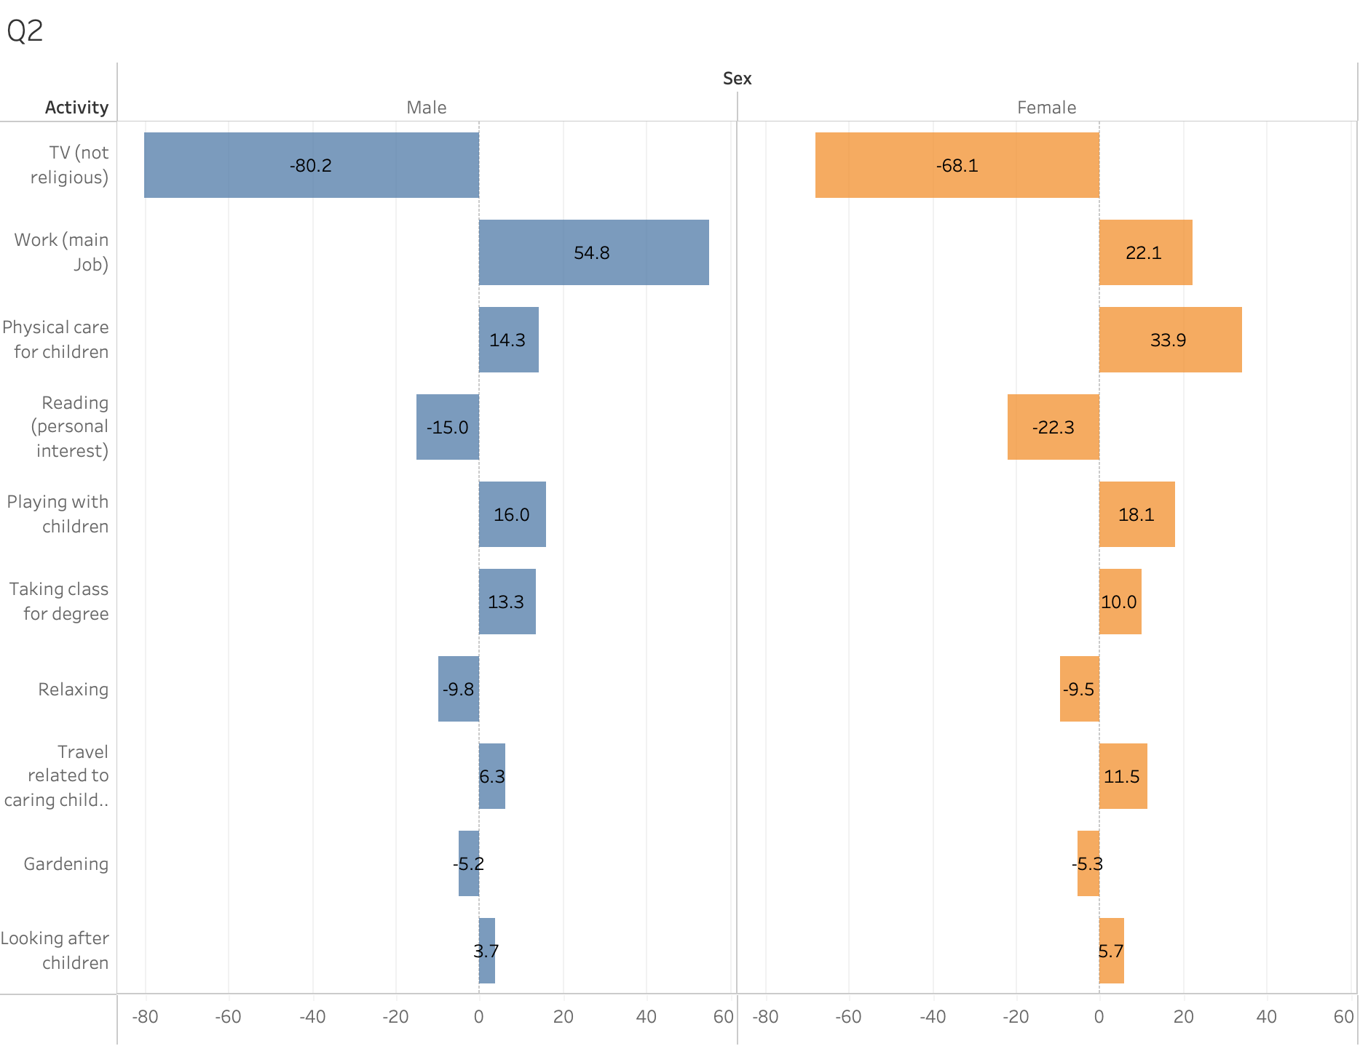
The top-10 activities in terms of the difference in time spent on each acitivity of those who have children compared to those without children (minutes)
Male
Female
The Difference in Time spent on each acitivity of those who have children
compared to those without children (minutes)

Slide 3
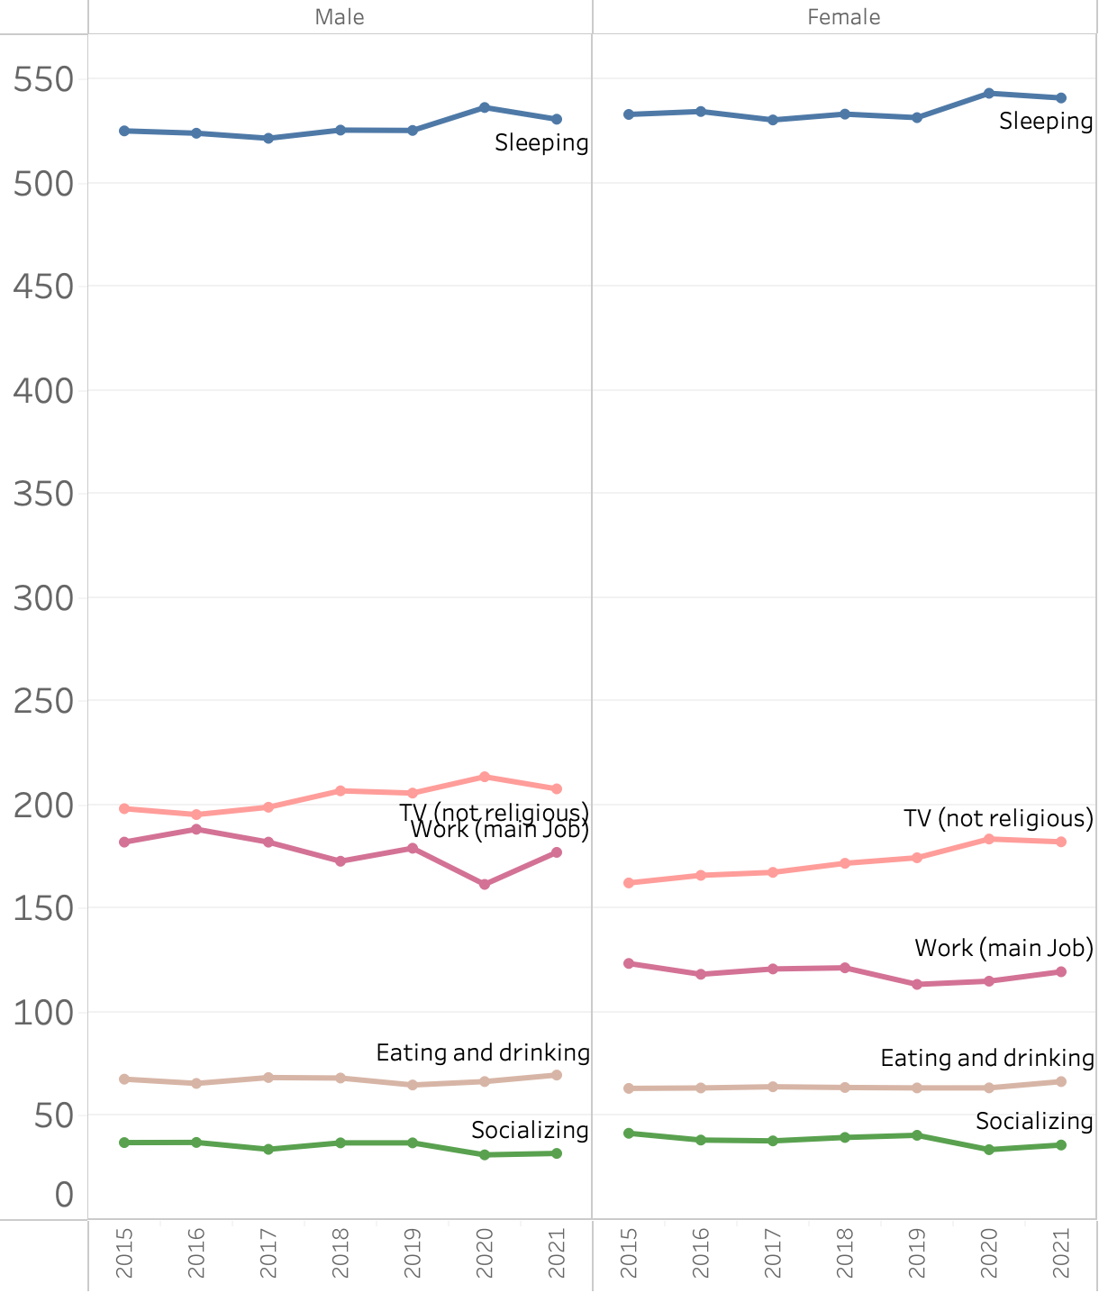
The Time on the Top-5 Activities over Time (2015-2021)
Male
Female
Pandemic
(2020-)
Pandemic
(2020-)
Avg. Time (mins)
year

Slide 4
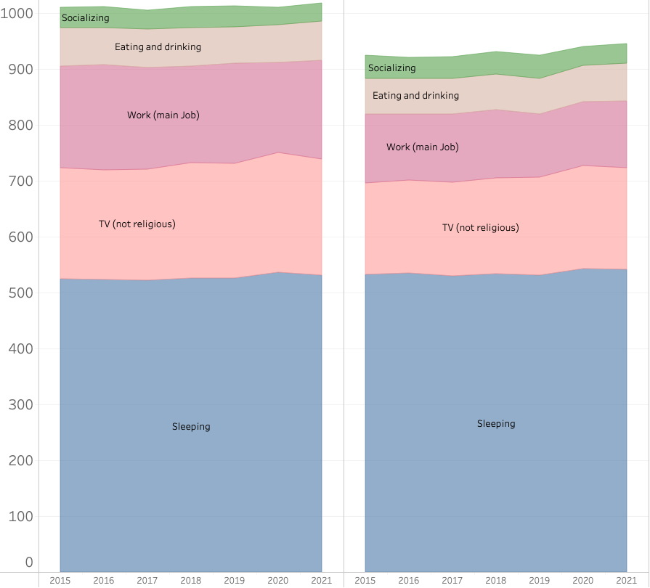
The Time on the Top-5 Activities over Time (2015-2021)
Male
Female
Pandemic
(2020-)
Pandemic
(2020-)
Avg. Time (mins)
year

Slide 5
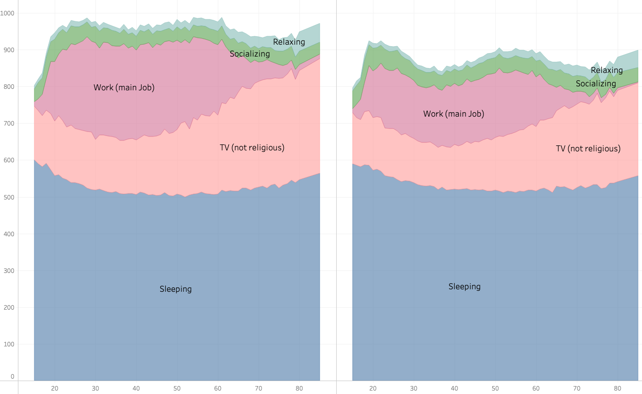
The Time on Selected Activities over Age
Male
Female
Avg. Time (mins)
Age (year)

