Slide 1




A pregnancy, planned or unplanned, brings spouses, families & everyone closer to each other. #Life is beautiful! #USA
It's so brilliant that #lovewins - now extend the equality to women's rights #abortionrights
Positive
Sentiment
#DonRients: people aren't just killed by guns. 9 people died and that's sad. But how many die daily from #abortion?
My body, my life. You fuck it up in a way I'm not prepared for and I will kill you.
Negative
Sentiment
Stance = Against
Stance = In-favor

Slide 2
A pregnancy, planned or unplanned, brings spouses, families & everyone closer to each other. #Life is beautiful! #USA
It's so brilliant that #lovewins - now extend the equality to women's rights #abortionrights
Sentiment
Positive
@ScottWalker goes along with the world is the law of God and not of men
Only one can have bodily autonomy
Sentiment
Neutral
#DonRients: people aren't just killed by guns. 9 people died and that's sad. But how many die daily from #abortion?
My body, my life. You fuck it up in a way I'm not prepared for and I will kill you.
Sentiment
Negative
Stance = Against
Stance = In-favor

Slide 3
1.2% of abortions happen at 21 weeks+ (these are only exceptions) #letstalkabortion
Stance = Neutral-or-unclear

Slide 4
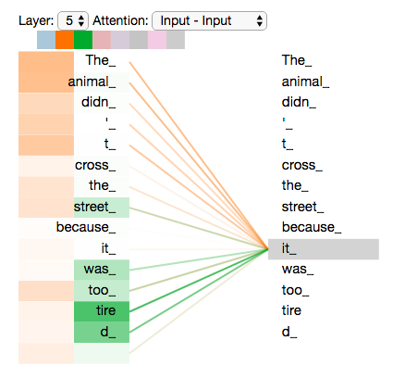
Multi-head Attention in Action
Head 1

Slide 5
Multi-head Attention in Action
Head 1
Head 2

