Slide 1
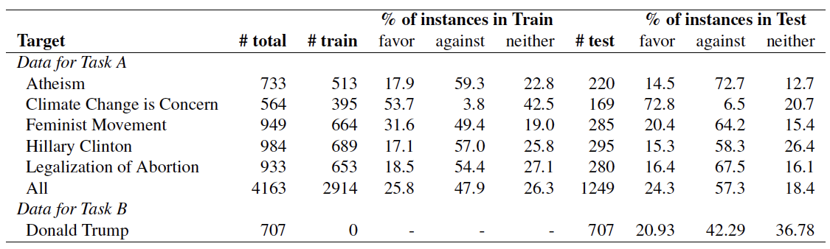

Slide 2




A pregnancy, planned or unplanned, brings spouses, families & everyone closer to each other. #Life is beautiful! #USA
It's so brilliant that #lovewins - now extend the equality to women's rights #abortionrights
Positive
Sentiment
#DonRients: people aren't just killed by guns. 9 people died and that's sad. But how many die daily from #abortion?
My body, my life. You fuck it up in a way I'm not prepared for and I will kill you.
Negative
Sentiment
Stance = Against
Stance = In-favor

Slide 3
A pregnancy, planned or unplanned, brings spouses, families & everyone closer to each other. #Life is beautiful! #USA
It's so brilliant that #lovewins - now extend the equality to women's rights #abortionrights
Sentiment
Positive
@ScottWalker goes along with the world is the law of God and not of men
Only one can have bodily autonomy
Sentiment
Neutral
#DonRients: people aren't just killed by guns. 9 people died and that's sad. But how many die daily from #abortion?
My body, my life. You fuck it up in a way I'm not prepared for and I will kill you.
Sentiment
Negative
Stance = Against
Stance = In-favor

Slide 4
1.2% of abortions happen at 21 weeks+ (these are only exceptions) #letstalkabortion
Stance = Neutral-or-unclear

Slide 5
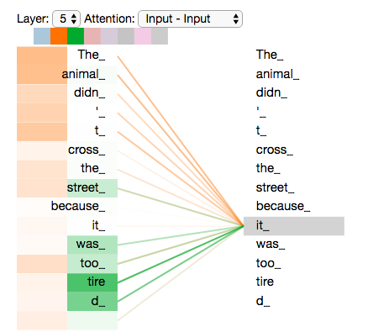
Head 1

Slide 6
Head 1
Head 2

Slide 7
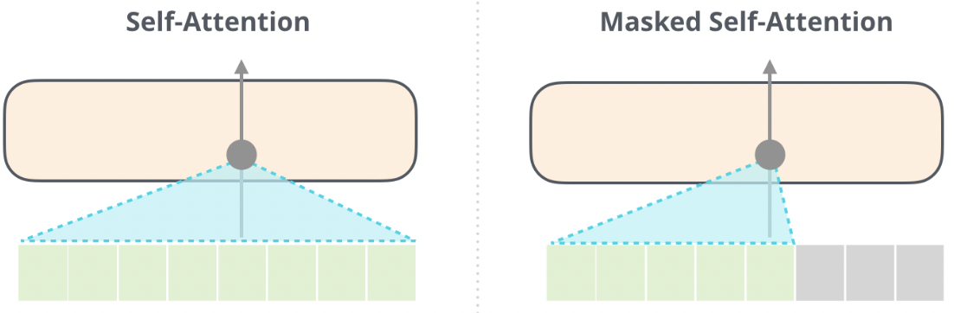
Encoder
Decoder
Tweet
Tweet Embedded in the Prompt
Generated Words

Slide 8
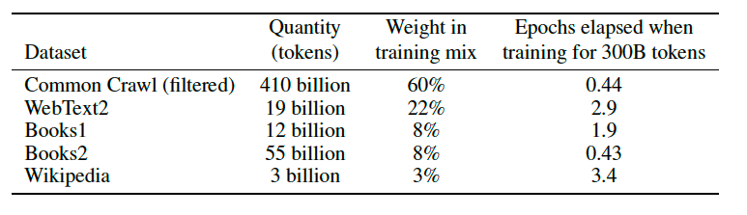

Slide 9
Task Description
What is the stance of the tweet below with respect to 'Legalization of Abortion'? Please use exactly one word from the following 3 categories to label it: 'in-favor', 'against', 'neutral-or-unclear'. Here is the tweet: “It's so brilliant that #lovewins - now extend the equality to women's rights #abortionrights.” The stance of the tweet is:
Possible Labels
Tweet of Interest

Slide 10
Task Description
What is the stance of the tweet below with respect to 'Legalization of Abortion'? If we can infer from the tweet that the tweeter supports 'Legalization of Abortion', please label it as 'in-favor'. If we can infer from the tweet that the tweeter is against 'Legalization of Abortion', please label is as 'against'. If we can infer from the tweet that the tweeter has a neutral stance towards 'Legalization of Abortion', please label it as 'neutral-or-unclear'. If there is no clue in the tweet to reveal the stance of the tweeter towards 'Legalization of Abortion', please also label is as 'neutral-or-unclear'. Please use exactly one word from the following 3 categories to label it: 'in-favor', 'against', 'neutral-or-unclear'. Here is the tweet: “It's so brilliant that #lovewins - now extend the equality to women's rights #abortionrights.” The stance of the tweet is:
Label Definitions
Possible Labels
Tweet of Interest

Slide 11
What is the stance of the tweet below with respect to COVID-19 vaccine? If the tweet is in-favor of COVID-19 vaccine, please label it as "in-favor". If the tweet is against COVID-19 vaccine, please label is as "against". If the tweet is neutral to COVID-19 vaccine, please label it as "neutral-or-unclear". If the stance of the tweet is not clear, please also label it as "neutral-or-unclear". If the tweet is sarcastic and is difficult to infer the true stance, please also label is as "neutral-or-unclear". Please use exactly one word from the following 3 categories to label it: "in-favor", "against", "neutral-or-unclear". Here is the tweet. "covid clusters among the vaccinated are killing our back-to-normal dreams" The stance of the tweet is:

Slide 12
Examples (1 per class)
What is the stance of the tweet below with respect to 'Legalization of Abortion'? If we can infer from the tweet that the tweeter supports 'Legalization of Abortion', please label it as 'in-favor'. If we can infer from the tweet that the tweeter is against 'Legalization of Abortion', please label is as 'against'. If we can infer from the tweet that the tweeter has a neutral stance towards 'Legalization of Abortion', please label it as 'neutral-or-unclear'. If there is no clue in the tweet to reveal the stance of the tweeter towards 'Legalization of Abortion', please also label is as 'neutral-or-unclear'. Please use exactly one word from the following 3 categories to label it: 'in-favor', 'against', 'neutral-or-unclear'. Here are some examples of tweets. Make sure to classify the last tweet correctly.
Q: Tweet: it's a free country. freedom includes freedom of choice.
Is this tweet in-favor, against, or neutral-or-unclear?
A: in-favor
Q: Tweet: i really don't understand how some people are pro-choice. a life is a life no matter if it's 2 weeks old or 20 years old.
Is this tweet in-favor, against, or neutral-or-unclear?
A: against
Q: Tweet: so ready for my abortion debate Is this tweet in-favor, against, or neutral-or-unclear?
A: neutral-or-unclear
Q: Tweet: “i really don't understand how some people are pro-choice. a life is a life no matter if it's 2 weeks old or 20 years old.”
Is this tweet in-favor, against, or neutral-or-unclear?
A:
Tweet of Interest

Slide 13
What is the stance of the tweet below with respect to 'Legalization of Abortion'? If we can infer from the tweet that the tweeter supports 'Legalization of Abortion', please label it as 'in-favor'. If we can infer from the tweet that the tweeter is against 'Legalization of Abortion', please label is as 'against'. If we can infer from the tweet that the tweeter has a neutral stance towards 'Legalization of Abortion', please label it as 'neutral-or-unclear'. If there is no clue in the tweet to reveal the stance of the tweeter towards 'Legalization of Abortion', please also label is as 'neutral-or-unclear'. Here is the tweet: “It's so brilliant that #lovewins - now extend the equality to women's rights #abortionrights.” Please make sure that at the end of your response, use exactly one word from the following 3 categories to label the stance with respect to 'Legalization of Abortion': 'in-favor', 'against', 'neutral-or-unclear'. Let's think step by step.
Tweet of Interest
Possible Labels
Request for
Chain-of-Thought

Slide 14
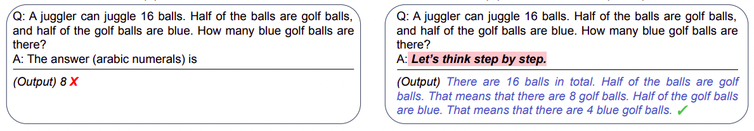
Zero-shot
Zero-shot CoT

Slide 15
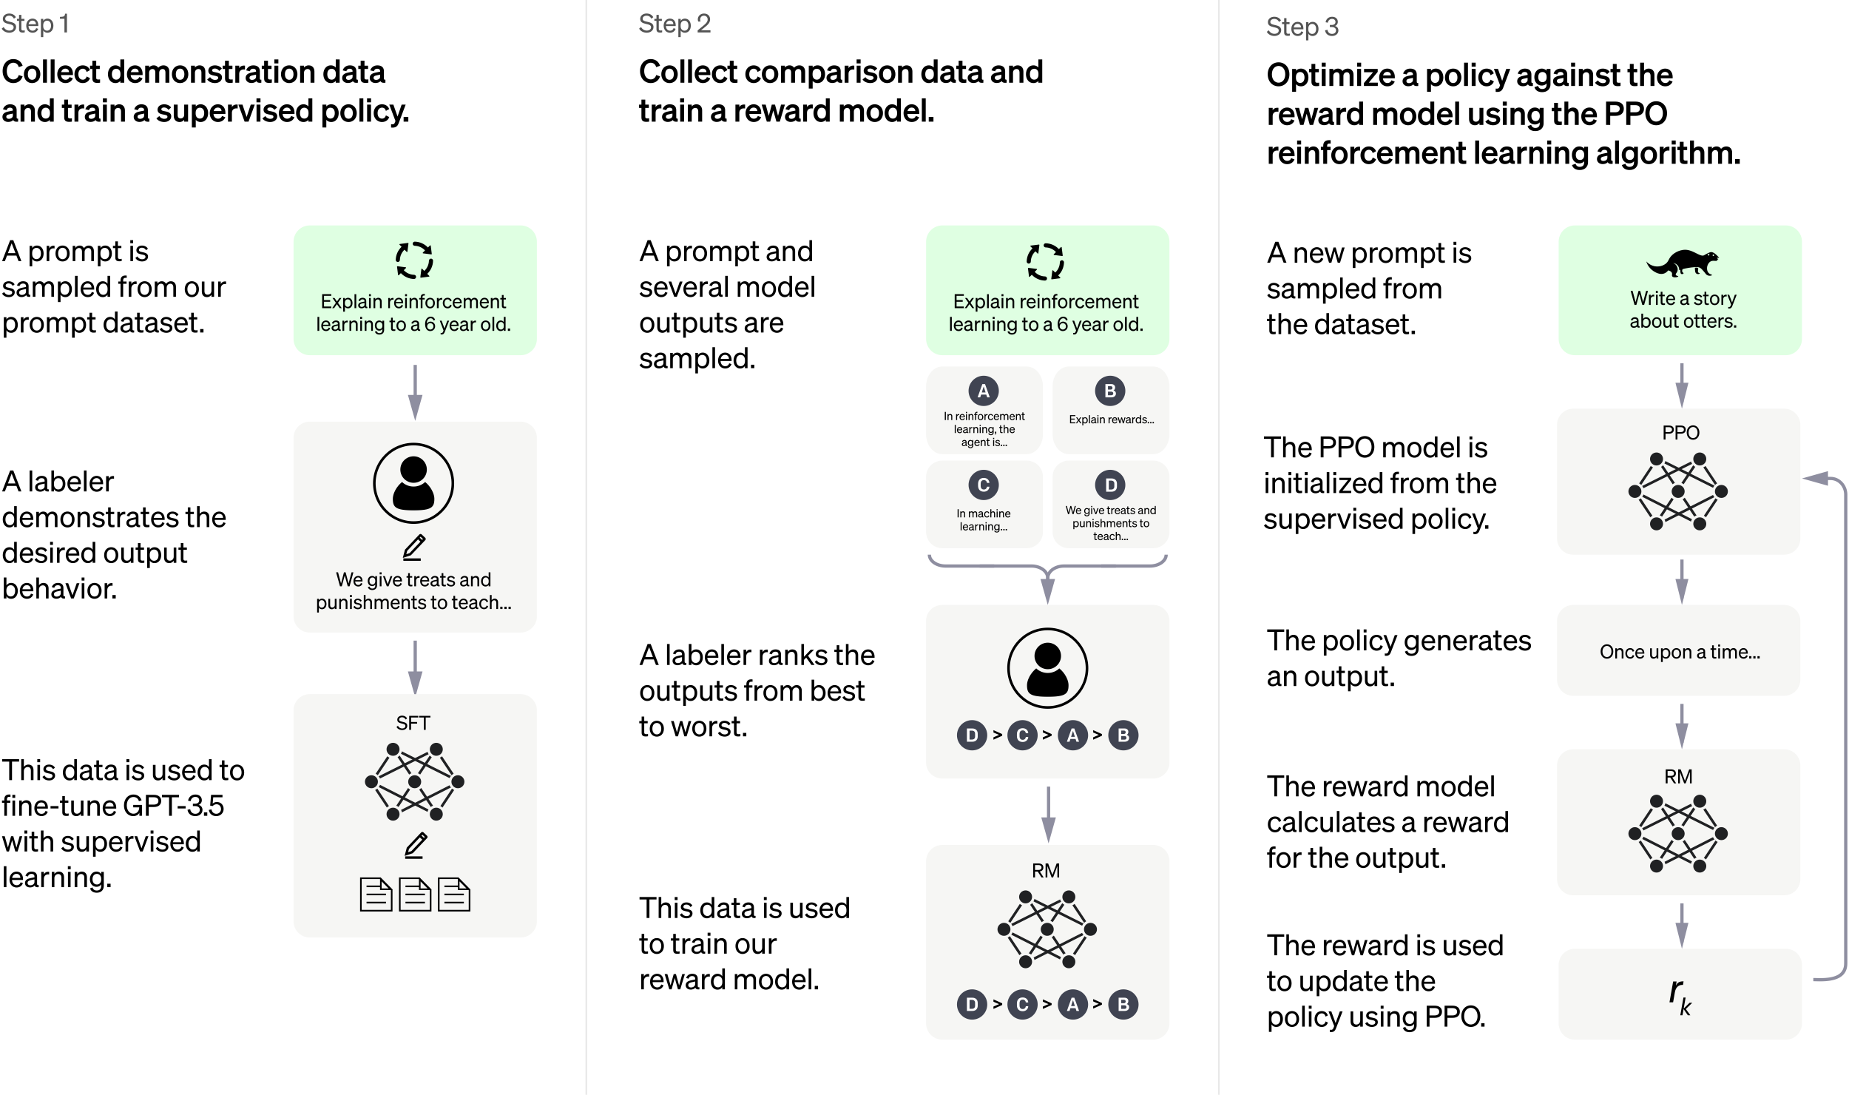

Slide 16
