Slide 1
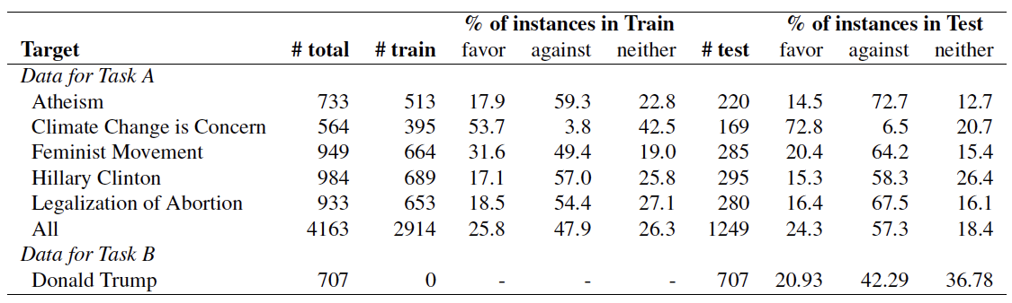

Slide 2




A pregnancy, planned or unplanned, brings spouses, families & everyone closer to each other. #Life is beautiful! #USA
It's so brilliant that #lovewins - now extend the equality to women's rights #abortionrights
Positive
Sentiment
#DonRients: people aren't just killed by guns. 9 people died and that's sad. But how many die daily from #abortion?
My body, my life. You fuck it up in a way I'm not prepared for and I will kill you.
Negative
Sentiment
Stance = Against
Stance = In-favor

Slide 3
A pregnancy, planned or unplanned, brings spouses, families & everyone closer to each other. #Life is beautiful! #USA
It's so brilliant that #lovewins - now extend the equality to women's rights #abortionrights
Sentiment
Positive
@ScottWalker goes along with the world is the law of God and not of men
Only one can have bodily autonomy
Sentiment
Neutral
#DonRients: people aren't just killed by guns. 9 people died and that's sad. But how many die daily from #abortion?
My body, my life. You fuck it up in a way I'm not prepared for and I will kill you.
Sentiment
Negative
Stance = Against
Stance = In-favor

Slide 4
Two Stance Detection Paradigms
Stance
xxx
Pro-abortion
Can be generalize to…
xxx
Anti-abortion
Sentiment, Relevance etc.
Paradigm 1: Fine-tuning BERT
Paradigm 2: Prompting LLMs
Load a pre-trained BERT
Download pre-trained BERT Standard BERT Domain-specific BERT Pre-training your own BERT
Fine-tune BERT
Fine-tune with large amount of labeled tweets
Prompt Engineering
Zero-shot Few-shot CoT Prompt-tuning
Prompt LLMs
ChatGPT FLAN-T5 Other LLMs Fine-tune LLMs
Evaluate
Require few labeled tweets to select LLMs and prompts

Slide 5
Two Stance Detection Paradigms
Stance
xxx
Anti-vaccine
Also…
xxx
Pro-vaccine
Sentiment, Political Leaning, Relevance etc.
Method 1: Human + BERT
Method 2: Prompt LLM (GPT-3 etc.)
Human Labeling
Trained Human Raters Crowd-sourcing
Quality Assurance
Inter-rater reliability BACE model
Fine-tune BERT
Pre-trained models Domain-specific models
Prompt Engineering
Zero-shot Few-shot CoT AutoPrompt
Prompt GPT
GPT-3 Flan-t5 Fine-tuning
Quality Assurance
Few human labels

Slide 6
1.2% of abortions happen at 21 weeks+ (these are only exceptions) #letstalkabortion
Stance = Neutral-or-unclear

Slide 7
“The animal didn't cross the street because it was too tired.”

Slide 8
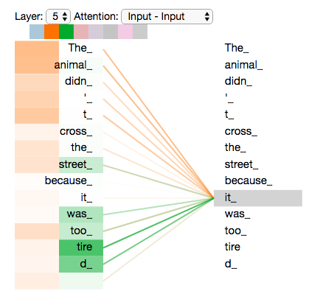
Head 1

Slide 9
Head 1
Head 2

Slide 10
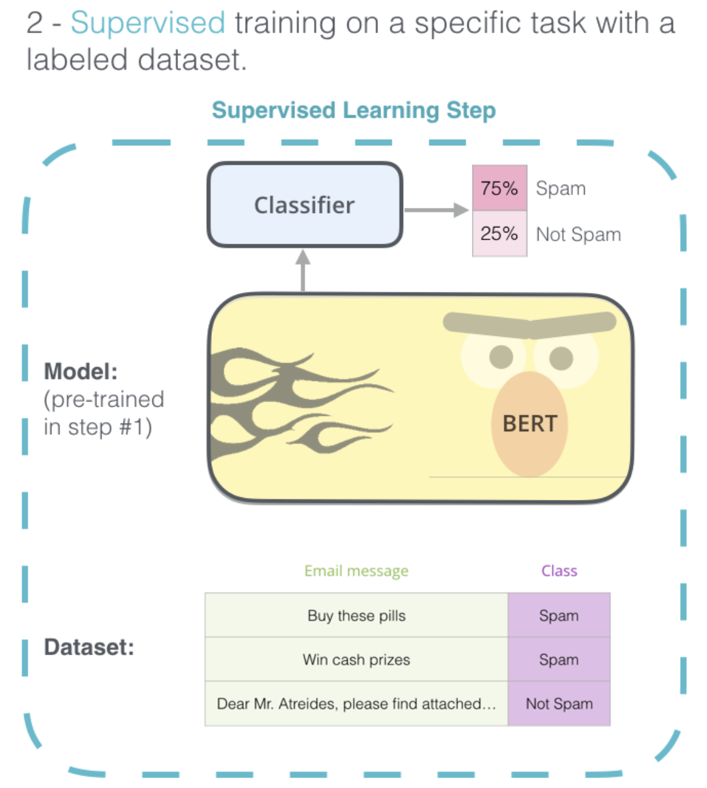
Against
In-favor
Tweet
Stance
Life is beautiful! | Against
Stop killing lives! | Against
My body, my life. | In-favor

Slide 12
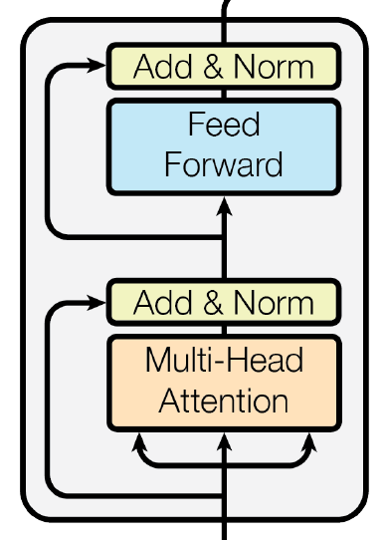
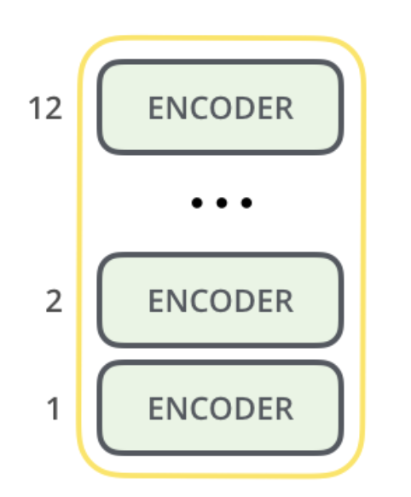
Classifier
Prediction
“Encoder”
Multi-Head
Attention
Input Text

Slide 13
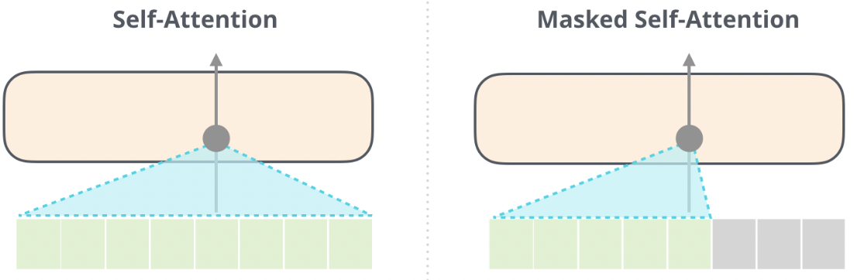
Encoder
Decoder
Tweet
Tweet Embedded in the Prompt
Generated Words

Slide 14
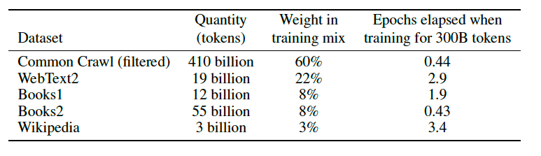

Slide 15
Task Description
What is the stance of the tweet below with respect to 'Legalization of Abortion'? Please use exactly one word from the following 3 categories to label it: 'in-favor', 'against', 'neutral-or-unclear'. Here is the tweet: “It's so brilliant that #lovewins - now extend the equality to women's rights #abortionrights.” The stance of the tweet is:
Possible Labels
Tweet of Interest

Slide 16
Task Description
What is the stance of the tweet below with respect to 'Legalization of Abortion'? If we can infer from the tweet that the tweeter supports 'Legalization of Abortion', please label it as 'in-favor'. If we can infer from the tweet that the tweeter is against 'Legalization of Abortion', please label is as 'against'. If we can infer from the tweet that the tweeter has a neutral stance towards 'Legalization of Abortion', please label it as 'neutral-or-unclear'. If there is no clue in the tweet to reveal the stance of the tweeter towards 'Legalization of Abortion', please also label is as 'neutral-or-unclear'. Please use exactly one word from the following 3 categories to label it: 'in-favor', 'against', 'neutral-or-unclear'. Here is the tweet: “It's so brilliant that #lovewins - now extend the equality to women's rights #abortionrights.” The stance of the tweet is:
Label Definitions
Possible Labels
Tweet of Interest

Slide 17
What is the stance of the tweet below with respect to COVID-19 vaccine? If the tweet is in-favor of COVID-19 vaccine, please label it as "in-favor". If the tweet is against COVID-19 vaccine, please label is as "against". If the tweet is neutral to COVID-19 vaccine, please label it as "neutral-or-unclear". If the stance of the tweet is not clear, please also label it as "neutral-or-unclear". If the tweet is sarcastic and is difficult to infer the true stance, please also label is as "neutral-or-unclear". Please use exactly one word from the following 3 categories to label it: "in-favor", "against", "neutral-or-unclear". Here is the tweet. "covid clusters among the vaccinated are killing our back-to-normal dreams" The stance of the tweet is:

Slide 18
Examples (1 per class)
What is the stance of the tweet below with respect to 'Legalization of Abortion'? If we can infer from the tweet that the tweeter supports 'Legalization of Abortion', please label it as 'in-favor'. If we can infer from the tweet that the tweeter is against 'Legalization of Abortion', please label is as 'against'. If we can infer from the tweet that the tweeter has a neutral stance towards 'Legalization of Abortion', please label it as 'neutral-or-unclear'. If there is no clue in the tweet to reveal the stance of the tweeter towards 'Legalization of Abortion', please also label is as 'neutral-or-unclear'. Please use exactly one word from the following 3 categories to label it: 'in-favor', 'against', 'neutral-or-unclear'. Here are some examples of tweets. Make sure to classify the last tweet correctly.
Q: Tweet: it's a free country. freedom includes freedom of choice.
Is this tweet in-favor, against, or neutral-or-unclear?
A: in-favor
Q: Tweet: i really don't understand how some people are pro-choice. a life is a life no matter if it's 2 weeks old or 20 years old.
Is this tweet in-favor, against, or neutral-or-unclear?
A: against
Q: Tweet: so ready for my abortion debate Is this tweet in-favor, against, or neutral-or-unclear?
A: neutral-or-unclear
Q: Tweet: “i really don't understand how some people are pro-choice. a life is a life no matter if it's 2 weeks old or 20 years old.”
Is this tweet in-favor, against, or neutral-or-unclear?
A:
Tweet of Interest

Slide 19
What is the stance of the tweet below with respect to 'Legalization of Abortion'? If we can infer from the tweet that the tweeter supports 'Legalization of Abortion', please label it as 'in-favor'. If we can infer from the tweet that the tweeter is against 'Legalization of Abortion', please label is as 'against'. If we can infer from the tweet that the tweeter has a neutral stance towards 'Legalization of Abortion', please label it as 'neutral-or-unclear'. If there is no clue in the tweet to reveal the stance of the tweeter towards 'Legalization of Abortion', please also label is as 'neutral-or-unclear'. Here is the tweet: “It's so brilliant that #lovewins - now extend the equality to women's rights #abortionrights.” Please make sure that at the end of your response, use exactly one word from the following 3 categories to label the stance with respect to 'Legalization of Abortion': 'in-favor', 'against', 'neutral-or-unclear'. Let's think step by step.
Tweet of Interest
Possible Labels
Request for
Chain-of-Thought

Slide 20
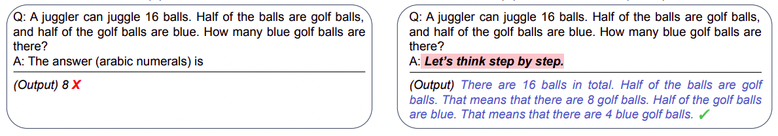
Zero-shot
Zero-shot CoT

Slide 21
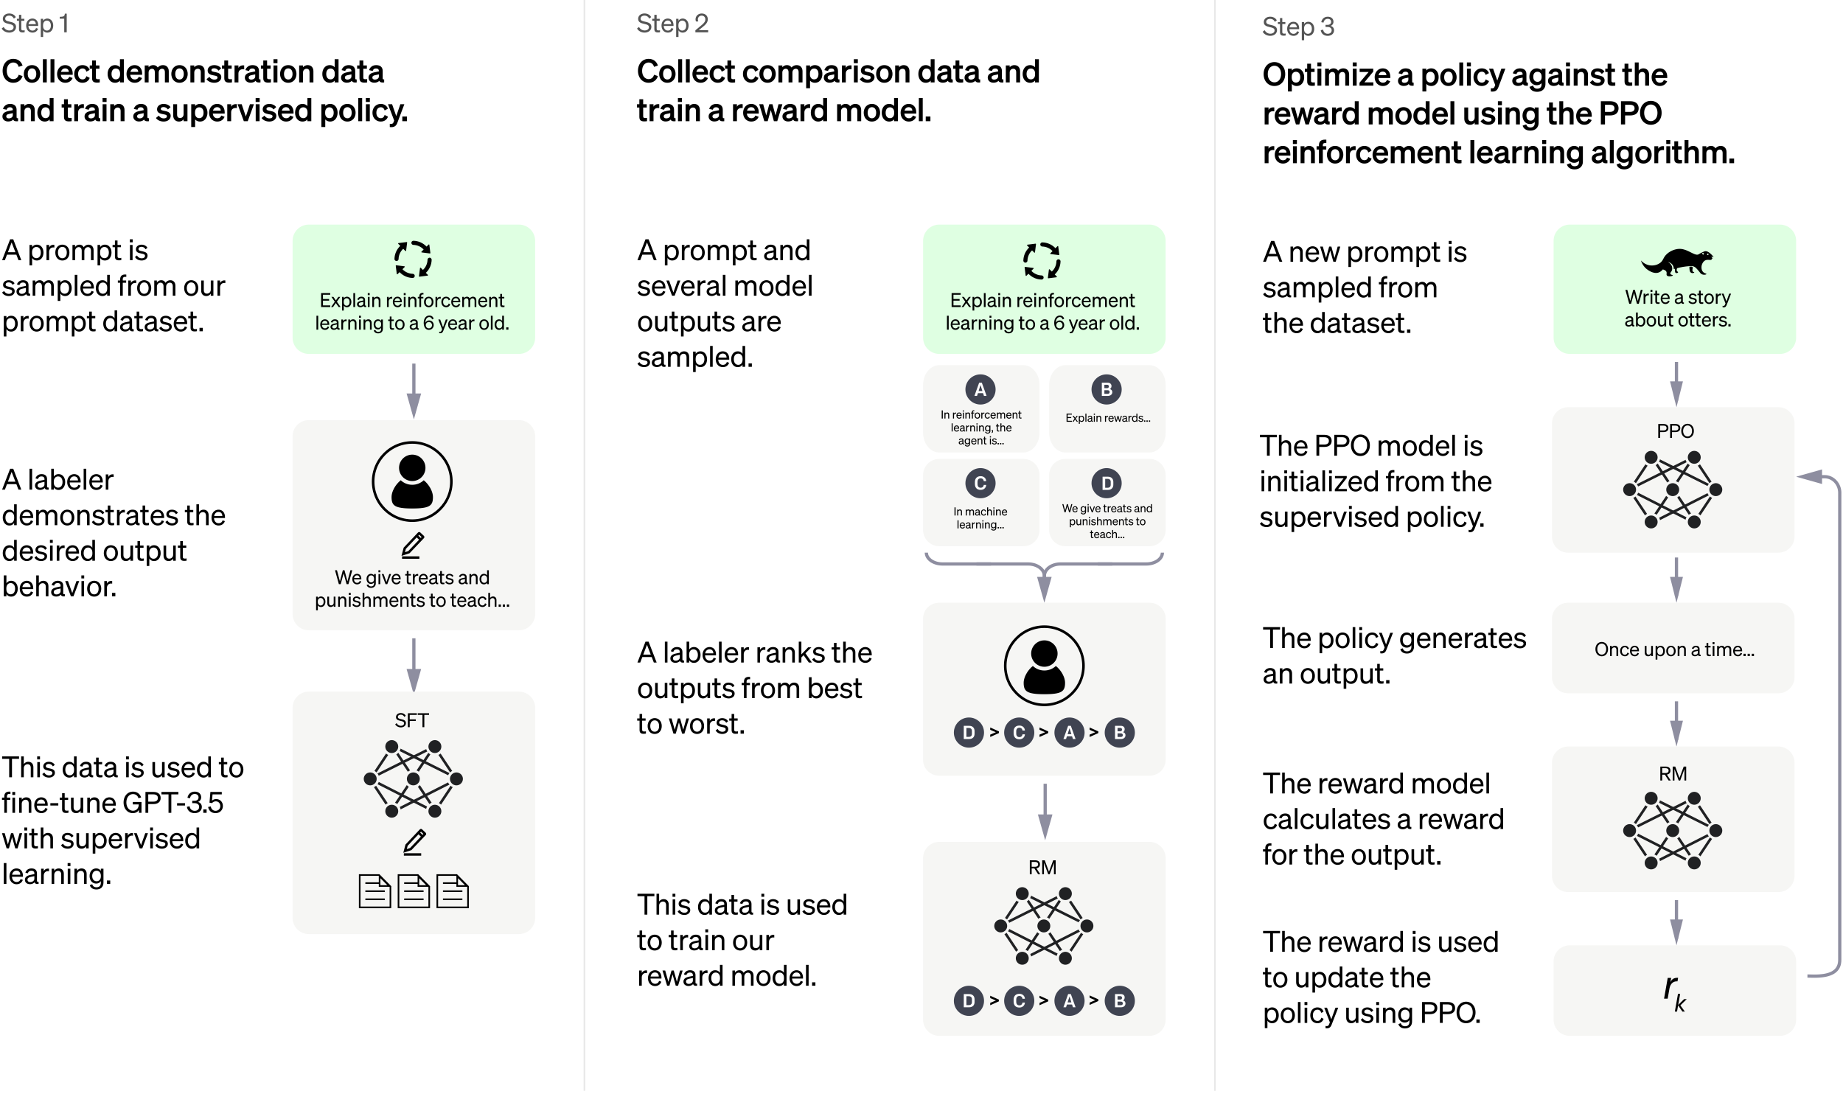

Slide 22
