Slide 1
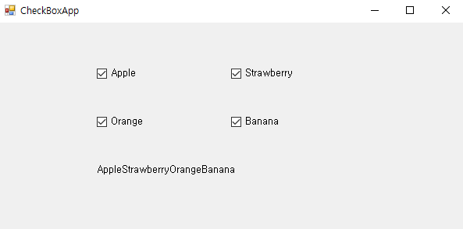
using System;
using System.Windows.Forms;
namespace CheckBoxSample
{
public partial class Form1 : Form
{
public Form1()
{
InitializeComponent();
}
private void UpdateLabel(string s, bool b)
{
if (b)
{
label1.Text += s; // label1의 Text 프로퍼티에 문자열 추가
}
else
{
string strTemp = label1.Text;
int i = strTemp.IndexOf(s);
label1.Text = strTemp.Remove(i, s.Length);
}
}
private void checkBox1_CheckedChanged(object sender, EventArgs e)
{
UpdateLabel(checkBox1.Text, checkBox1.Checked);
}
private void checkBox2_CheckedChanged(object sender, EventArgs e)
{
UpdateLabel(checkBox2.Text, checkBox2.Checked);
}
private void checkBox3_CheckedChanged(object sender, EventArgs e)
{
UpdateLabel(checkBox3.Text, checkBox3.Checked);
}
private void checkBox4_CheckedChanged(object sender, EventArgs e)
{
UpdateLabel(checkBox4.Text, checkBox4.Checked);
}
}
}

Slide 2
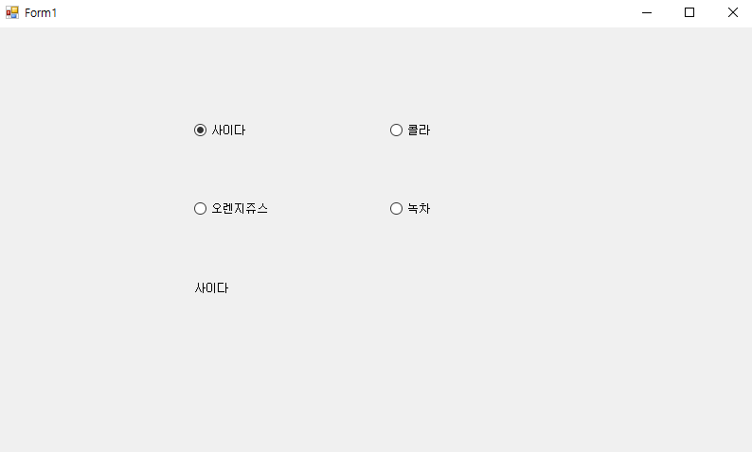
using System;
using System.Windows.Forms;
namespace RadioButtonApp
{
public partial class Form1 : Form
{
public Form1()
{
InitializeComponent();
}
private void radioButton1_CheckedChanged(object sender, EventArgs e)
{
label1.Text = radioButton1.Text;
}
private void radioButton2_CheckedChanged(object sender, EventArgs e)
{
label1.Text = radioButton2.Text;
}
private void radioButton3_CheckedChanged(object sender, EventArgs e)
{
label1.Text = radioButton3.Text;
}
private void radioButton4_CheckedChanged(object sender, EventArgs e)
{
label1.Text = radioButton4.Text;
}
}
}

Slide 3
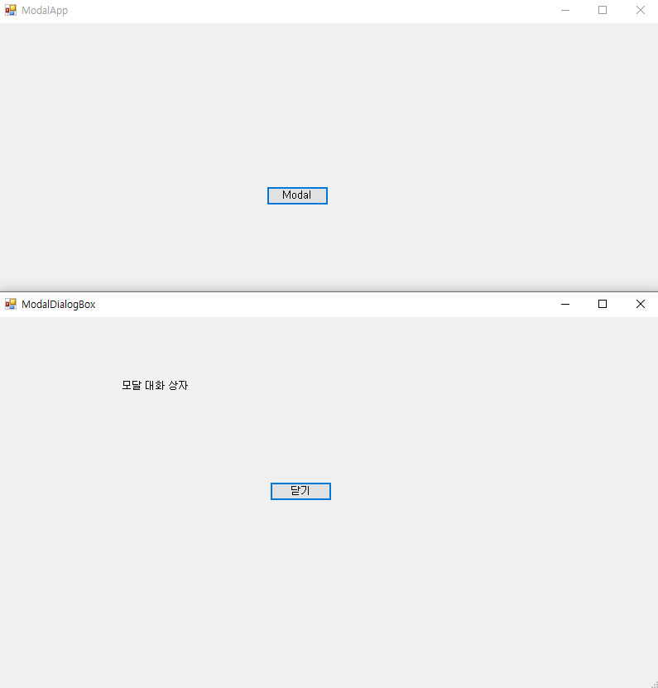
using System;
using System.Windows.Forms;
namespace ModalApp
{
public partial class Form1 : Form
{
public Form1()
{
InitializeComponent();
}
private void button1_Click(object sender, EventArgs e)
{
Form2 form2 = new Form2(); // form2를 모달 방식으로 띄운다.
form2.ShowDialog();
}
}
}
using System;
using System.Windows.Forms;
namespace ModalApp
{
public partial class Form2 : Form
{
public Form2()
{
InitializeComponent();
}
private void button1_Click(object sender, EventArgs e)
{
Close();
}
}
}

Slide 4
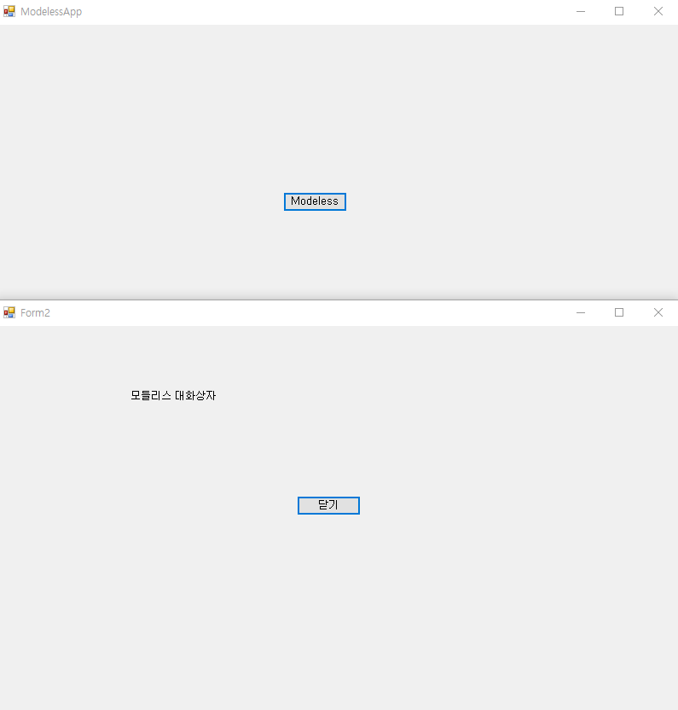
using System;
using System.Windows.Forms;
namespace ModelessApp
{
public partial class Form1 : Form
{
public Form1()
{
InitializeComponent();
}
private void button1_Click(object sender, EventArgs e)
{
Form2 form2 = new Form2(); // form2를 모덜리스 방식으로 띄운다.
form2.Show();
}
}
}
using System;
using System.Windows.Forms;
namespace ModelessApp
{
public partial class Form2 : Form
{
public Form2()
{
InitializeComponent();
}
private void button1_Click(object sender, EventArgs e)
{
Close();
}
}
}

Slide 5
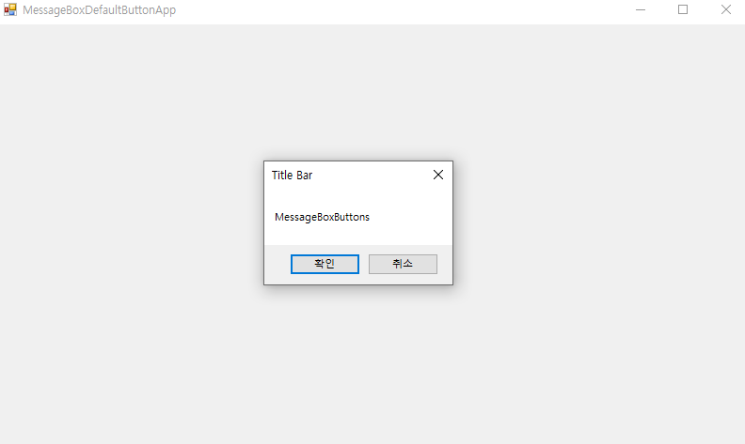
using System;
using System.Windows.Forms;
namespace MessageBoxApp
{
public partial class Form1 : Form
{
public Form1()
{
InitializeComponent();
}
private void Form1_Load(object sender, EventArgs e)
{
}
private void Form1_Click(object sender, EventArgs e)
{
MessageBox.Show("MessageBoxButtons", "Title Bar", MessageBoxButtons.OKCancel);
}
}
}

Slide 6
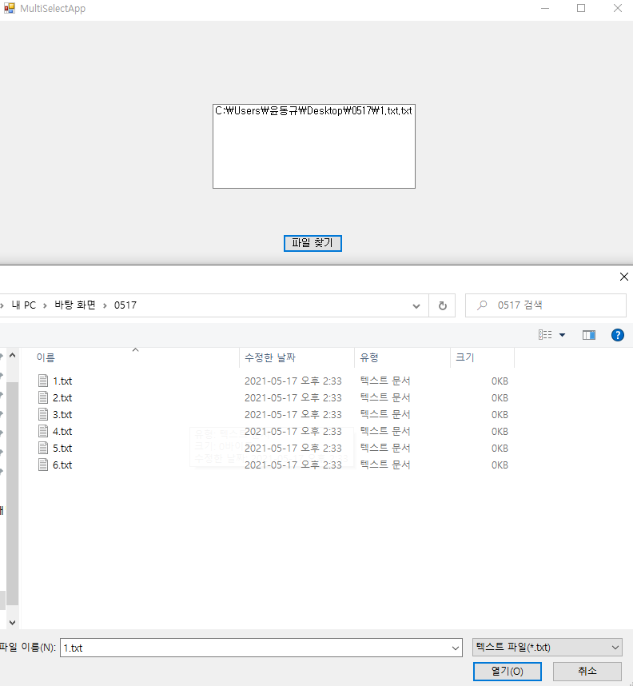
using System;
using System.Windows.Forms;
namespace OpenFileDialogApp
{
public partial class Form1 : Form
{
public Form1()
{
InitializeComponent();
}
private void button1_Click(object sender, EventArgs e)
{
openFileDialog1.InitialDirectory = @"C:\";
openFileDialog1.Filter = "텍스트 파일(*.txt)|*.txt|모든 파일(*.*)|*.*";
openFileDialog1.FilterIndex = 1; // "텍스트 파일(*.txt)|*.txt“
openFileDialog1.RestoreDirectory = true;
openFileDialog1.ShowDialog();
textBox1.Text = openFileDialog1.FileName;
}
}
}

Slide 7
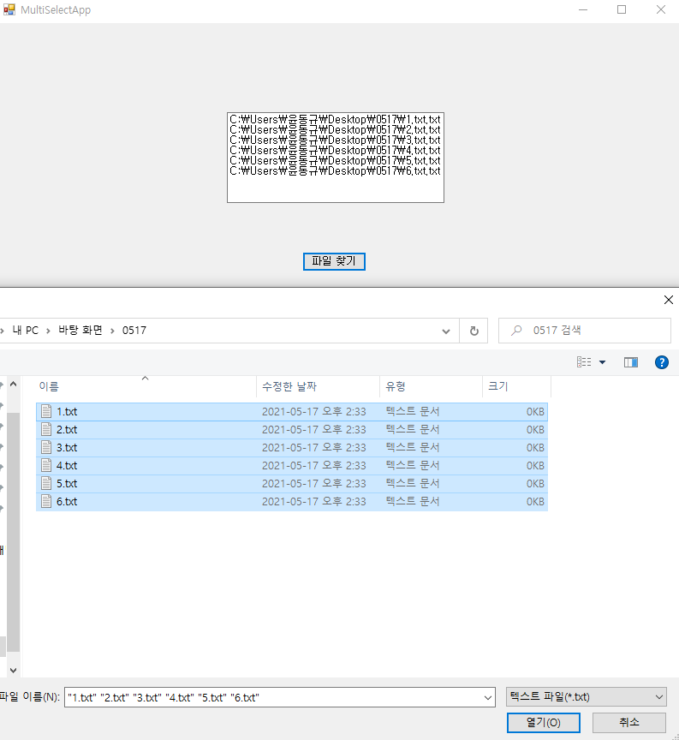
using System;
using System.Windows.Forms;
namespace OpenFileDialogApp
{
public partial class Form1 : Form
{
public Form1()
{
InitializeComponent();
}
private void button1_Click(object sender, EventArgs e)
{
openFileDialog1.InitialDirectory = @"C:\";
openFileDialog1.Filter = "텍스트 파일(*.txt)|*.txt|모든 파일(*.*)|*.*";
openFileDialog1.FilterIndex = 1;
openFileDialog1.RestoreDirectory = true;
openFileDialog1.Multiselect = true;
openFileDialog1.ShowDialog();
foreach (string strTmp in openFileDialog1.FileNames)
{
textBox1.Text += strTmp;
textBox1.Text += "\r\n";
}
}
}
}

