Slide 1



DEPTCONNECT
Smart Department Event Hub
Team Name
Sparkers
PROJECT MEMBERS
Mohammed Yunus A
Naveena S
Nandeesh G
Pranesh Babu T J
AIHARI D (19ITR028)
PROJECT GUIDE
Ms.S.Sripriya
Notes:
30 June 2023
1-59
1

Slide 2

Abstract
The DeptConnect web application is a centralized platform designed to streamline the management and participation of departmental events within academic institutions. Traditional methods of event communication—via notice boards or messaging apps—often lead to missed opportunities, confusion, and poor engagement. DeptConnect addresses these challenges by offering a unified, interactive, and intelligent event hub. Built using modern web technologies, the platform ensures a responsive, user-friendly, and scalable solution tailored for departmental needs.

Slide 3
Objectives
To Centralize Event Management
To Enable Real-Time Communication
Guide Students with Accurate Directions
To Enhance User Experience
To Empower Organizers
To Collect Feedback and Improve Future Events

Slide 4
Existing System
Traditional methods of event communication—via notice boards or messaging apps—often lead to missed opportunities, confusion, and poor engagement.
Students often miss or forget about department events due to lack of centralized communication, unclear directions, and scattered registration processes.
Event schedules, locations, and registration processes are often poorly communicated, leading to confusion and reduced participation.
Existing platforms don’t provide live updates, reminders, or feedback mechanisms, limiting engagement and post-event reflection.

Slide 5
Proposed Solution
A centralized web application to manage all department events with
Live registration and countdown
Map-based navigation to venues
Real-time updates and notifications
Participation tracking and feedback system
Admin Dashboard for Event Management

Slide 6
Technology Used
Frontend: HTML, CSS, JavaScript, React
Backend: Node.js
Database: MongoDB / MySQL
APIs: Google Maps API
Hosting: Netlify

Slide 7
Development Tools
Visual Studio Code – Code editor
GitHub – Version control and collaboration
Firebase Storage – For hosting

Slide 8
Modules
1.Login Module
2.Home Module
3.Event Dashboard
4. Interactive Map and Location
5. Admin Panel
6. Certificate & Feedback Manager

Slide 9
Logic Used
Smart search and filter algorithm for event recommendations
Real-time countdown timer logic
Geolocation and routing for venue direction
QR generation logic for registrations
Leaderboard tracking using point-based sorting

Slide 10
Impacts and Benefits
Improved event participation
Clear communication for students and staff
Organized history of department activities
Boosts student involvement and transparency
Encourages collaboration and innovation

Slide 11
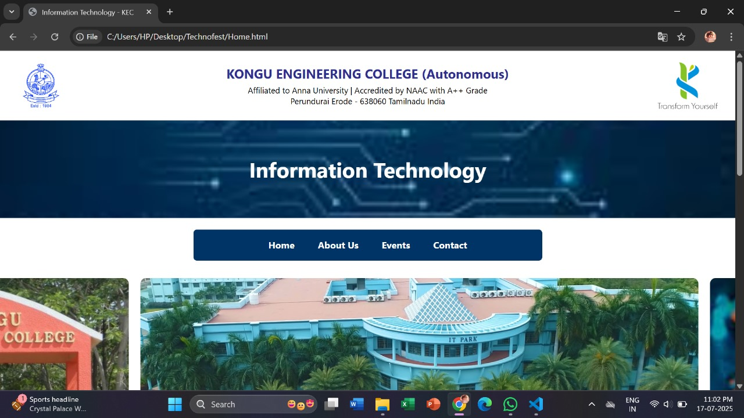
Home Module

Slide 12
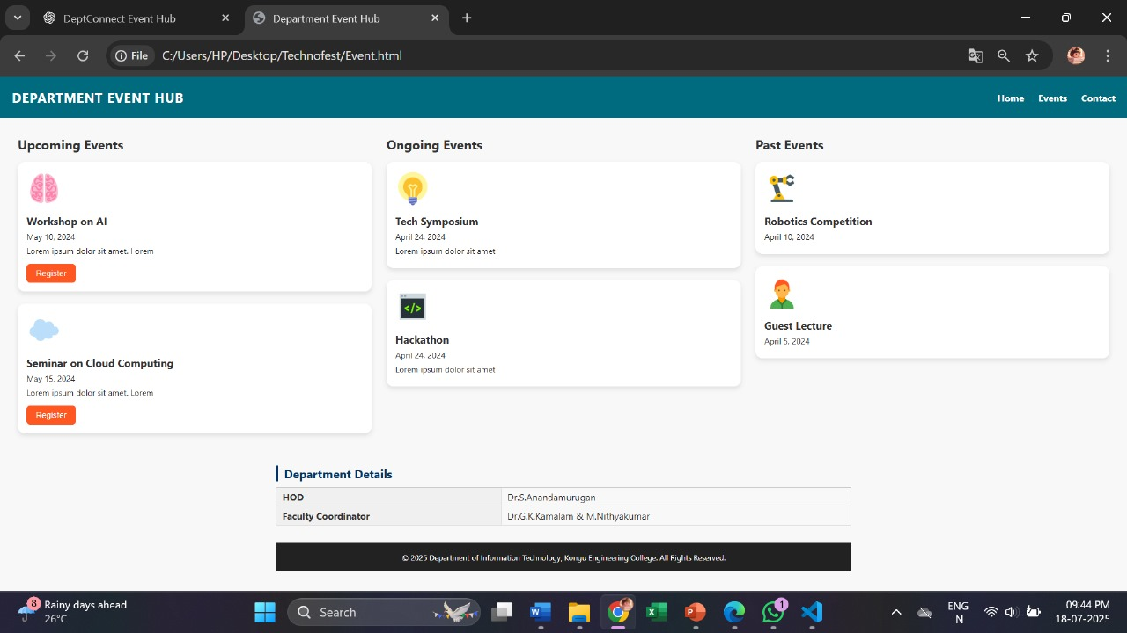
Event Dashboard

Slide 13
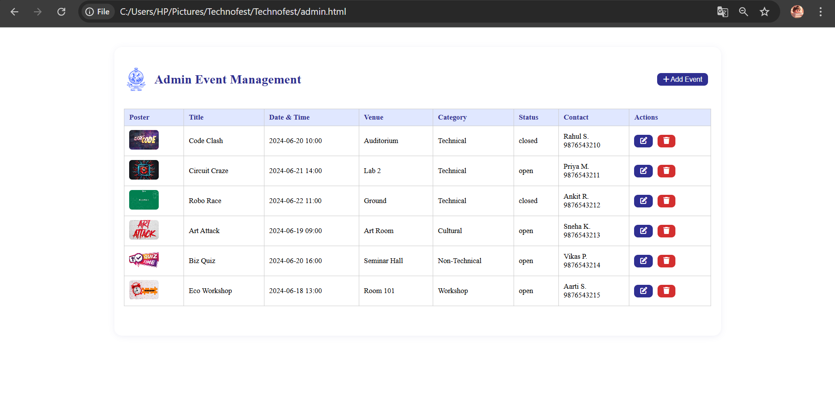
Admin Module

Slide 14
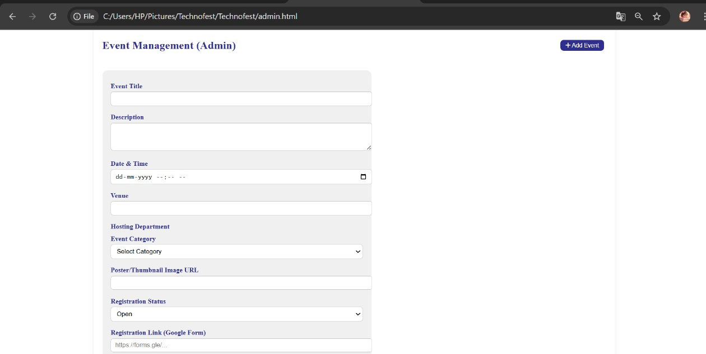
Admin Module

Slide 15
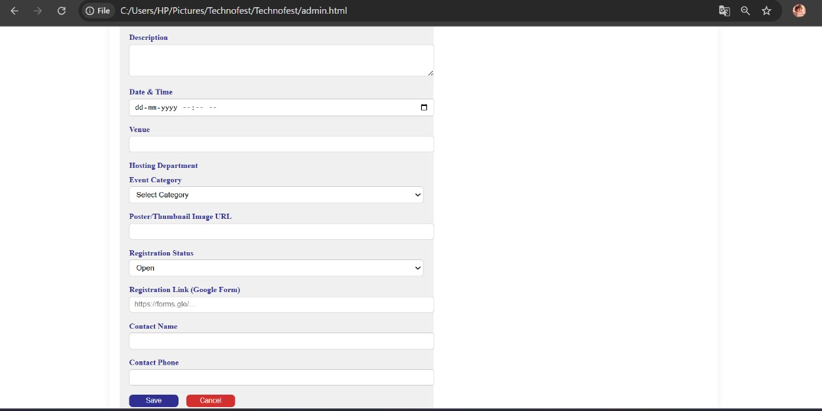
Admin Module

Slide 16
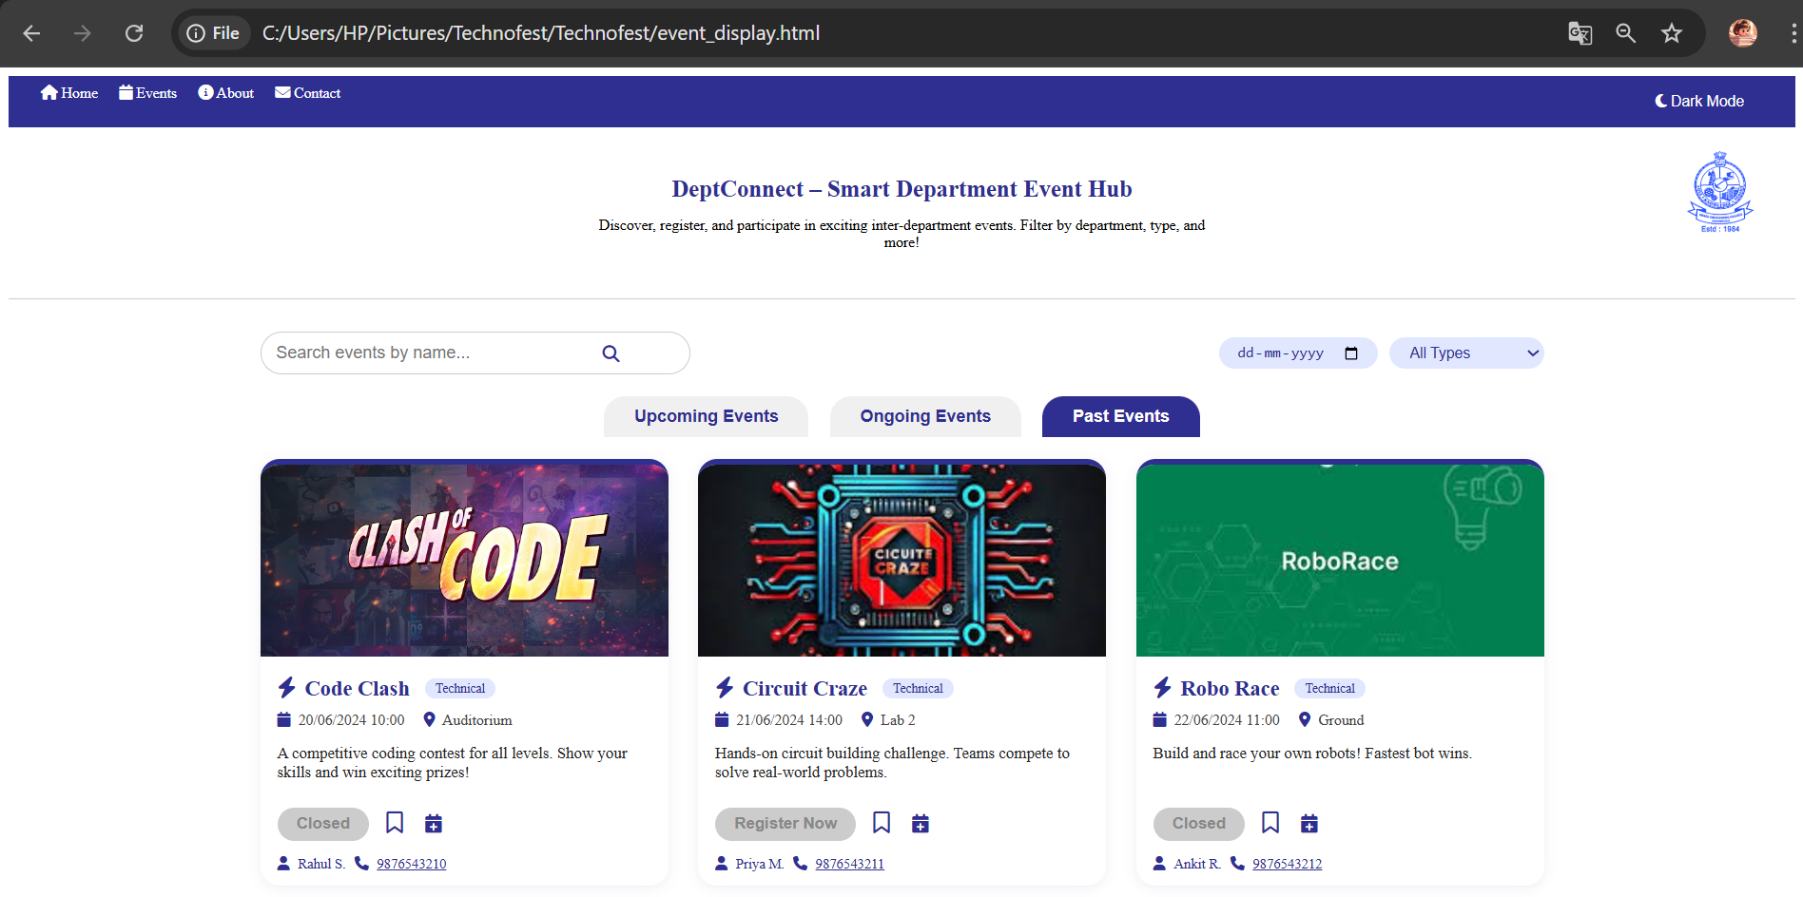
Admin Module

Slide 17
Thank you !!

