Slide 1
Increasing property value
in Ames, Iowa
Yunus Herman

Slide 2
Audience :
Golden Realty sales agents
Problem:
How to increase company revenue and sales agent commissions
Data source :
Houses in Ames, IO (2006 - 2010)
https://www.kaggle.com/c/dsir-202021214-e-project-2-regression-challenge/data

Slide 3
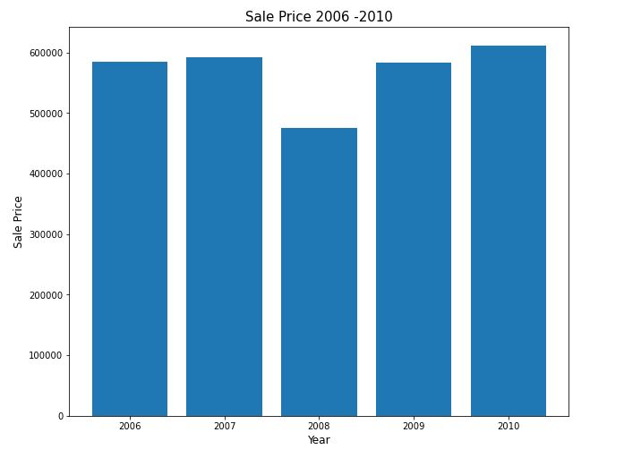

Slide 4
Heating quality
Basement Full Bathroom
Basement Half Bathroom
Full bathroom
Half bathroom
Bedroom
Kitchen quality
Fireplaces
Kitchen
Garage condition
Garage fit cars
Paved driveway
Wood deck in sqft
Open porch in sqft
Enclosed porch
Screen porch
Central Air
Features:

Slide 5
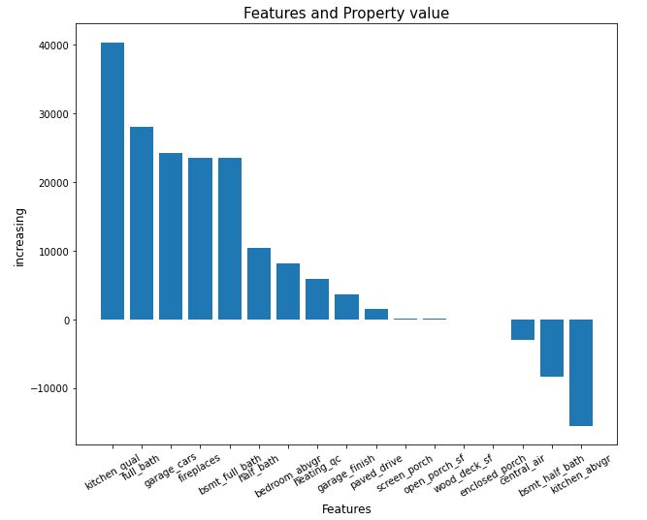
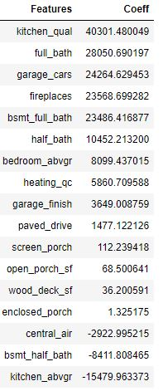

Slide 6
solution:
Don’t:
Additional Kitchen
Half bathroom in Basement
Central Air
Enclosed Porch
Wood Deck
Suggest:
Kitchen renovation
Add full bathroom
Expand Garage (can fit 2, 3 cars)
Add fireplace
Built full bathroom in basement
By increase the house value before selling, good for customers, Golden realty, and sales agents

