Slide 1
Spotify vs Netflix
Yunus Herman

Slide 2
Webscraping
Using pushshift API (https://api.pushshift.io)
Subreddits : Spotify and Netflix
10,000 rows each Subreddit, before Jan 31,2021

Slide 3
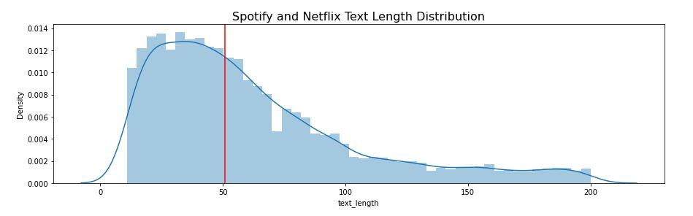
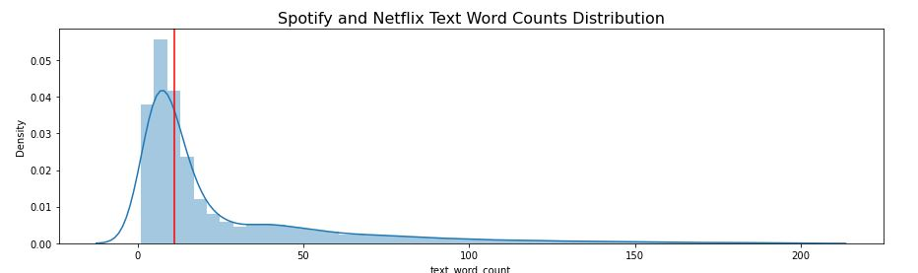
Distribution:

Slide 4
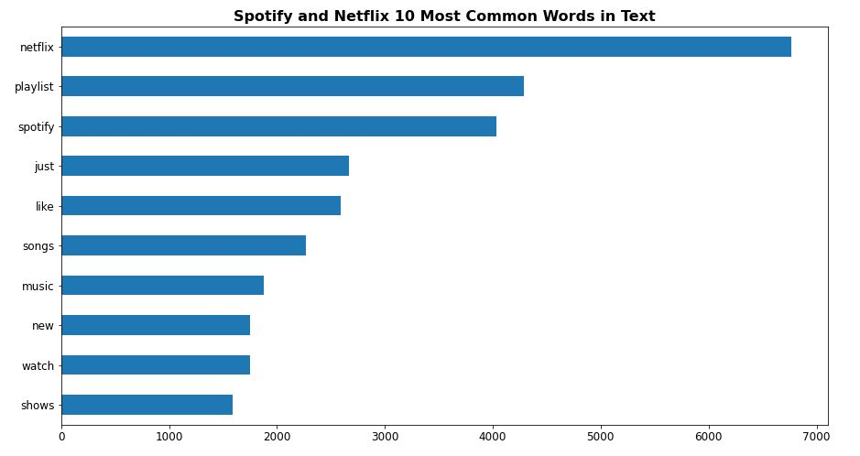
Top 10 common words

Slide 5
Modeling
Using Count Vectorizer and TF-IDF with english stop words:
Bayes
KNN
Random Forest Classifier

Slide 6
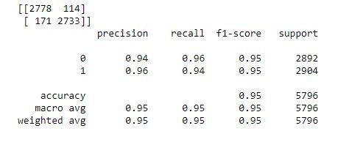
Bayes
Train score : 97.5 %
Test score : 95 %

Slide 7
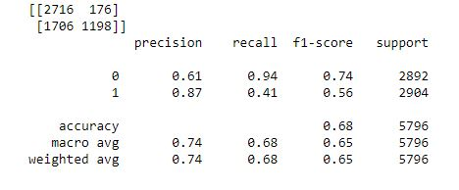
KNN
Train score: 75%
Test score : 67.5%

Slide 8
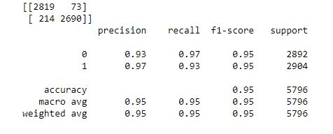
Random forest Classifier
Train score : 99.9%
Test score : 95%

Slide 9
Conclutions:
Bayes and Random forest classifier model is the best to predict classification data
In this project or similar project

