Slide 1
DOM VS V-DOM
DOM is a HTML sctructure while V-DOM is the Virtual Version of DOM.

Slide 2
ReactJS
A JS frontend library that is developed by Facebook and it’s a SPA

Slide 3
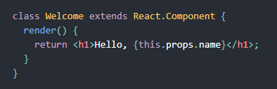
Class Component
OOP concept to be used in components making and is considered stateful

Slide 4

Functional Component
Function based concept, it’s considered stateless

