Slide 1
AAD Project
Data Flow & JWT Handling
Frontend ↔ Backend communication overview

Slide 2
Frontend Communication Flow
CoreModule hosts singleton services & interceptors
AuthService.login(): POST /api/auth/login ⇒ saves JWT to localStorage
JwtInterceptor attaches `Authorization: Bearer <token>` to each request
AuthGuard / RoleGuard protect routes based on login state & user.role

Slide 3
Typical Request Life‑Cycle
Add‑to‑Cart Example:
1. ProductCard → cart.add(product.id)
2. CartService POST /api/carts/items (token auto‑injected)
3. Backend authenticates via JwtFilter → SecurityContext
4. CartController → CartService → CartRepository persists item
5. Response updates currentCart$ → UI badge refreshes

Slide 4
Backend Architecture & JWT Validation
Layered structure:
• @RestController → @Service → @Repository
JWT flow on each request:
1. SecurityConfig sets STATELESS & adds JwtAuthenticationFilter
2. Filter extracts & validates token, builds Authentication
3. SecurityContextHolder stores user → Controllers use @AuthenticationPrincipal

Slide 5
End‑to‑End Login Trace
Angular LoginComponent
→ AuthService.login()
→ POST /api/auth/login
→ AuthController → AuthenticationManager
→ JwtService.generateToken()
← { token, user } ← AuthController
AuthService.saveToken() → localStorage + BehaviorSubject

Slide 6
Key Takeaways
Single source of truth: token lives only in AuthService
Automatic header injection keeps code DRY
Backend is fully stateless; user context is rebuilt per request
Clear separation: Components → Services → HTTP → Controllers → Services → Repos

Slide 7
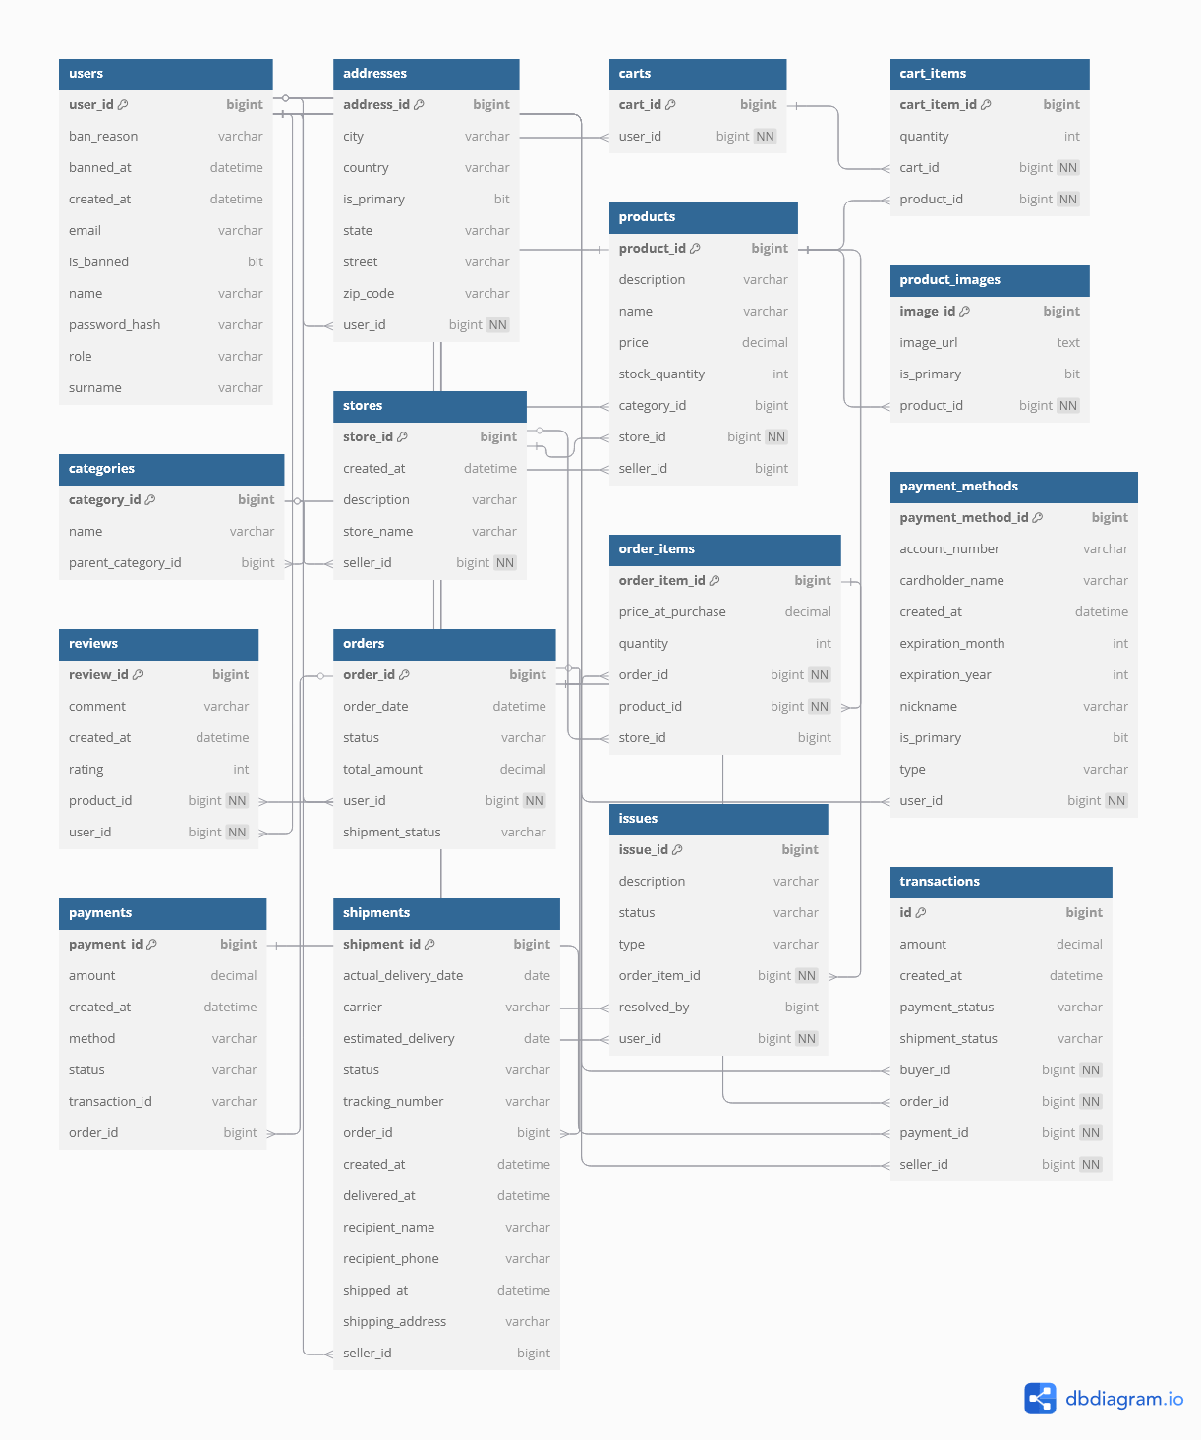
ER model

Slide 8
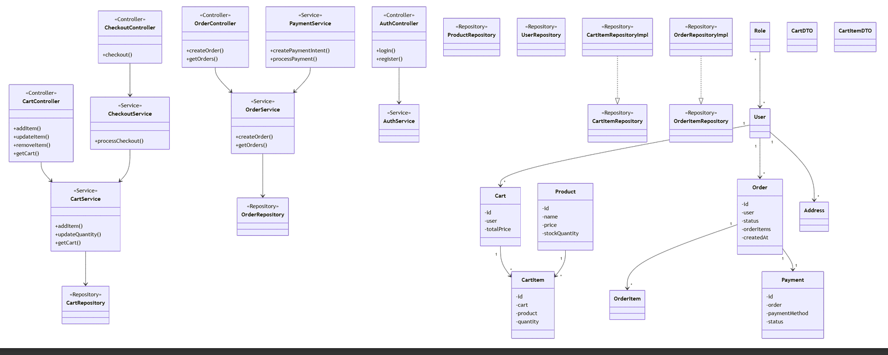

Slide 9
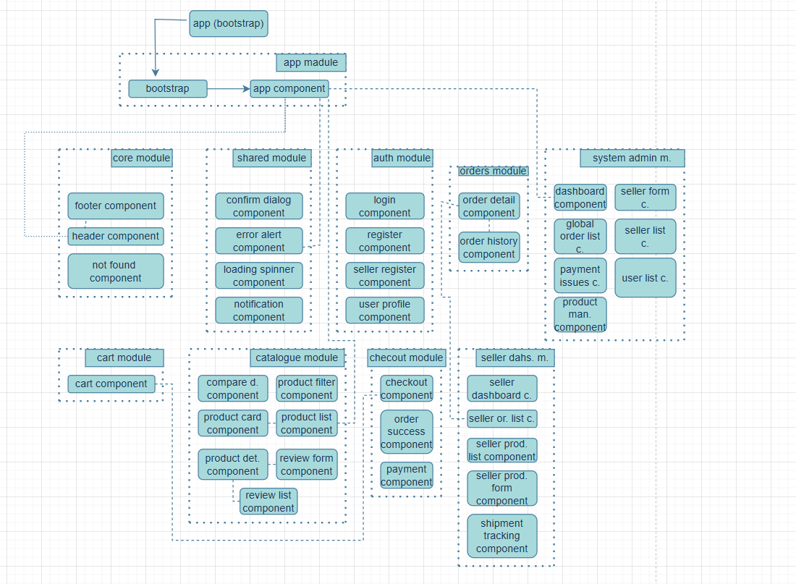

Slide 10
