Slide 1

Technology Trend Analysis: The 2024 Report
Saw Yu Nwe
12/6/2025

Slide 2



OUTLINE
Executive Summary
Introduction
Methodology
Results
Visualization – Charts
Dashboard
Discussion
Findings & Implications
Conclusion
Appendix

Slide 3

EXECUTIVE SUMMARY
Data Source: Stack Overflow Developer Survey (2024)
Focus: Programming Languages, Database Systems, Cloud Platforms, and Web Frameworks
Outlook: 2025 - 2026

Slide 4

INTRODUCTION
This report provides a strategic forecast, indicating a critical shift in the technology landscape.
Key component of this shift include:
The convergence of established technologies with the rapid, pervasive integration of Artificial Intelligence (AI).
An increasing focus on high-performance computing solutions.

Slide 5

METHODOLOGY
(Source: Stack Overflow Developer Survey 2024)
Data Preparation (Python): Python was used to perform all data cleaning and wrangling tasks on the survey dataset.
External Data Integration: An external country list from worldometers.info was integrated to accurately clean and validate the 'Country' column.
Categorization: The 'EdLevel' column data was grouped and simplified into broader categories for easier analysis and clearer interpretation.
Visualization: All final analysis and corresponding data visualizations (graphs) were produced and presented using Google Looker Studio.

Slide 6
RESULTS

Slide 7
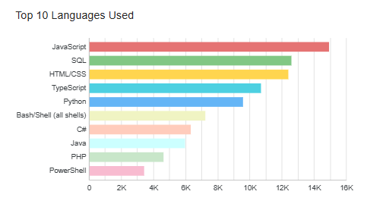
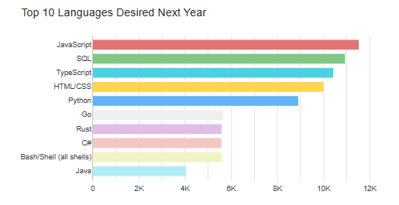
PROGRAMMING LANGUAGE TRENDS
Current Year
Next Year

Slide 8
PROGRAMMING LANGUAGE TRENDS - FINDINGS & IMPLICATIONS
Full-Stack Dominance: JavaScript and TypeScript continue their dominance in full-stack development.
AI Growth Leader: Python's popularity has surged in recent years, a trend that is expected to continue, driven primarily by developments in Data Science and Machine Learning.
Performance Focus: Rust and Go are rapidly adopted for critical infrastructure due to speed and memory safety, replacing older languages like PHP.

Slide 9
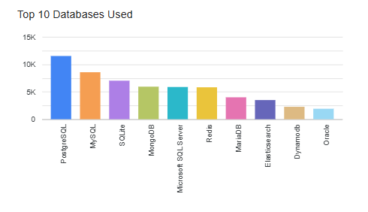
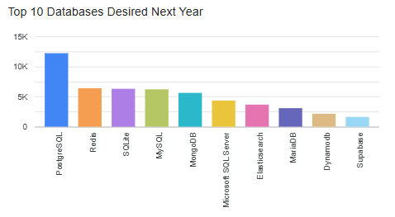
DATABASE TRENDS
Current Year
Next Year

Slide 10
DATABASE TRENDS - FINDINGS & IMPLICATIONS
RDBMSs: The relational database remains essential, with PostgreSQL solidifying its position as the preferred choice for enterprise-grade applications, often displacing MySQL.
AI/Vector Database Adoption : The rise of AI applications, such as RAG and semantic search, drives demand for diverse, powerful vector databases, alongside specialized key-value stores like Redis and traditional SQL/NoSQL systems.
Market Shift: The rise of Supabase signals a move toward open-source, integrated PostgreSQL backends that accelerate development, directly contrasting with Oracle's decline due to its high cost, proprietary nature, and legacy complexity.

Slide 11

DASHBOARD
https://github.com/yunwe/IBM-Data-Analyst-Capstone/blob/main/Tech_Trends.pdf

Slide 12
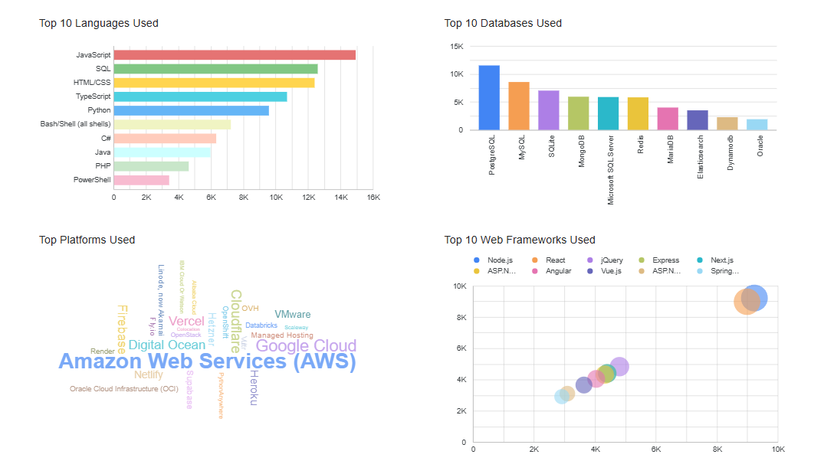
DASHBOARD TAB 1

Slide 13
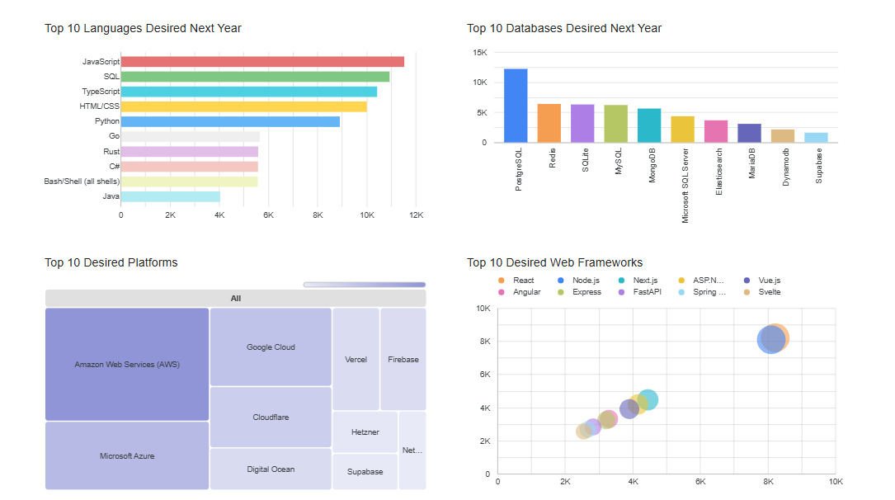
DASHBOARD TAB 2

Slide 14
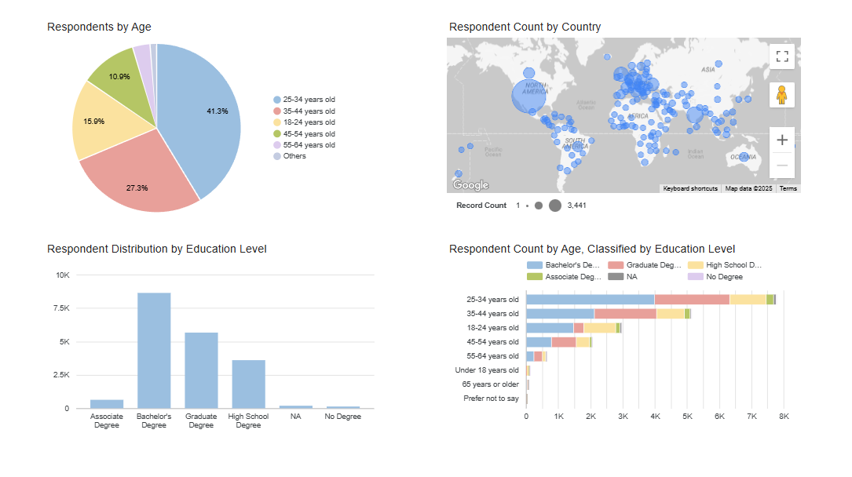
DASHBOARD TAB 3

Slide 15
DISCUSSION
Core Languages and Development Stack
Shifting Demand: New Languages and Frameworks
Demographics of the Professional Developer Workforce

Slide 16
OVERALL FINDINGS & IMPLICATIONS
Core Languages and Development Staples
These points reflect areas where the core technologies remain popular:
Focus on Web/Full Stack : The top 4 core technology remains nearly unchanged, with JavaScript, TypeScript, HTML/CSS, and SQL dominating the required skill set. Despite the attention given to AI, most developers are still focused on learning full-stack and web development.
Python's Rise is AI-Driven: Python remains the fifth sought-after language due directly to the recent rise of AI and Machine Learning.
Database Consistency: PostgreSQL was and remains the single most preferred choice for new database projects.

Slide 17
OVERALL FINDINGS & IMPLICATIONS
Shifting Demand: New Languages and Frameworks
These points highlight specific technologies that are actively gaining momentum or replacing older technologies:
New Language Adoption: High-performance languages like Go and Rust are becoming more popular, displacing established veterans like C#, Java, and PHP.
Web Framework Dominance and Change:
Node.js and React continue to dominate the web framework market with the largest market shares.
Older technologies like JQuery and Express are losing favor and, JQuery is dropping out of the top 10 for future learning.
FastAPI and Svelte are noted as fast-rising technologies to watch.
Cloud Platform Momentum: AWS remains the most desired platform to learn; however, Microsoft Azure shows the most promising trend, ranking as the second-most desired platform despite not being in the current top 10 in usage.

Slide 18
OVERALL FINDINGS & IMPLICATIONS
Demographics of the Professional Developer Workforce
Age Distribution: The professional developer workforce is primarily middle-aged, with nearly 70% of the population falling between the ages of 25 and 44.
Educational Background: Despite common narratives suggesting formal education is less critical (e.g., successful dropouts), the data shows that approximately 76% of professional developers hold one or more degrees.
Geographic Distribution (Top 10): The top three countries represented in the developer population are the USA, followed by Germany, and then India. India is the only Asian country to appear in the top 10 list.

Slide 19

CONCLUSION
Stable Core and SQL Preference: Fundamental skills (JavaScript, SQL, HTML/CSS) and the Full-Stack/Web focus remain stable. PostgreSQL is the consistently preferred database.
AI & Performance Drive Change: Python's popularity is now fueled by AI. High-performance languages like Go and Rust are displacing older ones, and modern frameworks (Svelte, FastAPI) are gaining ground over legacy options (JQuery, Express).
Workforce Demographics: The developer workforce is primarily middle-aged (25-44). Despite common narratives of dropouts, the vast majority (76%) of developers hold formal degrees.

Slide 20
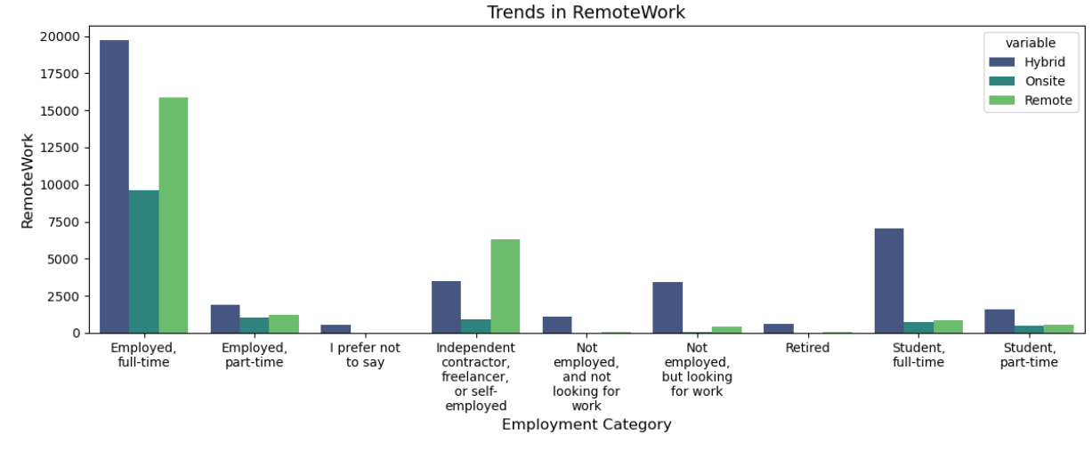
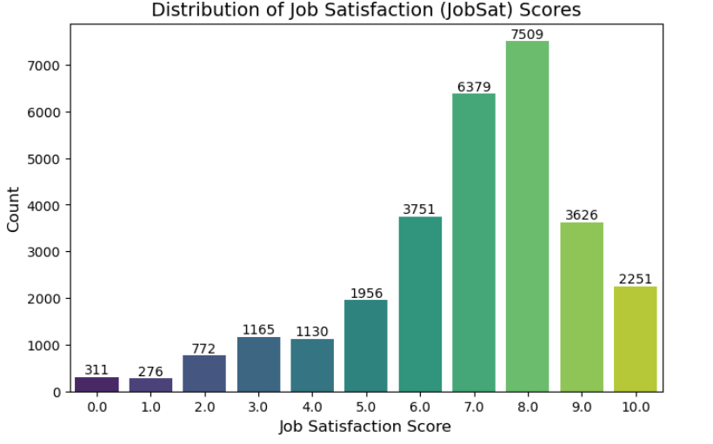
APPENDIX

Slide 21
JOB POSTINGS

Slide 22
POPULAR LANGUAGES

