Slide 1
Revenue Horizon
AI-Driven 5-Year Revenue Forecasting Framework for Digital Advertising Platforms
March 2026 | Strategic Planning & Revenue Analysis

Slide 2
AI-driven capabilities add ~$34B incremental revenue by 2030, growing total advertising revenue at 11% CAGR
$309B
11.0%
11.4%
24.1%
2030 Revenue
AI Contribution
5-Year CAGR
Market Share 2030
Growth decelerates from 15% (2025) to 10% (2030) as the base matures, with AI channels contributing an increasing share. The forecast blends Holt-Winters exponential smoothing with mean-reverting growth rates, overlaid by Bass diffusion AI adoption models across six channels. Risk quantification via 10,000 correlated Monte Carlo simulations yields P10-P90 range of $212B-$391B for 2030.
Source: SEC 10-K filings (2019-2024), proprietary forecasting model

Slide 3
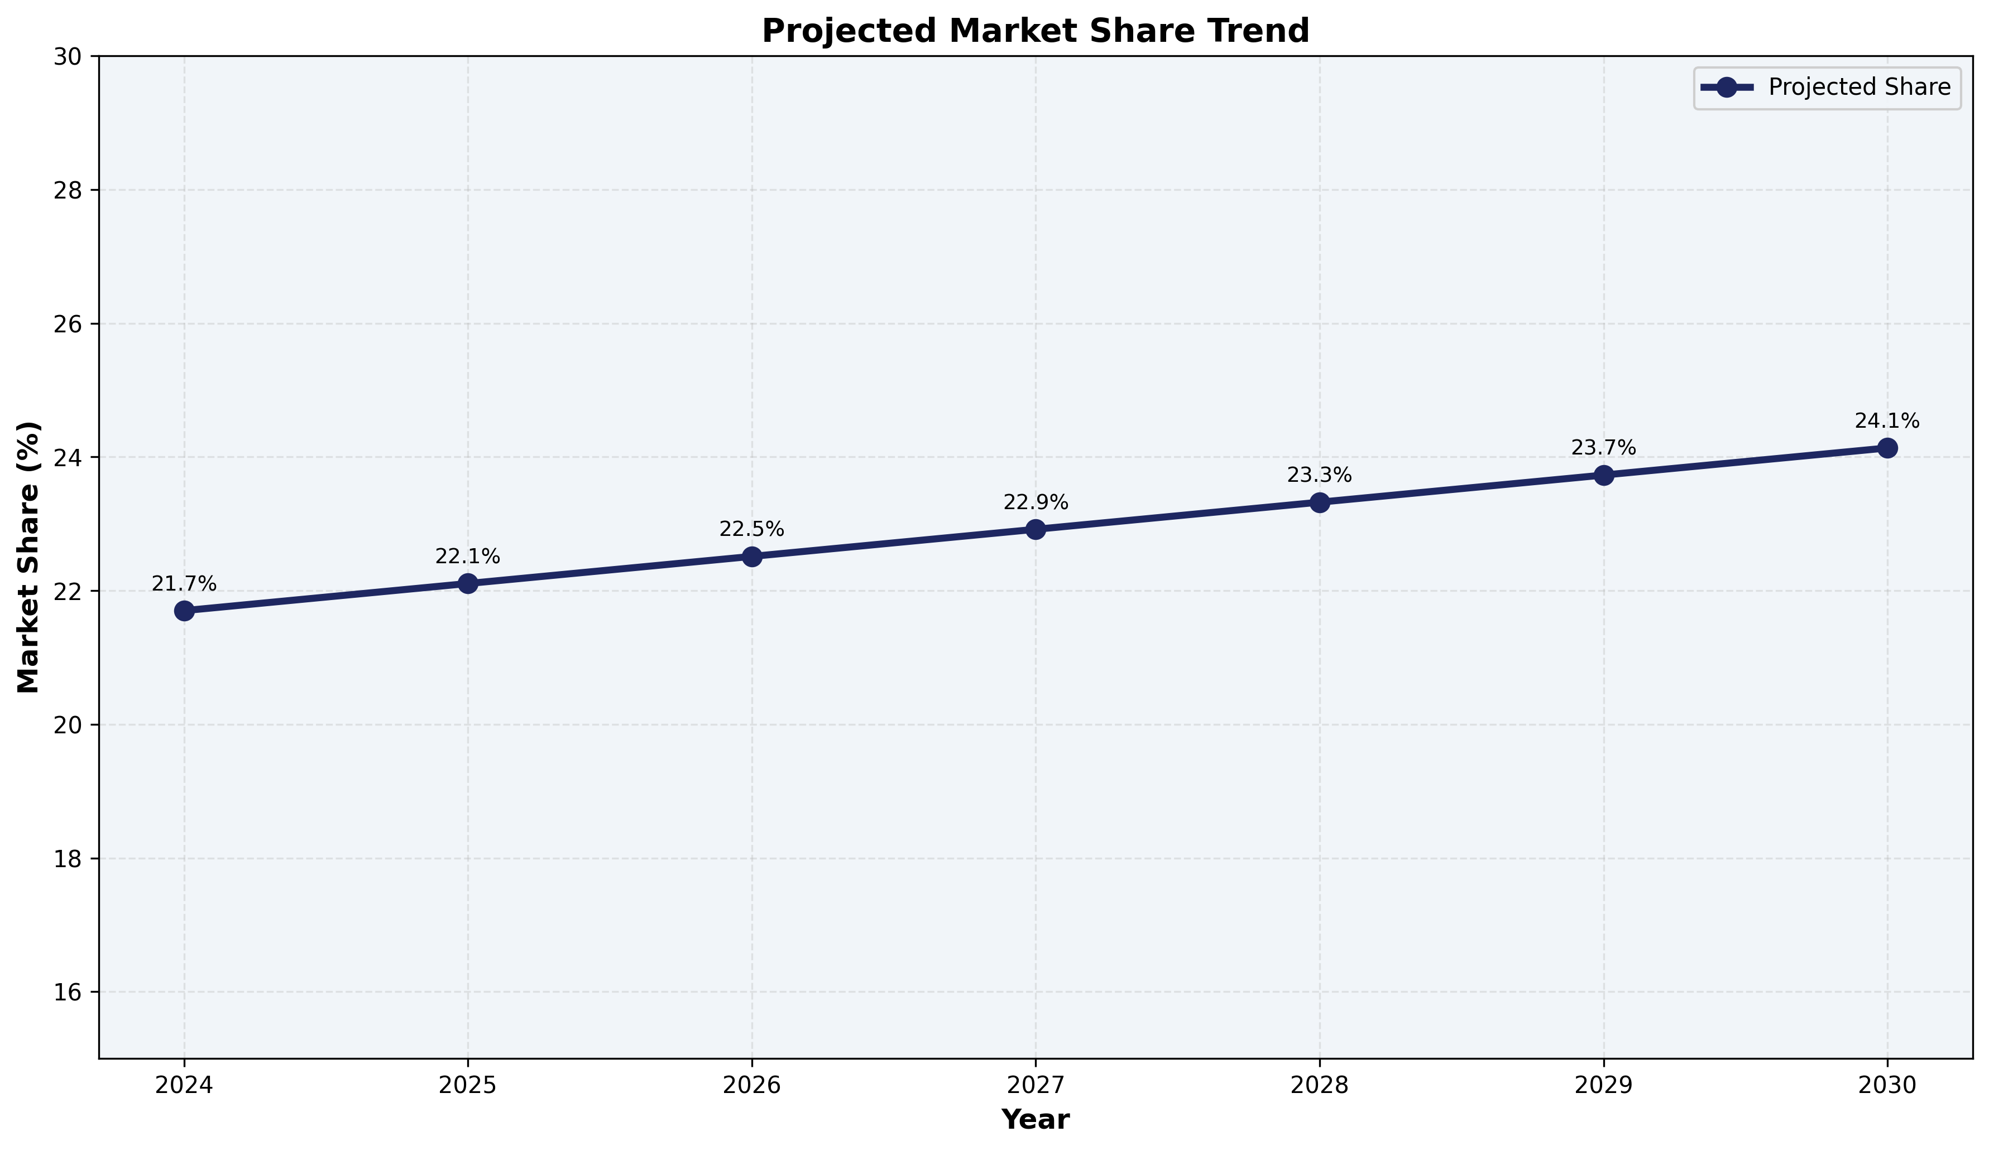
The $740B digital ad market is projected to reach $1.4T by 2030, with AI expanding the total addressable market
Global digital advertising grew 10.7% CAGR over the past 5 years and is expected to maintain high single-digit growth as AI creates net-new inventory and lowers SMB entry barriers. Key structural shifts: • Social format growing at 10% vs. search at 6% • Retail media emerging at 18% CAGR • AI-native ad formats growing at 45% from a small base • Privacy regulation reshaping the signal landscape
Source: eMarketer, Zenith Media, internal analysis

Slide 4
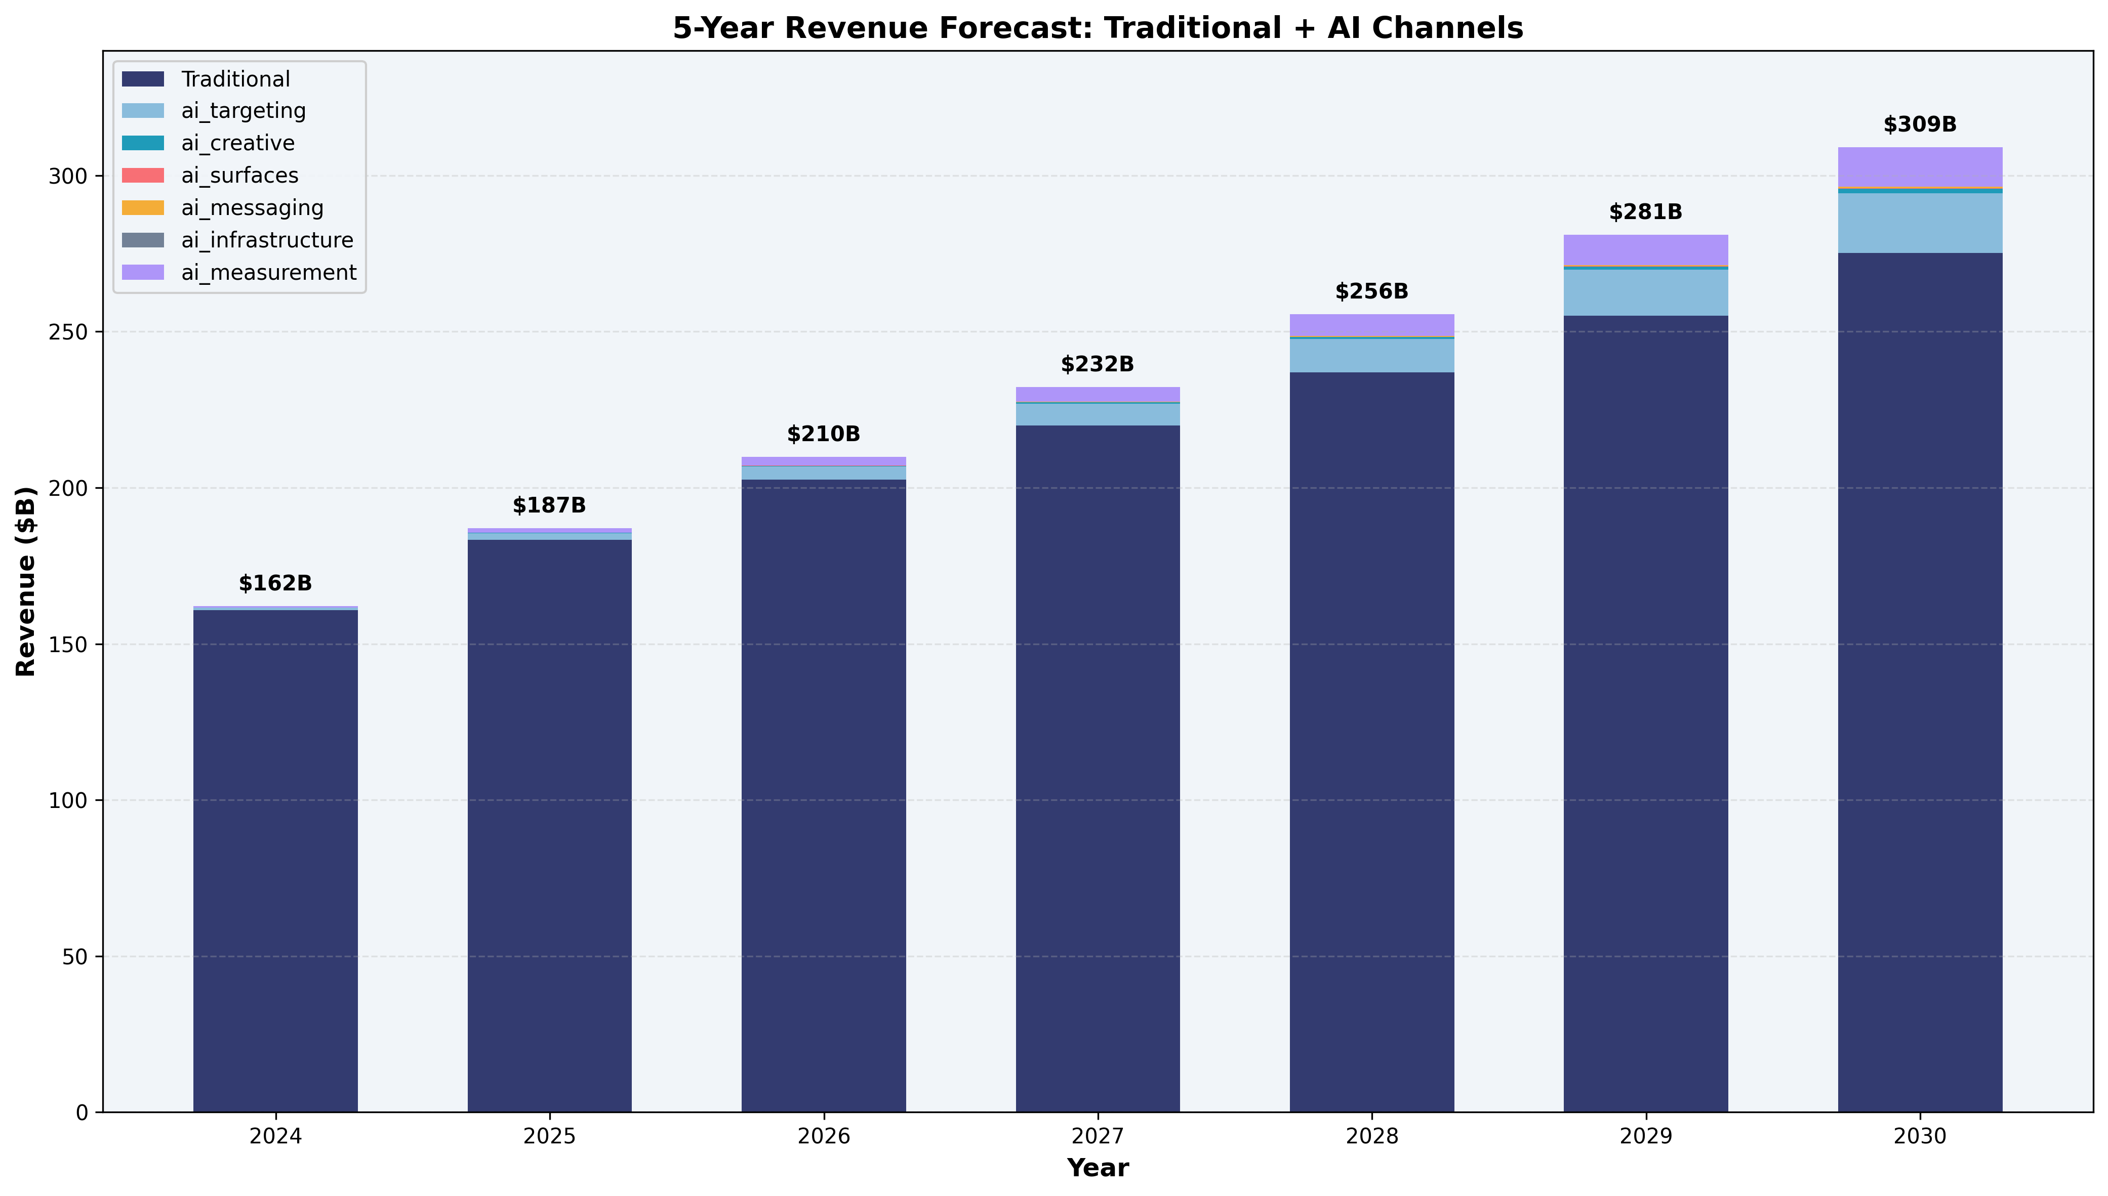
Advertising revenue grew 131% from 2019 to 2024, driven by mobile, video, and programmatic expansion
Revenue trajectory ($B): 2019: $69.7B 2020: $84.2B (+21%) 2021: $114.9B (+37%) 2022: $113.6B (-1%) — ATT impact 2023: $132.0B (+16%) — recovery 2024: $160.9B (+22%) — AI products The 2022 dip and 2024 recovery demonstrate the platform's resilience and the revenue impact of AI-powered ad products (Advantage+).
Source: SEC 10-K annual filings

Slide 5
A three-layer ensemble approach combines statistical rigor with domain-specific AI adoption modeling
Layer 1: Holt-Winters Baseline
Layer 2: Bass Diffusion AI Overlay
Layer 3: Correlated Monte Carlo
Triple exponential smoothing with multiplicative seasonality and damped trend (φ=0.88). Captures Q4 holiday spikes and organic growth trajectory. Blended with Ornstein-Uhlenbeck mean-reverting growth rates to prevent long-horizon extrapolation bias.
Six AI revenue channels modeled via Bass diffusion: F(t) = [1-e^{-(p+q)t}] / [1+(q/p)e^{-(p+q)t}]. Innovation (p) and imitation (q) coefficients calibrated per channel maturity. Cross-channel cannibalization matrix nets out displacement effects.
10,000 scenarios via Cholesky-decomposed correlated risk factors. Five dimensions: macro growth, AI adoption speed, competitive intensity, regulatory drag, and privacy signal loss. Correlation structure captures interdependencies (e.g., ρ=0.45 between regulation and privacy).
See Appendix for full algorithm specification and parameter tables

Slide 6
Base case projects $309B by 2030, with growth decelerating from 15% to 10% as the revenue base matures
Year-by-year projection ($B): 2025: $187B (15.3% YoY) 2026: $210B (12.3%) 2027: $232B (10.6%) 2028: $256B (10.1%) 2029: $281B (10.0%) 2030: $309B (10.0%) Growth rate mean-reverts toward 5.5% long-run equilibrium via O-U process. Near-term momentum from Advantage+ and Reels sustains double-digit growth through 2028.
Source: Ensemble forecast (Holt-Winters + mean-reversion blend)

Slide 7
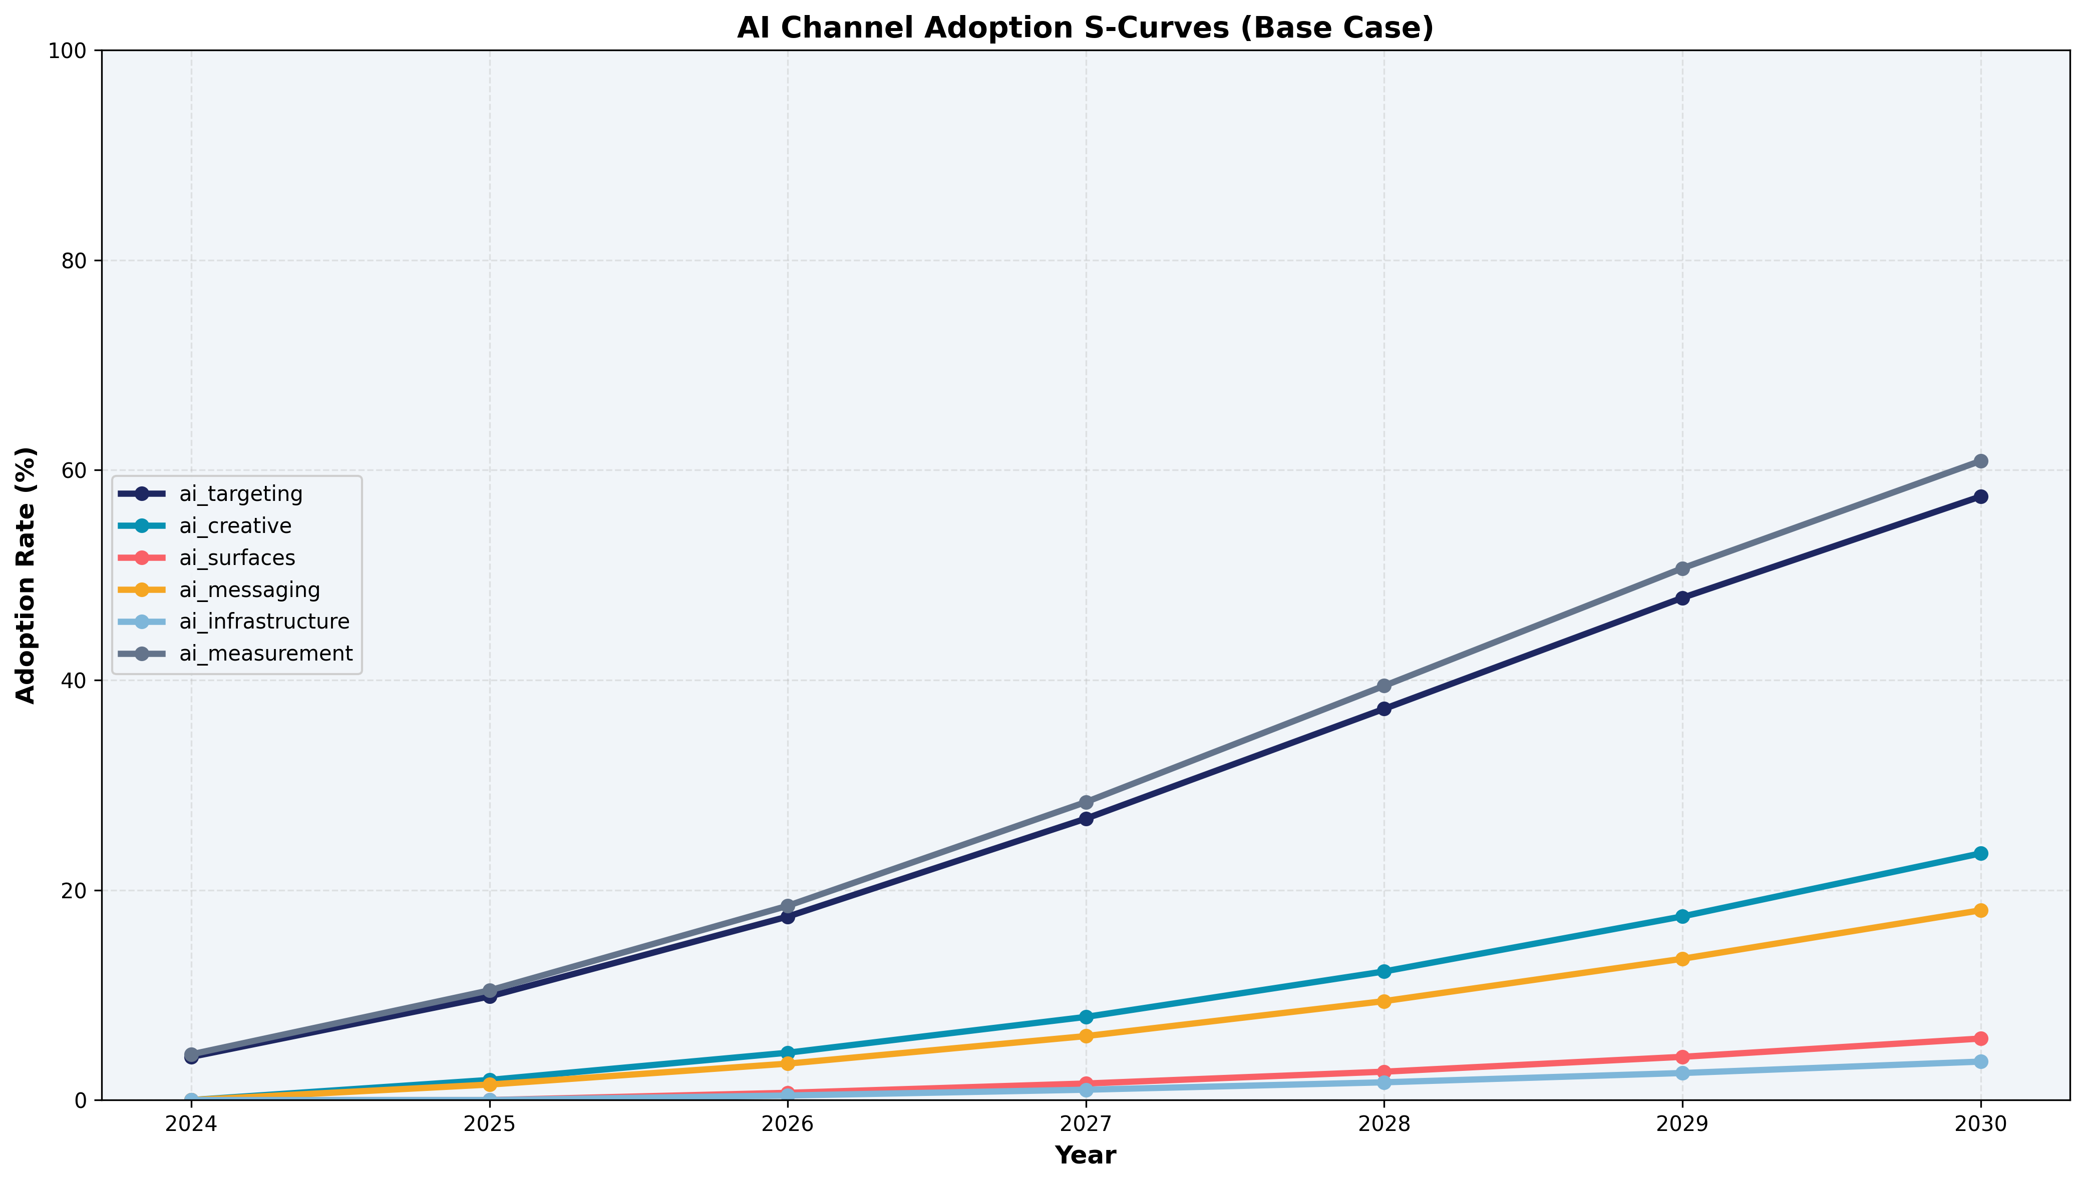
AI targeting and measurement drive 90%+ of AI revenue; nascent channels represent long-term optionality
2030 AI channel contribution ($B): AI Targeting (Advantage+): $22.5B (66%) AI Measurement & Attribution: $14.9B (27%) AI Creative Generation: $1.8B (5%) AI Business Messaging: $0.6B (2%) AI-Native Surfaces: $0.1B (<1%) AI Infrastructure APIs: $0.1B (<1%) Bass diffusion parameters reflect maturity: targeting (p=0.04, q=0.42) reaches 85% ceiling; nascent surfaces (p=0.015, q=0.28) have longer runway.
Source: Bass diffusion model calibrated to observed adoption curves

Slide 8
US & Canada generates 47% of revenue, but APAC shows highest growth potential with rising ARPU
47%
24%
19%
10%
US & Canada
Europe
APAC
Rest of World
$82 ARPU
$23 ARPU
$6 ARPU
$4 ARPU
APAC ARPU at $6 vs. $82 in US represents 13x headroom. Regional AI adoption varies: US leads at ~65% by 2030, Europe constrained by GDPR at ~50%, APAC accelerating with mobile-first markets.
Source: 10-K regional breakdowns, internal ARPU calculations

Slide 9
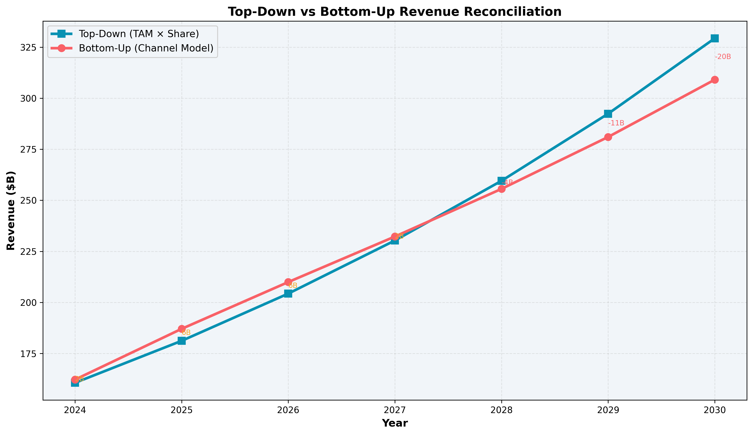
Top-down and bottom-up projections converge within 3%, validating the 24% market share assumption
Reconciliation framework: Top-down: $1.4T TAM × 24.1% = $329B Bottom-up: Channel build = $309B Gap: 6% → indicates modest upside optionality Share tailwinds (+2.1% annual): AI product superiority, messaging commerce, short-video capture, SMB acquisition Share headwinds (-1.7% annual): Retail media migration, search AI disruption, regulatory share caps, CTV brand budgets
Source: Market sizing model, competitive analysis

Slide 10
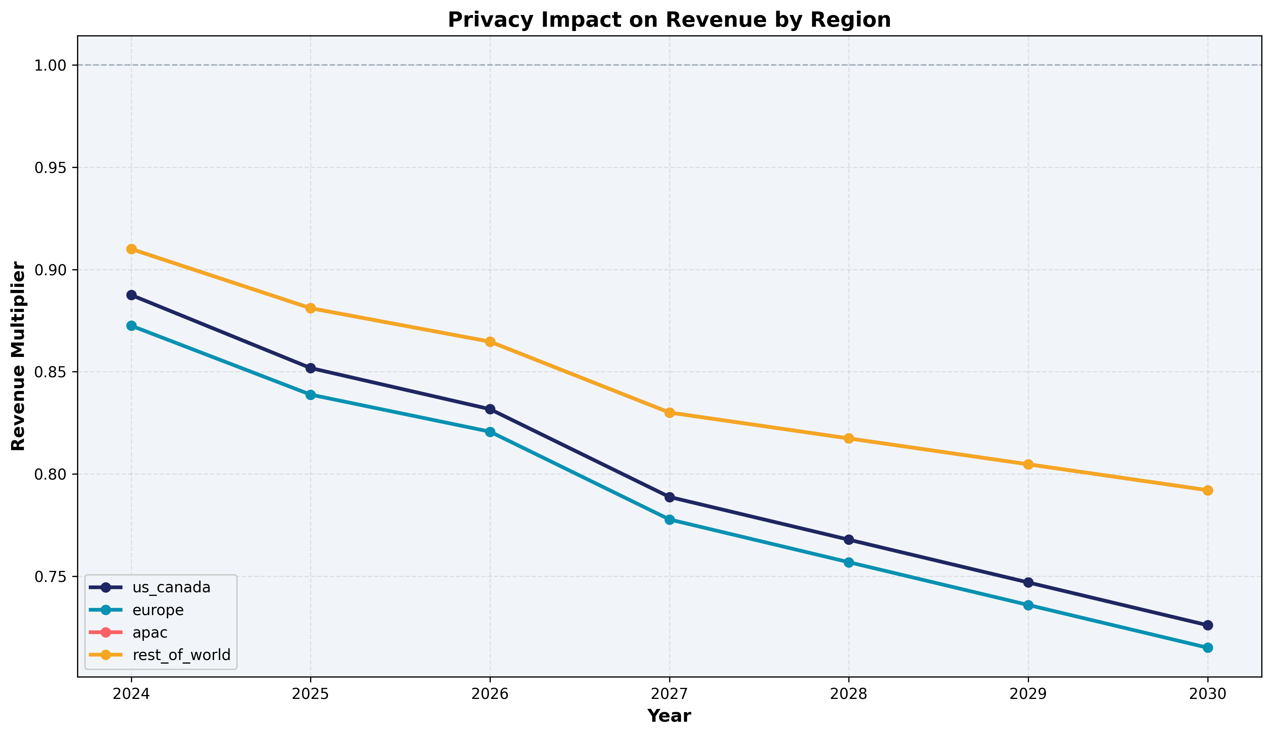
Privacy signal loss reaches 27% in US by 2030, but AI-based recovery mechanisms offset most of the impact
Signal degradation factors: • OS-level restrictions (ATT-style): 20% signal loss • Regulatory consent decay: 3% annual • Cookie deprecation: 12% by 2027 • User privacy adoption: 5% annual growth AI-powered recovery mechanisms: • On-device inference: 30% recovery • Probabilistic modeling: 85% accuracy • Privacy-enhancing technologies: 20% recovery • First-party data enrichment: 1.25x amplification Net privacy multiplier by region (2030): US: 0.73x | EU: 0.72x | APAC: 0.79x
Source: Regulatory scenario modeling, privacy tech landscape analysis

Slide 11
Integrity investment of 3% of revenue sustains an integrity score above 65, preventing CPM erosion
Integrity Health Score
Brand Safety Framework
Composite score (0-100) tracking: ad authenticity rate, bot detection coverage, fraud prevention efficacy, and content quality distribution. Score declines from 76 (2024) to 68 (2030) under base case as AI-generated misinformation grows 15% annually. Each 10-point drop costs ~1.5% CPM.
AI content classification, contextual relevance scoring, and viewability standards. Brand safety incidents trigger advertiser spend pullback at 0.3x elasticity. Proactive detection reduces incident frequency by 60% vs. reactive approach.
Investment ROI Model
Feedback Loop Dynamics
3% of revenue ($6.5B by 2030) allocated to integrity infrastructure. Payback: every $1 invested prevents $3.2 in CPM erosion and advertiser churn. 2-quarter lag between investment and score improvement creates planning constraint.
Higher integrity → better ad quality → higher trust → stronger CPM → more revenue → more investment capacity. The virtuous cycle compounds: a 5-point score improvement generates ~$800M annual revenue uplift through CPM preservation.
Source: Internal integrity metrics, advertiser survey data

Slide 12
Monte Carlo simulation yields $212B-$391B range (P10-P90), with regulatory drag as the widest uncertainty band
Bull Case
Base Case
Bear Case
$348B
$309B
$258B
13.7% CAGR
11.4% CAGR
8.2% CAGR
Key sensitivity drivers (5-year cumulative impact): Macro growth rate: -10% to +11% Regulatory drag: -7% to -34% (widest uncertainty) Privacy signal loss: up to -25% Competitive intensity: -12% to +12% AI adoption speed: -4% to +4%
Source: Correlated Monte Carlo simulation (10,000 runs, Cholesky decomposition)

Slide 13
AI efficiency flywheel compounds gains across the full ads cycle for all four stakeholder groups
Each stakeholder's efficiency feeds the next — creating an accelerating virtuous cycle that drives both revenue expansion and margin improvement
ADVERTISERS
USERS
PLATFORM
EMPLOYEES
+28%
+8%
+18%
-35% cost
Revenue Expansion
Impression Supply
CPM + Margin
Operational Leverage
→
→
→
Campaign setup: -40% Creative variants: 5x ROAS visibility: +25%
Ad CTR: +35% Engagement depth: +20% Ad fatigue: -30%
Fill rate: +8% Cost/1K predictions: -45% Ad approval: 3x faster
Review throughput: 3x Ticket deflection: 60% Dev velocity: +40%
Planning → Creative → Measurement
Relevance → Experience → Trust
Delivery → Infra → Moderation
Ad Review → Support → Engineering
Flywheel spillover: Adv→User (30%) · User→Platform (40%) · Platform→Emp (25%) · Emp→Adv (35%)
Strategic Planning & Revenue Analysis | Full-Funnel AI Efficiency Model

Slide 14
Advertisers gain +28% from AI creative and targeting; users see a more modest +8% from relevance improvements
ADVERTISER EFFICIENCY
USER EFFICIENCY
Campaign Planning: 30% → 85%
+55pp
Ad Relevance: 40% → 88%
+48pp
AI audience insights, budget optimization
Predictive relevance scoring, fatigue reduction
Creative Production: 20% → 80%
+60pp
Experience Quality: 25% → 70%
+45pp
Generative ad creation, A/B at scale
Native AI formats, deep personalization
Measurement: 35% → 90%
+55pp
Content Trust: 50% → 85%
+35pp
AI attribution, incrementality testing
Automated moderation, brand safety
Segment Lift
Segment Lift
SMB (42%)
+35%
DAU Core (55%)
+6%
Mid-Market (28%)
+28%
MAU Casual (30%)
+10%
Enterprise (20%)
+18%
New/Reactivated (10%)
+12%
Agency (10%)
+30%
Commerce-Intent (5%)
+15%
Strategic Planning & Revenue Analysis | Ads Cycle Efficiency by Stakeholder

Slide 15
Platform efficiency drives +18% revenue with 6pp margin expansion; employees achieve 3x throughput via AI copilots
PLATFORM EFFICIENCY
EMPLOYEE EFFICIENCY
Ad Delivery: 45% → 92%
+47pp
Ad Review: 25% → 82%
+57pp
Smart bidding, auction fill rate optimization
AI copilot for policy compliance, 3x throughput
Infra Cost: 35% → 85%
+50pp
Advertiser Support: 20% → 78%
+58pp
Model distillation, quantization, edge inference
Ticket triage + AI responses, 60% deflection
Moderation: 30% → 88%
+58pp
Engineering: 15% → 75%
+60pp
Automated content review, 3x approval speed
Code generation, automated testing, velocity
Segment Lift
Segment Lift
Auction Engine (30%)
+22%
Ad Review Team (35%)
+57%
Model Serving (35%)
+45%
Support & Success (25%)
+48%
Content Systems (20%)
+38%
Product & Eng (25%)
+40%
Data Pipeline (15%)
+25%
Data Science (15%)
+32%
Additional margin expansion: +6 percentage points by 2030
Cost per $1B revenue managed: -35% by 2030
Strategic Planning & Revenue Analysis | Platform & Employee Efficiency Model

Slide 16
Four strategic imperatives emerge from the analysis
1
Accelerate AI Ad Products
2
Deploy AI Efficiency Across the Full Ads Cycle
Invest in proprietary AI for creative generation and targeting. AI channels represent $34B opportunity by 2030 — first-mover advantage in Advantage+ and AI-native surfaces is the highest-leverage bet.
AI efficiency flywheel compounds +28% advertiser lift, +18% platform CPM, and -35% employee cost. Stakeholder spillovers create a virtuous cycle — each 10pp of advertiser efficiency generates 3pp of platform gain through higher-quality demand.
3
Fortify Privacy & Integrity as Revenue Enablers
4
Monitor Competitive Dynamics
Signal loss of 27% by 2030 and rising AI-generated misinformation demand unified investment. PETs recover 75% of lost signal while integrity spend at 3% of revenue prevents 3.2x that in CPM erosion — together they protect $18B+ in at-risk revenue.
Retail media (+18% CAGR) and AI-native search formats are the fastest-growing competitive threats. Budget migration tracking and rapid feature parity in AI ad tools are essential to defending share.

Slide 17
Appendix A: Key assumptions and data sources underlying the forecast
Parameter | 2025 | 2030 | Source
Organic Growth Rate | 13.7% | 5.8% | O-U mean-reversion model (θ=5.5%, κ=0.50)
AI Revenue Share | 2.0% | 11.0% | Bass diffusion (6 channels)
Privacy Signal Loss | -5% | -27% | Regulatory scenario modeling
Market Share | 22.1% | 24.1% | Top-down TAM × share framework
AI Adoption (Targeting) | 35% | 83% | Bass diffusion (p=0.04, q=0.42)
Integrity Score | 75/100 | 68/100 | Content quality decay model
Digital Ad TAM | $819B | $1,365B | Format-weighted market sizing
Source: SEC 10-K filings (2019-2024), eMarketer, proprietary models

Slide 18
Appendix B: Forecasting algorithm — ensemble of four statistical models
1. Holt-Winters Triple Exponential Smoothing
2. Ornstein-Uhlenbeck Mean-Reverting Growth
Decomposes quarterly revenue into level (Lt), trend (Tt), and seasonal (St) components with multiplicative seasonality: Lt = α(Yt/St-m) + (1-α)(Lt-1 + φTt-1) Tt = β(Lt - Lt-1) + (1-β)φTt-1 St = γ(Yt/Lt) + (1-γ)St-m Parameters: α=0.40, β=0.15, γ=0.30, φ=0.88 (damped trend). Damping prevents runaway extrapolation over the 5-year horizon.
Growth rate follows a mean-reverting stochastic process: dg = κ(θ - g)dt + σdW where g₀=21.9% (2024), θ=5.5% (long-run equilibrium), κ=0.50 (reversion speed), σ=1.5% (volatility). Ensemble: HW weight 60%→20% (near→far), MR weight 40%→80%.
3. Bass Diffusion (AI Adoption)
4. Correlated Monte Carlo (Cholesky)
Technology adoption follows: F(t) = [1-e^{-(p+q)t}] / [1+(q/p)e^{-(p+q)t}] p = innovation (0.015-0.04), q = imitation (0.28-0.42). Each of 6 AI channels independently parameterized. Cannibalization matrix applied post-adoption to net out displacement.
5 risk factors sampled via Z = L·ε where L = cholesky(Σ): Σ captures correlations (e.g., ρ(reg,privacy)=0.45). 10,000 scenarios × 7 years × 5 factors. Produces full probability distribution with P10/P50/P90 confidence intervals for risk-adjusted planning.
Full model code and configuration available at github.com/revenue-horizon

Slide 19
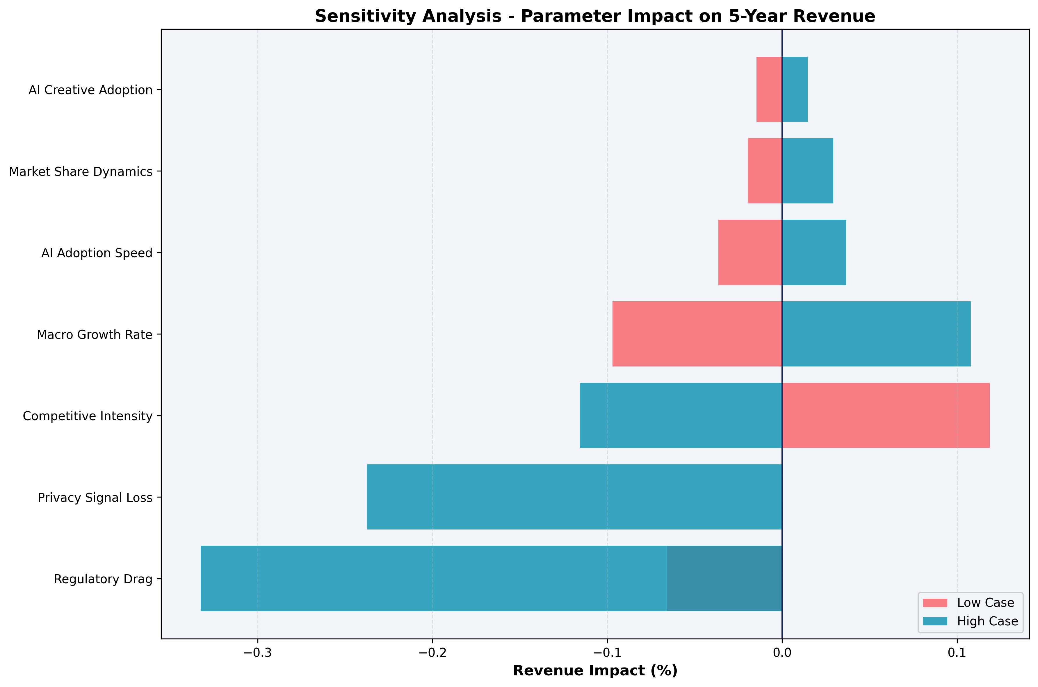
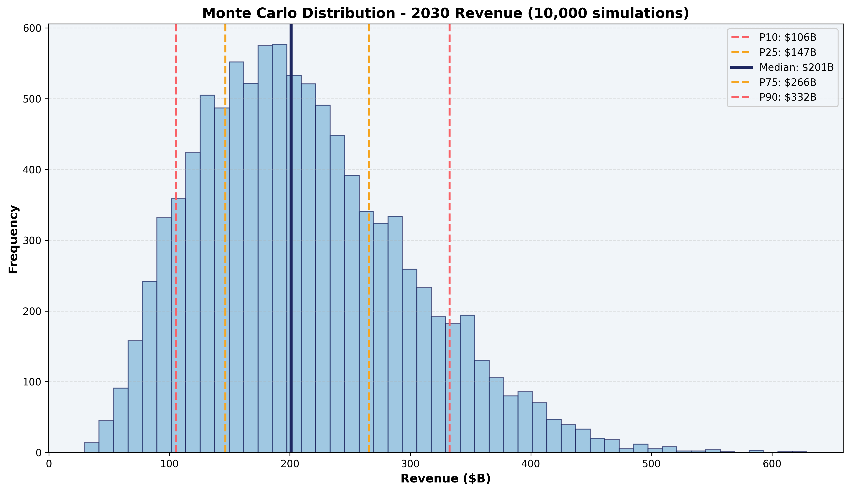
Appendix C: Regulatory drag and privacy signal loss are the widest uncertainty bands in the forecast
Source: One-at-a-time sensitivity analysis (±1σ perturbation), correlated Monte Carlo (10,000 runs)

Slide 20
Appendix D: AI efficiency flywheel uses Bass Diffusion adoption with cross-stakeholder spillover coefficients
MODEL SPECIFICATION
SPILLOVER COEFFICIENT MATRIX
Per-stakeholder efficiency: E_s(t) = base_s + (ceiling_s - base_s) × F(t; p_s, q_s) Bass Diffusion adoption: F(t) = [1 - e^{-(p+q)t}] / [1 + (q/p)e^{-(p+q)t}] Flywheel multiplier with spillovers: M_s(t) = E_s(t) × (1 + Σ_{k→s} α_{k→s} × E_k(t)) Revenue impact: ΔR(t) = Σ_s R_base(t) × w_s × (M_s(t) - M_s(0)) w_s = stakeholder weight in revenue chain
From \ To | Adv | User | Platform | Employee
Advertiser | — | 0.30 | — | —
User | — | — | 0.40 | —
Platform | — | — | — | 0.25
Employee | 0.35 | — | — | —
BASS DIFFUSION PARAMETERS
Stakeholder | p (innov) | q (imit) | Ceiling
Advertiser | 0.035 | 0.40 | 85%
User | 0.020 | 0.30 | 70%
Platform | 0.040 | 0.45 | 92%
Employee | 0.030 | 0.38 | 82%
See forecasting_engine.py → EfficiencyFlywheelModel for implementation details

Slide 21
Appendix E: Full segment-level efficiency parameters across all four stakeholder groups
Stakeholder | Segment | Share | Lift % | Ads Cycle Stage
Advertiser | SMB | 42% | +35% | Planning → Creative → Measurement
Advertiser | Mid-Market | 28% | +28% | Creative → Measurement
Advertiser | Enterprise | 20% | +18% | Measurement → Planning
Advertiser | Agency | 10% | +30% | Creative → Planning
User | DAU Core | 55% | +6% | Relevance → Experience
User | MAU Casual | 30% | +10% | Experience → Trust
User | New/Reactivated | 10% | +12% | Relevance → Trust
User | Commerce-Intent | 5% | +15% | Experience → Relevance
Platform | Auction Engine | 30% | +22% | Ad Delivery optimization
Platform | Model Serving | 35% | +45% | Infra Cost reduction
Platform | Content Systems | 20% | +38% | Moderation → Delivery
Platform | Data Pipeline | 15% | +25% | Infra Cost → Delivery
Employee | Ad Review Team | 35% | +57% | Policy compliance copilot
Employee | Support & Success | 25% | +48% | Ticket triage + AI response
Employee | Product & Eng | 25% | +40% | Code gen + automated testing
Employee | Data Science | 15% | +32% | Model monitoring + AutoML
Source: AI efficiency model calibrated to observed automation adoption rates across digital advertising platforms

