Slide 1
Revenue Horizon
AI-Driven 5-Year Revenue Forecasting Framework for Digital Advertising Platforms
March 2026 | Strategic Planning & Revenue Analysis

Slide 2
AI-driven capabilities add ~$34B incremental revenue by 2030, growing total advertising revenue at 11% CAGR
$309B
11.0%
11.4%
24.1%
2030 Revenue
AI Contribution
5-Year CAGR
Market Share 2030
Growth decelerates from 15% (2025) to 10% (2030) as the base matures, with AI channels contributing an increasing share. The forecast blends Holt-Winters exponential smoothing with mean-reverting growth rates, overlaid by Bass diffusion AI adoption models across six channels. Risk quantification via 10,000 correlated Monte Carlo simulations yields P10-P90 range of $212B-$391B for 2030.
Source: SEC 10-K filings (2019-2024), proprietary forecasting model

Slide 3
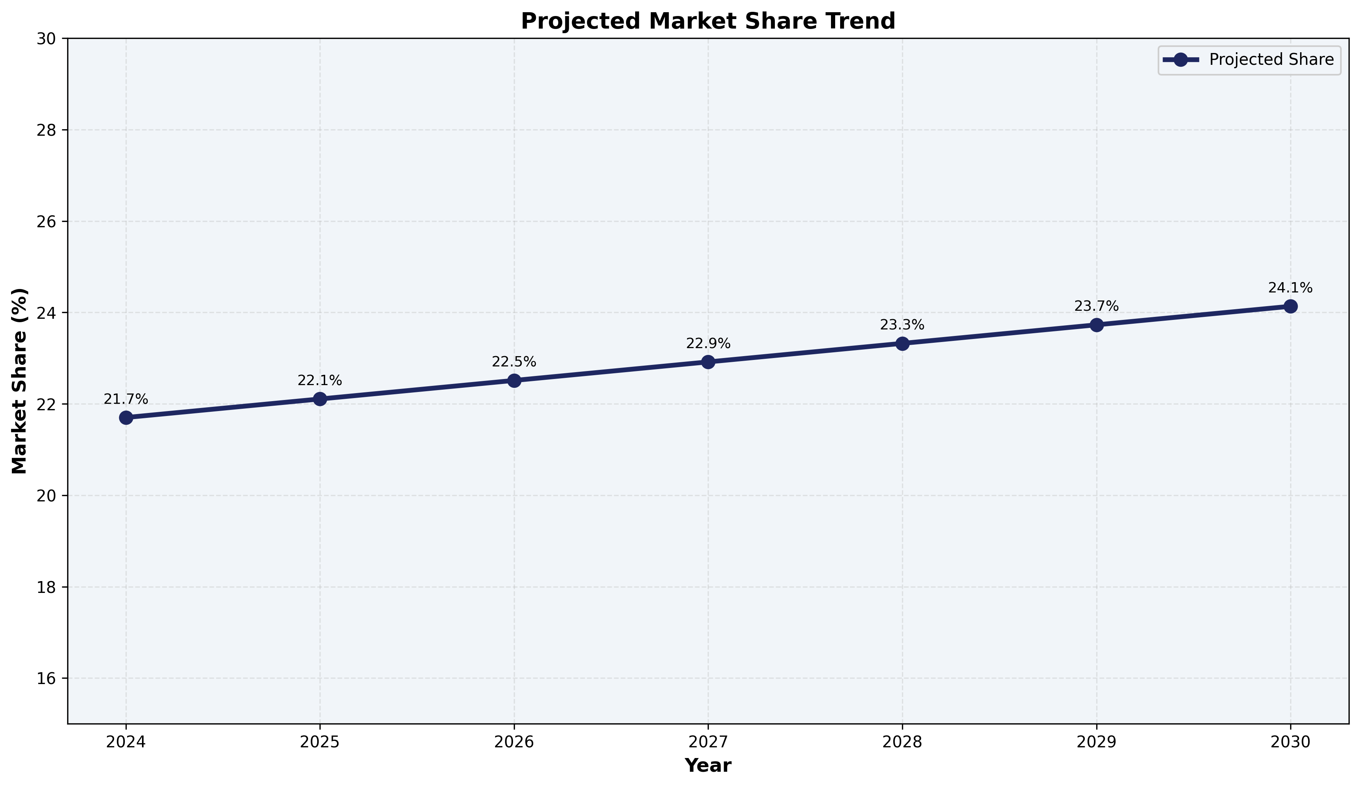
The $740B digital ad market is projected to reach $1.4T by 2030, with AI expanding the total addressable market
Global digital advertising grew 10.7% CAGR over the past 5 years and is expected to maintain high single-digit growth as AI creates net-new inventory and lowers SMB entry barriers. Key structural shifts: • Social format growing at 10% vs. search at 6% • Retail media emerging at 18% CAGR • AI-native ad formats growing at 45% from a small base • Privacy regulation reshaping the signal landscape
Source: eMarketer, Zenith Media, internal analysis

Slide 4
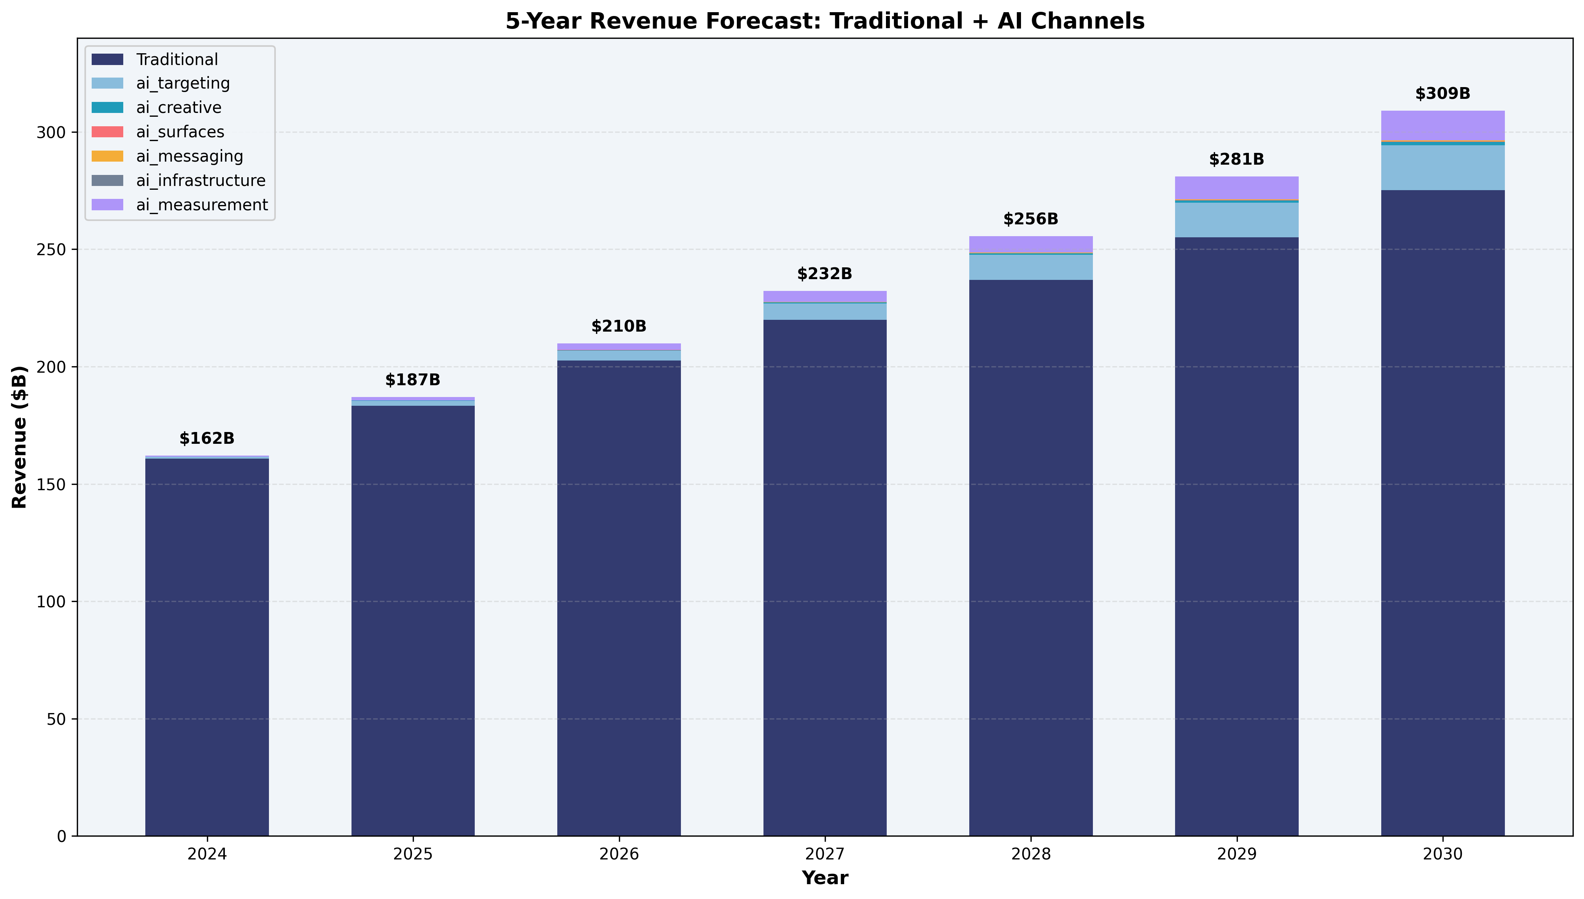
Advertising revenue grew 131% from 2019 to 2024, driven by mobile, video, and programmatic expansion
Revenue trajectory ($B): 2019: $69.7B 2020: $84.2B (+21%) 2021: $114.9B (+37%) 2022: $113.6B (-1%) — ATT impact 2023: $132.0B (+16%) — recovery 2024: $160.9B (+22%) — AI products The 2022 dip and 2024 recovery demonstrate the platform's resilience and the revenue impact of AI-powered ad products (Advantage+).
Source: SEC 10-K annual filings

Slide 5
A three-layer ensemble approach combines statistical rigor with domain-specific AI adoption modeling
Layer 1: Holt-Winters Baseline
Layer 2: Bass Diffusion AI Overlay
Layer 3: Correlated Monte Carlo
Triple exponential smoothing with multiplicative seasonality and damped trend (φ=0.88). Captures Q4 holiday spikes and organic growth trajectory. Blended with Ornstein-Uhlenbeck mean-reverting growth rates to prevent long-horizon extrapolation bias.
Six AI revenue channels modeled via Bass diffusion: F(t) = [1-e^{-(p+q)t}] / [1+(q/p)e^{-(p+q)t}]. Innovation (p) and imitation (q) coefficients calibrated per channel maturity. Cross-channel cannibalization matrix nets out displacement effects.
10,000 scenarios via Cholesky-decomposed correlated risk factors. Five dimensions: macro growth, AI adoption speed, competitive intensity, regulatory drag, and privacy signal loss. Correlation structure captures interdependencies (e.g., ρ=0.45 between regulation and privacy).
See Appendix for full algorithm specification and parameter tables

Slide 6
Base case projects $309B by 2030, with growth decelerating from 15% to 10% as the revenue base matures
Year-by-year projection ($B): 2025: $187B (15.3% YoY) 2026: $210B (12.3%) 2027: $232B (10.6%) 2028: $256B (10.1%) 2029: $281B (10.0%) 2030: $309B (10.0%) Growth rate mean-reverts toward 5.5% long-run equilibrium via O-U process. Near-term momentum from Advantage+ and Reels sustains double-digit growth through 2028.
Source: Ensemble forecast (Holt-Winters + mean-reversion blend)

Slide 7
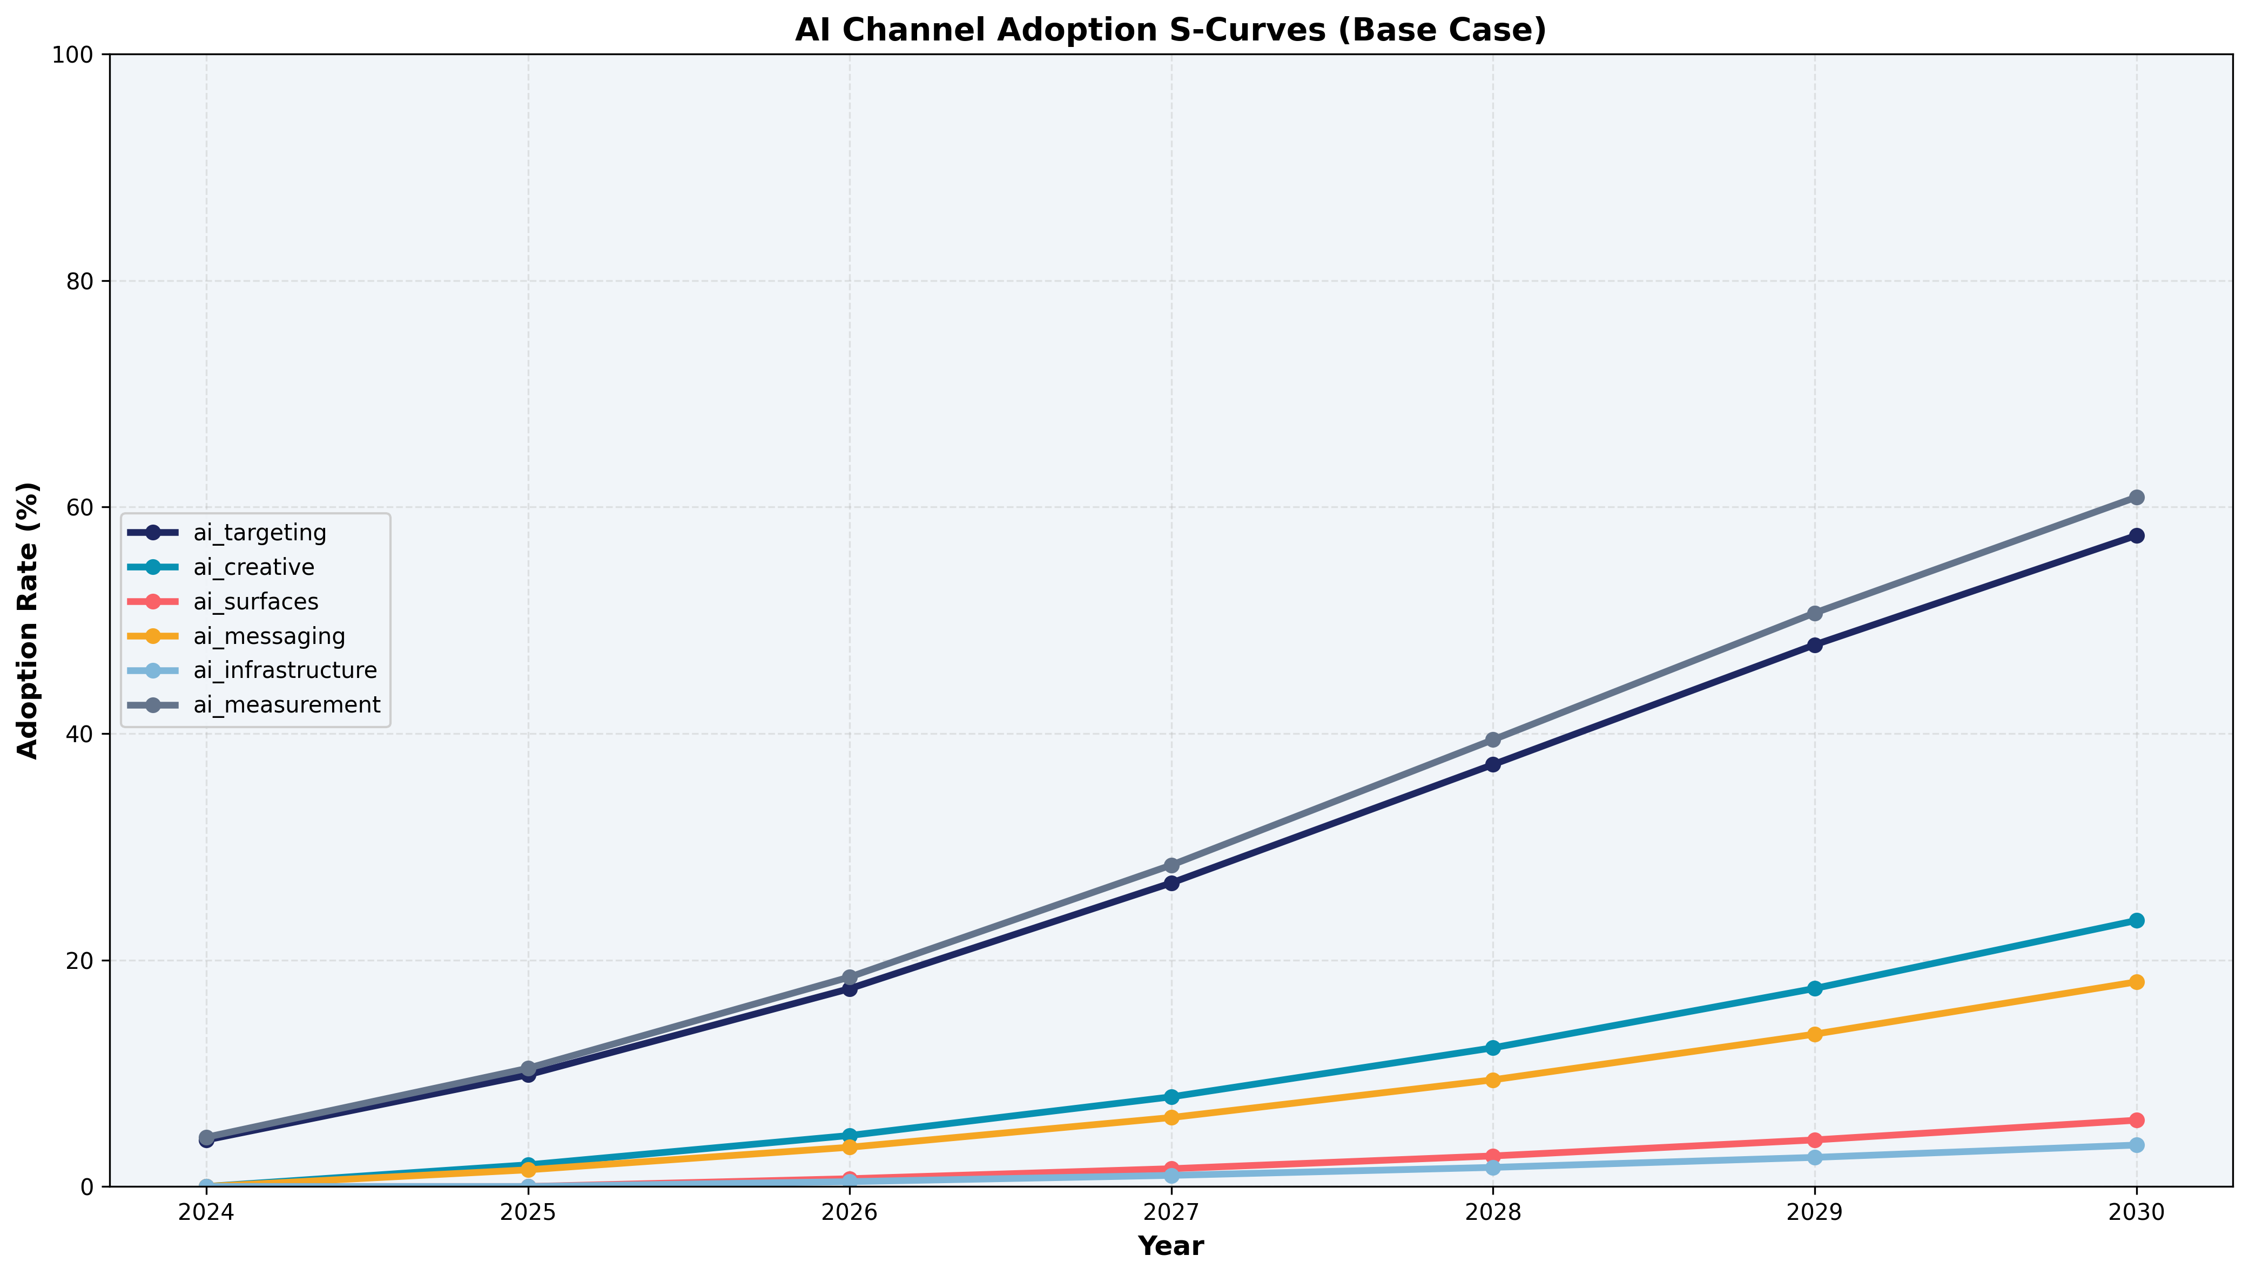
AI targeting and measurement drive 90%+ of AI revenue; nascent channels represent long-term optionality
2030 AI channel contribution ($B): AI Targeting (Advantage+): $22.5B (66%) AI Measurement & Attribution: $14.9B (27%) AI Creative Generation: $1.8B (5%) AI Business Messaging: $0.6B (2%) AI-Native Surfaces: $0.1B (<1%) AI Infrastructure APIs: $0.1B (<1%) Bass diffusion parameters reflect maturity: targeting (p=0.04, q=0.42) reaches 85% ceiling; nascent surfaces (p=0.015, q=0.28) have longer runway.
Source: Bass diffusion model calibrated to observed adoption curves

Slide 8
US & Canada generates 47% of revenue, but APAC shows highest growth potential with rising ARPU
47%
24%
19%
10%
US & Canada
Europe
APAC
Rest of World
$82 ARPU
$23 ARPU
$6 ARPU
$4 ARPU
APAC ARPU at $6 vs. $82 in US represents 13x headroom. Regional AI adoption varies: US leads at ~65% by 2030, Europe constrained by GDPR at ~50%, APAC accelerating with mobile-first markets.
Source: 10-K regional breakdowns, internal ARPU calculations

Slide 9
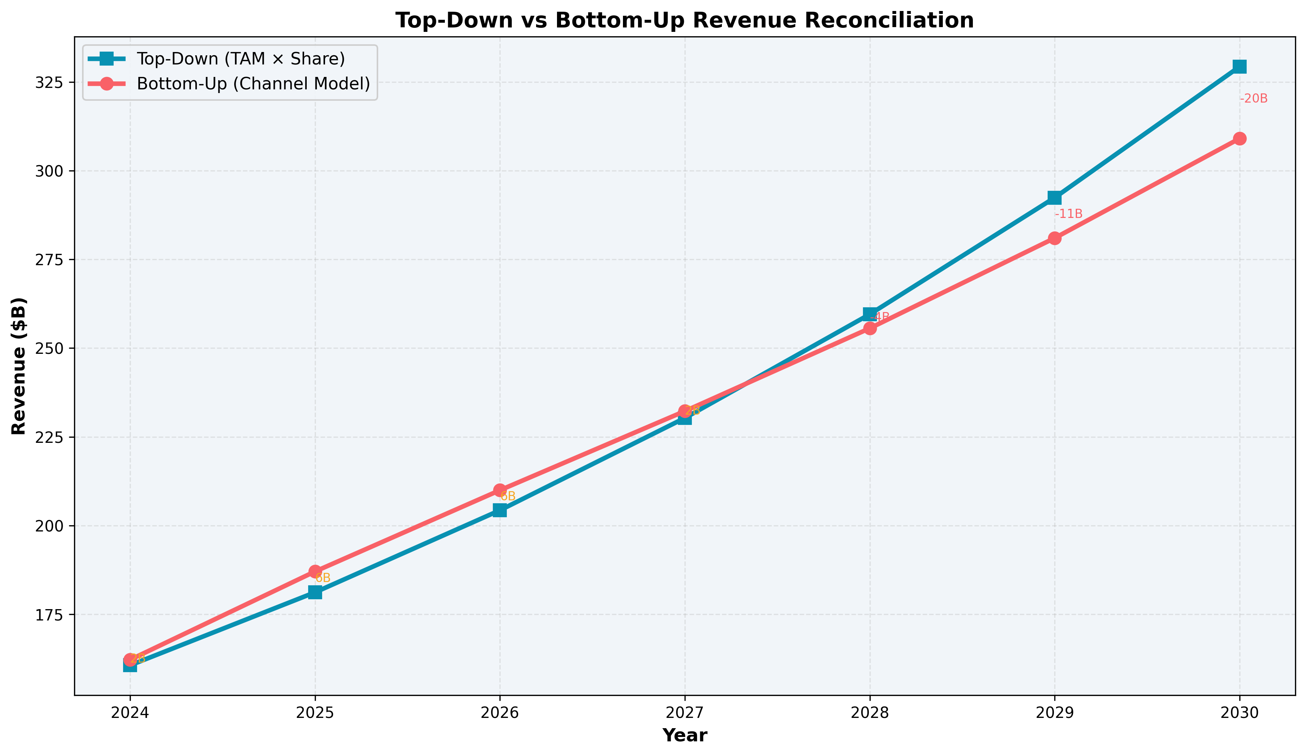
Top-down and bottom-up projections converge within 3%, validating the 24% market share assumption
Reconciliation framework: Top-down: $1.4T TAM × 24.1% = $329B Bottom-up: Channel build = $309B Gap: 6% → indicates modest upside optionality Share tailwinds (+2.1% annual): AI product superiority, messaging commerce, short-video capture, SMB acquisition Share headwinds (-1.7% annual): Retail media migration, search AI disruption, regulatory share caps, CTV brand budgets
Source: Market sizing model, competitive analysis

Slide 10
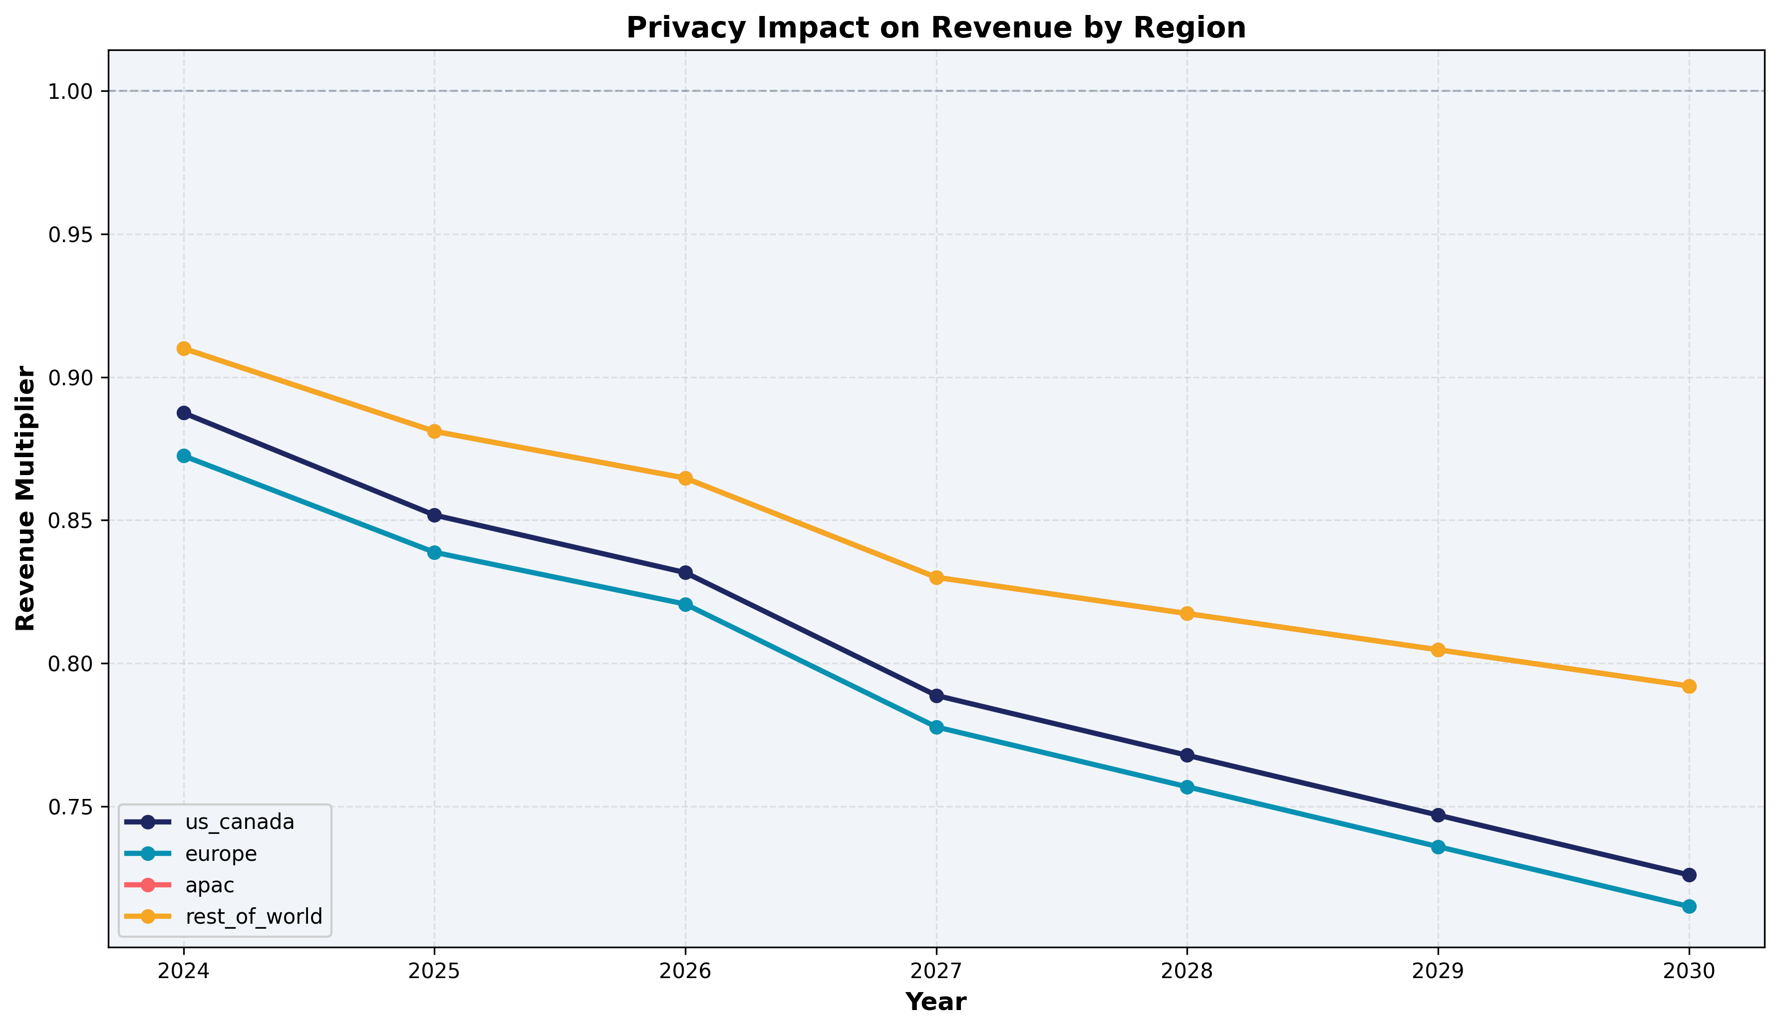
Privacy signal loss reaches 27% in US by 2030, but AI-based recovery mechanisms offset most of the impact
Signal degradation factors: • OS-level restrictions (ATT-style): 20% signal loss • Regulatory consent decay: 3% annual • Cookie deprecation: 12% by 2027 • User privacy adoption: 5% annual growth AI-powered recovery mechanisms: • On-device inference: 30% recovery • Probabilistic modeling: 85% accuracy • Privacy-enhancing technologies: 20% recovery • First-party data enrichment: 1.25x amplification Net privacy multiplier by region (2030): US: 0.73x | EU: 0.72x | APAC: 0.79x
Source: Regulatory scenario modeling, privacy tech landscape analysis

Slide 11
Integrity investment of 3% of revenue sustains an integrity score above 65, preventing CPM erosion
Integrity Health Score
Brand Safety Framework
Composite score (0-100) tracking: ad authenticity rate, bot detection coverage, fraud prevention efficacy, and content quality distribution. Score declines from 76 (2024) to 68 (2030) under base case as AI-generated misinformation grows 15% annually. Each 10-point drop costs ~1.5% CPM.
AI content classification, contextual relevance scoring, and viewability standards. Brand safety incidents trigger advertiser spend pullback at 0.3x elasticity. Proactive detection reduces incident frequency by 60% vs. reactive approach.
Investment ROI Model
Feedback Loop Dynamics
3% of revenue ($6.5B by 2030) allocated to integrity infrastructure. Payback: every $1 invested prevents $3.2 in CPM erosion and advertiser churn. 2-quarter lag between investment and score improvement creates planning constraint.
Higher integrity → better ad quality → higher trust → stronger CPM → more revenue → more investment capacity. The virtuous cycle compounds: a 5-point score improvement generates ~$800M annual revenue uplift through CPM preservation.
Source: Internal integrity metrics, advertiser survey data

Slide 12
Monte Carlo simulation yields $212B-$391B range (P10-P90), with regulatory drag as the widest uncertainty band
Bull Case
Base Case
Bear Case
$348B
$309B
$258B
13.7% CAGR
11.4% CAGR
8.2% CAGR
Key sensitivity drivers (5-year cumulative impact): Macro growth rate: -10% to +11% Regulatory drag: -7% to -34% (widest uncertainty) Privacy signal loss: up to -25% Competitive intensity: -12% to +12% AI adoption speed: -4% to +4%
Source: Correlated Monte Carlo simulation (10,000 runs, Cholesky decomposition)

Slide 13
Four strategic imperatives emerge from the analysis
1
Accelerate AI Ad Products
2
Build Privacy-Preserving Infrastructure
Invest in proprietary AI for creative generation and targeting. AI channels represent $34B opportunity by 2030 — first-mover advantage in Advantage+ and AI-native surfaces is the highest-leverage bet.
Signal loss of 27% in US by 2030 requires pre-emptive investment. On-device inference, probabilistic modeling, and PETs can recover 75% of lost signal — the gap determines whether revenue drag is 5% or 20%.
3
Scale Integrity as a Revenue Enabler
4
Monitor Competitive Dynamics
At 3% of revenue, integrity spend prevents 3.2x that in CPM erosion. As AI-generated content grows, proactive investment in trust infrastructure is a competitive moat, not a cost center.
Retail media (+18% CAGR) and AI-native search formats are the fastest-growing competitive threats. Budget migration tracking and rapid feature parity in AI ad tools are essential to defending share.

Slide 14
Appendix A: Key assumptions and data sources underlying the forecast
Parameter | 2025 | 2030 | Source
Organic Growth Rate | 13.7% | 5.8% | O-U mean-reversion model (θ=5.5%, κ=0.50)
AI Revenue Share | 2.0% | 11.0% | Bass diffusion (6 channels)
Privacy Signal Loss | -5% | -27% | Regulatory scenario modeling
Market Share | 22.1% | 24.1% | Top-down TAM × share framework
AI Adoption (Targeting) | 35% | 83% | Bass diffusion (p=0.04, q=0.42)
Integrity Score | 75/100 | 68/100 | Content quality decay model
Digital Ad TAM | $819B | $1,365B | Format-weighted market sizing
Source: SEC 10-K filings (2019-2024), eMarketer, proprietary models

Slide 15
Appendix B: Forecasting algorithm — ensemble of four statistical models
1. Holt-Winters Triple Exponential Smoothing
2. Ornstein-Uhlenbeck Mean-Reverting Growth
Decomposes quarterly revenue into level (Lt), trend (Tt), and seasonal (St) components with multiplicative seasonality: Lt = α(Yt/St-m) + (1-α)(Lt-1 + φTt-1) Tt = β(Lt - Lt-1) + (1-β)φTt-1 St = γ(Yt/Lt) + (1-γ)St-m Parameters: α=0.40, β=0.15, γ=0.30, φ=0.88 (damped trend). Damping prevents runaway extrapolation over the 5-year horizon.
Growth rate follows a mean-reverting stochastic process: dg = κ(θ - g)dt + σdW where g₀=21.9% (2024), θ=5.5% (long-run equilibrium), κ=0.50 (reversion speed), σ=1.5% (volatility). Ensemble: HW weight 60%→20% (near→far), MR weight 40%→80%.
3. Bass Diffusion (AI Adoption)
4. Correlated Monte Carlo (Cholesky)
Technology adoption follows: F(t) = [1-e^{-(p+q)t}] / [1+(q/p)e^{-(p+q)t}] p = innovation (0.015-0.04), q = imitation (0.28-0.42). Each of 6 AI channels independently parameterized. Cannibalization matrix applied post-adoption to net out displacement.
5 risk factors sampled via Z = L·ε where L = cholesky(Σ): Σ captures correlations (e.g., ρ(reg,privacy)=0.45). 10,000 scenarios × 7 years × 5 factors. Produces full probability distribution with P10/P50/P90 confidence intervals for risk-adjusted planning.
Full model code and configuration available at github.com/revenue-horizon

Slide 16
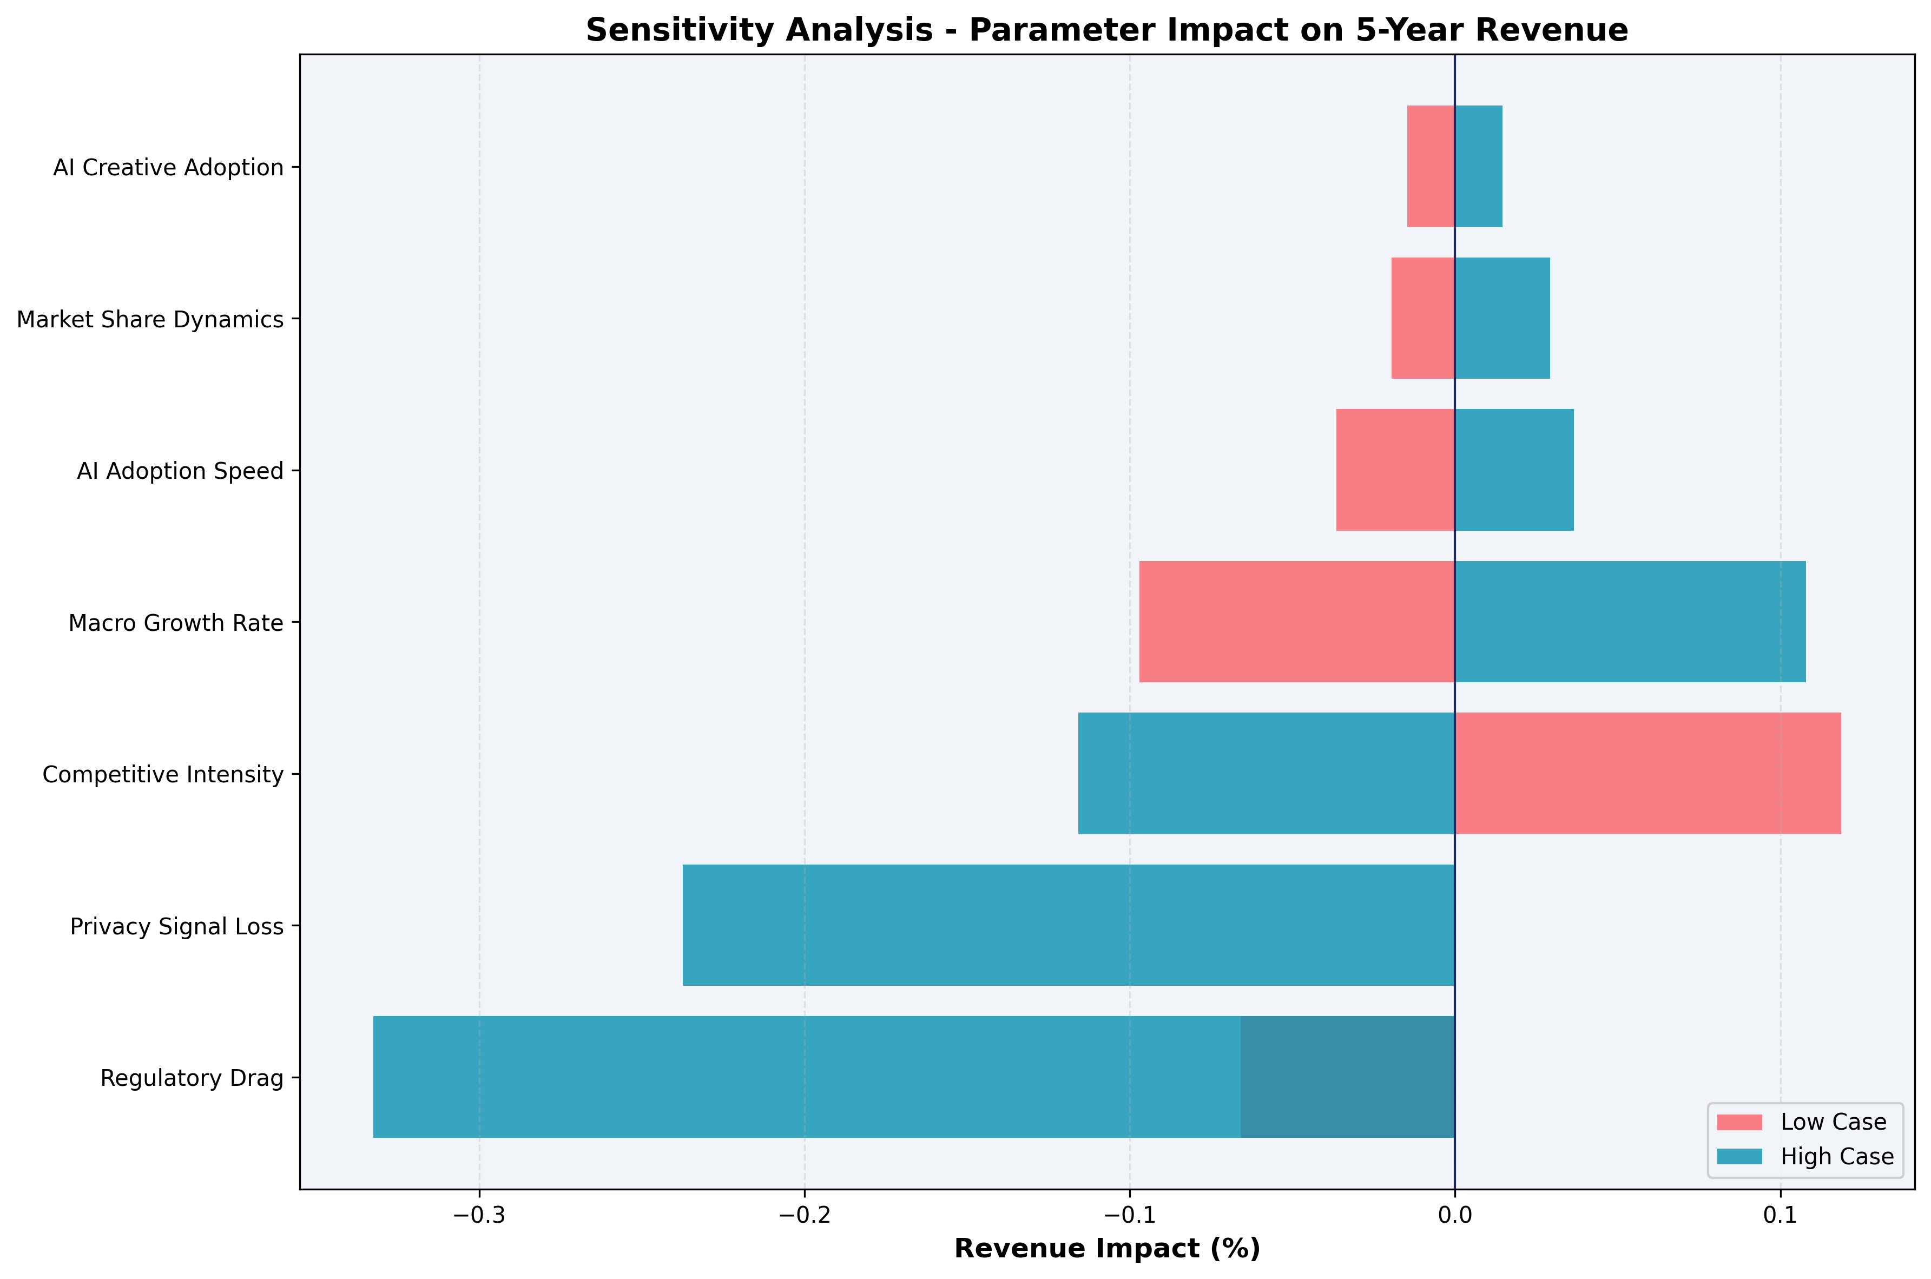
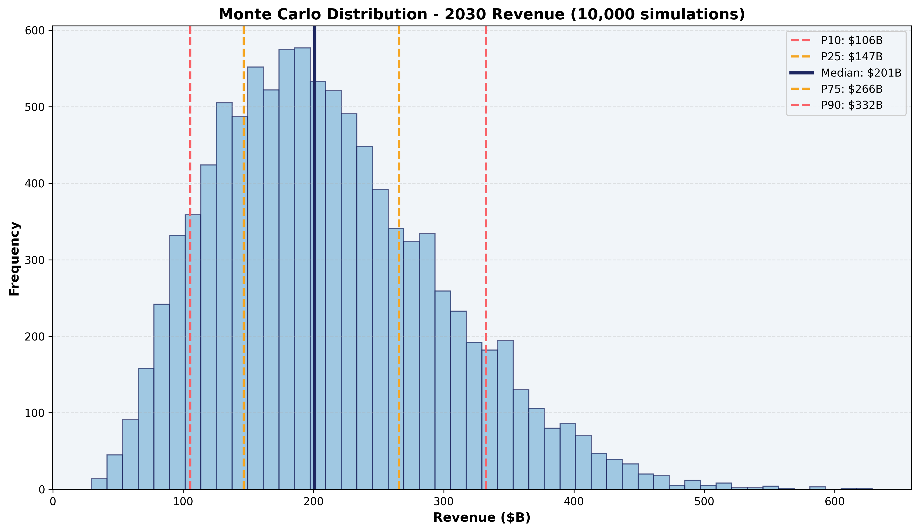
Appendix C: Regulatory drag and privacy signal loss are the widest uncertainty bands in the forecast
Source: One-at-a-time sensitivity analysis (±1σ perturbation), correlated Monte Carlo (10,000 runs)

