Slide 1

Sorting Algorithms II
CHAPTER 4
Wilson Ren

Slide 2
List of Algorithms
1. Merge Sort
2. Heap Sort
3. Quick Sort
Wilson Ren

Slide 3
Merge Sort
- The principle of merge sort is quite simple. Take advantage of the fact that combining two sorted arrays has O(n) time complexity, using the pointer skill.
- This sorting algorithm is a classic example of “divide and conquer.”
Wilson Ren

Slide 4
Pseudocode I of Merge Sort
MERGE(A1, A2): result = [ ], i = 0, j = 0 while i < A1.length and j < A2.length: if A1[i] > A2[j]: add A2[j] to result j++ else: add A1[i] to result i++ // either arr1 or arr2 will have something left // use loop to put all remaining things into the result
Wilson Ren

Slide 5
Pseudocode II of Merge Sort
MERGE-SORT(A): if A.length equals to 1: return A else: middle = A.length / 2 left = A.slice(0, middle) right = A.slice(middle, A.length) return MERGE(MERGE-SORT(right), MERGE-SORT(left))
Wilson Ren

Slide 6

Overview of Merge Sort
Worse Case Performance: O($n\log{n}$)
Best Case Performance: O($n\log{n}$)
Average Performance: O($n\log{n}$)
Wilson Ren

Slide 7
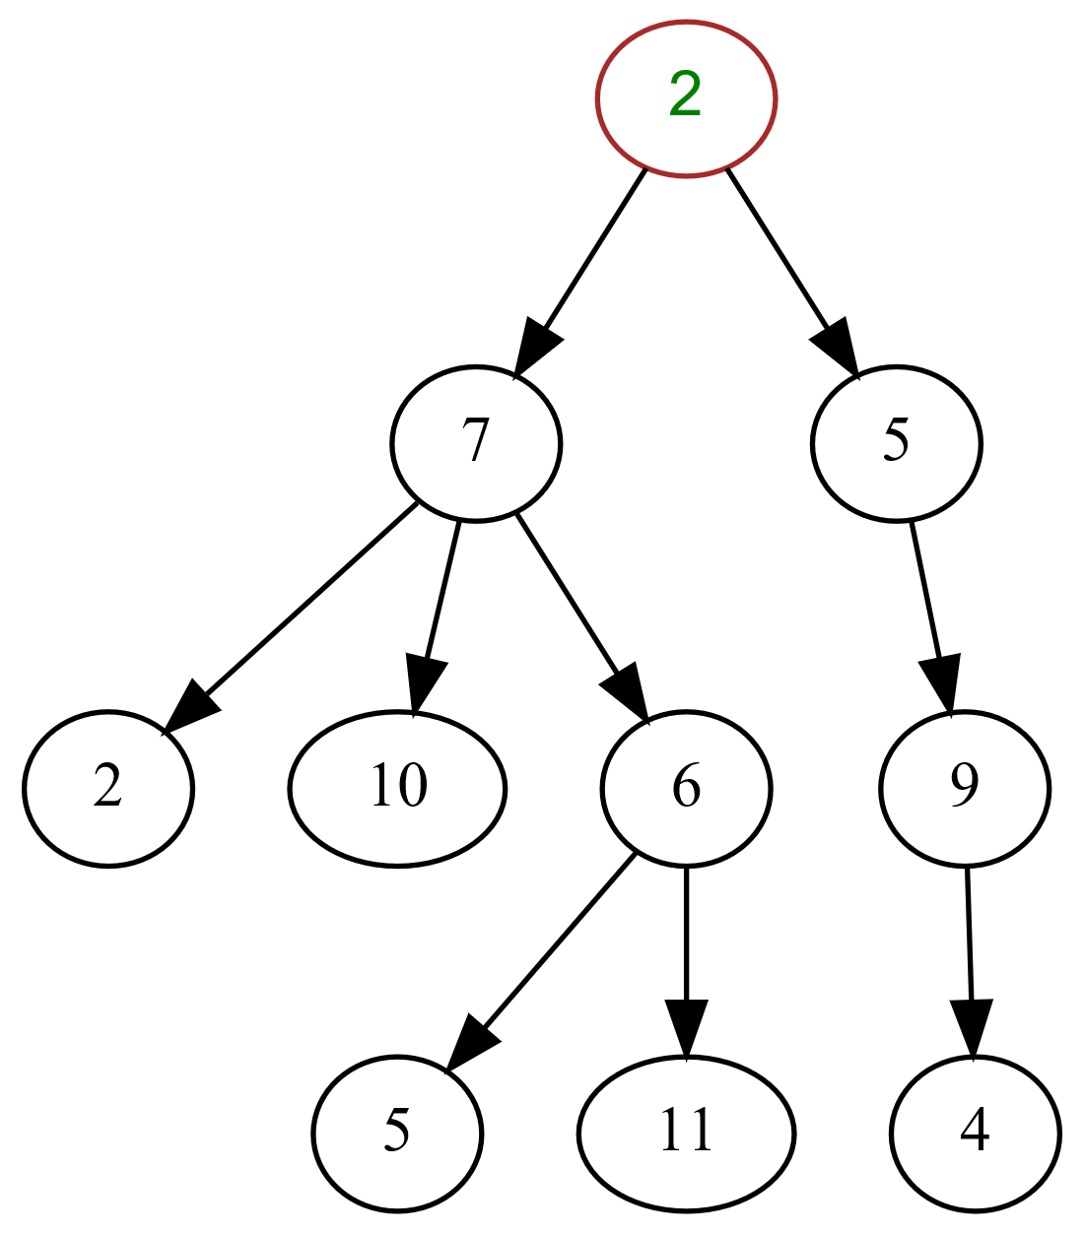
Tree (Data Structure)
- In computer science, a tree is a widely used abstract data type that simulates a hierarchical tree structure, with a root value and subtrees of children with a parent node, represented as a set of linked nodes.
- A tree should have only one root.
- Another definition of tree is “tree is acyclic graph.”
Wilson Ren

Slide 8
Binary Tree
- Binary Tree means each node has at most two children, which are referred to as the left child and the right child.
- Complete Binary Tree means an “almost-full” binary tree, the right most nodes of the bottom might be missing.
- Full Binary Tree means a binary tree in which all leaf nodes have the same depth.
- Max Heap means a complete binary tree where the largest node is always the at root for any sub-trees.
Wilson Ren

Slide 9
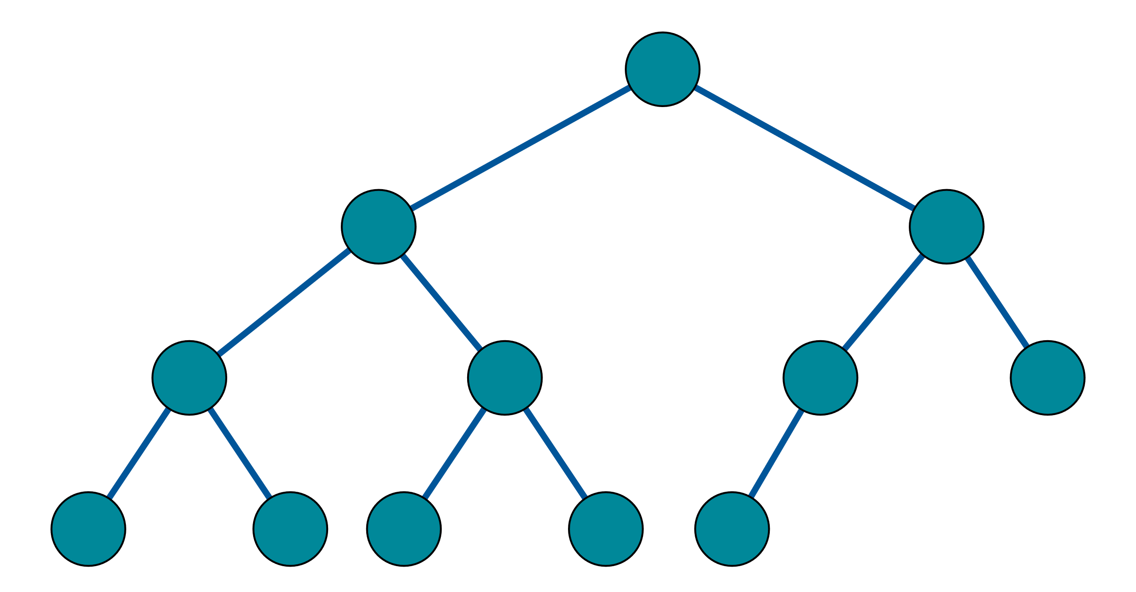
A Complete Binary Tree (Not Full)
Wilson Ren

Slide 10
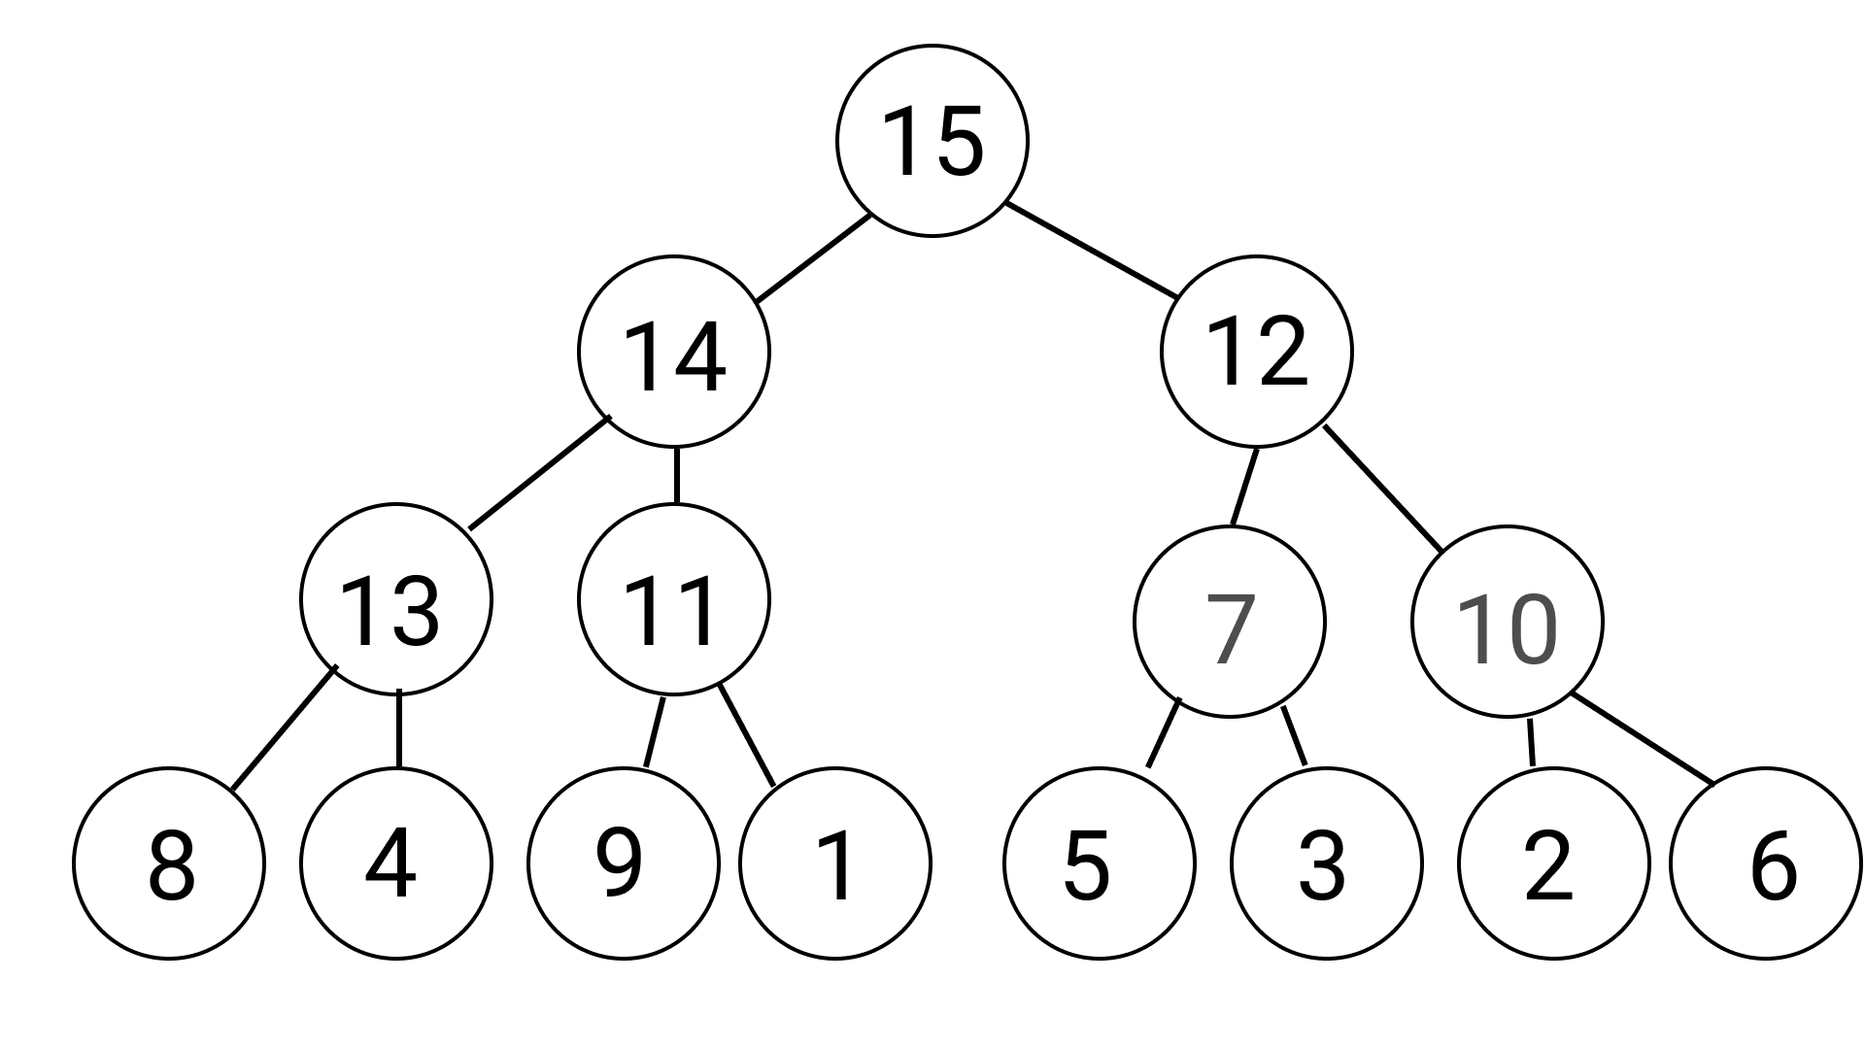
Max Heap
Wilson Ren

Slide 11
Heap Sort
- Heap sort uses Max Heap to sort.
- In order to understand our next sorting algorithm, Heap Sort, you must first understand what a "max heap" is. Also, we need to know how max heap algorithm works.
Wilson Ren

Slide 12
How to create max heap?
When we swap a node N down, just keep swapping if the node N has a child node that is bigger than the node N.
Array = [6, 13, 10, 4, 1, 5, 2, 8 ,14, 9, 11, 7, 3, 15, 12]
Max Heap = [15, 14, 12, 13, 11, 7, 10, 8, 4, 9, 1, 5, 3, 2, 6]
Wilson Ren

Slide 13
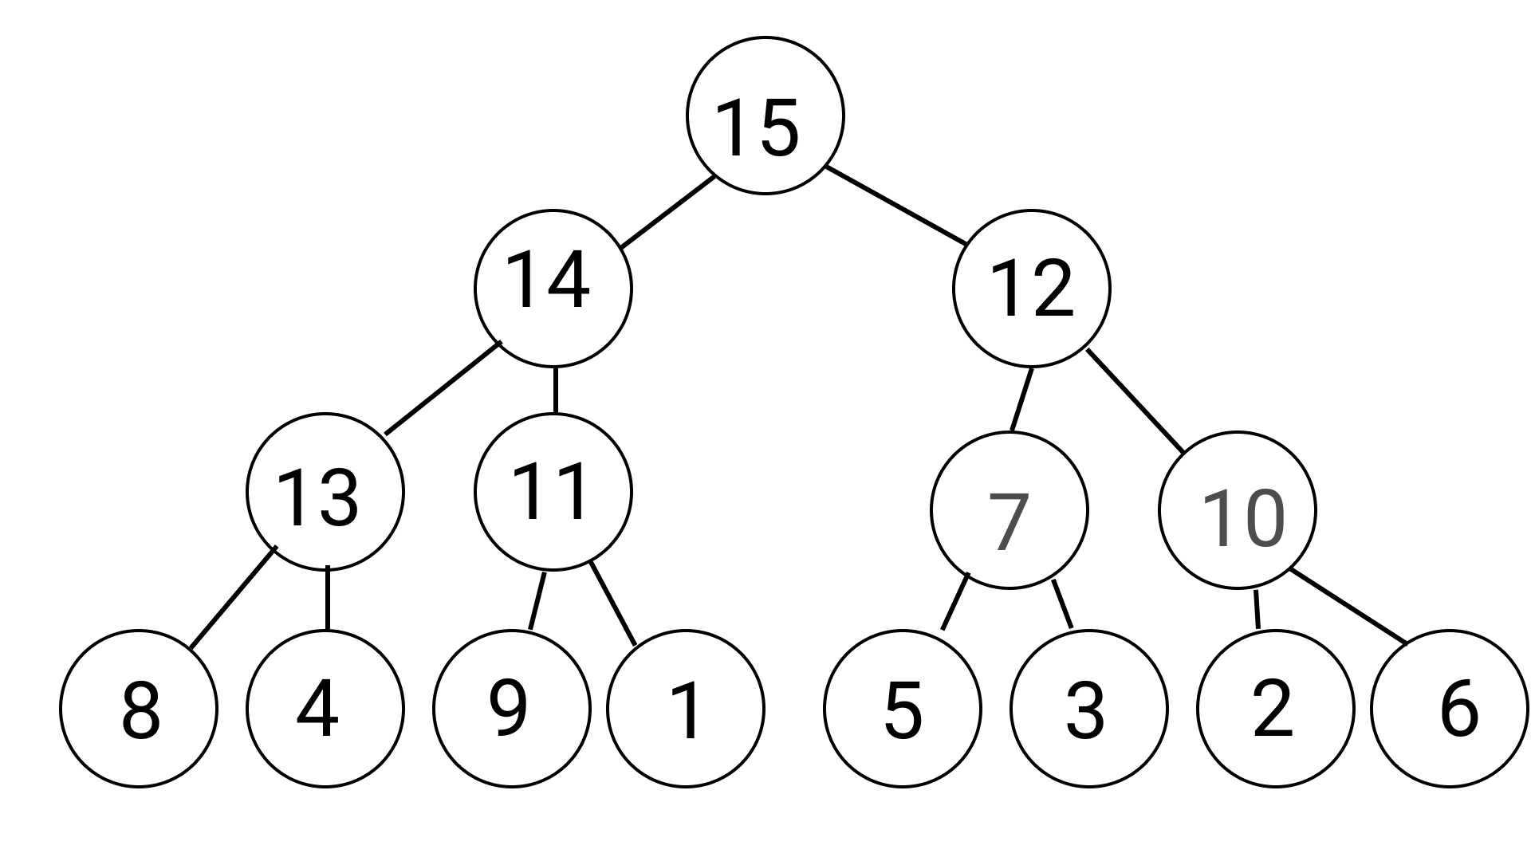
How does Heap Sort Work?
Wilson Ren

Slide 14
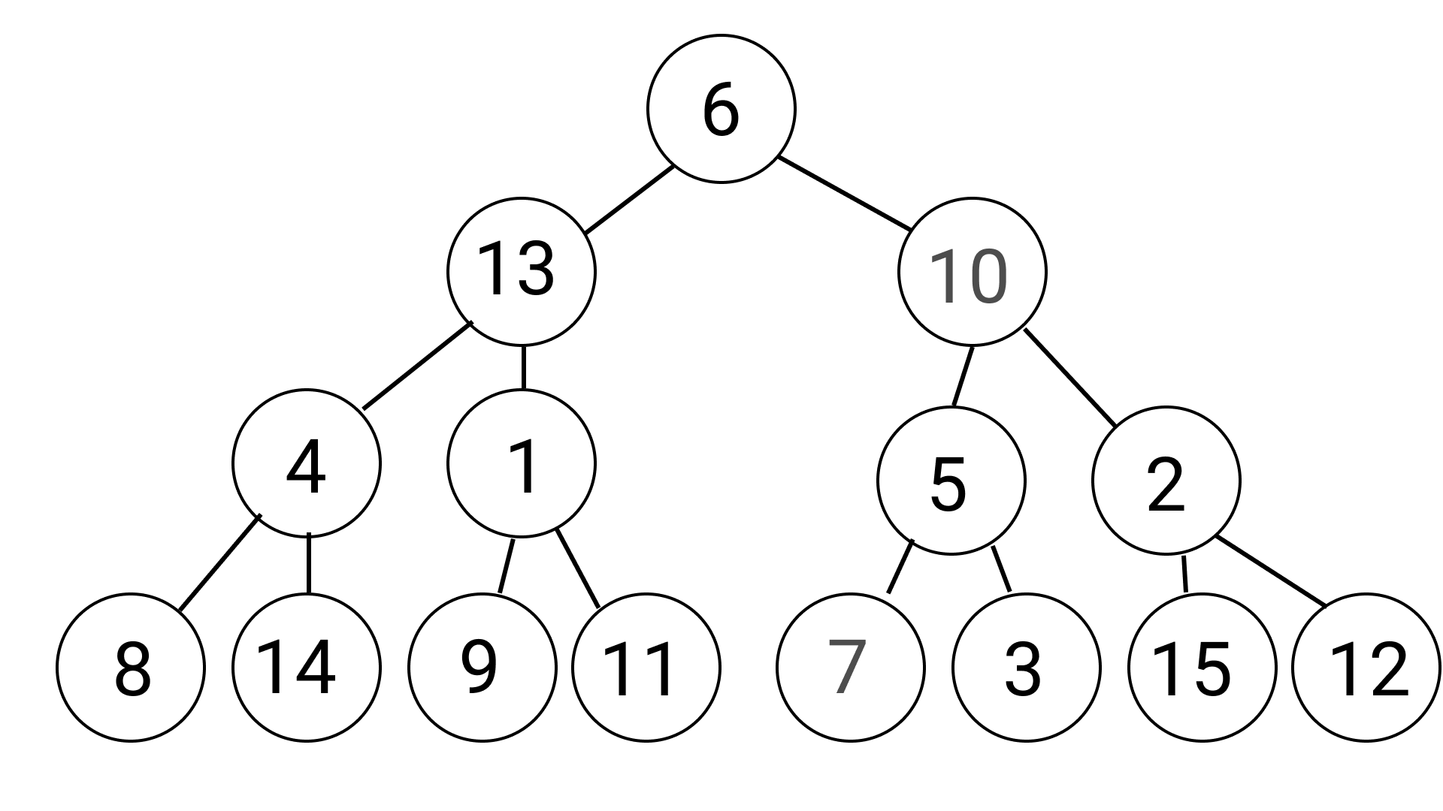

Slide 15
Pseudocode of Build Max Heap
BUILD-MAX-HEAP(): heapSize = A.length – 1 for i from (A.length / 2) to 0 (inclusive): MAX-HEAPIFY(i)
* heapSize and A are global variables, since they are used in more than one function.
Wilson Ren

Slide 16
Pseudocode of Max Heapify
MAX-HEAPIFY(i): l = 2 * i + 1 r = 2 * i + 2 if l <= heapSize and A[l] > A[i]: largest = l else: largest = i if r <= heapSize and A[r] > A[largest]: largest = r if largest is not i: swap A[i] with A[largest] MAX-HEAPIFY(largest)
* heapSize and A are global variables, since they are used in more than one function.
Wilson Ren

Slide 17
Pseudocode of Heap Sort
HEAP-SORT(): BUILD-MAX-HEAP() for i from A.length - 1 to 0: exchange A[0] with A[i] heapSize = heapSize – 1 MAX-HEAPIFY(0)
* heapSize, and A are global variables, since they are used in more than one function.
Wilson Ren

Slide 18

Overview of Heap Sort
Worse Case Performance: O($n\log{n}$)
Best Case Performance: O($n\log{n}$) or O(n)
Average Performance: O($n\log{n}$)
Wilson Ren

Slide 19
Quick Sort
- As you know from its name, quick sort is quick.
- Developed by British computer scientist Tony Hoare in 1959 and published in 1961, it is still a commonly used algorithm for sorting.
Wilson Ren

Slide 20
Partition
- By itself, Partition is not a sorting algorithm, but it is an important subroutine of the Quicksort algorithm. So, to understand Quicksort, you must first understand Partition.
- The idea of partition algorithm is to divide the array into 2 parts. Either part is a sorted array, but the element in the middle is sorted (we found its correct final spot)
Wilson Ren

Slide 21
Pseudocode of Partition
PARTITION(p, r): x = A[r] i = p – 1 for j from p to r – 1(inclusive): if A[j] <= x: i = i + 1 exchange A[i] with A[j] exchange A[i + 1] with A[r] return i + 1
*. i this variable is counting how many items are less than the pivot
Wilson Ren

Slide 22
Pseudocode of Quick Sort
QUICK-SORT(p, r): if p < r: q = partition(p, r) QUICK-SORT(p, q - 1) QUICK-SORT(q + 1, r)
*. When calling QUICK-SORT() the first time, just pass 0 and array.length – 1 as parameters.
Wilson Ren

Slide 23

Overview of Quick Sort
Worse Case Performance: O($n^{2}$)
Best Case Performance: O($n\log{n}$)
Average Performance: O($n\log{n}$)
Wilson Ren

