Slide 1

Data Structure 1
CHAPTER 5
Wilson Ren

Slide 2
List of Data Structures
1. Linked List
2. Stack and Queue
3. Hashtable
Wilson Ren

Slide 3
What is Linked List?
- In computer science, a linked list is a linear collection of data elements whose order is not given by their physical placement in memory. Instead, each element points to the next.
- A data structure that contains only head and length property.
- Link list consists of nodes, and each node has a value (number, string, array, or anything) and a pointer to another node or null.
Wilson Ren

Slide 4
Advantages of Linked List
- Elements can be inserted into linked lists indefinitely, while an array will eventually either fill up or need to be resized.
- Very fast insertion and deletion compared to Array.
Wilson Ren

Slide 5
Disadvantages of Linked List
1. They use more memory than arrays because of the storage used by their pointers.
2. Nodes in a linked list must be read in order from the beginning as linked lists are inherently sequential access.
3. Nodes are stored noncontiguous, greatly increasing the time periods required to access individual elements within the list, especially with a CPU cache.
4. Difficulties arise in linked lists when it comes to reverse traversing. For instance, singly-linked lists are cumbersome to navigate backward and while doubly linked lists are somewhat easier to read, memory is consumed in allocating space for a back-pointer.
Wilson Ren

Slide 6
Difference between Array and Linked List
Linked List
- Do Not Have indices
- Connection between nodes are a "next" pointer
- Random access is not allowed(Must go through each item before accessing)
Array
- Items are indexed in order
- Insertion and deletion are expensive
- Elements can quickly be accessed with a specific index
Wilson Ren

Slide 7
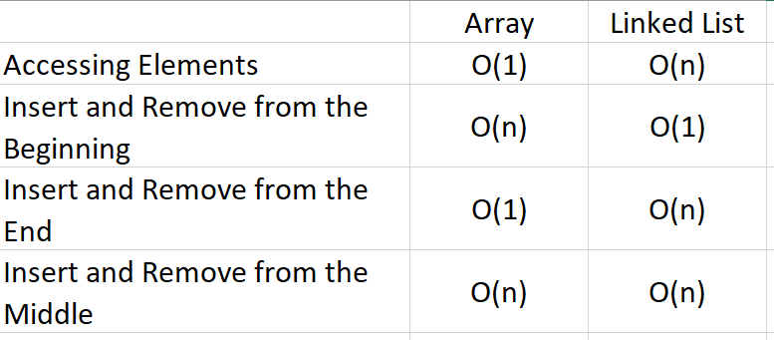
Overview of Linked List
Wilson Ren

Slide 8

Singly and Doubly Linked List
Wilson Ren

Slide 9


Stack and Queue
- In computer science, stacks and queues are abstract data types.
- The idea of stacks and queues are commonly used in software engineering, such as JavaScript Call Stack and undo/redo button.
Wilson Ren

Slide 10
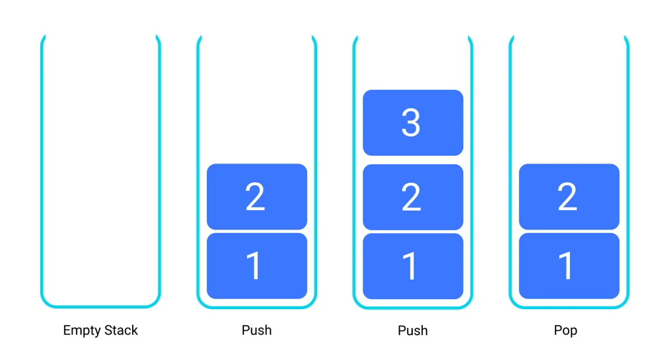
Stack
- If you want to add something to a stack, then you add it to the top.
- If you want to remove something from a stack, then you remove the top item.
Wilson Ren

Slide 11
Stack
- The principle of understanding stack is “LIFO” (Last in first out)
- Elements have no index.
- Can only add to the top and remove from the top.
Wilson Ren

Slide 12
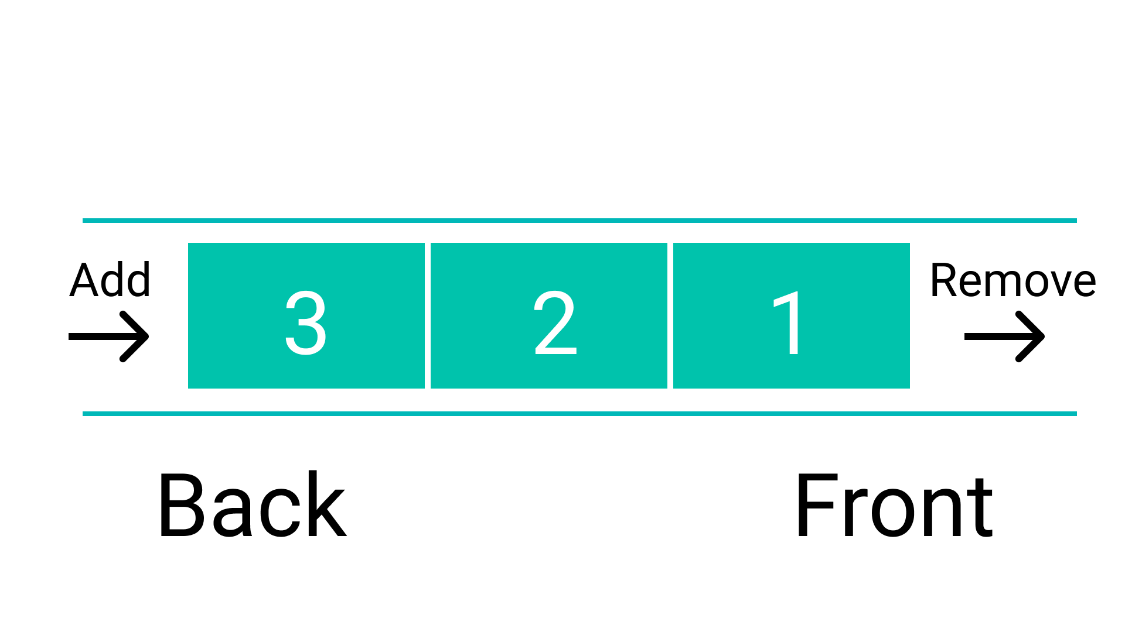
Queue
- If you want to add something to a queue, then you add it from the back.
- If you want to remove something from a queue, then you remove from the front.
Wilson Ren

Slide 13
Queue
- The principle of understanding stack is “FIFO” (First in first out)
- Elements have no index.
- Can only add to the back and remove from the front.
- Enqueue means to add something to the queue, and dequeue means remove something from a queue.
Wilson Ren

Slide 14
Stack Example
What is the size of the stack after all the operations have completed?
What element is currently on top of the stack?
push flour
push milk
push eggs
pop
push leavening
push sugar
pop
pop
Wilson Ren

Slide 15
Queue Example
What is the size of the queue after all the operations have completed?
What element is currently at the tail of the queue?
What element is currently at the head of the queue?
enqueue pencil
enqueue pen
enqueue stapler
enqueue phone
dequeue
dequeue
enqueue tablet
enqueue notes
dequeue
Wilson Ren

Slide 16
Deque
Deque is also known as "double-ended queue“. It is sort of like a hybrid of a stack and a queue. You can add and remove elements from either the front or the back -- but not the middle.
Wilson Ren

Slide 17

Problem
- Searching for a specific value in a traditional array is slow.
- Searching for a specific value in a direct-addressed array is fast, but impractical due to the high memory requirements.
Wilson Ren

Slide 18
Doesn’t seem nice…
- No matter what we do, we always end up with one of two situations:
1. Save memory but waste time
2. Save time but waster memory
Huh… so how are we going to fix this?
Hashtable! Save both time and memory. Sounds like a magic? Let’s see how it works.
Wilson Ren

Slide 19
Hash Function
- “Hash” is… not a very commonly used word in English. Mostly people know it with “hash brown.”
- In computer science, hash function is a commonly used idea. There’s tons of different hash functions. Ex. Passwords are hashed before storing into database. JavaScript objects and arrays are hashed.
- The principle of a hash function is to convert one value to another.
- From the problem we observed before, let’s think about how to solve it… why not hashed all players ID into a small integer?
Wilson Ren

Slide 20
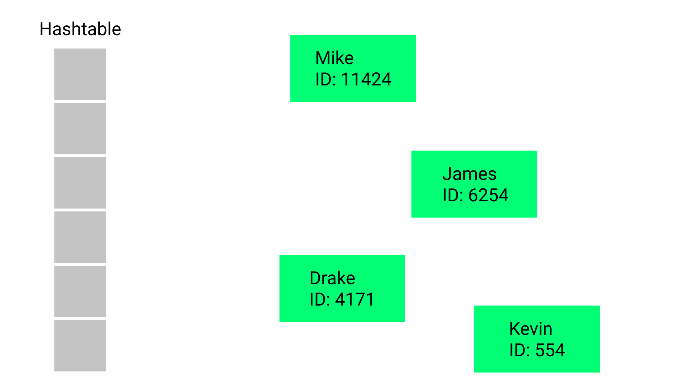
Hash Function I – Division Method
m = hashtable size
n = # of elements to store into hashtable
Division Method: Index = Key mod m
Wilson Ren

Slide 21
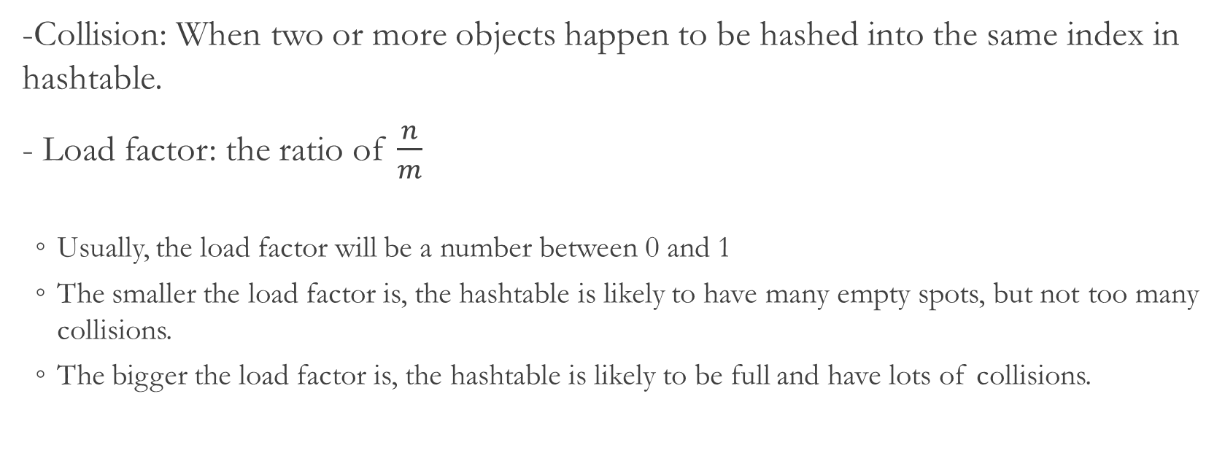
Collision and Load Factor
-Collision: When two or more objects happen to be hashed into the same index in hashtable.
- Load factor: the ratio of $\frac{n}{m}$
Usually, the load factor will be a number between 0 and 1
The smaller the load factor is, the hashtable is likely to have many empty spots, but not too many collisions.
The bigger the load factor is, the hashtable is likely to be full and have lots of collisions.
Wilson Ren

Slide 22
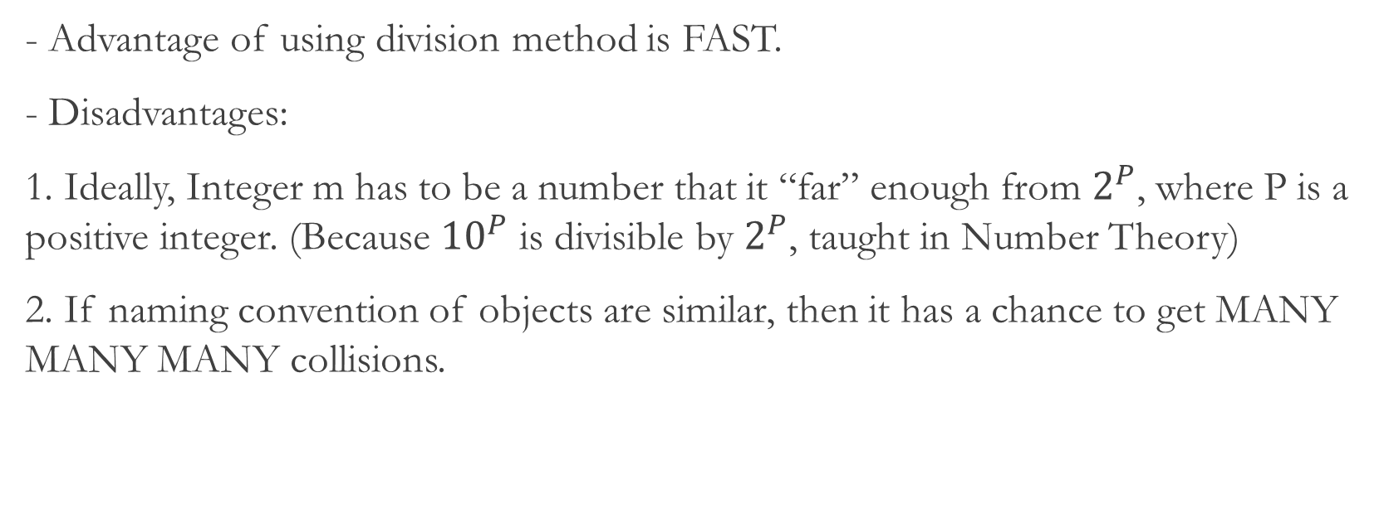
Division Method
- Advantage of using division method is FAST.
- Disadvantages:
1. Ideally, Integer m has to be a number that it “far” enough from $2^{P}$, where P is a positive integer. (Because ${10}^{P}$ is divisible by $2^{P}$, taught in Number Theory)
2. If naming convention of objects are similar, then it has a chance to get MANY MANY MANY collisions.
Wilson Ren

Slide 23
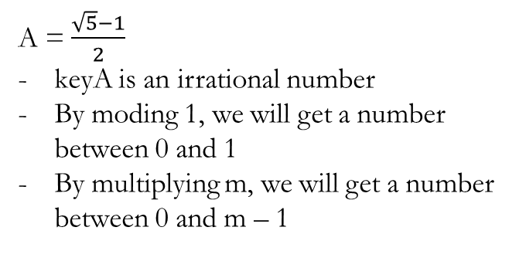
Hash Function II – Multiplication Method
m = hashtable size
n = # of elements to store into hashtable
Multiplication Method: Index = [m(keyA % 1)]
A = $\frac{\sqrt{5}−1}{2}$
keyA is an irrational number
By moding 1, we will get a number between 0 and 1
By multiplying m, we will get a number between 0 and m – 1
Wilson Ren

Slide 24
(Challenging) Deeper Understanding
Why does Multiplication method work? Let’s look into it in binary digits.
Wilson Ren

Slide 25
Handling Collisions
- No matter what hash function methods we use, we will have collisions.
- When coming across collision, we just store elements into an array. Therefore, our hashtable is actually a “array of arrays”.
Wilson Ren

Slide 26
Hash keys that are not Numbers
- Convert the string to an integer using whatever technique you wish.
The simplest (but not very effective) algorithm is to use the length of the string.
Or you could take the sum of all the ASCII values of all the characters in the string.
Or you could take some combination of the character's position in the string (0...length) and its ASCII value, and multiply/add them creative ways.
What other fun ideas can you think of?
Wilson Ren

Slide 27
CSS Color Simulator
white => # FFFFFF
red => #FF0000
magenta => #FF00FF
Wilson Ren

Slide 28
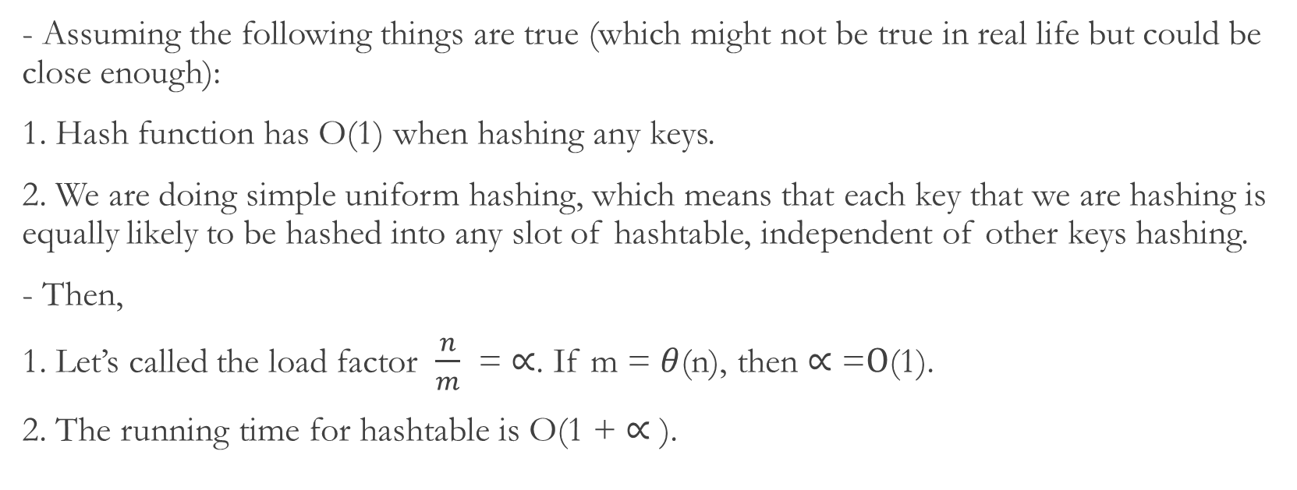
Understanding Hashtable
- Assuming the following things are true (which might not be true in real life but could be close enough):
1. Hash function has O(1) when hashing any keys.
2. We are doing simple uniform hashing, which means that each key that we are hashing is equally likely to be hashed into any slot of hashtable, independent of other keys hashing.
- Then,
1. Let’s called the load factor $\frac{n}{m}$ = $∝$. If m = $θ$(n), then $∝$ =$O$(1).
2. The running time for hashtable is O(1 + $∝$ ).
Wilson Ren

Slide 29
Real Life Application of Hashtable
- Python has Dictionaries
- JavaScript has Objects, Arrays
- Java (including Android API) has HashSet, HashMap, LinkedHashSet, and LinkedHashMap generic collections.
- Password Hashing
Wilson Ren

