Slide 1

Data Structure II
CHAPTER 6
Wilson Ren

Slide 2
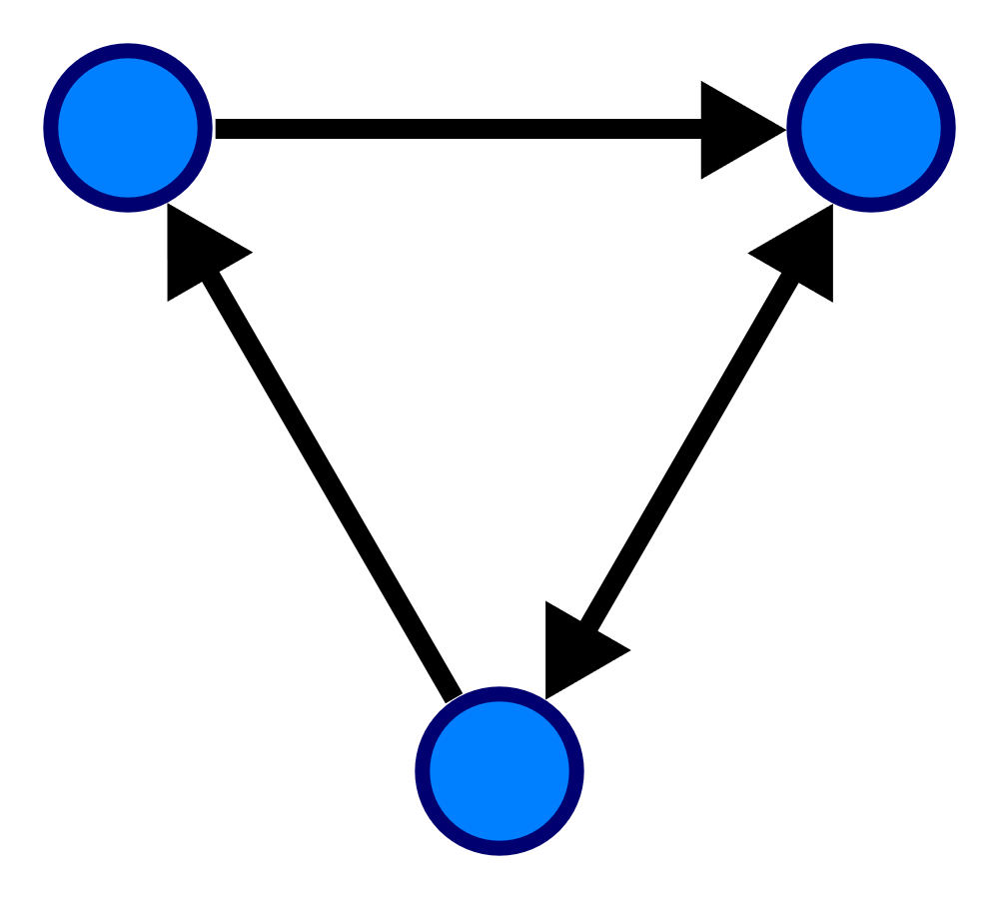
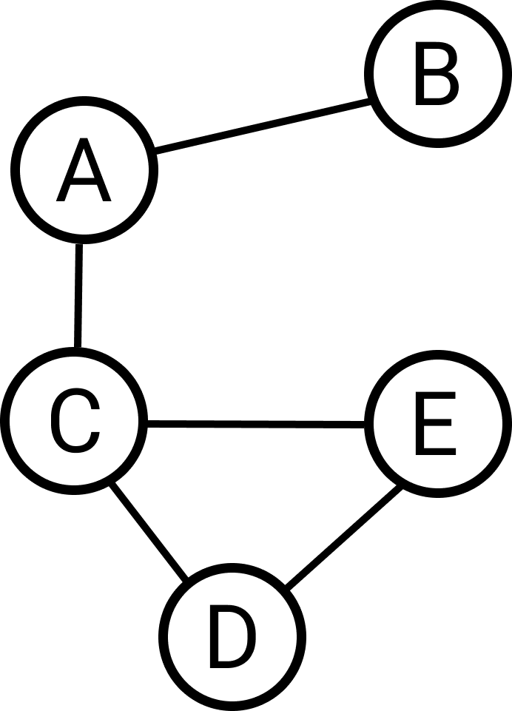
Graph (Definition)
- In computer science, a graph is an abstract data type.
- A graph data structure consists of a finite set of vertices (also called nodes or points.)
- Lines between nodes are known as edges (also called links or lines), and for a directed graph are also known as arrows.
Wilson Ren

Slide 3
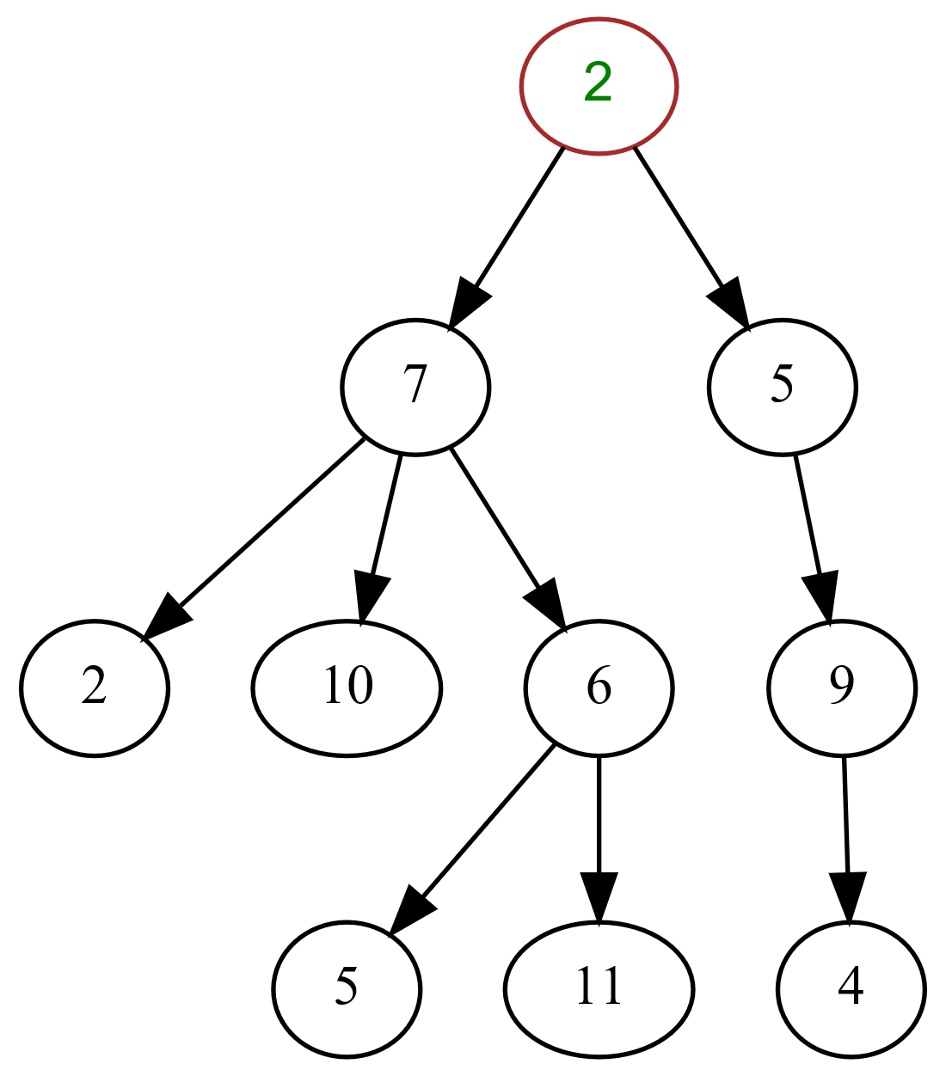
Tree (Definition)
- Tree is a graph without a loop.
- Tree must have one and only one root.
Real Life Application of Tree:
1. DOM (Document Object Model)
2. File System in Operating System
3. Artificial Intelligence
Wilson Ren

Slide 4
Tree Traversal
- Since tree is a commonly used data structure, we need a systematic way to know what nodes are in a tree.
- There are two ways to do tree traversal:
Breadth-First Tree Traversal
Depth-First Tree Traversal
Wilson Ren

Slide 5
Breadth-First Tree Traversal
BFTT(): queue.add(root) for i from 0 to queue.length: currentNode = queue[i] for j from 0 to currentNode’s children count - 1 (inclusive): queue.add(currentNode’s child)
Wilson Ren

Slide 6
Pseudocode of BFTT
// use a queue
BFTT(): queue.add(root) for i from 0 to queue.length: currentNode = queue[i] for j from 0 to currentNode’s children count - 1 (inclusive): queue.add(currentNode’s child)
Wilson Ren

Slide 7
Depth-First Tree Traversal - PreOrder
Definition: Process all nodes of a tree by processing the root, then recursively processing all subtrees. Also known as prefix traversal.
Understanding: root, left, right
Wilson Ren

Slide 8
Pseudocode of PreOrder
PREORDER(n): write(n) for i from 0 to n’s children count-1: PREORDER(n[i])
Wilson Ren

Slide 9
Depth-First Tree Traversal - InOrder
Definition: Process all nodes of a tree by recursively processing the left subtree, then processing the root, and finally the right subtree.
Understanding: left, root, right
Wilson Ren

Slide 10
Pseudocode of InOrder
INORDER(n): INORDER(n[0]) write(n) for i from 1 to n’s children count-1: INORDER(n[i])
Wilson Ren

Slide 11
Depth-First Tree Traversal - PostOrder
Definition: Process all nodes of a tree by recursively processing all subtrees, then finally processing the root.
Understanding: left, right, root
Wilson Ren

Slide 12
Pseudocode of PostOrder
POSTORDER(n): for i from 0 to n’s children count-1: POSTORDER(n[i]) write(n)
Wilson Ren

Slide 13
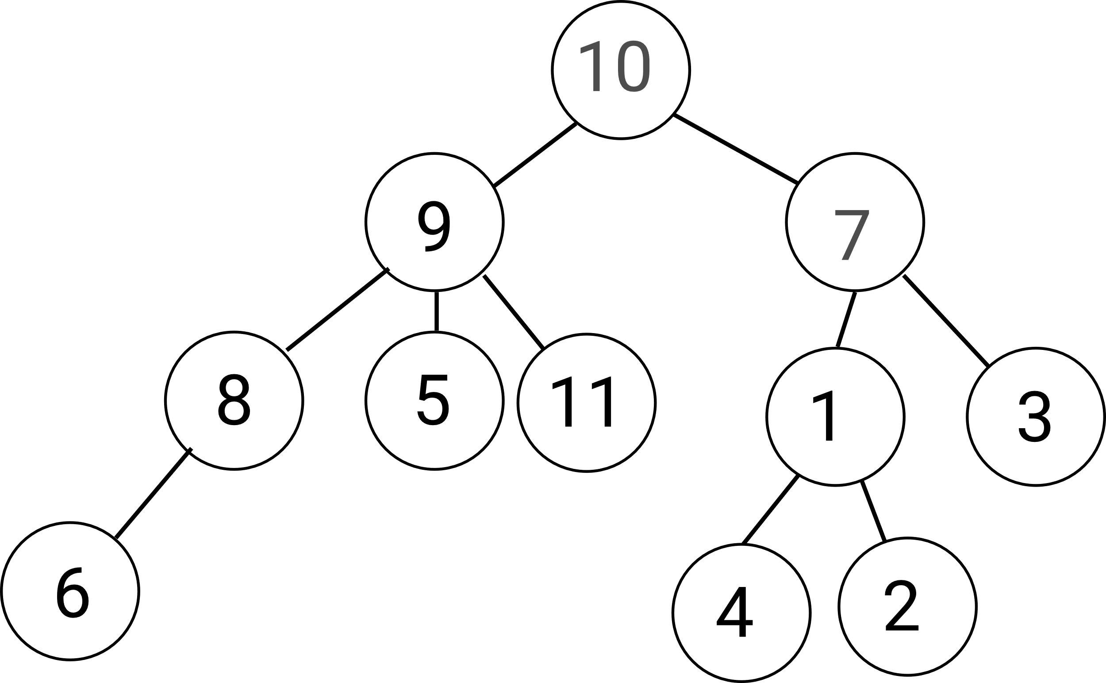
Practice
Wilson Ren

Slide 14
Binary Search Tree
- Suppose that you have a system that allows user to store their data. Users might keep inserting new data into your database. Therefore, you can choose to:
1. Store data in an array. When getting data out from database, you have O(n) complexity, since you are using sequential search.
2. Store data into hashtable. When getting data out from database, you have O(1) complexity. But… when implementing hashtable, you have to know how many data you will store before hand.
3. Umm…. Maybe you need a new tool – Binary Search Tree!
Wilson Ren

Slide 15
Binary Search Tree (aka BST)
- Binary Tree means each node has at most two children, which are referred to as the left child and the right child.
- Binary Search Tree is a binary tree, but the left child is always less than the root, and the right child is always greater than the root.
Wilson Ren

Slide 16
Constructing Binary Search Tree
Given a sequence of numbers, how to construct a binary search tree?
5, 7, 1, 15, 9, 2, 14, 8, 3
Wilson Ren

Slide 17
Pseudocode of Insertion in BST
INSERT(z): y = null x =root while (x !== null): y = x if z.key < x.key: x = x.left else: x = x.right if y == null: root = z else if z.key < y.key: y.left = z else: y.right = z
Wilson Ren

Slide 18
Pseudocode of Search Recursively
SEARCH(x, key): if x == null or key = x.key: return x if key < x.key: return SEARCH(x.left, key) else: return SEARCH(x.right, key)
Wilson Ren

Slide 19
Pseudocode of Search Iteratively
SEARCH(x, key): while x != null and key!= x.key: if key < x.key: x = x.left else: x = x.right return x
Wilson Ren

Slide 20
Pseudocode of PreOrder in BST
PREORDER(n): if n != null: print n.key PREORDER(n.left) PREORDER(n.right)
Wilson Ren

Slide 21
Pseudocode of InOrder in BST
PREORDER(n): if n != null: PREORDER(n.left) print n.key PREORDER(n.right)
Wilson Ren

Slide 22
Pseudocode of PostOrder in BST
PREORDER(n): if n != null: PREORDER(n.left) PREORDER(n.right) print n.key
Wilson Ren

Slide 23
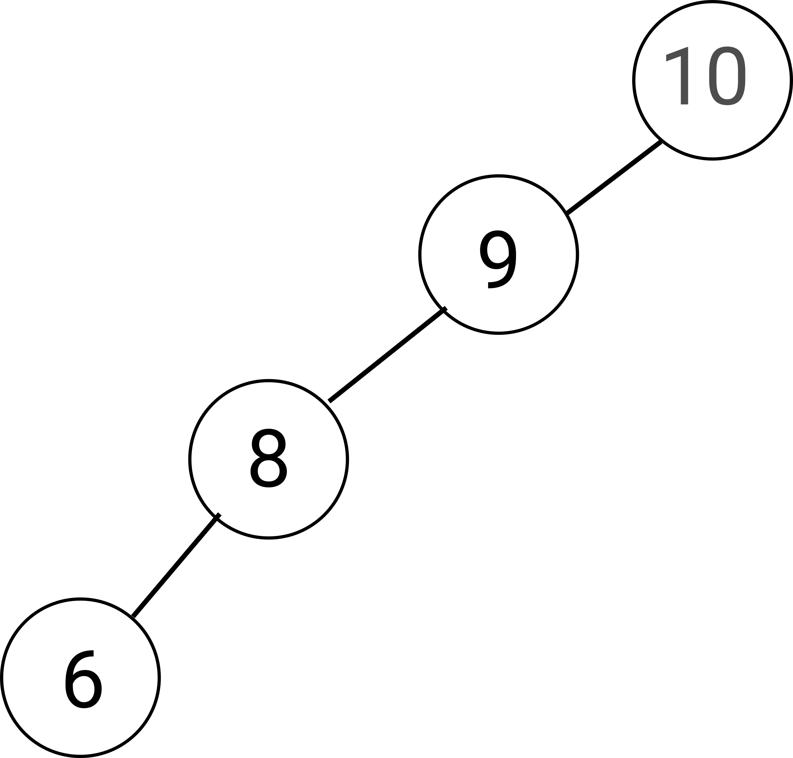
Overview of Binary Search Tree
Worst Case Performance: O(n)
Best Case Performance: O(1)
Average Case Performance: O(log n)
Wilson Ren

Slide 24
Priority Queue
- In computer science, a priority queue is an abstract data type similar to a regular queue in which each element additionally has a "priority" associated with it.
- Elements with higher priorities are served before elements with lower priorities. (Just like emergency room in a hospital).
- Since priority queue is a concept, we can implement it with a linked list, queue, array, or other data structures. But… which one is the most efficient? Max Heap!!
*. Max heap is a binary tree that the parent node is always greater than both the right child and left child. However, the right child doesn’t necessarily need to be greater than left child.
Wilson Ren

Slide 25
Deeper Understanding – Why Max Heap?
- Big O of Enqueue and Dequeue of Priority Queue using Max Heap.
Enqueue: O(logn)
Dequeue: O(logn)
- Big O of Enqueue and Dequeue of Priority Queue using Array or LinkedList.
Enqueue: O(n) (using insertion sort for a nearly sorted array)
Dequeue: O(1) or O(n) (LinkedList or Array)
Wilson Ren

Slide 26
Max Heap Insertion
- In heap sort, we learned how to build a max heap with a given array. Now, since priority queue is dynamic, which means that we will keep adding new items into max heap.
- The principle of dynamic max heap is simple, just keep swapping the new node up if necessary.
Wilson Ren

Slide 27

Math Relation in PQ
$x⇒(2x+1, 2x+2)$is the index relationship between parent node to child nodes.
$x⇒Math.floor(\frac{\left(x −1\right)}{2})$ is the index relationship between child node to parent node.
Wilson Ren

Slide 28
Pseudocode of PQ Enqueue
ENQUEUE(value, priority): if PQ is empty: add node into PQ else: push node into PQ newIndex = PQ.length – 1 parentIndex = Math.floor(newIndex - 1 / 2) while (parentIndex >= 0) and newNode.priority > parent.priority: swap parent and child newIndex = parentIndex parentIndex = Math.floor(newNodeIndex - 1 / 2)
Wilson Ren

Slide 29
Pseudocode of PQ Dequeue
DEQUEUE(): if PQ.length == 0: return false if PQ.length == 1: remove PQ[0] return PQ[0] else: swap PQ[0] and PQ[PQ.length - 1] PQ.pop() maxHeapify(0)
*. maxHeapify is the same function we used in heap sort.
Wilson Ren

Slide 30
Encoding Theory
- In computing, all data are stored digitally in our devices. Briefly speaking, all digital files, including music, picture, video, string and numbers are just 0s and 1s.
- When storing files, what is the best way to perform “Lossless Compression”?
*. In Lossy compression, A file does not restore or rebuilt in its original form. While in Lossless Compression, A file can be restored in its original form.
Wilson Ren

Slide 31
Bits Storage Example
Supposed that our machine that can only present 6 words – A, B, C, D, E, F. Since machines only work with binary digits, we can encode them as:
A – 000
B – 001
C – 010
D – 011
E – 100
F – 101
Space - 110
How many bits do we need to store the word “A FADED DEAD”?
Wilson Ren

Slide 32
How does compression work?
- Not Correct Approach: Let’s remove the unnecessary 0s in the front.
- Problem with simple approach:
A – 000
B – 001
C – 010
D – 011
E – 100
F – 101
Space - 110
Wilson Ren

Slide 33
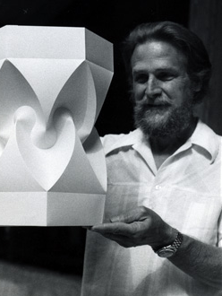
Huffman Encoding
- This is an algorithm developed by David A. Huffman while he was a Sc.D. student at MIT, and published in the 1952 paper "A Method for the Construction of Minimum-Redundancy Codes".
- The principle of Huffman encoding is, if a letter appears many times in a file, then it be compressed into short bits. On the other hand, a letter appears very less in a file, it can be compressed into more bits.
Wilson Ren

Slide 34
Example of Huffman Encoding
AAAABBB C => 000000000000001001001110110010 (30bits) Huffman Encoding: AAAABBB C => 0000111111101101100 (19 bits)
Wilson Ren

Slide 35
Huffman Encoding - Compression
1. Read the file, count the frequency of each character.
2. Sort the frequency table.
3. According to the frequency table, constructor a Huffman Tree. Priority Queue is a good option for building Huffman Tree.
4. Generate Huffman codes for the nodes in Huffman Tree.
5. Read the whole file again and compress the file, according to the Huffman codes. Every byte can be written into the compressed file. (Java has BufferedOutputStream class to write raw byte data to a file. Node.js might have something similar.)
*. At the beginning of the compressed file, include Huffman codes and its corresponding letter, as we need those information for decompression.
Wilson Ren

Slide 36
Huffman Encoding – Decompression
1. Read the information of Huffman Codes and its corresponding letters. Store the information in a Hashtable.
2. Read the compressed file, for each byte, we convert it back to 8 bits. Store the bits in an array. (I called it bitArray)
3. Read through bitArray, use left and right point algorithm to convert bits back to its corresponding letters.
Wilson Ren

Slide 37
Minimal Spanning Tree
- If you have a graph, and selectively remove edges (without removing nodes) so that it forms a tree, what's left is called a SPANNING TREE.
- That is, a spanning tree is a subset of the graph that has all the nodes of the original, but just enough edges to hold it together. For any graph, there are usually many possible spanning trees.
- However, the MINIMAL SPANNING TREE is one whose edges have the smallest total weight. (This assumes a weighted graph; i.e. a graph in which each edge has a "weight" or a cost associated with it.)
Wilson Ren

Slide 38
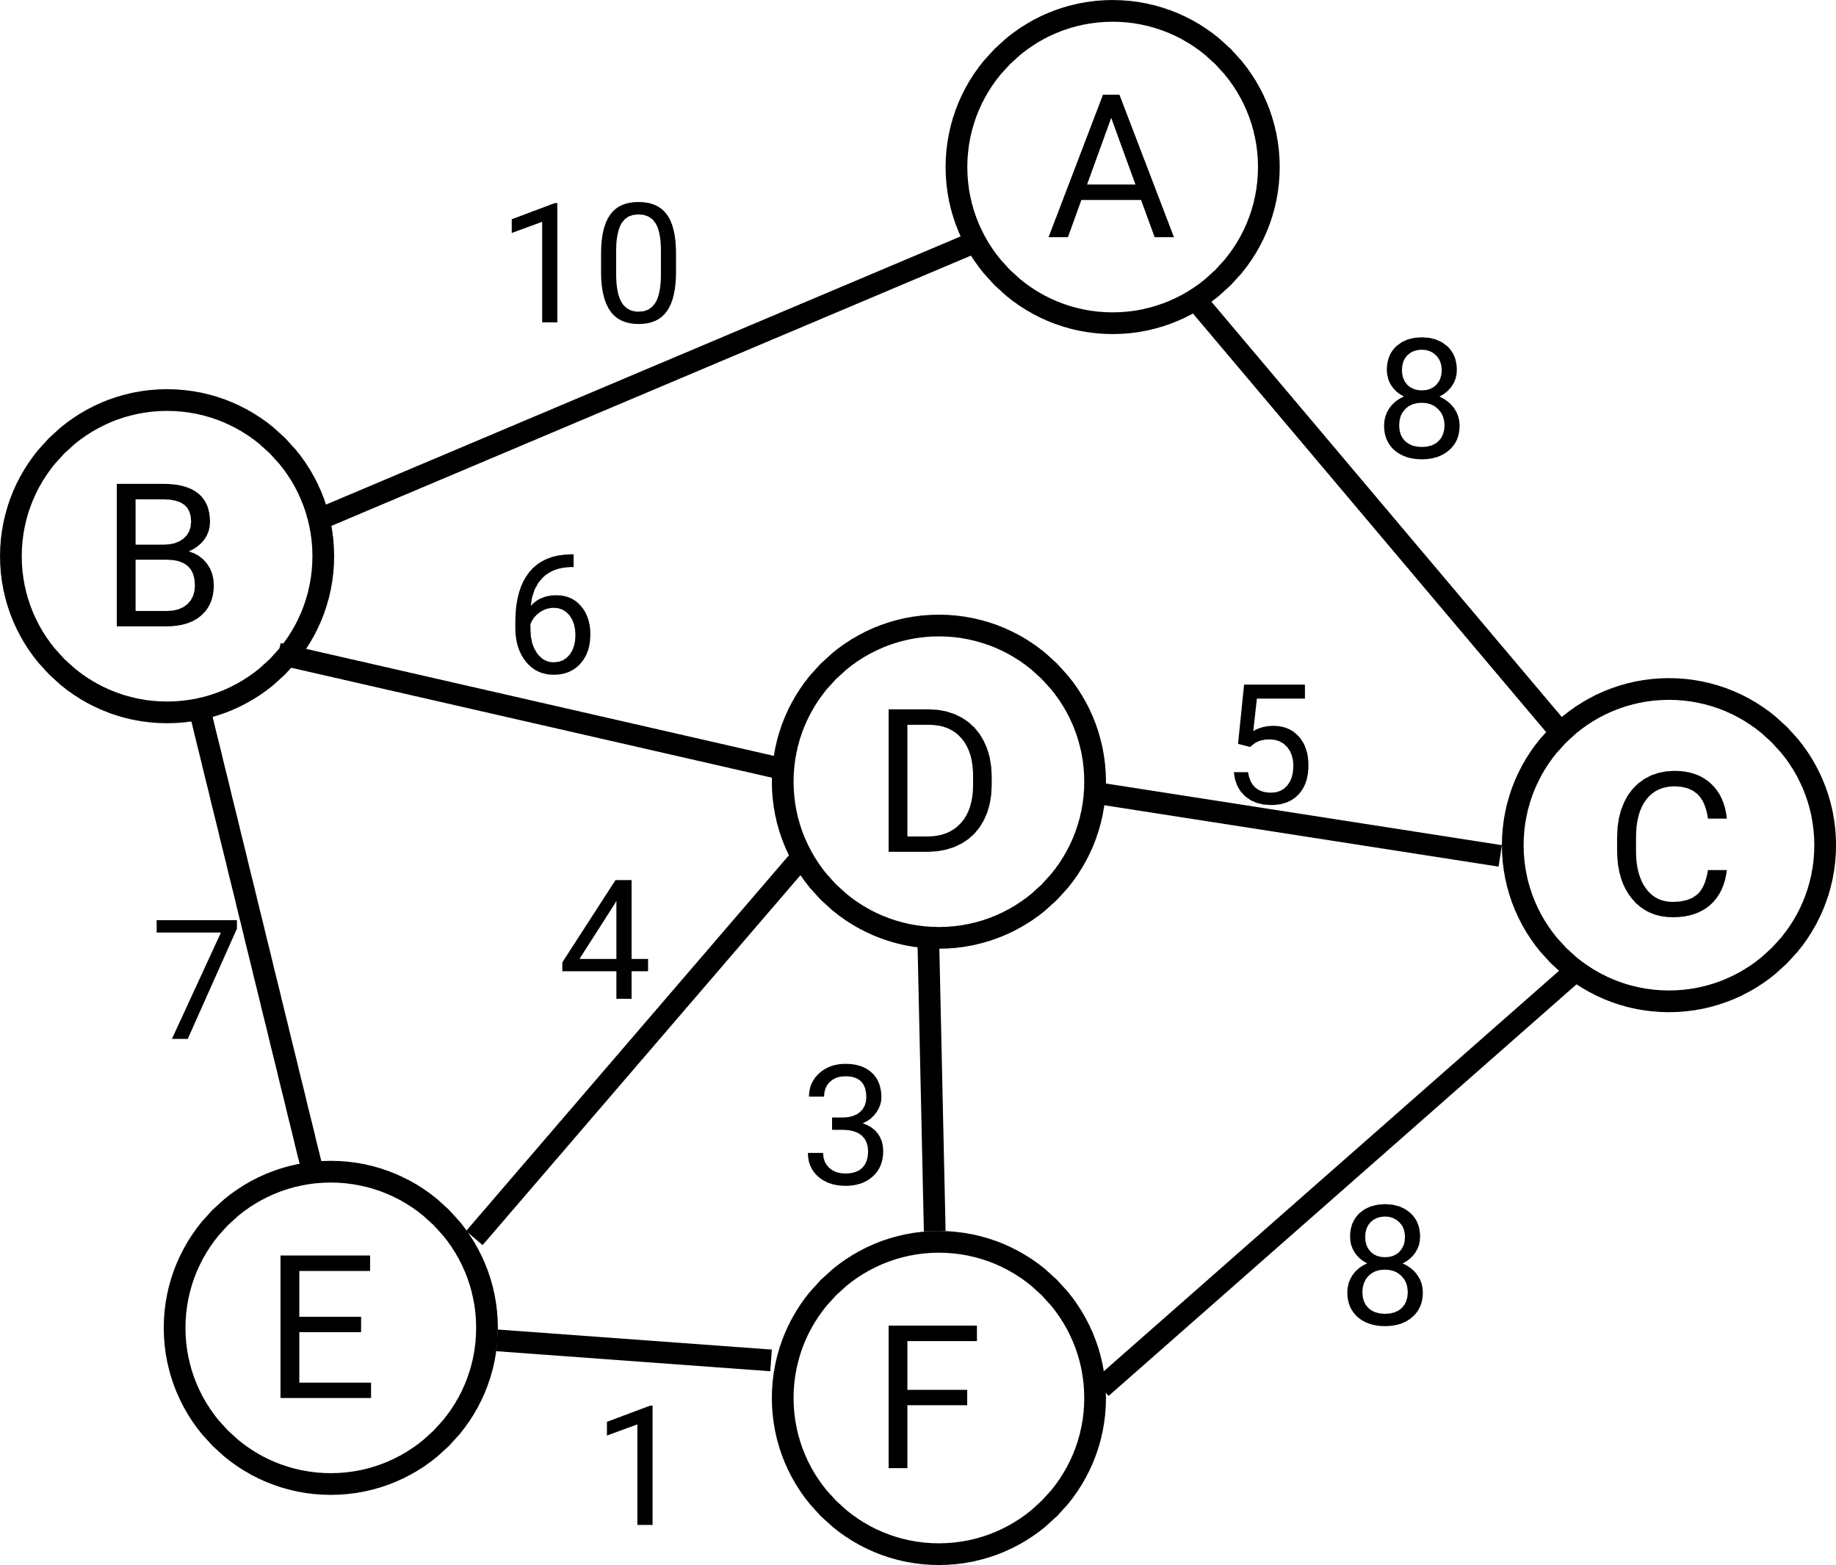
Example
Wilson Ren

Slide 39
Prim’s Algorithm of Finding MST
- Start at any node we want.
- Keep track of what nodes have been visited.
- Keep a list of edges. (These are the edges we use in building MST.)
- For all edges of visited node but not in MST edges list, find the smallest weighted edge that doesn’t create a cycle, and add the edge to the MST edge list. (Remember, MST is a tree, which should be cyclic.) (If the smallest weight graph is connected to two nodes that are in MST array, then the edge would create a cycle)
- Keep doing this until we come across a situation that a smallest weighted edge will 100% create a cycle. (That means that all nodes in this graph are in MST array) If we hit this point, then stop.
Wilson Ren

Slide 40
Kruskal’s Algorithm

Slide 41
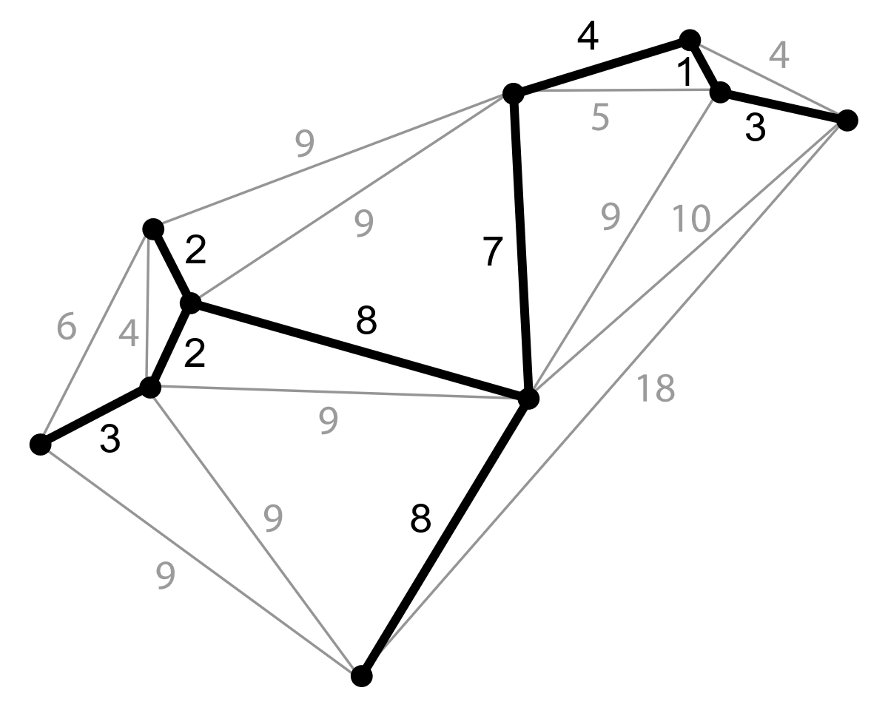
Application
- Take the cable television wiring as an example. If you can only route along the street, the streets are the edges, and the intersections are the nodes.
- There must be a minimum spanning tree to minimize the wiring cost.
Wilson Ren

